Slide 1
Front-end Web Design
Lecture 7

Slide 2
Today during class we will cover
CSS backgrounds
<div> tag
CSS borders
CSS margin and padding
My project

Slide 3
CSS backgrounds
The CSS background properties for elements.
background-color
background-image
background-repeat
background-attachment
background-position

Slide 4
Background-color
Specifies the background color of a chosen element
body { background-color: lightblue;}
p { background-color: #915BE9;}
h1 {background-color: #6DEC8C;}
#myid {background-color:red;}

Slide 5
Background-image
The background-image property specifies an image that we will use as a background of an element. Image will be repeated and will cover the entire element by default.
body { background-image:url(1.jpg)}
p { background-image:url(1.jpg)}
table { background-image:url(1.jpg)}

Slide 6
Background-repeat
By default, the background-image property repeats an image both horizontally and vertically.
To repeat the picture only horizontally or vertically we set the background-repeat: repeat-x; or background-repeat: repeat-y;
background-repeat: no-repeat;

Slide 7
Background-position and fixed position
To specify that the background image should be fixed (will not scroll with the rest of the page), use the background-attachment property:
body { background-position: right top;
background-attachment: fixed
}

Slide 8
Background
body {
background: #ffffff url(“1.png") no- repeat right top;
}

Slide 9
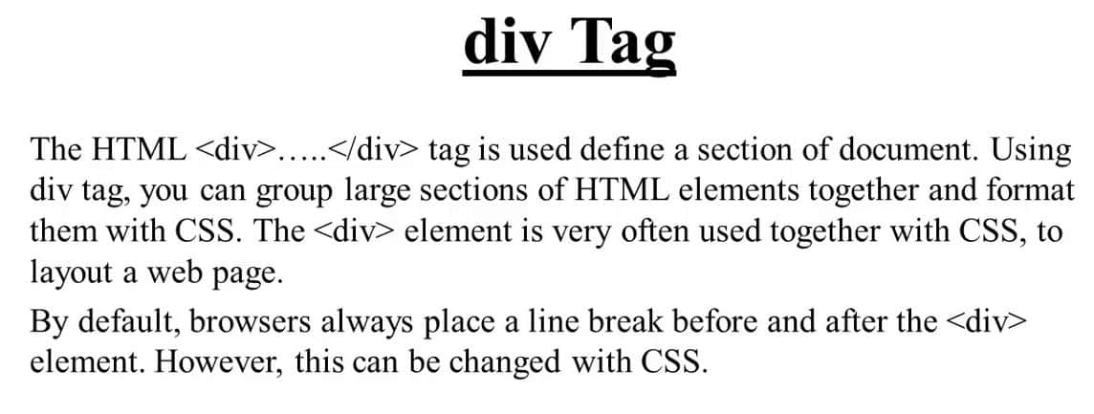

Slide 10
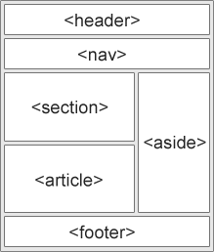
Div tag
The <div> tag is nothing more than a container unit that encapsulates other page elements and divides the HTML document into sections.
It does not represent anything

Slide 11
div tag
The <div> tag defines a division or a section in an HTML document.
The <div> tag is used to group block-elements to format them with CSS

Slide 12
CSS borders
The CSS border properties allow you to specify the style, width, and color of an element's border
The border-style property specifies what kind of border to display.
The following values are allowed:
dotted - defines a dotted border, dashed - defines a dashed border
solid - defines a solid border, double - defines a double border
groove - defines a 3d grooved border
ridge - defines a 3d ridged border inset - defines a 3d inset border.
outset - defines a 3d outset border. none - defines no border
hidden - defines a hidden border

Slide 13
CSS borders
The border-style property can have from one to four values (for the top border, right border, bottom border, and the left border).
Border Width
The border-width property specifies the width of the four borders.
The border-width property can have from one to four values (for the top border, right border, bottom border, and the left border).
1
4
2
3

Slide 14
CSS borders
p {border-style: solid; border-width: 2px 10px 4px 20px; border-color: red green blue yellow;
}

Slide 15
CSS borders
p { border-top-style: dotted; border-right-style: solid; border-bottom-style: dotted; border-left-style: solid;
}

Slide 16
CSS border
p { border: 5px solid red; }

Slide 17
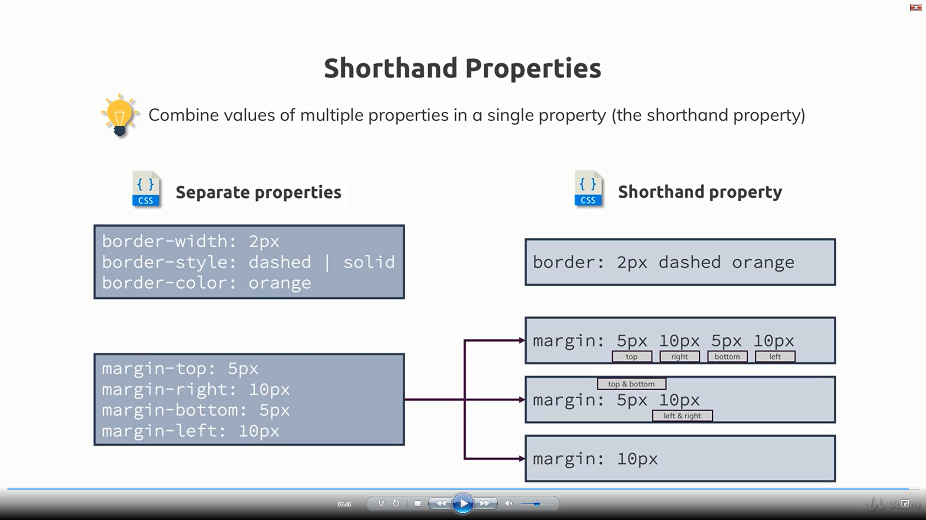

Slide 18
CSS margins
The CSS margin properties are used to create space around elements, outside of any defined borders.
With CSS, you have full control over the margins. There are properties for setting the margin for each side of an element (top, right, bottom, and left).
CSS has properties for specifying the margin for each side of an element:
margin-top
margin-right
margin-bottom
margin-left

Slide 19
CSS margins
All the margin properties can have the following values:
auto - the browser calculates the margin
length - specifies a margin in px, pt, cm, etc.
% - specifies a margin in % of the width of the containing element
inherit - specifies that the margin should be inherited from the parent element

Slide 20
CSS padding
The CSS padding properties are used to generate space around an element's content, inside of any defined borders.
With CSS, you have full control over the padding. There are properties for setting the padding for each side of an element (top, right, bottom, and left).

Slide 21
CSS padding
div {
padding-top: 50px;
padding-right: 30px;
padding-bottom: 50px;
padding-left: 80px;
}

Slide 22
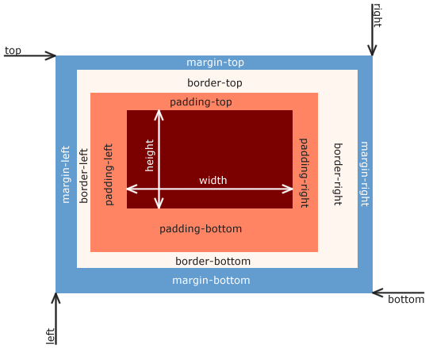

Slide 23


Slide 24
Thanks for attention

