Slide 1
Front-end Web Design
Lecture 8

Slide 2
During this lecture we will cover
CSS Height and width
CSS text
HTML 5 header
Navigation bar
Marque tool

Slide 3
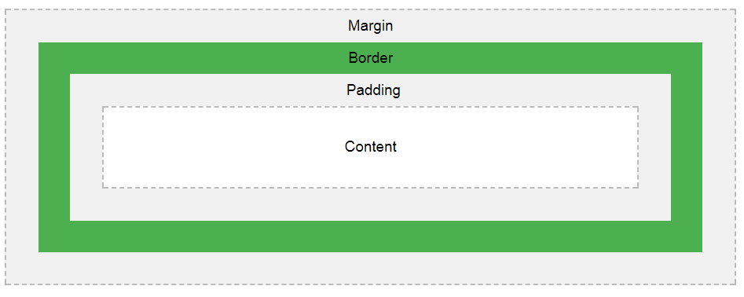

Slide 4
Height and width
The height and width can be set to auto.
Means that the browser calculates the height and width, or be specified in length values, for example px or in percent (%) of the containing block.

Slide 5
Width and height
<head> <style>
div {
height: 200px;
width: 50%;
background-color: powderblue;
}
</style> </head>
<body>
<p>This div element has a height of 200px and a width of 50%:</p>
<div></div>
</body>

Slide 6
Text color
body { color: blue; } h1 { color: green; }

Slide 7
Text Alignment
The text-align property is used to set the horizontal alignment of a text.
A text can be left or right aligned, centered, or justified.
h1 { text-align: center;} h2 { text-align: left;} h3 { text-align: right;}
div { text-align: justify;}

Slide 8
Text Decoration
h1 {
text-decoration: overline;
}
h2 {
text-decoration: line-through;
}
h3 {
text-decoration: underline;
}

Slide 9
Text Transformation
p { text-transform: uppercase; } p{ text-transform: lowercase; } p { text-transform: capitalize;
}

Slide 10
Text Indentation, Letter Spacing, Word Spacing
p { text-indent: 50px; }
h1 { letter-spacing: 3px; } h2 { letter-spacing: -3px; }

Slide 11
Text-shadow
In the example is shown the position of the horizontal shadow (3px), the position of the vertical shadow (2px) and the color of the shadow (red):
h1 { text-shadow: 3px 2px red; }

Slide 12
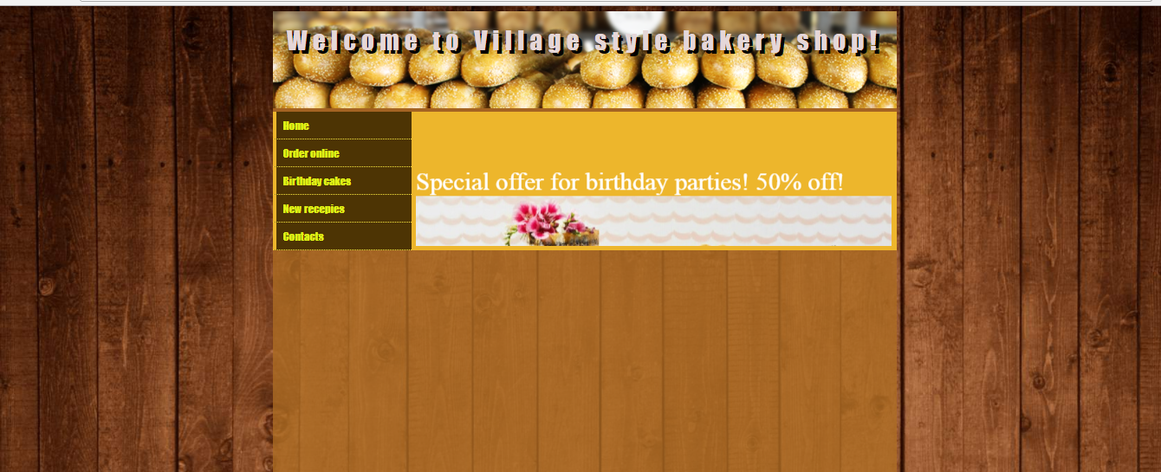

Slide 13
Adding header (html)
<!doctype html>
<html>
<head>
<meta charset="utf-8">
<title>MY first page</title>
<link href="formypage.css" rel="stylesheet" type="text/css">
</head>
<body>
<div id="mainbox">
<header>Welcome to IUHD canteen</header>
</div>
</body>
</html>

Slide 14
900
150
130

Slide 15
Adding header (css)
@charset "utf-8";
body{
background-image:url(1.jpg)}
#mainbox{
width:900px;
height:900px;
background-color:hsla(34,66%,21%,0.83);
margin:0 auto 0 auto}
header{
width:880px;
margin:10px;
height:150px;
background-image:url(11.png);
color:#ffffff;
font-family:Segoe, "Segoe UI", "DejaVu Sans", "Trebuchet MS", Verdana, sans-serif;
text-align:center;
font-size:75px; text-shadow: 3px 10px black}

Slide 16
Adding navigation bar (menu)- HTML
<div id="menubar">
<ul>
<li><a href=“#">Home</a></li>
<li><a href=“#" target="_self">About Us</a></li>
<li><a href=“#" target="_self">Courses</a></li>
<li><a href=“#" target="_self">Downloads</a></li>
<li><a href=“#" target="_self">Contact Us</a></li>
</ul>
</div>

Slide 17
900
150
130
200
200

Slide 18
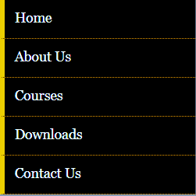
200
40
40
200
40
40
40
175

Slide 19
Adding navigation bar (menu)-CSS
#menubar {
width:200px;
float:left; }
#menubar ul{
list-style-type:none;
margin:0px;
padding:0px}
#menubar ul li a {
display:block;
padding:10px;
border-left:solid 5px hsla(43,84%,55%,1.00);
width:175px;
border-bottom:dotted 1px hsla(54,100%,63%,1.00);
height:19px;
background-color:hsla(39,90%,16%,1.00);
color:hsla(65,89%,52%,1.00);
text-decoration:none;
font-family:Impact, Haettenschweiler, "Franklin Gothic Bold", "Arial Black", sans-serif;
font-size:16px;
transition:all 1s ease-out;}
#menubar ul li a:hover{
border-left:solid 80px hsla(43,84%,55%,1.00);
width:100px}

Slide 20
Image box
Marquee tool

Slide 21
900
150
130
200
200
700

Slide 22
Adding image box- HTML
<div id="imagebox">
</div>

Slide 23
Adding image box- CSS
#imagebox{
width:686px;
height:186px;
font-size:36px;
color:hsla(0,0%,100%,1.00);
text-align:center;
float:right;
background-color:hsla(43,84%,55%,1.00);
padding:7px;
}

Slide 24
Marquee tool
The HTML <marquee> tag is used for scrolling piece of text or image displayed either horizontally across or vertically down your web site page depending on the settings.
***The <marquee> tag deprecated in HTML5.
Do not use this element, instead you can use JavaScript and CSS to create such effects.

Slide 25
Attributes
Width- This specifies the width of the marquee. This can be a value like 10 or 20% etc.
Height - This specifies the height of the marquee. This can be a value like 10 or 20% etc.
Direction - This specifies the direction in which marquee should scroll. This can be a value like up, down, left or right.
Behavior - This specifies the type of scrolling of the marquee. This can have a value like scroll, slide and alternate.
Scrolldelay -This specifies how long to delay between each jump. This will have a value like 10 etc.
Scrollamount- This specifies the speed of marquee text. This can have a value like 10 etc.
Loop- This specifies how many times to loop. The default value is INFINITE, which means that the marquee loops endlessly.

Slide 26
Adding marquee-HTML
<div id="imagebox">
<marquee behavior="scroll" direction="up" width="700" height="186" onMouseOver="stop()" onMouseOut="start()">
Special offer for birthday parties! 50% off!
<img src="images/formarquee.jpg">
</marquee>
</div

Slide 27
Next lecture
CSS lists
Section and Articles

