Slide 1
Front-end Web Design
Lecture 2

Slide 2
Content
HTML attributes
Colors
Lists
Tables
Core attributes
Meta tags
Forms

Slide 3
HTML Attributes
All HTML elements can have attributes
Attributes provide additional information about an element
Attributes are always specified in the start tag
Attributes usually come in name/value pairs like: name="value"

Slide 4
HTML attributes
The name is the property you want to set. For example, the paragraph element in the example carries an attribute whose name is align, which you can use to indicate the alignment of paragraph on the page.
The value is what you want the value of the property to be set and always put within quotations. The below example shows three possible values of align attribute: left, center and right.
<p align="right"></p>

Slide 5
Example
<p align="left">This is left aligned text</p>
<p align="center">This is center aligned text</p>
<p align="right">This is right aligned text</p>

Slide 6
Example
<p title="I'm a tooltip"> This is a paragraph.</p>
<p><font color="teal" size="6" face="Comic Sans MS"> Hello everybody! </font> as you can see, the text is red and Arial</p>

Slide 7
Colors
aqua | #00ffff | navy | #000080
black | #000000 | olive | #808000
blue | #0000ff | purple | #800080
fuchsia | #ff00ff | red | #ff0000
gray | #808080 | silver | #c0c0c0
green | #008000 | teal | #008080
lime | #00ff00 | white | #ffffff
maroon | #800000 | yellow | #ffff00

Slide 8

You shall not pass!!!

Slide 9
Attributes of an image
<Src> Src stands for source
<Alt> Define alternate text for an image
<Width> Defines the width of the image
<Height> Defines the height of the image
<Border> Defines border of the image
<Hspace> Horizontal space of the image
<Vspace> Vertical space of the image
<Align> Align an image within the text
<background> Add a background image to an HTML page

Slide 10
HTML lists
Ordered Lists
Unordered Lists
Definition Lists

Slide 11
Ordered Lists
The list items are marked with numbers. An ordered list starts with the <ol> tag. Each list item starts with the <li> tag.
<ol>
<li>Coffee</li>
<li>Tea</li>
<li>Milk</li>
</ol>
Attribute: type="1“, “A”, “a”, “I”, “i”; start="5"

Slide 12
Unordered Lists :
The list items are marked with bullets (typically small black circles). An unordered list starts with the <ul> tag. Each list item starts with the <li> tag.
<ul>
<li>Coffee</li>
<li>Tea</li>
<li>Milk</li>
</ul>
Attribute: style="list-style-type:circle, disc, square, none

Slide 13
Definition Lists :
A definition list is not a list of single items. It is a list of items (terms), with a description of each item (term).A definition list starts with a <dl> tag (definition list). Each term starts with a <dt> tag (definition term). Each description starts with a <dd> tag (definition description).
<dl>
<dt>Coffee</dt>
<dd>- black hot drink</dd>
<dt>Milk</dt>
<dd>- white cold drink</dd>
</dl>

Slide 14
HTML tables
Tag | Description
<table> | It defines a table.
<tr> | It defines a row in a table.
<th> | It defines a header cell in a table.
<td> | It defines a cell in a table.
<caption> | It defines the table caption.

Slide 15
Tables
<table>
<tr><th>FirstName</th><th>Last Name</th><th>Group</th></tr>
<tr><td>Eziz</td><td>Rahmanov</td><td>Soft2</td></tr>
<tr><td>Bahar</td><td>Amanova</td><td>IT2</td></tr>
<tr><td>Merdan</td><td>Danatarov</td><td>IT2</td></tr>
<tr><td>Mustafa</td><td>Gelenov</td><td>Comtech2</td></tr>
</table>
Attribute: border=“1”

Slide 16
Attributes of table
<table border="1">
<tr>
<th>Faculty</th>
<th colspan="3">Majors</th>
</tr>
<tr>
<td>Economics</td>
<td>Soft</td>
<td>IT</td>
<td>Comtech</td>
</tr>
</table>

Slide 17
<table>
<tr><th>Name</th><td>Ajeet Maurya</td></tr>
<tr><th rowspan="2">Mobile No.</th><td>7503520801</td></tr>
<tr><td>9555879135</td></tr>
</table>

Slide 18
Comments in HTML
The comment tag is used to insert a comment in the HTML source code. A comment can be placed anywhere in the document and the browser will ignore everything inside the brackets.
<!-- This is a comment -->

Slide 19
Next lecture
Core attributes
Frames and meta tags
Forms

Slide 20
Core attributes
The four core attributes that can be used on the majority of HTML are:
Id
Title
Class
Style

Slide 21
Id
The id attribute of an HTML tag can be used to uniquely identify any element within an HTML page. There are two primary reasons that you might want to use an id attribute on an element −
If an element carries an id attribute as a unique identifier, it is possible to identify just that element and its content.
If you have two elements of the same name within a Web page (or style sheet), you can use the id attribute to distinguish between elements that have the same name.
<p id = "html">This para explains what is HTML</p>
<p id = "css">This para explains what is Cascading Style Sheet</p>

Slide 22
Title
The title attribute gives a suggested title for the element.
<h3 title = "Hello HTML!">Titled Heading Tag Example</h3>
<p title = "Hello HTML!">Titled paragraph Tag Example</p>
<img src=“1111.jpg” title = "Hello HTML!">Titled image Tag Example

Slide 23
Class
The class Attribute
The class attribute is used to associate an element with a style sheet, and specifies the class of element.

Slide 24
Style
The style Attribute
The style attribute allows you to specify Cascading Style Sheet (CSS) rules within the element.
<p style = "font-family:arial; color:#FF0000;">Some text...</p>

Slide 25
Meta tags
Meta tags don’t do anything to the content that is presented in the browser window, but they are used by the likes of search engines to catalogue information about the web page.
There is one meta tag which can be used as many times as you desire inside a head element and they can contain the attributes charset, name, http-equiv, and content.
When the name or http-equiv attribute is used, the content attribute is then used in conjunction with them to apply meta data itself.

Slide 26
Names
The name attribute can be anything you like. The most commonly used names are author, description, and keywords. Author is used to explicitly state one of the HTML page’s authors and description with keywords often used by search engines (such as Google) to display a description of a web page in its search results.

Slide 27
Keywords tag
Keywords Tag — The keywords meta tag lists the search keywords for a site. The keywords entered here should reflect any words or phrases Internet users might use to search for the site.

Slide 28
Keywords
< html> < head> < meta name="keywords" content=“my, keywords, people, can, find, my wonderful, page"> < title>My title goes here< /title> < /head> < body>content goes here< /body> < /html>

Slide 29
Description
Description Tag — The description meta tag defines site information a search engine displays when it lists the site. The description meta tag should concisely explain the nature and contents of the page.

Slide 30
Example
<head>
<title>Premier East Valley Realty - Homes for Sale</title>
<meta name="description" content="Premier East Valley Realty specializing in luxury real estate. We are your location specialists.">
<meta name="keywords" content="Real Estate,Agent,Realtor,Buy, Home,Sell,Homes,Sale,Broker,Commercial,invest,investing,investor">
</head>

Slide 31
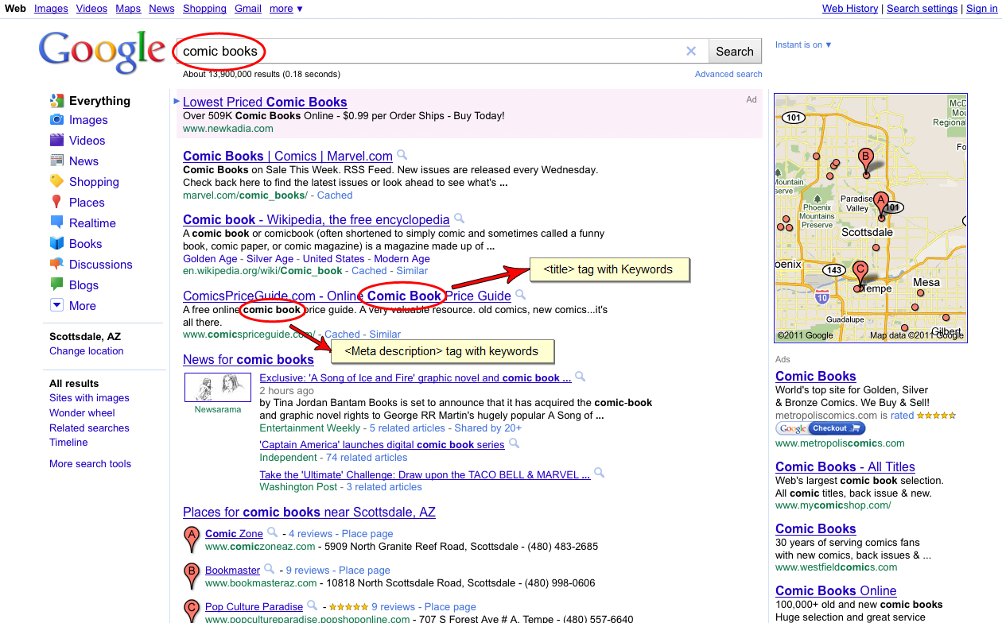

Slide 32
HTTP Equivalents
The http-equiv attribute can be used instead of the name attribute and will make an HTTP header, which is information sent to the server where the web page is held. The attribute should rarely be used but the value can be:
content-type, an encoding declaration, defining what character set is being used,
or refresh, which defines how often (in seconds) a page automatically refreshes or if it should automatically redirect to another page. Not great for accessibility.

Slide 33
Charset
Specify Character Set
You can use <meta> tag to specify character set used within the webpage.
By default, Web servers and Web browsers use ISO-8859-1 (Latin1) encoding to process Web pages. Following is an example to set UTF-8 encoding −
meta charset="utf-8"

Slide 34
Content type
< html> < head> < meta http-equiv="content-type" content="text/html; charset=windows-1251"> < meta name="keywords" content=“Keywords go here"> < meta name="description" content=“Description goes here”> < title>My page title will be here«title»< /title> < /head> < body>some data< /body> < /html>

Slide 35
Refresh
A <meta> tag can be used to specify a duration after which your web page will keep refreshing automatically.
If you want your page keep refreshing after every 5 seconds then use the following syntax.
<head>
<title>Meta Tags Example</title>
<meta name = "keywords" content = "HTML, Meta Tags, Metadata" />
<meta name = "description" content = "Learning about Meta Tags." />
<meta http-equiv = "refresh" content = "5" />
</head>
<body>
<p>Hello HTML!</p>
</body>

Slide 36
Page Redirection
You can use <meta> tag to redirect your page to any other webpage. You can also specify a duration if you want to redirect the page after a certain number of seconds.
<head>
<title>Meta Tags Example</title>
<meta name = "keywords" content = "HTML, Meta Tags, Metadata" />
<meta name = "description" content = "Learning about Meta Tags." />
<meta http-equiv = "refresh" content = "5; URL=mypage.html " />
</head>
<body>
<p>Hello HTML5!</p>
</body>

