Slide 1
Front-end Web Design
Lecture 5

Slide 2
What is Dreamweaver?
Web design software for creating a Web page or a complex Web site

Slide 3
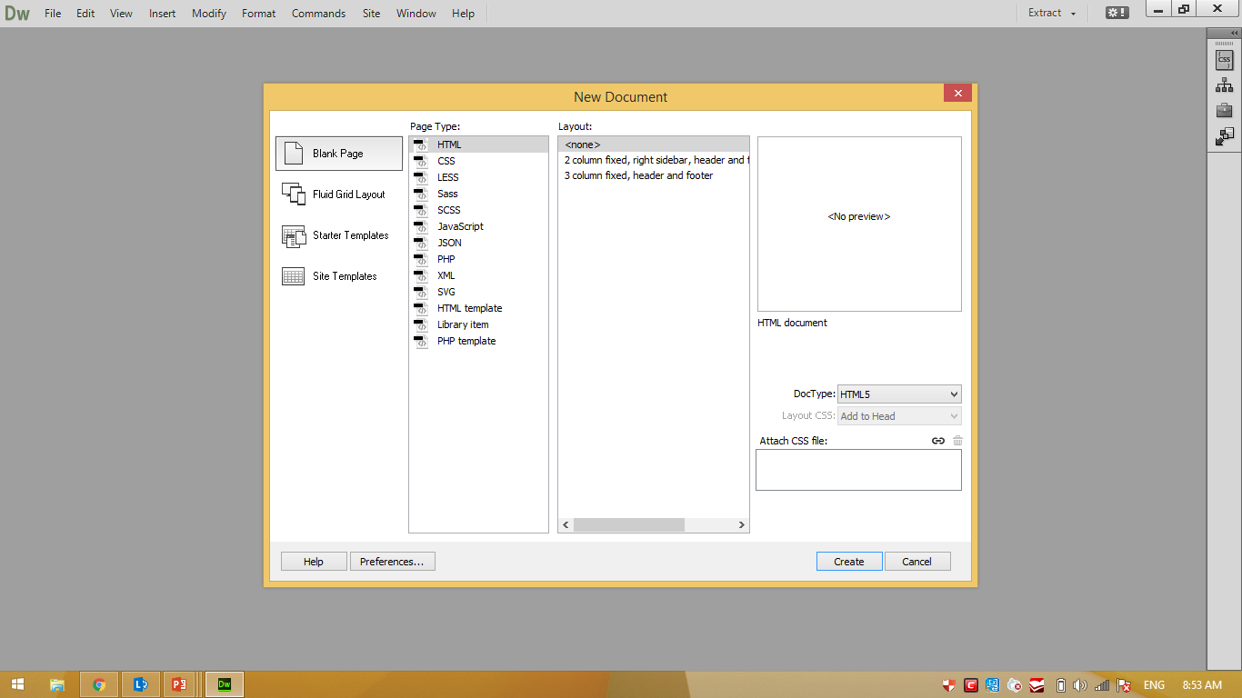
Getting started

Slide 4
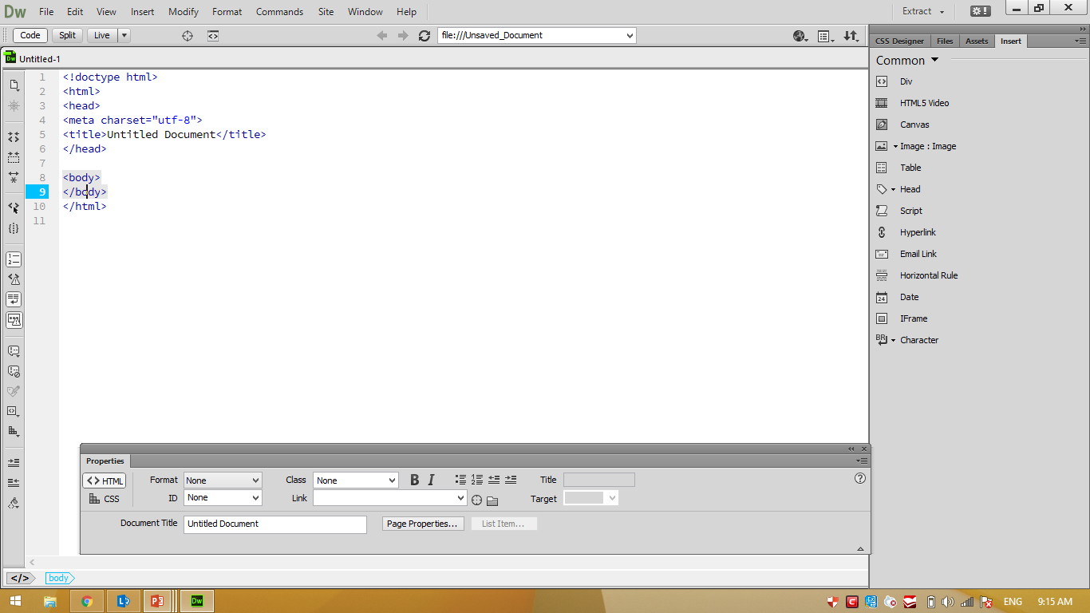
Workspace
Preview/debug
in browser
Menu bar
Document toolbar
Document
window
Insert panel
Property
panel
Tag selector

Slide 5

Reason for learning HTML

Slide 6
Web design
Three layers:
HTML | Structure
CSS | Style
Javascript | behavior

Slide 7
Today we will cover:
“What is CSS?”
Structure of CSS
How to use CSS in your webpage

Slide 8
What is CSS?
CSS stands for “Cascading Style Sheets”
Cascading: refers to the procedure that determines which style will apply to a certain section, if you have more than one style rule.

Slide 9
What is CSS?
CSS stands for “Cascading Style Sheets”
Style: how you want a certain part of your page to look. You can set things like color, margins, font, etc for things like tables, paragraphs, and headings.

Slide 10
What is CSS?
CSS stands for “Cascading Style Sheets”
Sheets: the “sheets” are like templates, or a set of rules, for determining how the webpage will look.

Slide 11
What is CSS?
CSS (all together) is a styling language – a set of rules to tell browsers how your webpage should look.

Slide 12
What is “Style”?
“Style” is a command that you set to tell the browser how a certain section of your webpage should look.
You can use style on many HTML “elements”
(like <p> <h1> <table> )

Slide 13
CSS syntax
Three terms for describing your stiles:
CSS rule
CSS selector
CSS declaration
Notes:
Selector: the thing I want to make styled: a paragraph, a table, a header, etc.
Declaration: what I want to do to my paragraph, table, header, etc.

Slide 14
CCS rule
Selector { property: value; }
declaration
Every style is defined by a selector and a declaration. The declaration contains at least one property/value pair. Together they are called a CSS Rule.

Slide 15
CSS rule
selector { property: value; }
Essentially means:
The thing I want to change {the aspect of that thing I want to change: what I want it to be;}
h1 {color: red;}

Slide 16
CSS selector
body {font-family: Arial, Helvetica}
p {color: #666666}
h1 {font-size: 24px}
a {color: blue}
The selector associates CSS rules with HTML elements.

Slide 17
CSS selector
p { color: red }
The selector is typed in front of the declaration, with a space separating it and the opening curly-bracket.
h1,h2,h3,h4 { font-weight: bold }
Applying styles to multiple selectors in the same rule by separating the selectors with commas

Slide 18
CSS declaration
p { property: value }
The declaration is always defined in a property/ value pair and separated by a colon.
p { font-family: Arial, sans-serif; font-size: 14px; color: #666666; }
You can apply multiple declarations to a selector by separating the declarations with semi-colons.

Slide 19
CSS Selectors
p Type (element)
# ID
. Class

Slide 20
Type (element) Selectors
body {declaration}
p {declaration}
h1 {declaration}
ul {declaration}
The simplest selector is the type selector, which targets an html element by name.

Slide 21
ID selectors
CSS #logo {declaration}
HTML <img id=”logo” src=”bmw.jpg” alt=”logo BMW”>
An ID is an html attribute that is added to your html markup. You reference that ID in your css with a hash.

Slide 22
Class selector
CSS .ingredients {declaration}
HTML <ul class=”ingredients”>
A class is an html attribute that is added to your html markup. You reference that ID in your css with a period

Slide 23
IDs versus Classes
The most important difference between IDs and classes is that there can be only one ID on a page, but multiple classes.
An ID is more specific than a class.
An element can have both an ID and multiple classes.

Slide 24


IDs versus Classes
 | ID: #344-34-4344 Class: Male Class: Employee
 | ID: #123-54-9877 Class: Female Class: Employee

Slide 25
Where do I put my styles?
There are three types of style-rule-places that we will cover:
- Inline
- Internal Style Sheet
- External Style Sheet
Notes:
We just saw an example of “inlined” style. Are there any Qs?

Slide 26
Inline CSS example
<html>
<head><title>My Wonderful Example</title>
</head>
<body>
<p> What was I thinking?</p>
</body>
</html>
Original html code

Slide 27
Inline CSS example
<body>
<h1 style="background:yellow;color:blue;margin-left:30px;text-align:right;">Super heading</h1>
<p style="text-align: center; font-weight: bold; color: yellow;">What was I thinking?</p>
</body>

Slide 28
Dobby is back!
<img src="1111.jpg" style="width:100px; height:100px; border:solid 1px; border-color:blue">

Slide 29
Internal CSS example
<head><title>My Wonderful title</title>
<style type="text/css">
body{ background-color:pink;}
p{ text-align:center; color:blue; } </style>
</head>

Slide 30
External CSS example
<html>
<head><title>My separate CSS</title>
<link href="formypage.css" rel="stylesheet" type="text/css">
</head>
<body>
</body>
</html>

Slide 31
Question
What style will be used when there is more than one style specified for an HTML element????

Slide 32
Priority
Inline
Internal
External
Browser default

Slide 33

Be creative!

Slide 34
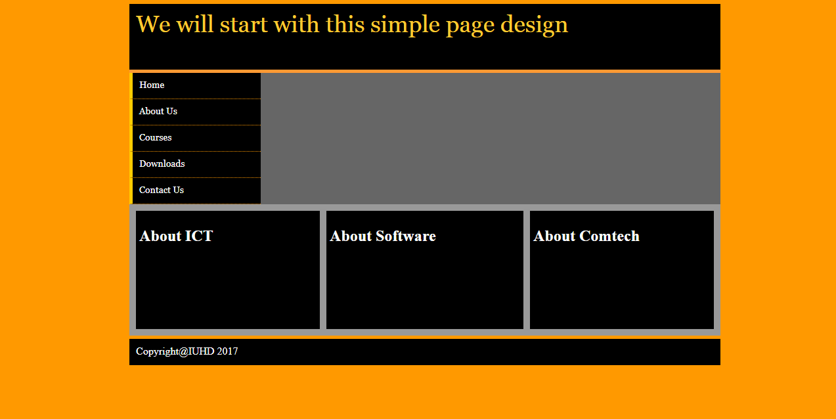

Slide 35
Next lecture
External CSS

