Slide 1

A Research Project Proposal On MedScribe -
Revolutionising Healthcare through AI-Powered Medical Report Analysis
Tribhuvan University
Institute of Science and Technology
Presented By: Tilak Parajuli, Suman khadka , Swechha Shrestha
Department of Computer Science and Information Technology
Bhaktapur Multiple Campus
Dudhapati, Bhaktapur

Slide 2
Brief Overview
Introduction:
In an era of advanced technology, AI in healthcare serves as a transformative force, revolutionizing patient care.
Augmenting medical expertise.
Improving accuracy, and streamlining processes.
Ultimately ensuring better health outcomes for all.

Slide 3
Brief Overview
Objective:
To develop a medical report analysis system using transformers architecture and NLP techniques.
To provide concise summary.(based on textual reports of patients)
To provide treatment recommendation. (based on textual reports of patients)

Slide 4
Brief Overview
Expected Outcomes:
The automation of report summarization and abnormality detection will save valuable time for healthcare providers.
Healthcare professionals can quickly grasp the key information, leading to more efficient decision-making and diagnosis
Patients will gain a better understanding of their medical conditions, fostering informed decision-making .

Slide 5
Problem Statement
Challenges in manual medical report analysis:
Time-consuming and challenging task
Identification of key information can be difficult, especially for complex cases or multiple reports
Generating concise summaries for patient understanding can be challenging
Developing personalized treatment plans based on individual medical history can be complex

Slide 6
Rationale of Study
Significance:
Automating information extraction from medical reports can significantly improve efficiency and accuracy.
Transformers have demonstrated superior performance in natural language processing tasks.
A transformer-based medical report analysis system can revolutionize healthcare data management and analysis.

Slide 7
Rationale of Study
Benefits for clinicians:
Save time
Improve accuracy
Make better decisions
Provide better care to patients
.

Slide 8
Rationale of Study
Benefits for patients:
Improve understanding of their medical conditions
Make informed decisions about their care
Receive better care

Slide 9
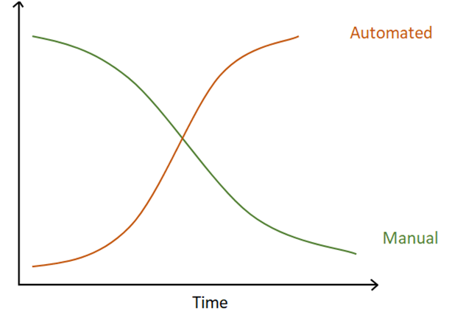

Slide 10
Scope and Limitations
Scope of the medScribe project:
Develop and deploy an AI-powered medical report analysis tool using transformers
Automate information extraction, summary generation, and personalized treatment recommendations
Train the tool on electronic health records (EHRs)
Make the tool accessible to clinicians and patients through a web app

Slide 11
Scope and Limitations
Limitations of the medScribe project:
Tool is currently under development and performance evaluation is ongoing
Tool will be trained on data from a specific hospital and may not generalize well to all healthcare systems
Tool may not accurately analyze reports in languages other than English or with complex information
Tool may not identify all key information in a medical report
Tool is not a substitute for professional medical judgment
Tool may have biases in generating treatment recommendations

Slide 12
Theoretical Foundations
Natural Language Processing (NLP):
NLP is a field of computer science that deals with the interaction between computers and human language.
It helps to perform tasks like translation, sentiment analysis, and summarization.

Slide 13
Theoretical Foundations
Transformers:
Transformers are a deep learning architecture that has revolutionized NLP.
They rely on an attention mechanism to capture long-range dependencies between words in a sentence.
They have achieved state-of-the-art results in various NLP tasks, including machine translation, text summarization, and question answering.

Slide 14
Previous Studies on Medical Report Analysis
Rule-based systems: Handcrafted rules are used to extract specific information from medical reports.
Statistical methods: Statistical models are used to identify patterns in medical reports.
Machine learning approaches: Supervised machine learning techniques are used to train models to extract information from medical reports.

Slide 15
Limitations of Prior Approaches
Rule-based systems are brittle and require manual updates as medical report formats change.
Statistical methods may not capture complex relationships between words in medical reports.
Traditional machine learning approaches often require large amounts of labeled data for training.

Slide 16
Feasibility Study
Technical
Transformer and Google Colab are the key technologies used.
Team consists of students with shared enthusiasm of AI, NLP and Deep Learning

Slide 17
Feasibility Study
Operational
The necessary resources and support systems are in place to successfully implement and deploy the tool.
The medScribe team will implement appropriate security measures, such as encryption and access control, to protect patient privacy and confidentiality.

Slide 18
Feasibility Study
Economic
This is a research based project for our college work. So we do not seek funds but in the future after deploying it, the team has developed a plan to secure funding, obtain the necessary resources, and sustain the project after it is deployed.

Slide 19
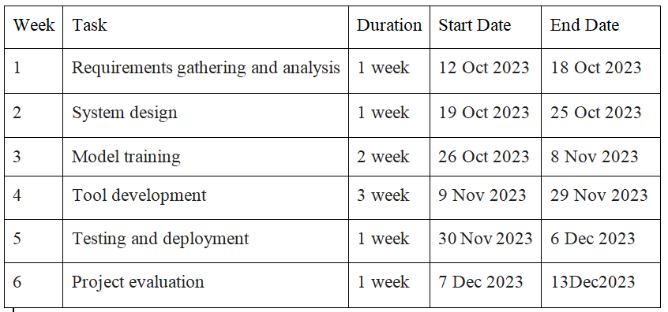
Feasibility Study
Schedule

Slide 20
Research Methodology
Research question:
How can Transformer-based medical report analyser provide clear and explainable summaries and treatment recommendation for healthcare professionals to trust AI-assisted decision-making?
How can Transformer-based models be optimized to accurately summarize medical reports while simplifying medical jargon and retaining crucial information?

Slide 21
Research Methodology
Data Preparation:
Collect electronic health records (EHRs) from Bhaktapur hospital
EHR of case reports
Lab investigation report
Ensure data privacy and confidentiality

Slide 22
Research Methodology
Data preprocessing:
Clean and prepare EHR data for transformer training
Address data inconsistencies and missing values

Slide 23
Research Methodology
Model development:
Employ a transformer-based language model.
Fine-tune the pre-trained model on the prepared medical report dataset.

Slide 24
Research Methodology
Evaluation:
Evaluate the performance of the trained model on a held-out test set.
Use metrics such as precision, recall, and F1-score to assess the model's accuracy.

Slide 25
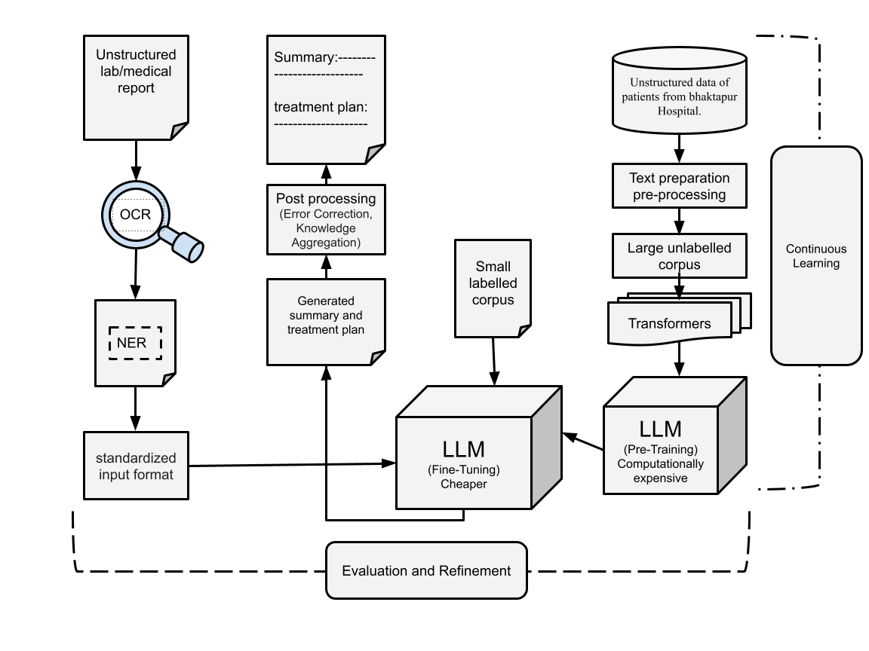
Methodology of the proposed system

Slide 26
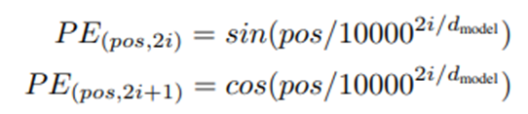
Description of Algorithms
Steps in Transformer architecture are:
Embedding
Positional Encoding
Where:
pos is the position of the word in the sentence
i is the index of the positional encoding dimension
dmodel is the dimension of the embedding vectors

Slide 27
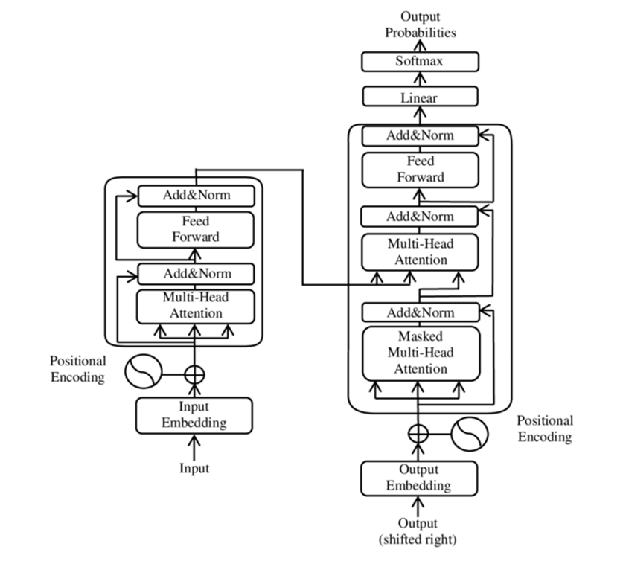

Slide 28
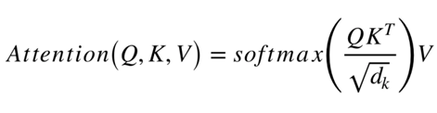
Description of Algorithms
Scaled dot-product attention head
Where:
Q is the query vector
K is the key vector
V is the value vector
dk is the dimension of the key vector

Slide 29
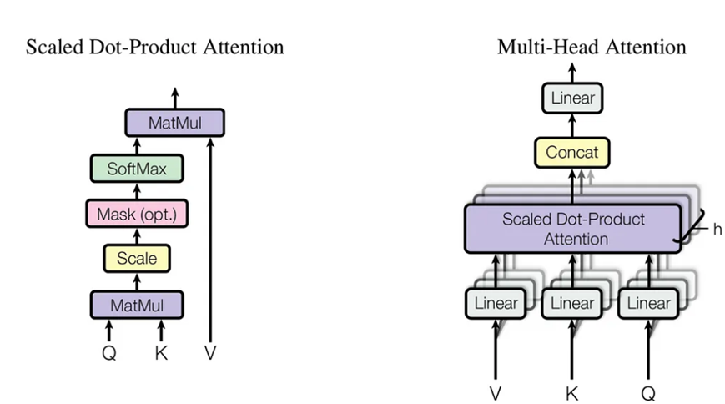

Slide 30
Description of Algorithms
Multi-head attention
Where,
the matrix X is the concatenation of word embeddings
the matrices WiQ, Wik, WiV are "projection matrices" owned by individual attention head i
W0 is a final projection matrix owned by the whole multi-headed attention head

Slide 31
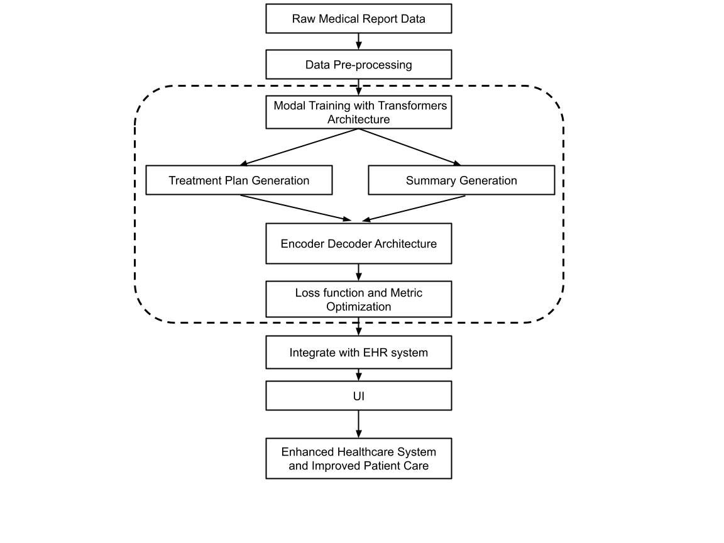
Working Mechanism of Proposed System

Slide 32
-------------–The End—----------

