Slide 1

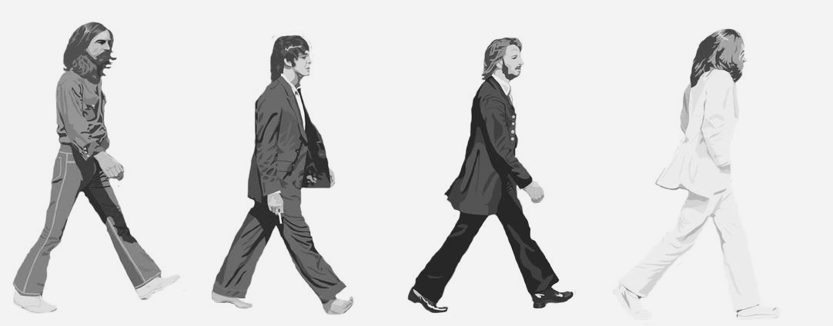
Who is the Most Popular BEATLE?
(According to Spotify)
A Capstone Presentation
Parker Hanna

Slide 2
The Goal:
Uncover which Beatle can be regarded as the more popular with data from Spotify
Unpack musical features to determine which, if any, musical features correlate to higher popularity
Track musical developments chronologically to understand how popularity was interpreted at the time
The Issues:
John and Paul credit their songs simply as ‘Lennon/McCartney’, even when only one was the singular creator - a case which is true in most Beatles songs
Extending our analysis beyond 201 Beatles songs to solo career and contemporary bands to understand popularity correlations in new context.

Slide 3
Collecting the Data
Utilizing Spotify’s API and a Python library called Spotipy, we get Beatles tracks and musical features
Target the API requests to exclude compilations, live albums, and extended reissues (i.e. ‘Magical Mystery Tour – 2015 Remastered Extended Deluxe Edition’)
Webscraping Beatles fansite archives where fans have identified a primary songwriter for each song
A lifetime of personal fandom stored in the ol’ noggin to help contextualize our investigation and findings

Slide 4
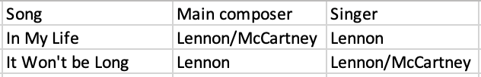
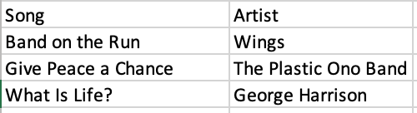
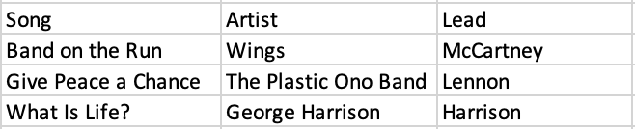
Transforming the Data
We need to transform our data sourced from both Spotify and the Beatles fansite to allow us to join the 201 Beatles songs in consideration and attribute a primary creator:
Normalizing all solo career projects and bands to reflect a single Beatle:
Additional clean-up and tidying

Slide 5
The Variables All definitions sourced from Spotify Web API Reference Material
Popularity - The popularity is calculated by algorithm and is based, in the most part, on the total number of plays the track has had and how recent those plays are.
Acousticness - A confidence measure from 0.0 to 1.0 of whether the track is acoustic (1.0) or electric (0.0)
Danceability – How suitable a track is for dancing based on a combination of musical elements including tempo, rhythm stability, beat strength, and overall regularity. 0.0 is least danceable and 1.0 is most danceable.
Energy - Represents a perceptual measure of intensity and activity. Typically, energetic tracks feel fast, loud, and noisy. Perceptual features contributing to this attribute include dynamic range, perceived loudness, or timbre.
Valence - A measure from 0.0 to 1.0 describing the musical positiveness conveyed by a track. Tracks with high valence sound more positive (happy, cheerful, euphoric), while tracks with low valence sound more negative (sad, depressed, angry).

Slide 6
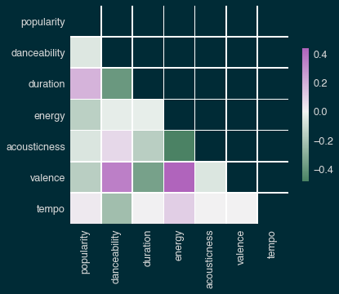
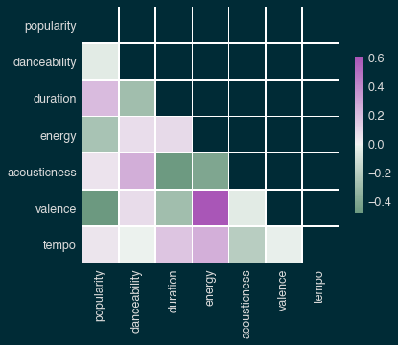
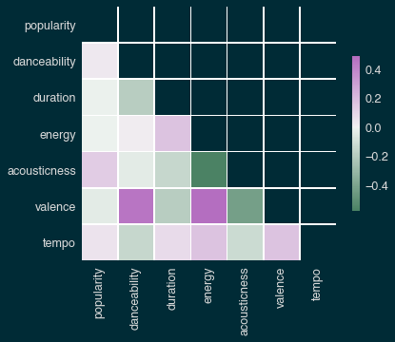
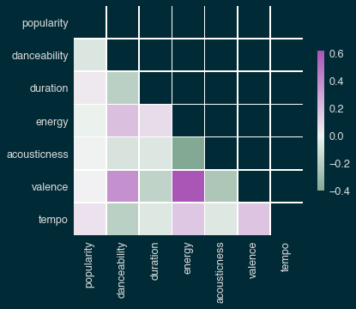

Beatles Correlation
Top 25 Correlation
Solo Act Correlation
Bands Correlation

Slide 7
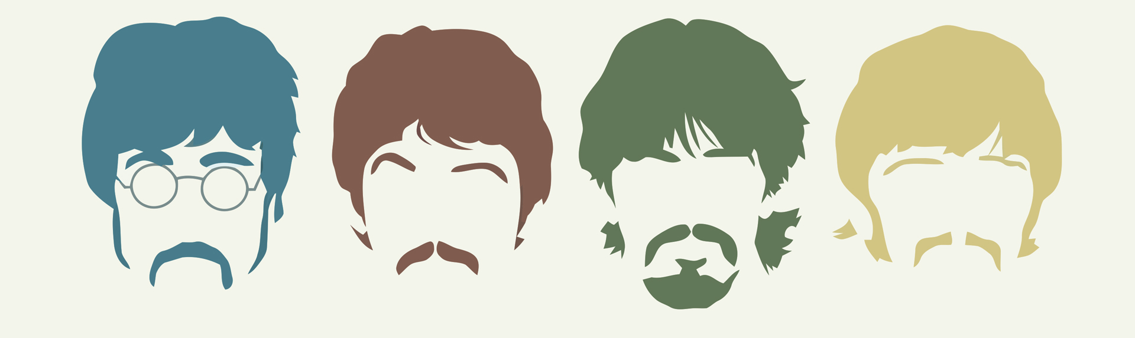
The Findings:
Paul McCartney is tops when looking at the Beatles’ catalog, and John Lennon wins when take into consideration solo careers
There are essentially no correlations in musical features that contribute to a more popular Beatles song. It seems we love the most timeless Beatles songs for their variety of musical stylings and features, and not in spite of it.
There are clear changes in musical stylings that can be tracked in the broader music scene overtime.
Popularity measures compared to musical features don’t reveal much 60ish years removed in time, but the changes at the time the music was created give us interesting insights into how popularity was determined, identified, and reacted to during the 60’s and early 70’s

