Slide 1

Jumping for JS

Slide 2
Today’s Class

Slide 3
Objectives
In today’s class we’ll be covering:
Array Assignments
The Concept of Loops and Iteration

Slide 4
Basics Recap

Slide 5
Deep Philosophy
What is JavaScript?
(And what is it used for?)

Slide 6
JavaScript Definitions
JavaScript is the third of the three fundamental programming languages of the modern web (along with HTML, CSS)
JavaScript allows developers to create dynamic web applications capable of taking in user inputs, changing what’s displayed to users, animating elements, and much more.

Slide 7
Please… Don’t Pick Me.
What is a Variable?
(And how do we declare one?)

Slide 8
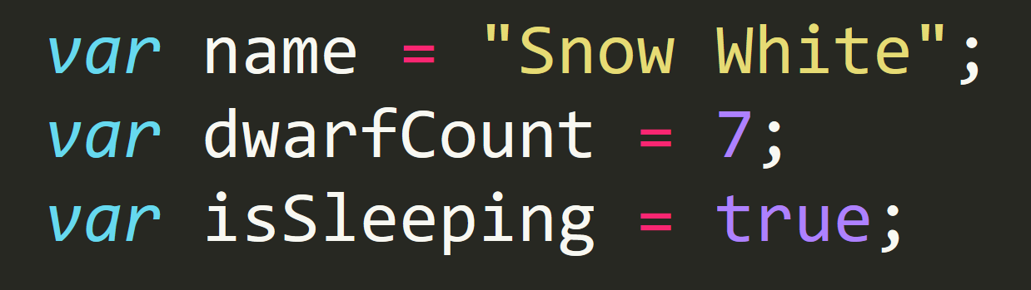
Basic Variables
Variables are the nouns of programming.
They are “things” (Numbers, Strings, Booleans, etc.)
They are composed of variable names and values

Slide 9
Please… Don’t Pick Me.
What is meant by console.log?
(And how does it differ from an alert, prompt, or confirm?)

Slide 10
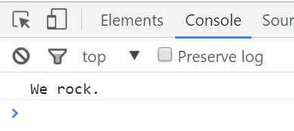
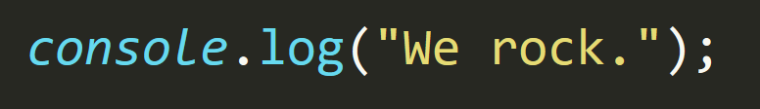
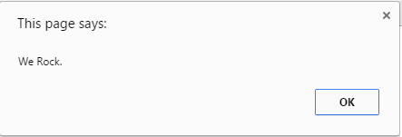
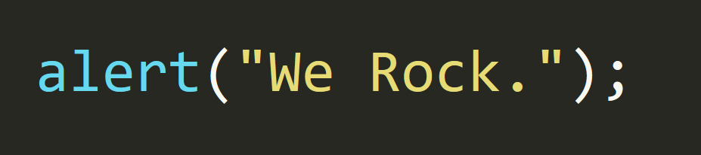
Basic Variables
Console.log displays discreetly to the debugger.
Alert displays a pop-up message to the user.

Slide 11
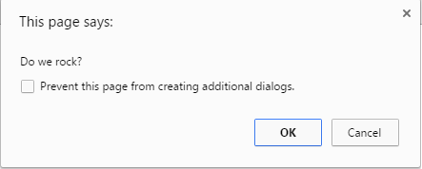
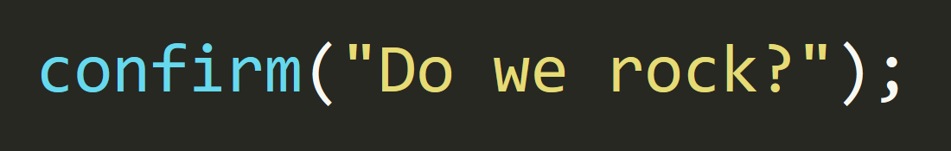
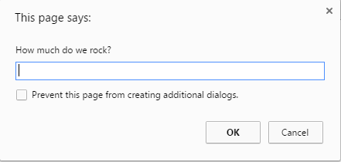
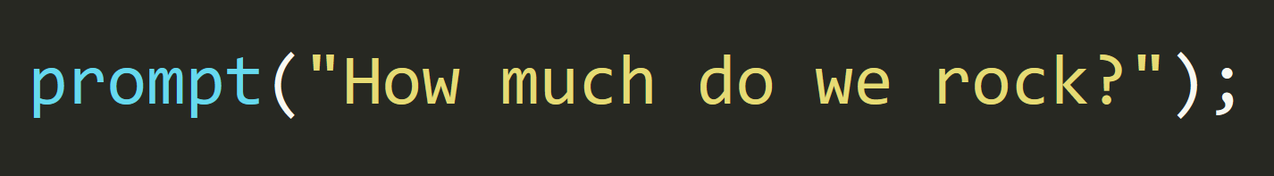
Basic Variables
Confirm displays a True/False popup.
Prompt displays a prompt with a text-box input.

Slide 12
Please… Don’t Pick Me.
How do we check conditions?

Slide 13
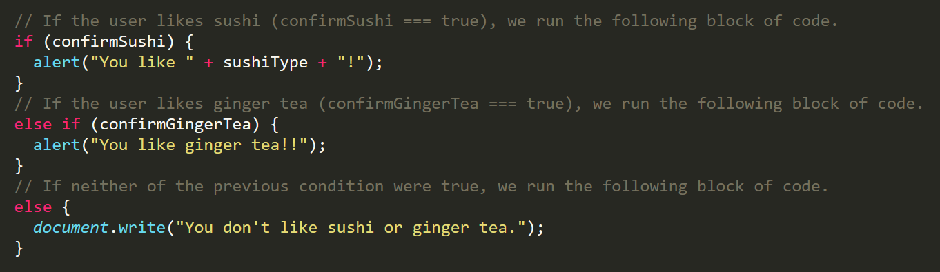
If/Else Statements
If/Else statements are critical.
Each statement is composed of an if, else-if, or else (keyword), a condition, and the resulting code in { } curly brackets.

Slide 14
What is an array?

Slide 15
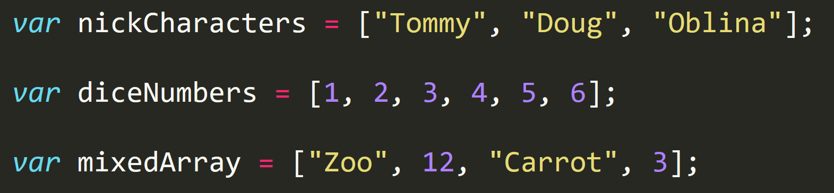
Basic Arrays
Arrays are a type of variable that are collections.
These collections can be made up of strings, numbers, booleans, other arrays, objects, anything.
Each element of the array is marked by an index. Indexes always start with 0.

Slide 16
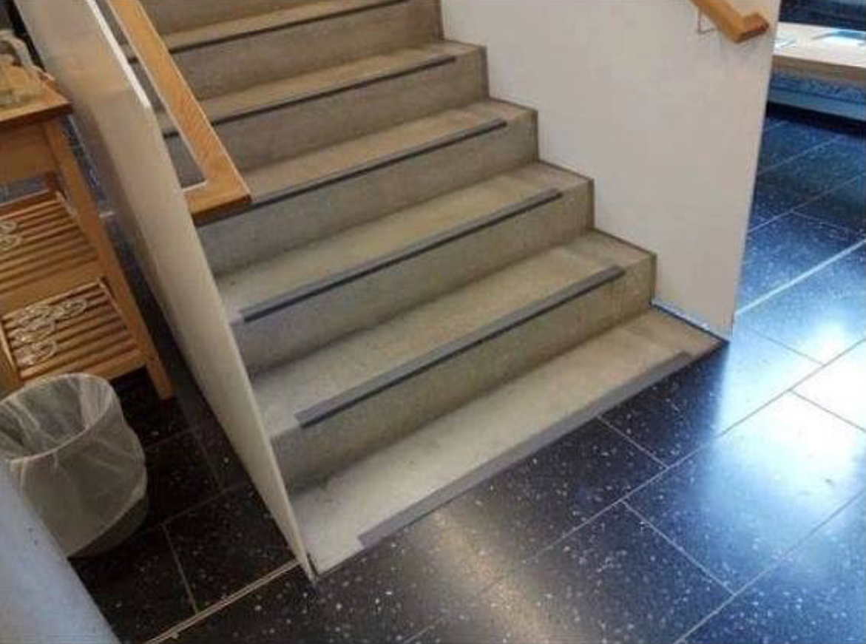
Array Index
Each element of the array is marked by an index. Indexes always start with 0.

Slide 17
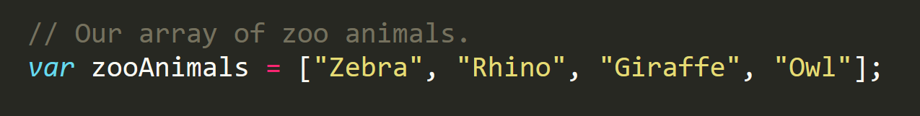
Array Name: zooAnimals
Zebra
Rhino
Giraffe
Owl
Index 0
Index 1
Index 2
Index 3

Slide 18
For Loops

Slide 19
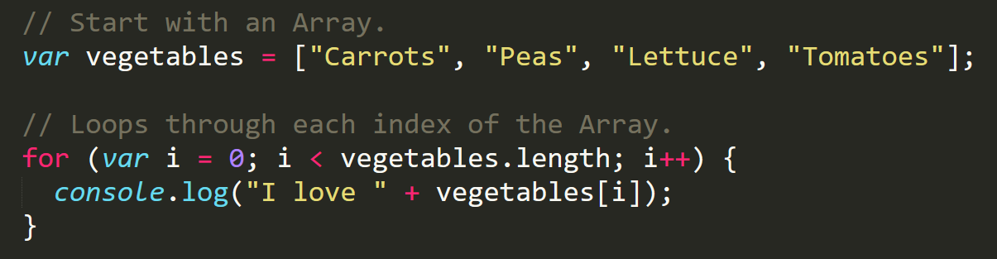
Enter the For-Loop
For loops are critical in programming.
We use for loops to run repeated blocks of code over a set period.
Each for loop is composed of a:
Variable declaration or counter (iterator)
A loop condition
An iteration (addition)

Slide 20
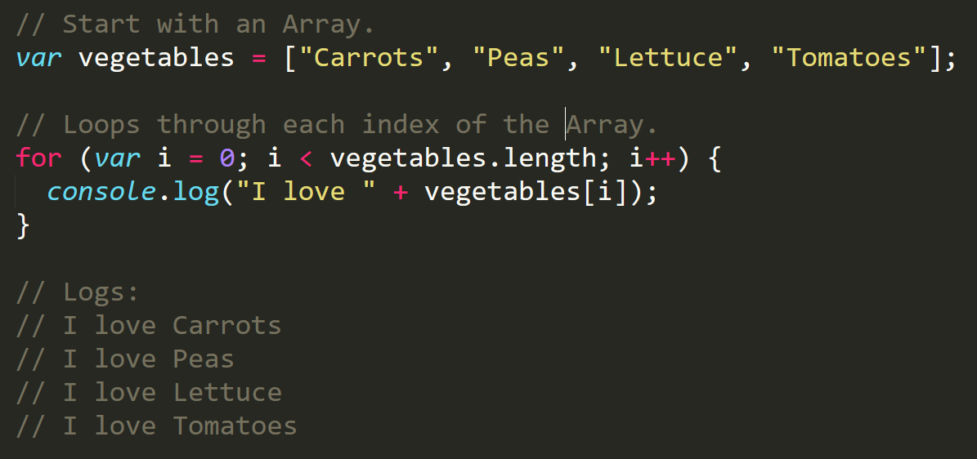
Enter the For-Loop
Iterator. Condition. Increment.

Slide 21
Enter the For-Loop
Code between the { } gets repeated each time the iterator is smaller than the condition. (i.e. in this case i < 4)

Slide 22
Enter the For-Loop
Running the code “loops” through and prints each element in the array.

Slide 23
Run That Loop
When i = 0 … console.log(“I love Carrots”)
Carrots
Peas
Lettuce
Tomatoes
Index 0
Index 1
Index 2
Index 3

Slide 24
Run That Loop
When i = 1 … console.log(“I love Peas”)
Carrots
Peas
Lettuce
Tomatoes
Index 0
Index 1
Index 2
Index 3

Slide 25
Run That Loop
When i = 2 … console.log(“I love Lettuce”)
Carrots
Peas
Lettuce
Tomatoes
Index 0
Index 1
Index 2
Index 3

Slide 26
Run That Loop
When i = 3 … console.log(“I love Tomatoes”)
Carrots
Peas
Lettuce
Tomatoes
Index 0
Index 1
Index 2
Index 3

Slide 27
Questions

