Slide 1
Chapter 13
Finite Difference Methods: Outline
Solving ordinary and partial differential equations
Finite difference methods (FDM) vs Finite Element Methods (FEM)
Vibrating string problem
Steady state heat distribution problem

Slide 2
PDEs and Examples of Phenomena Modeled
Ordinary differential equation: equation containing derivatives of a function of one variable
Partial differential equation: equation containing derivatives of a function of two or more variables
Models:
Air flow over an aircraft wing
Blood circulation in human body
Water circulation in an ocean
Bridge deformations as its carries traffic
Evolution of a thunderstorm
Oscillations of a skyscraper hit by earthquake
Strength of a toy
Financial Markets

Slide 3
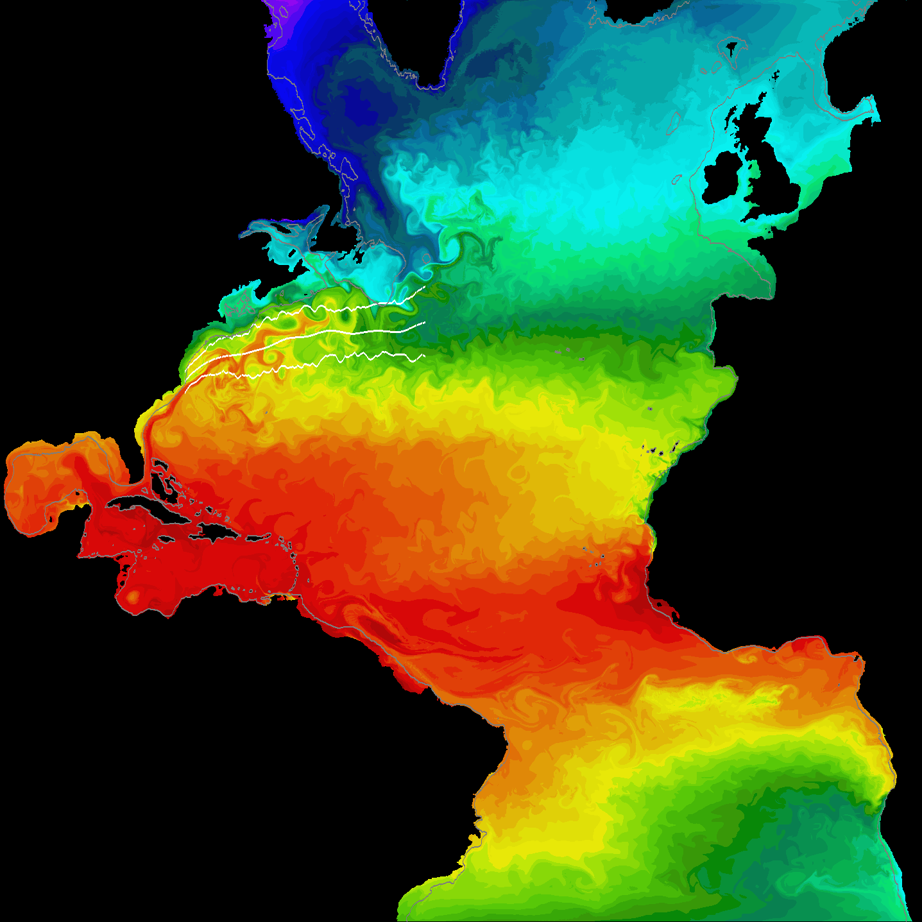
Model of Sea Surface Temperature in Atlantic Ocean
Courtesy MICOM group
at the Rosenstiel School
of Marine and Atmospheric
Science, University of Miami

Slide 4
Solving PDEs
Finite element method
Finite difference method (our focus)
  Converts PDE into matrix equation
    Linear system over discrete basis elements
  Result is usually a sparse matrix
  Matrix-based algorithms represent matrices explicitly
  Matrix-free algorithms represent matrix values implicitly (our focus)

Slide 5
Class of Linear
Second-order PDEs
Linear second-order PDEs are of the form
where A - H are functions of x and y only
Elliptic PDEs: B² - AC < 0
    (steady state heat equations)
Parabolic PDEs: B² - AC = 0
    (heat transfer equations)
Hyperbolic PDEs: B² - AC > 0
    (wave equations)

Slide 6
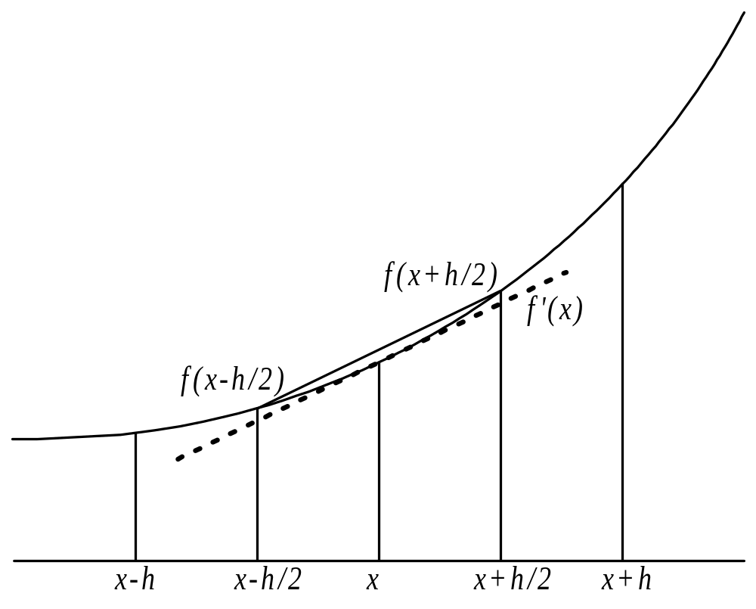
Difference Quotients

Slide 7
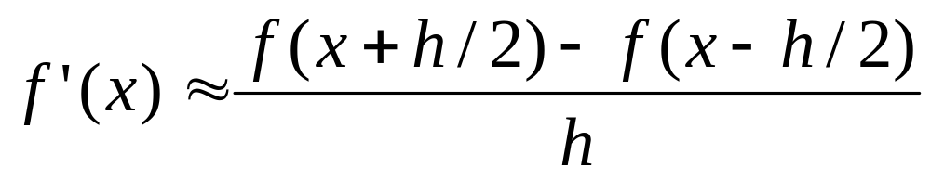
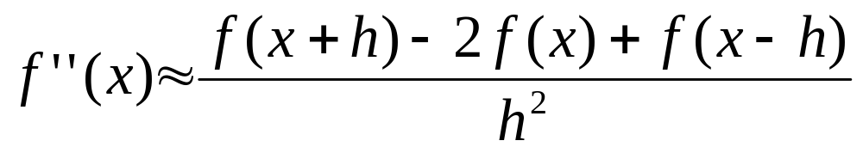
Formulas for 1st, 2d Derivatives

Slide 8
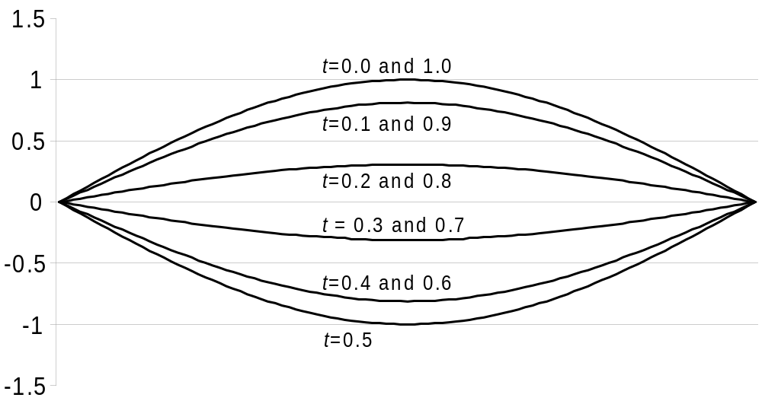
Vibrating String Problem
Vibrating string modeled by a hyperbolic PDE

Slide 9
Solution Stored in 2-D Array
Each row represents state of string at some point in time
Each column shows how position of string at a particular point changes with time

Slide 10
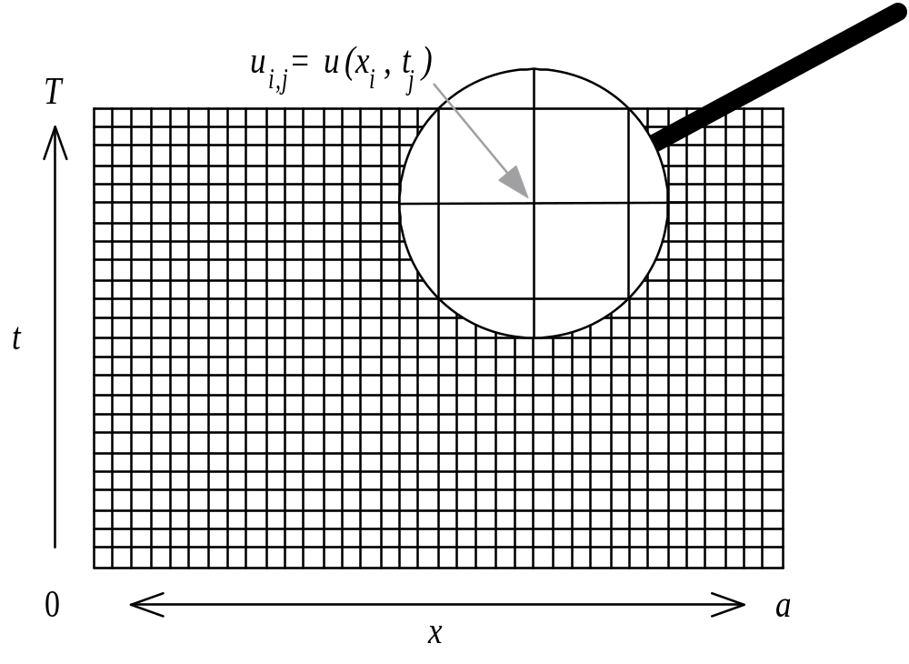
Discrete Space, Time Intervals Lead to 2-D Array

Slide 11
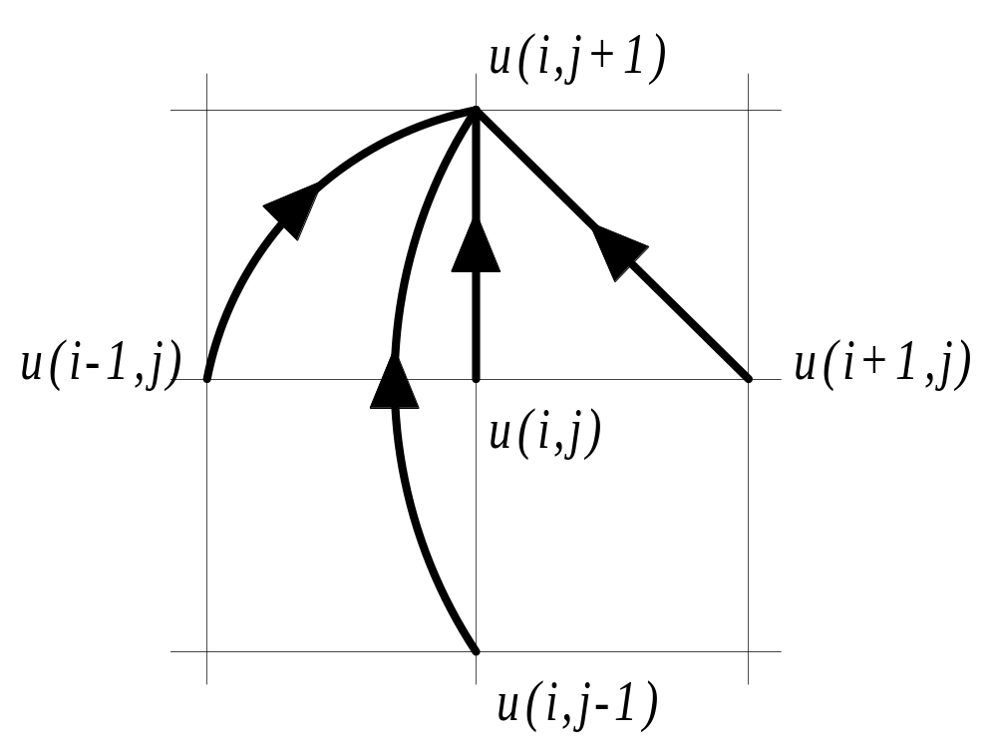
Heart of Sequential C Program
u[j+1][i] = 2.0*(1.0-L)*u[j][i] +
L*(u[j][i+1] + u[j][i-1]) - u[j-1][i];

Slide 12
Parallel Program Design
Associate primitive task with each element of matrix
Examine communication pattern
Agglomerate tasks in same column
Static number of identical tasks
Regular communication pattern
Strategy: agglomerate columns, assign one block of columns to each task

Slide 13
Result of Agglomeration and Mapping

Slide 14
Communication Still Needed
Initial values (in lowest row) are computed without communication
Values in black cells cannot be computed without access to values held by other tasks

Slide 15
Ghost Points
Ghost points: memory locations used to store redundant copies of data held by neighboring processes
Allocating ghost points as extra columns simplifies parallel algorithm by allowing same loop to update all cells

Slide 16
Matrices Augmented with Ghost Points
Green cells are the ghost points.

Slide 17
Communication in an Iteration
This iteration the process is responsible for
computing the values of the yellow cells.

Slide 18
Computation in an Iteration
This iteration the process is responsible for
computing the values of the yellow cells.
The striped cells are the ones accessed as
the yellow cell values are computed.

Slide 19
Complexity Analysis
Computation time per element is constant, so sequential time complexity per iteration is Θ(n)
Elements divided evenly among processes, so parallel computational complexity per iteration is Θ(n / p)
During each iteration a process with an interior block sends two messages and receives two messages, so communication complexity per iteration is Θ(1)

Slide 20
Isoefficiency Analysis
Sequential time complexity: Θ(n)
Parallel overhead: Θ(p)
Isoefficiency relation:
n ≥ Cp
To maintain the same level of efficiency, n must increase at the same rate as p
If M(n) = n², algorithm has poor scalability
If matrix of 3 rows rather than m rows is used, M(n) = n and system is perfectly scalable

Slide 21
Replicating Computations
If only one value transmitted, communication time dominated by message latency
We can reduce number of communications by replicating computations
If we send two values instead of one, we can advance simulation two time steps before another communication

Slide 22
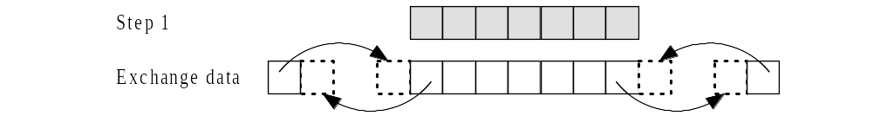
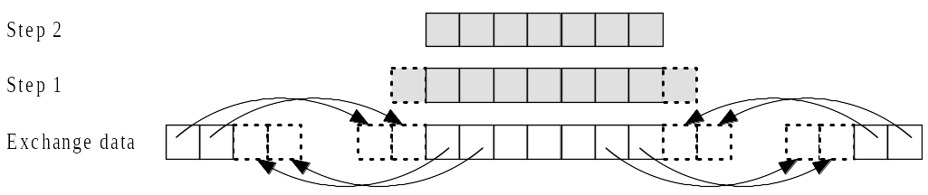
Replicating Computations
Without replication:
With replication:

Slide 23
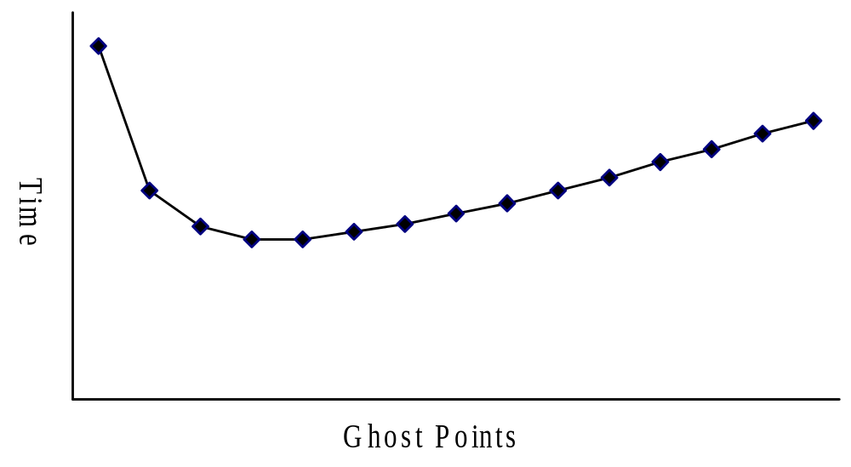
Communication Time vs. Number of Ghost Points

Slide 24
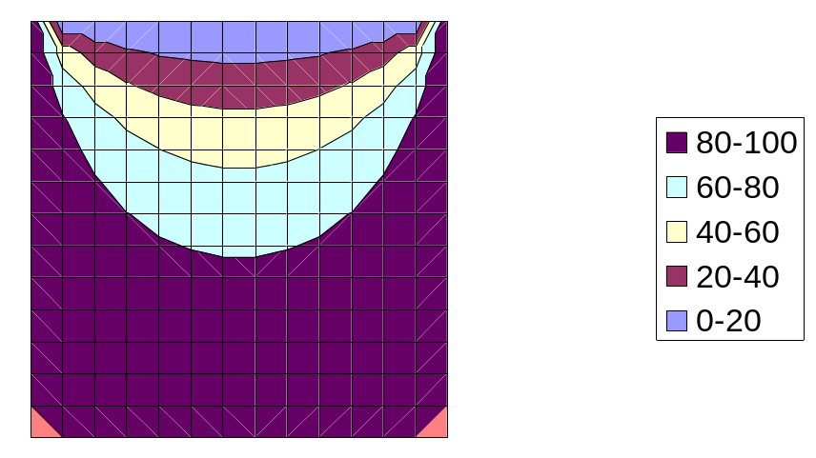
Next Case: Steady State Heat Distribution Problem
Ice bath
Steam
Steam
Steam

Slide 25
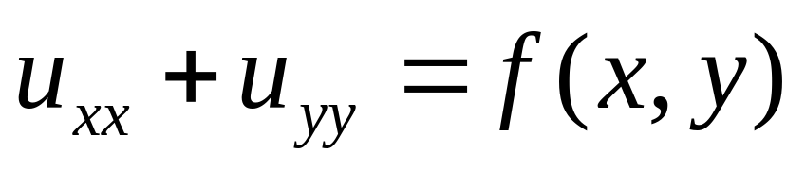
Solving the Problem
Underlying PDE is the Poisson equation
This is an example of an elliptical PDE
Will create a 2-D grid
Each grid point represents value of state state solution at particular (x, y) location in plate

Slide 26
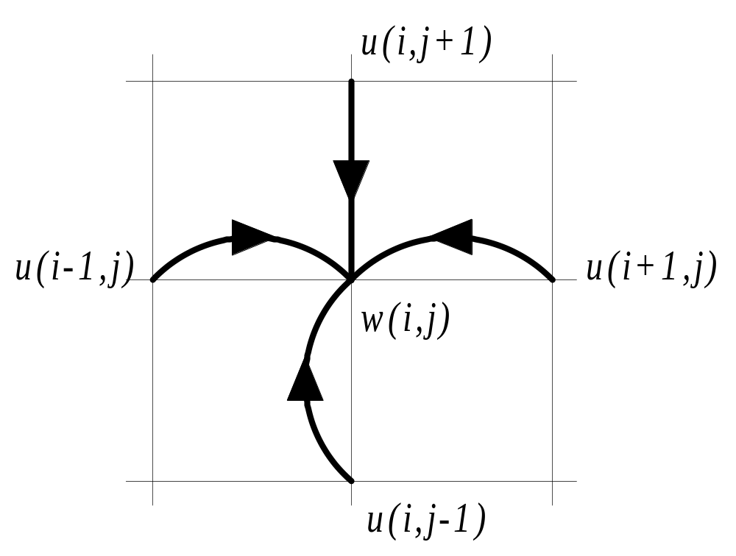
Heart of Sequential C Program
w[i][j] = (u[i-1][j] + u[i+1][j] +
u[i][j-1] + u[i][j+1]) / 4.0;

Slide 27
Parallel Algorithm 1
Associate primitive task with each matrix element
Agglomerate tasks in contiguous rows (rowwise block striped decomposition)
Add rows of ghost points above and below rectangular region controlled by process

Slide 28
Example Decomposition
16 × 16 grid
divided among 4 processors

Slide 29
Complexity Analysis
Sequential time complexity:
Θ(n²) each iteration
Parallel computational complexity:
Θ(n² / p) each iteration
Parallel communication complexity:
Θ(n) each iteration (two sends and two receives of n elements)

Slide 30
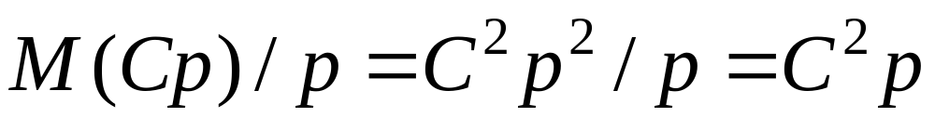
Isoefficiency Analysis
Sequential time complexity: Θ(n²)
Parallel overhead: Θ(pn)
Isoefficiency relation:
n² ≥ Cnp ⇒ n ≥ Cp
This implementation has poor scalability

Slide 31
Parallel Algorithm 2
Associate primitive task with each matrix element
Agglomerate tasks into blocks that are as square as possible (checkerboard block decomposition)
Add rows of ghost points to all four sides of rectangular region controlled by process

Slide 32
Example Decomposition
16 × 16 grid
divided among
16 processors

Slide 33
Implementation Details
Using ghost points around 2-D blocks requires extra copying steps
Ghost points for left and right sides are not in contiguous memory locations
An auxiliary buffer must be used when receiving these ghost point values
Similarly, buffer must be used when sending column of values to a neighboring process

Slide 34
Complexity Analysis
Sequential time complexity:
Θ(n²) each iteration
Parallel computational complexity:
Θ(n² / p) each iteration
Parallel communication complexity:
Θ(n /√p ) each iteration (four sends and four receives of n /√p elements each)

Slide 35
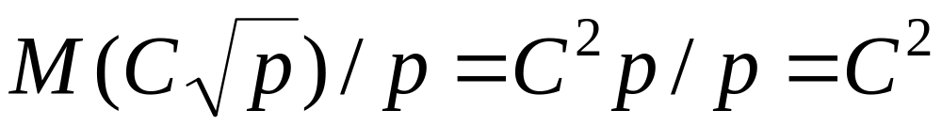
Isoefficiency Analysis
Sequential time complexity: Θ(n²)
Parallel overhead: Θ(n √p )
Isoefficiency relation:
n² ≥ Cn √p ⇒ n ≥ C √p
This system is perfectly scalable

Slide 36
Summary (1/4)
PDEs used to model behavior of a wide variety of physical systems
Realistic problems yield PDEs too difficult to solve analytically, so scientists solve them numerically
Two most common numerical techniques for solving PDEs
  finite element method
  finite difference method

Slide 37
Summary (2/4)
Finite difference methods
  Matrix-based methods store matrix explicitly
  Matrix-free implementations store matrix implicitly
We have designed and analyzed parallel algorithms based on matrix-free implementations

Slide 38
Summary (4/4)
Ghost points store copies of values held by other processes
Explored increasing number of ghost points and replicating computation in order to reduce number of message exchanges
Optimal number of ghost points depends on characteristics of parallel system

