Slide 1
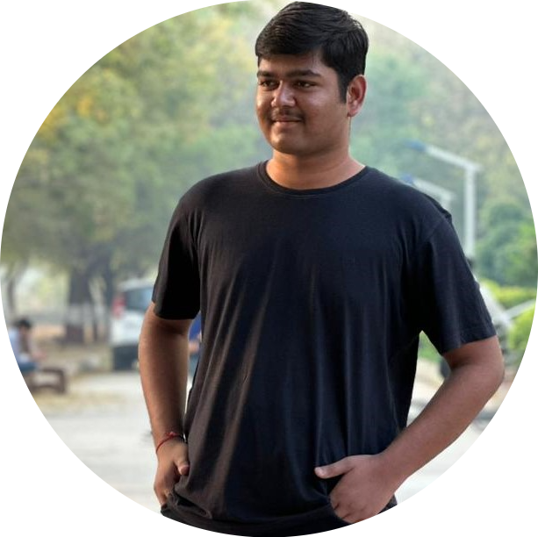
MY FAMILY DETAILS
Father's Name
Hareshbhai Dholakia
Businessman
Father's Job
Mother's Name
Avani Dholakia
Mother's Job
Housewife
EDUCATION
PARAM
DHOLAKIA
PERSONAL INFO
Date of Birth 11-02-2004
Gender Male
Marital Status Single
Religion Hindu
Caste Leva Patel
Height 6’ft
Weight 95kg
Blood Group O-
Skin Medium tone
Address Near Royal Enfield Showroom,
Chitra Bhavnagar
Highest Degree
Bachelor's in Computer Engineering
College
GCET,Anand
Graduation Year
2026
OTHER QUALIFICATIONS
High School Oaj institute (2022)
HOBBIES AND INTERESTS
Hobbies
Reading, Playing Chess
Interests
Nature, Travel
CONTACT DETAILS
Phone 9426505020
Email paramdholakia1@gmail.com

