Slide 1

Incremental Learning Based Identification of IoT Devices using Packet-level Behavioral Features
Param Bharatbhai Patel​
234101062​
Under the supervision of ​
Prof. Tamarapalli Venkatesh​
Department of Computer Science and Engineering Indian Institute of Technology Guwahati
June, 2025

Slide 2
Outline
Introduction
Literature Review
Limitations of Existing Studies
Methodology
Feature Extraction and Selection
Learning Pipeline Design
Results and Discussion
Comparison with Previous Work
Conclusions
References

Slide 3
Introduction

Slide 4
Introduction
What is IoT Device Identification?
IoT Device Identification involves recognizing devices in a network by analyzing their traffic patterns, behaviors, and protocol features for accurate classification.
Why is it Important?
With IoT networks becoming larger and more diverse, reliably identifying devices is key to keeping them secure, efficient, and free from impersonators.
Challenges with Traditional Methods
Traditional identifier-based methods often struggle in today’s dynamic IoT environments, leading to shift to behavior-based identification as a more flexible and reliable solution.

Slide 5
Introduction
The Problem :
Static ID-based methods ineffective in dynamic IoT networks.
Batch-trained models require costly retraining for new device data.
Motivation :
Need for models that learn and adapt continuously.
Avoid performance drop due to evolving device behavior.
Objective :
Use behavioral features for device identification.
Apply incremental learning for continuous updates.
Ensure high accuracy without full retraining.

Slide 6
Literature Review

Slide 7
Literature Review
Category | Study | Technique Used | Key Contributions | Limitations
Static ID-based method | Miettinen et al. - IoT Sentinel (2017) | MAC address clustering, signature matching | Lightweight device fingerprinting via ARP/MAC patterns | Depends on MAC identifiers; limited scalability in large networks
Fingerprint Aggregation | Bezawada et al. - IoTSense (2018) | Protocol and payload-based aggregated fingerprint | High average accuracy (99%) using lightweight fingerprints; uses entropy and payload length features. | Limited number of devices; merging assumes MAC identity; evaluation not generalized.
Flow Statistics based method | Sivanathan et al.- Classifying IoT Devices... (2019) | Flow-based statistical ML (NB, RF, etc.) | Used 6 months of traffic for 28 devices; extracted flow volume, sleep time, DNS, NTP features. | Port, DNS and cipher suite features lack generalizability; some devices excluded.

Slide 8
Literature Review
Category | Study | Technique Used | Key Contributions | Limitations
Packet-level Fingerprinting | Kostas et al.- IoTDevID (2022) | Decision Tree with GA-based Feature Selection | Generalizable behavioral features; supports non-IP devices | Full retraining needed for updates; not suitable for real-time deployments
Incremental learning in IoT | Zhang et al. – IoTTFID (2022) | Incremental RNN with traffic fingerprint evolution | Supports evolving traffic patterns and online model updates | Uses session-level input; less responsive to per-packet behavioral shifts

Slide 9
Limitations of Existing Studies
Static and Environment-Specific Features :
Many approaches rely on MAC/IP addresses or features like DNS queries and port usage, which are either spoofable or fail to generalize across different network environments.
Limited Robustness and Adaptability :
Most studies validate on small, homogeneous device sets and overlook evolving traffic patterns, making them less effective in dynamic, real-world deployments.
Lack of Real-Time Capability :
Session-based aggregation and offline training (e.g., Decision Trees, SVMs) hinder real-time classification and require full retraining when new device patterns emerge.

Slide 10
Methodology

Slide 11
Methodology Overview
Extracted behavioral features from network protocol headers.
Identified optimal feature subsets using voting-based filters and genetic algorithm
Simulated streaming conditions with incremental mini-batch updates (batch sizes: 250, 500, 1000).
Used incremental updates via partial_fit() to maintain model adaptability and efficiency.
Evaluated model performance, precision in real-time and compared against offline baseline method.

Slide 12
Methodology
Dataset Preparation :
Datasets Used :
Aalto Dataset: 27 consumer devices, lab environment, balanced traffic patterns.
UNSW Dataset: 33 diverse devices, real-world smart home setting, heterogeneous traffic.
Preprocessing Steps :
Remove invalid/missing value rows.
Encode device labels as integers.
Sequential ordering of data to simulate real-time arrival.
Mini-batch creation (sizes: 250, 500, 1000).

Slide 13
Feature Extraction and Feature Selection
Initial pool of 111+ features from packet headers and statistical properties.
Employed a multistage selection process:
Voting-based Filtering: Used multiple importance measures (Chi-square, Information Gain, L1-regularization) to rank and filter features.
Validation for Generality: Removed session-dependent features (e.g., IP IDs, TCP sequence numbers) to prevent dataset-specific biases.
Genetic Algorithm (GA) Optimization: Selected optimal subset (~32-35 features) ensuring generalization and improved classifier performance.

Slide 14
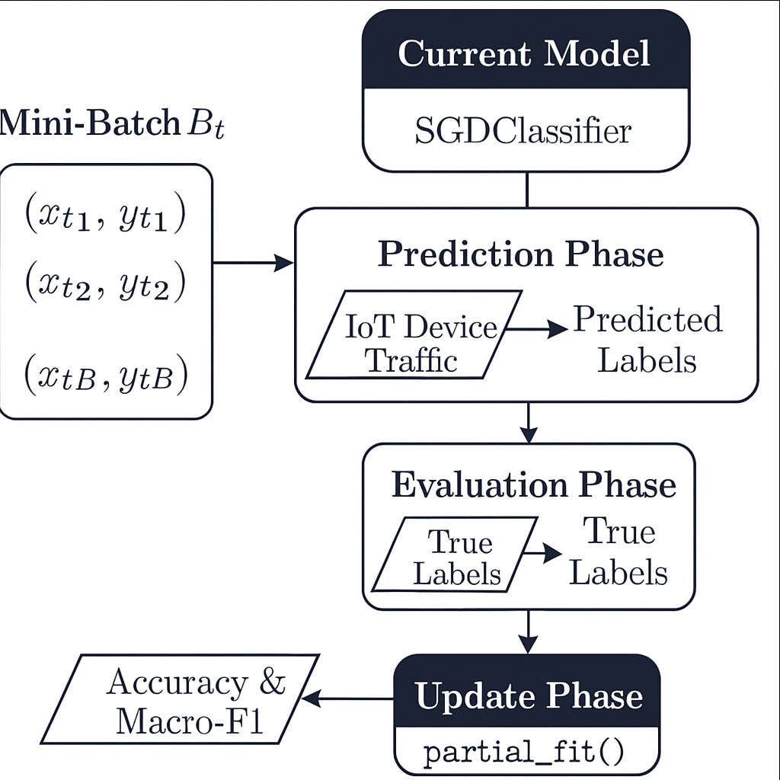
Learning Pipeline Design
Input :
Preprocessed and normalized packet-level behavioral features from raw network traffic.
Incremental Training Loop :
Data is split into fixed-size mini-batches.
For each batch:
Predict → Evaluate performance.
Update model with partial_fit().
Output :
Continuous stream of predictions with ongoing model refinement over time.

Slide 15
Results and Discussion

Slide 16
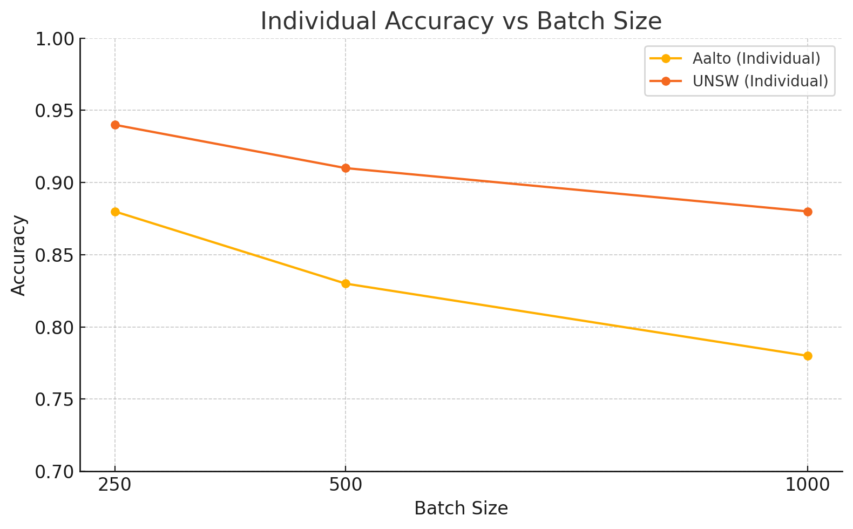
Impact of Batch size on Accuracy
Fine-grained updates from small batches help the model adapt better to behavioral drift.
Smaller batches increase update frequency, raising computational overhead in resource-limited settings.

Slide 17
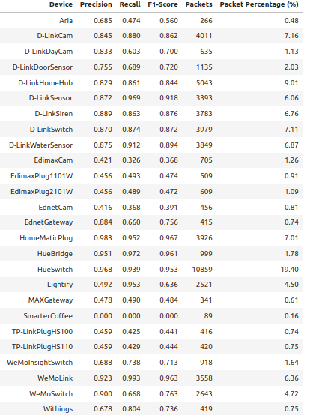
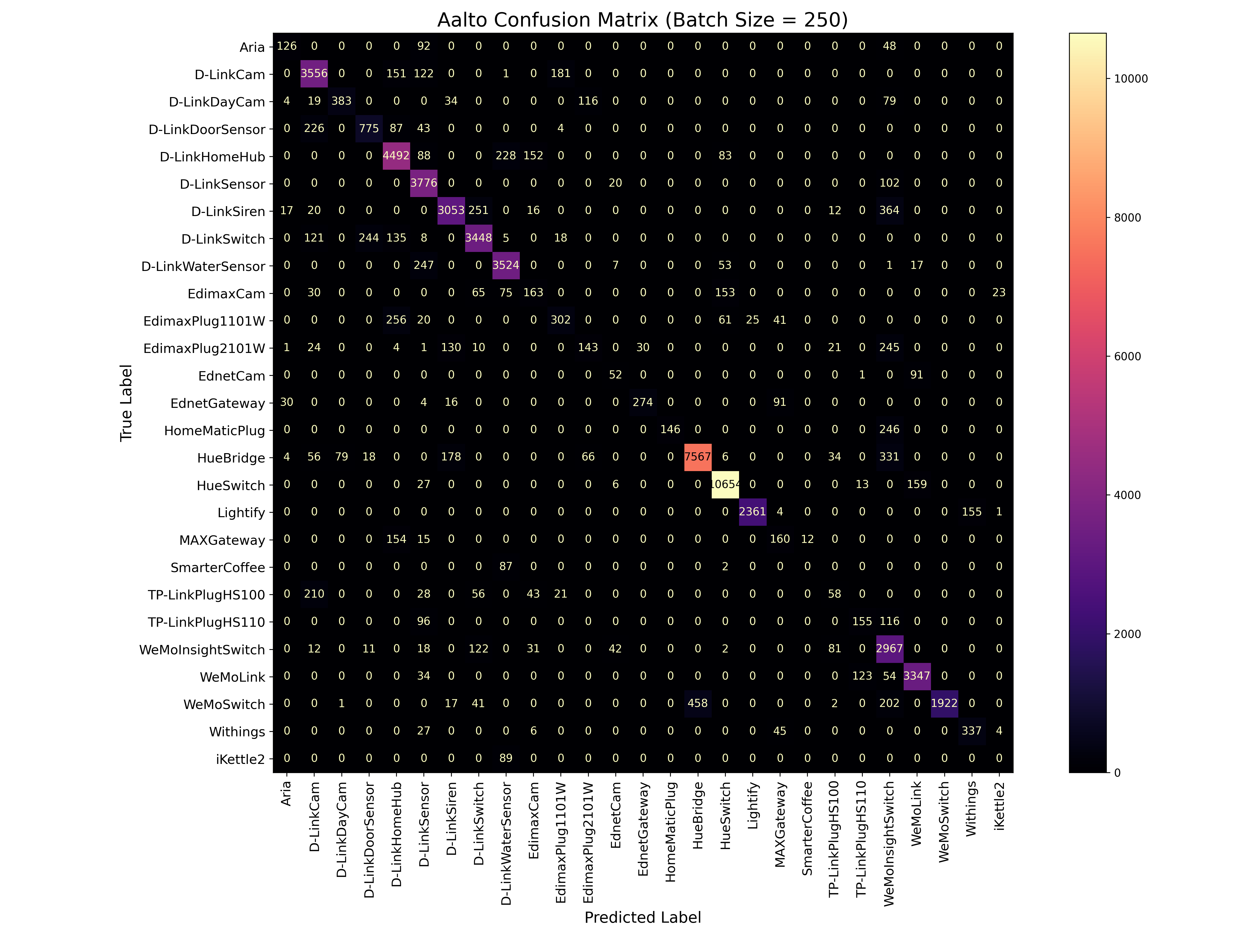
Per-Device Classification Results (Aalto Dataset)

Slide 18
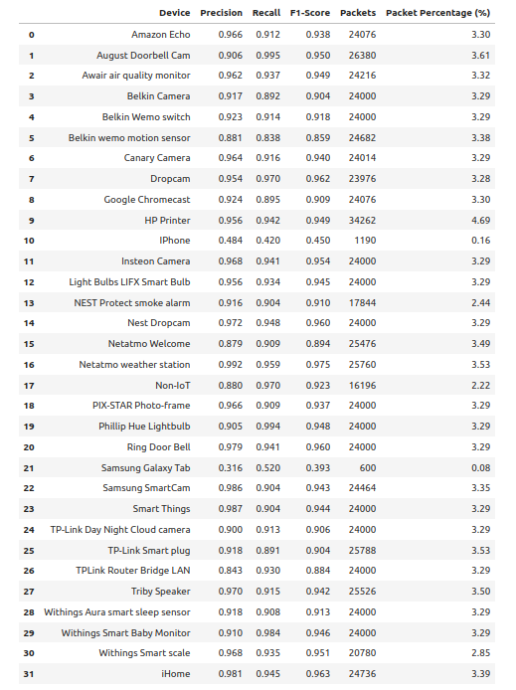
Per-Device Classification Results (UNSW Dataset)

Slide 19
Per-Device Classification Results
Insights :
Devices in the UNSW dataset achieved more uniform and higher accuracy compared to Aalto, owing to better representation, clearer behavioral patterns, and less inter-device confusion.
The Aalto dataset's performance is affected by intra-vendor similarity (e.g., multiple D-Link or Edimax devices), which causes misclassifications due to overlapping behavior across related device models.
Devices with very few packets (e.g., <500) often show low accuracy, possibly due to the selected batch size failing to provide sufficient updates or exposure early in the learning stream.

Slide 20
Comparison with Previous Work
Dataset | Study | Accuracy | Model Used
Aalto | IoTDevID | 0.750 | Decision Tree (Offline,full training)
 | Incremental | 0.869 | SGDClassifier(Online,batch size=250)
UNSW | IoTDevID | 0.853 | Decision Tree (Offline,full training)
 | Incremental | 0.926 | SGDClassifier(Online,batch size=250)

Slide 21
Conclusions

Slide 22
Conclusions
Successfully implemented an incremental learning-based framework for IoT device identification using behavioral network features at the packet level.
Achieved competitive or superior accuracy compared to traditional offline model like IoTDevID, especially on larger and more diverse datasets such as UNSW and Aalto.
Demonstrated adaptability to streaming traffic, with the model continuously updating without full retraining, making it suitable for real-time deployments.
Exhibited strong per-device classification performance, particularly for well-represented devices, while highlighting challenges for rare or ambiguous classes.
Validated the potential of incremental learning as a scalable and resource-efficient solution for dynamic, evolving IoT environments.

Slide 23
References

Slide 24
References
Kahraman Kostas, Mike Just, and Michael A. Lones. Iotdevid: A behavior-based device identification method for the iot. IEEE Internet of Things Journal, 9(23):23741–23749, 2022.
Konstantinos Demertzis, Lazaros Iliadis, Panayiotis Kotzanikolaou, and Pav-los S Efraimidis. Iottfid: An incremental iot device identification model based on traffic fingerprint. Computer Networks, 2023.
Anisa Sivanathan, Hamidreza H. Gharakheili, Felicia Loi, Angus Radford, and Vijay Sivaraman. Classifying iot devices in smart environments using network traffic characteristics. IEEE Transactions on Mobile Computing, 18(8):1745–1759, 2019.
Markus Miettinen, Samuel Marchal, Ijaz Hafeez, N. Asokan, Ahmad-Reza Sadeghi, and Sasu Tarkoma. Iot sentinel: Automated device-type identi- fication for security enforcement in iot. In 2017 IEEE 37th International Conference on Distributed Computing Systems (ICDCS), pages 2177–2184. IEEE, 2017.
Miettinen, M., Marchal, S., Hafeez, I., Asokan, N., Sadeghi, A. R., & Tarkoma, S. (2017). IoT Sentinel: Automated Device-Type Identification for Security Enforcement in IoT. In 2017 IEEE 37th International Conference on Distributed Computing Systems (ICDCS) (pp. 2177–2184). IEEE.

Slide 25
Thank You !

