Slide 1

SONA COMSTAR
Sona Comstar
Extending the EV runway
More EV content.
More programs.
A longer growth runway.
20%
21%
Revenue CAGR, FY26–30E
EPS CAGR, FY27–30E
INR 850
Model value per share
16 October 2026 / Client discussion
INR 660 core + INR 190 Denso 4W JV
Source: Supplied earnings model, Annual!N67:R126 and DCF!F34:F36
1
Notes:
User-provided Sona October 2026.xlsx. Values read from the saved model, including hidden sheets. Forecasts are analyst assumptions, not company guidance. IR and management notes supplied by Param Shah, undated. Named customer/program details attributed to those notes unless otherwise stated. Data cut-off: 16 October 2026. Latest reported financial quarter: Q1 FY27. All FY labels refer to years ending in March.
Investment thesis: rising EV content, Indian 2W/3W traction motors and differential assemblies drive forecast revenue. Margins remain below historical levels. The model assigns INR 660/share to the core and INR 189.75/share to the 49%-owned 4W Denso JV. This is a model valuation, not a newly approved published rating or live price target. Revenue CAGR FY26–30E = (Annual!R67/N67)^(1/4)-1. EPS CAGR FY27–30E = (R126/O126)^(1/3)-1.
Presentation units: bulk Indian-currency figures are INR million or billion. Per-share amounts remain INR per share. US-dollar presentation figures use the source model conversion of INR 94 per USD, rather than a current exchange-rate quote.

Slide 2
SONA COMSTAR
Electrification is already lifting Sona’s revenue mix
The cyclical recovery supports volumes. Higher content per vehicle extends the opportunity.
Global EV growth by region
Reserved for your updated chart
India / Europe / China / North America
107%
YoY BEV revenue growth
in Q1 FY27
Exposure expands through differential assemblies, traction motor systems and active suspension.
Source: Company Q4 FY26 / Q1 FY27 presentations, IR notes
2
Notes:
User-provided Sona October 2026.xlsx. Values read from the saved model, including hidden sheets. Forecasts are analyst assumptions, not company guidance. IR and management notes supplied by Param Shah, undated. Named customer/program details attributed to those notes unless otherwise stated. Data cut-off: 16 October 2026. Latest reported financial quarter: Q1 FY27. All FY labels refer to years ending in March.
Sources: https://sonacomstar.com/files/documents/investor-presentation-on-q4fy26-earnings-call-document-qlS1bG.pdf, printed p.4, p.6, p.29. https://sonacomstar.com/files/documents/investor-presentation-q1-financial-results-document-ZXfaAX.pdf, printed p.13, p.16, p.34. BEV mix is a share of automotive product revenue, not consolidated revenue. Q1 FY26 BEV revenue was INR 2,106mn and Q1 FY27 INR 4,355mn. User will supply an updated regional EV chart. No replacement regional-growth estimates have been invented. Product progression and customer opportunities are based on supplied IR notes.
Presentation units: bulk Indian-currency figures are INR million or billion. Per-share amounts remain INR per share. US-dollar presentation figures use the source model conversion of INR 94 per USD, rather than a current exchange-rate quote.

Slide 3
SONA COMSTAR
More EV programs are moving into production
INR 240bn net order book, with 64% in EVs. Twenty EV programs are now ramping.
India holds 34 of 69 programs and 29 of 49 programs still ramping or awaiting production. Counts do not indicate revenue size.
Source: Company Q4 FY26 / Q1 FY27 presentations, supplied Charts 2.0 sheet
3
Notes:
User-provided Sona October 2026.xlsx. Values read from the saved model, including hidden sheets. Forecasts are analyst assumptions, not company guidance. IR and management notes supplied by Param Shah, undated. Named customer/program details attributed to those notes unless otherwise stated. Data cut-off: 16 October 2026. Latest reported financial quarter: Q1 FY27. All FY labels refer to years ending in March.
Sources: https://sonacomstar.com/files/documents/investor-presentation-on-q4fy26-earnings-call-document-qlS1bG.pdf, printed pp.8–9, p.31. https://sonacomstar.com/files/documents/investor-presentation-q1-financial-results-document-ZXfaAX.pdf, printed p.16 and p.35. Totals include BEV and PHEV programs. At Q1 FY27 there were 69 programs across 36 customers. Lifecycle chart uses FY23–26 from supplied Charts 2.0!K66:N68 and latest Q1 FY27 from company. Regional chart: North America 9 mature/13 future, Europe 3/4, Asia 3/3, India 5/29. All figures are program counts, not equal-weight revenue. Program geography counts sum to 69.
Presentation units: bulk Indian-currency figures are INR million or billion. Per-share amounts remain INR per share. US-dollar presentation figures use the source model conversion of INR 94 per USD, rather than a current exchange-rate quote.

Slide 4
SONA COMSTAR
Assemblies and traction motors drive most of the growth
The model forecasts revenue of INR 92.3bn in FY30E, roughly double FY26.
29%
Assemblies CAGR
INR 7.6–20.6bn
39%
Traction motor CAGR
INR 4.9–18.2bn
17%
Railway CAGR
INR 6.2–11.5bn
The core forecast assumes driveline share gains and rapid growth in India’s electric 2W / 3W market.
Source: Supplied model, Annual!N36:R67
4
Notes:
User-provided Sona October 2026.xlsx. Values read from the saved model, including hidden sheets. Forecasts are analyst assumptions, not company guidance. IR and management notes supplied by Param Shah, undated. Named customer/program details attributed to those notes unless otherwise stated. Data cut-off: 16 October 2026. Latest reported financial quarter: Q1 FY27. All FY labels refer to years ending in March.
All segment figures come from the Annual product schedule. Differential assemblies and traction motors together contribute c.55% of the absolute FY26–30E product-schedule increase. Product schedules include a small other/electronics reconciliation difference against consolidated revenue. Consolidated revenue is taken only from row 67. Segment CAGR is calculated from rows 36, 46 and 52. No separate humanoid revenue estimate is added.
Presentation units: bulk Indian-currency figures are INR million or billion. Per-share amounts remain INR per share. US-dollar presentation figures use the source model conversion of INR 94 per USD, rather than a current exchange-rate quote.

Slide 5
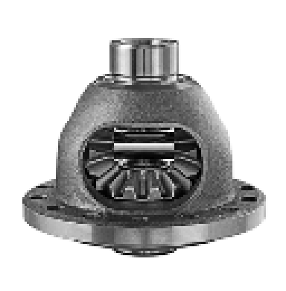
SONA COMSTAR
Differential assemblies offer more runway than gears
Localization and additional components raise content as new programs ramp.
INR 7.6–20.6bn
Assembly revenue, FY26–30E
Program | Growth lever
M&M BEVs | India localization
JLR | New EV launches
Ford | New mass-market EV
Gears retain a strong position. Assemblies and adjacent components provide the larger content opportunity.
Source: Supplied model, IR notes and company market-share disclosures
5
Notes:
User-provided Sona October 2026.xlsx. Values read from the saved model, including hidden sheets. Forecasts are analyst assumptions, not company guidance. IR and management notes supplied by Param Shah, undated. Named customer/program details attributed to those notes unless otherwise stated. Data cut-off: 16 October 2026. Latest reported financial quarter: Q1 FY27. All FY labels refer to years ending in March.
Model source: Annual!N36:R41. IR notes name M&M BEV localization through Valeo, JLR EV programs and Ford’s mass-market EV program, with FY28 mentioned for Ford. Exact timing is indicative and not a public SOP commitment. The notes refer to content increasing from about INR 0.0033–0.0066m on selected programs. This is a program example, not a portfolio ASP. Company global differential-gear share is 8.7% in CY25 (https://sonacomstar.com/files/documents/investor-presentation-q1-financial-results-document-ZXfaAX.pdf, printed p.36), while the model uses a different addressable-market definition. Do not confuse model-market share with company-disclosed share. Image: https://sonacomstar.com/files/documents/investor-presentation-q1-financial-results-document-ZXfaAX.pdf, printed p.37.
Presentation units: bulk Indian-currency figures are INR million or billion. Per-share amounts remain INR per share. US-dollar presentation figures use the source model conversion of INR 94 per USD, rather than a current exchange-rate quote.

Slide 6
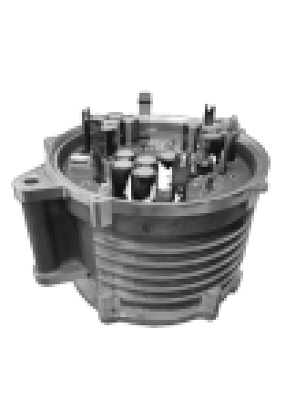
SONA COMSTAR
Traction motors can nearly quadruple by FY30E
Customer wins expand volumes, while integrated controllers increase content.
TVS / M&M / Royal Enfield
TVS iQube and electric 3Ws
M&M electric 3Ws
Royal Enfield Flying Flea
0.012–0.014
c. 0.018
Motor only (INR m)
With controller (INR m)
Content examples from IR, specific to selected platforms. Traction motor growth dilutes group margin percentage.
Source: Supplied model and management / IR notes
6
Notes:
User-provided Sona October 2026.xlsx. Values read from the saved model, including hidden sheets. Forecasts are analyst assumptions, not company guidance. IR and management notes supplied by Param Shah, undated. Named customer/program details attributed to those notes unless otherwise stated. Data cut-off: 16 October 2026. Latest reported financial quarter: Q1 FY27. All FY labels refer to years ending in March.
Annual!N46:R47. CAGR = (18211.836/4854.406)^(1/4)-1 = c.39.2%. User IR notes: TVS is the largest traction-motor customer, M&M electric 3W demand is strong, TVS e-3W program is ramping, and Royal Enfield Flying Flea uses an integrated motor-controller. User management notes cite TVS iQube integration. Indicative motor-only content INR12–14k versus c.INR18k integrated, and incremental INR4k for 3W controllers. These are selected-platform examples, not disclosed company-wide ASPs. Growth includes the existing business that Sona will transfer to a 51%-owned JV, not a second incremental business. Image from https://sonacomstar.com/files/documents/investor-presentation-q1-financial-results-document-ZXfaAX.pdf, printed p.39.
Presentation units: bulk Indian-currency figures are INR million or billion. Per-share amounts remain INR per share. US-dollar presentation figures use the source model conversion of INR 94 per USD, rather than a current exchange-rate quote.

Slide 7
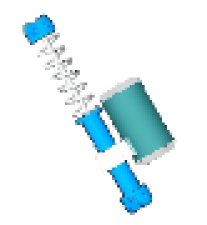
SONA COMSTAR
Suspension motors open a new pool of premium EV content
Chinese customer programs are scaling, with model and OEM expansion offering further upside.
Active suspension
Motor + controller
for premium EV ride control
12.5×
FY26–30E revenue growth
from a very small base
The model reaches only INR 500m by FY30E. New models and customers represent upside to this modest forecast.
Source: Supplied model, IR notes and company Q1 FY27 earnings call
7
Notes:
User-provided Sona October 2026.xlsx. Values read from the saved model, including hidden sheets. Forecasts are analyst assumptions, not company guidance. IR and management notes supplied by Param Shah, undated. Named customer/program details attributed to those notes unless otherwise stated. Data cut-off: 16 October 2026. Latest reported financial quarter: Q1 FY27. All FY labels refer to years ending in March.
Annual!N48:R49. User notes identify Nio premium vehicles as the lead customer application. Public Q1 FY27 call calls suspension motors the fastest-growing product and China the fastest-growing geography. https://sonacomstar.com/files/documents/earning-call-transcript-for-q1-financial-results-document-EtmXYW.pdf, printed pp.9–10 and p.23. Public materials do not substantiate the user note of one motor per car or the stated system price comparison. Those figures are deliberately excluded. The suspension business remains outside both Denso JV transactions, as management explicitly states on printed p.5. Product visual from https://sonacomstar.com/files/documents/investor-presentation-q1-financial-results-document-ZXfaAX.pdf, printed p.24.
Presentation units: bulk Indian-currency figures are INR million or billion. Per-share amounts remain INR per share. US-dollar presentation figures use the source model conversion of INR 94 per USD, rather than a current exchange-rate quote.

Slide 8
SONA COMSTAR
Railways adds a different source of growth and visibility
New products and maintenance contracts can deepen the acquired business.
INR 12bn
Railway order book
Purchase orders, largely within 12 months
Wider product portfolio
Brakes and couplers
HVAC, doors and panels
Annual maintenance contracts
FY27E growth is 40%, moderating to 15% in FY28E. Maintenance opportunity is qualitative upside, not a modelled margin step-up.
Source: Supplied model, Sona railway product materials and IR notes
8
Notes:
User-provided Sona October 2026.xlsx. Values read from the saved model, including hidden sheets. Forecasts are analyst assumptions, not company guidance. IR and management notes supplied by Param Shah, undated. Named customer/program details attributed to those notes unless otherwise stated. Data cut-off: 16 October 2026. Latest reported financial quarter: Q1 FY27. All FY labels refer to years ending in March.
Annual!N52:R53: INR 6.2bn FY26, INR 8.7bn FY27E, INR 10bn FY28E, INR 10.7bn FY29E, INR 11.5bn FY30E. Model FY26 revenue is an allocated segment estimate, not a separately verified segment filing. Product portfolio from https://sonacomstar.com/railway-business: brakes, couplers, suspension, HVAC, plug doors, electrical panels and vacuum evacuation. IR notes describe increasing AMC outsourcing, including product and labour, as potentially margin supportive. No quantified margin uplift is assumed. https://sonacomstar.com/files/documents/investor-presentation-q1-financial-results-document-ZXfaAX.pdf, printed p.20: railway order book INR12bn, largely executable in 12 months. It is not directly comparable with automotive lifetime program value.
Presentation units: bulk Indian-currency figures are INR million or billion. Per-share amounts remain INR per share. US-dollar presentation figures use the source model conversion of INR 94 per USD, rather than a current exchange-rate quote.

Slide 9
SONA COMSTAR
Earnings can compound without a return to peak margins
The model assumes 23.9% EBITDA margin in FY27E and 25.0% in FY30E.
INR 13.7
FY27E EPS
INR 24.5
FY30E EPS
21% CAGR from FY27E
100bp FY28E margin change
≈ INR 0.84 EPS
Mix and launch costs remain headwinds. Scale, pricing recovery and cost control support a gradual margin recovery.
Source: Supplied model, Annual!L67:R126, company Q1 FY27 call
9
Notes:
User-provided Sona October 2026.xlsx. Values read from the saved model, including hidden sheets. Forecasts are analyst assumptions, not company guidance. IR and management notes supplied by Param Shah, undated. Named customer/program details attributed to those notes unless otherwise stated. Data cut-off: 16 October 2026. Latest reported financial quarter: Q1 FY27. All FY labels refer to years ending in March.
Annual!L96:R96 model margins: FY24 28.3%, FY25 27.3%, FY26 24.3%, FY27E23.9%, FY28E24.5%, FY29E24.9%, FY30E25.0%. Latest company Q1FY27 margin 23.1% includes FX presentation effects and should not be blended with annual model values. Model EPS FY27E13.743, FY30E24.478 =21.2% CAGR. Q1 FY27 call attributes pressure to material inflation, lagged recovery and rising share of low-margin traction motors. Margin sensitivity: 100bp x FY28E revenue = INR694.999mn EBITDA. After25% tax /621.847mn shares =INR0.838/share EPS. Depreciation, funding, minority share and other income held constant. https://sonacomstar.com/files/documents/earning-call-transcript-for-q1-financial-results-document-EtmXYW.pdf, printed pp.9–11.
Presentation units: bulk Indian-currency figures are INR million or billion. Per-share amounts remain INR per share. US-dollar presentation figures use the source model conversion of INR 94 per USD, rather than a current exchange-rate quote.

Slide 10
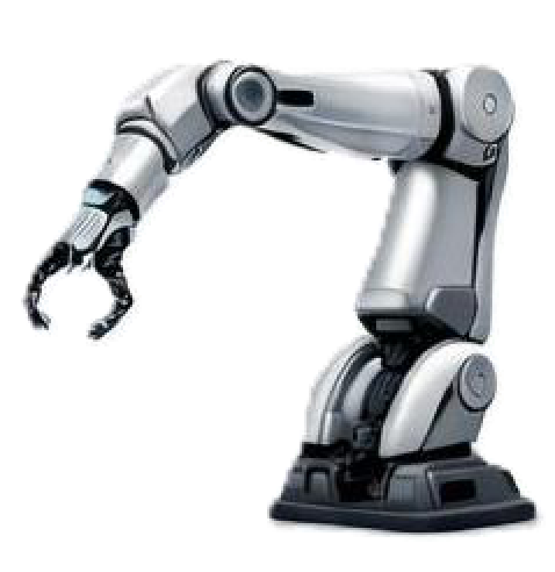
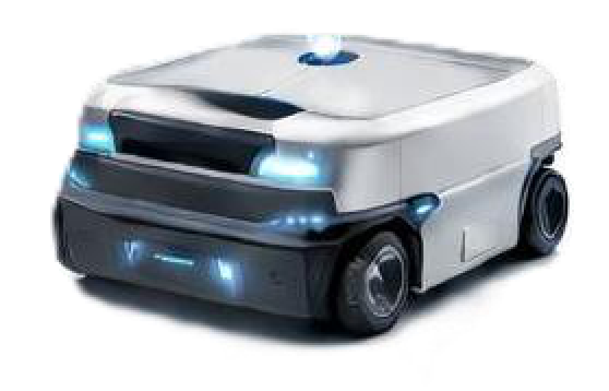
SONA COMSTAR
Robotics and sensing have moved beyond a technology roadmap
The INR 8bn order book spans components, perception software and radar systems.
Commercial evidence
Robotics subsystem
AMR perception software
Short-range radar for CVs
Treat order conversion and repeat wins as the proof points. The base case has no separate humanoid revenue forecast.
Source: Company Q1 FY27 presentation / call, supplied model
10
Notes:
User-provided Sona October 2026.xlsx. Values read from the saved model, including hidden sheets. Forecasts are analyst assumptions, not company guidance. IR and management notes supplied by Param Shah, undated. Named customer/program details attributed to those notes unless otherwise stated. Data cut-off: 16 October 2026. Latest reported financial quarter: Q1 FY27. All FY labels refer to years ending in March.
https://sonacomstar.com/files/documents/investor-presentation-q1-financial-results-document-ZXfaAX.pdf, printed p.10 and p.20. Company disclosed three new wins worth INR6bn and total Robotics & Physical AI order book INR8bn. Scope includes advanced robotic subsystem, radar perception stack for a farm AMR and short-range radar for an Indian CV OEM. This is not a humanoid-only order book, nor annual revenue. Four programs/four customers appear in the order-book disclosure. https://sonacomstar.com/files/documents/earning-call-transcript-for-q1-financial-results-document-EtmXYW.pdf, printed pp.7–8 and pp.22–24: most orders expected to begin production within12–15months of July2026, with uncertain product lifecycles. Model Annual!N50:R50 contains sensors/software, but no separate explicit humanoid revenue line. Image from printed p.10. No standalone incremental robotics valuation is added to the model.
Presentation units: bulk Indian-currency figures are INR million or billion. Per-share amounts remain INR per share. US-dollar presentation figures use the source model conversion of INR 94 per USD, rather than a current exchange-rate quote.

Slide 11
SONA COMSTAR
Denso expands the opportunity across vehicle segments
The two JVs have different ownership, economics and accounting treatment.
 | 2W / 3W JV | 4W / 4+ JV
Business | Existing motors + controllers | New high-voltage systems
Control | Sona | Denso
IP royalty recipient | Sona | Denso
Accounting expectation | Consolidated + minority | Equity-accounted
INR 17.5bn
Enterprise value of the existing
2W / 3W business at transaction
India comes first. Exports are a later opportunity. Forecast earnings remain before full JV ownership and cash-flow adjustments.
Source: Denso partnership announcement, 22 July 2026, and supplied model
11
Notes:
User-provided Sona October 2026.xlsx. Values read from the saved model, including hidden sheets. Forecasts are analyst assumptions, not company guidance. IR and management notes supplied by Param Shah, undated. Named customer/program details attributed to those notes unless otherwise stated. Data cut-off: 16 October 2026. Latest reported financial quarter: Q1 FY27. All FY labels refer to years ending in March.
https://sonacomstar.com/files/documents/press-release-sona-comstar-partners-with-denso-corporation-japan-document-r1oK7O.pdf, pp.2–3. 2W/3W JV: Sona51%, Denso49%, Sona control; existing traction motor and controller business transfers to a subsidiary, Denso acquires49% at TEV INR17.5bn.4W/4+ JV: Denso51%, Sona49%, Denso control; high-voltage liquid-cooled inverters, motors and generators for EV and hybrid applications. IP royalty paid to majority owner in respective JV. Accounting is an analyst inference from control: existing business remains consolidated with NCI, while 4WJV is an associate/JV equity-accounted absent other contractual rights. The model currently has zero forecast minority profit and no separate JV profit row; earnings forecasts are therefore before full transaction pro-forma effects. Do not add the existing2W/3W revenue a second time. FY28 operational expectation appears only in private IR notes, not public guidance. Suspension motors stay outside the transaction. This page deliberately avoids a firm SOP date.
Presentation units: bulk Indian-currency figures are INR million or billion. Per-share amounts remain INR per share. US-dollar presentation figures use the source model conversion of INR 94 per USD, rather than a current exchange-rate quote.

Slide 12
SONA COMSTAR
The model values Sona at INR 850 per share
INR 660 reflects the core business. About INR 190 depends on the long-term 4W Denso opportunity.
11% / 5%
Core DCF assumptions
WACC / terminal growth
INR 48–190
Denso value sensitivity
25–50% share, no exports to model exports
What needs to happen next
Next catalyst: Q2 FY27 results on 26 October. Program ramps, margins and Denso execution remain the key tests.
Source: Supplied model, DCF!F26:F36 and India EV Opportunity!P43:P48
12
Notes:
User-provided Sona October 2026.xlsx. Values read from the saved model, including hidden sheets. Forecasts are analyst assumptions, not company guidance. IR and management notes supplied by Param Shah, undated. Named customer/program details attributed to those notes unless otherwise stated. Data cut-off: 16 October 2026. Latest reported financial quarter: Q1 FY27. All FY labels refer to years ending in March.
Core DCF WACC11%, terminal growth5%, rounded core value660. 4W Denso valuation189.75/share is a discounted FY35E terminal enterprise value attributable49%, not a full equity DCF. It excludes interim JV FCF (calculated but not summed in source model), future net debt, funding, royalties and taxes/capital needs beyond simplified EBITDA/FCF assumptions. India FY35E motor TAM$3947.7mn, JVshare50%, India margin15%, export revenue83%of India at18%margin, EBITDA$590.97mn, multiple10x, discount factor0.43349, USDINR94,621.847mn shares. No live current price or upside percentage is shown because the model price662 is stale (cover dated23Jul2026). Core terminal value represents71.7%of core EV. Main risks: launch delays, mix, JV execution, competition and terminal assumptions. Appendix reference map: A01Q1 scorecard,A02mix,A03programs,A04content/competition,A05financials,A06cash,A07core DCF,A08JVbuild,A09sensitivity,A10rail,A11Novelic,A12robotics,A13risks,A14definitions.
Presentation units: bulk Indian-currency figures are INR million or billion. Per-share amounts remain INR per share. US-dollar presentation figures use the source model conversion of INR 94 per USD, rather than a current exchange-rate quote.

Slide 13
SONA COMSTAR / APPENDIX
A01 The latest quarter confirms strong EV momentum
Q1 FY27 is the latest reported quarter as of 16 October 2026.
Metric | Q1 FY26 | Q1 FY27
EBITDA, INR bn | 2.03 | 3.03
EBITDA margin | 23.8% | 23.1%
PAT incl. NCI, INR bn | 1.25 | 1.81
BEV mix of auto sales | 28% | 44%
Revenue growth was 54% on the company presentation basis. EBITDA grew 49% as margin declined by 70bp.
Source: Company Q1 FY27 presentation and board calendar
13
Notes:
User-provided Sona October 2026.xlsx. Values read from the saved model, including hidden sheets. Forecasts are analyst assumptions, not company guidance. IR and management notes supplied by Param Shah, undated. Named customer/program details attributed to those notes unless otherwise stated. Data cut-off: 16 October 2026. Latest reported financial quarter: Q1 FY27. All FY labels refer to years ending in March.
https://sonacomstar.com/files/documents/investor-presentation-q1-financial-results-document-ZXfaAX.pdf, printed p.13 and p.26; https://sonacomstar.com/investor/board-meetings. Company presentation revenue includes net FX gains. Q1FY26 revenue8509mn, EBITDA2025mn,BEV2106mn, PAT1247mn includingNCI. Q1FY27 revenue13104mn, EBITDA3026mn,BEV4355mn,PAT1805mn includingNCI. Parent-attributable reported profit1785mn differs from PAT includingNCI1805mn. Avoid mixing definitions. Q2FY27 board meeting scheduled26Oct2026, after deck cutoff.
Presentation units: bulk Indian-currency figures are INR million or billion. Per-share amounts remain INR per share. US-dollar presentation figures use the source model conversion of INR 94 per USD, rather than a current exchange-rate quote.

Slide 14
SONA COMSTAR / APPENDIX
A02 India is now Sona’s largest revenue geography
Diversification has increased, although customer-level concentration still needs monitoring.
Europe is a smaller direct exposure. China offers customer growth while also intensifying competition for legacy OEMs.
Source: Company presentations and supplied Charts 2.0 sheet
14
Notes:
User-provided Sona October 2026.xlsx. Values read from the saved model, including hidden sheets. Forecasts are analyst assumptions, not company guidance. IR and management notes supplied by Param Shah, undated. Named customer/program details attributed to those notes unless otherwise stated. Data cut-off: 16 October 2026. Latest reported financial quarter: Q1 FY27. All FY labels refer to years ending in March.
FY26 geography from Charts2.0!M27:M31 and Q1FY27 from https://sonacomstar.com/files/documents/investor-presentation-q1-financial-results-document-ZXfaAX.pdf, printed p.22. Q1India50%,NorthAmerica26%,Europe15%,Asia9%. FY26India51%,NorthAmerica27%,Europe17%,Asia5%. No definitive current customer concentration percentage is available in user notes; TVS described as largest EV customer. FY26 segment mix from modelCharts2.0!M131:M135:PV49%,CV9%,Nonauto31%,E2W/E3W10%,semis1%. Public geography is the company's reporting geography, not necessarily final retail destination.
Presentation units: bulk Indian-currency figures are INR million or billion. Per-share amounts remain INR per share. US-dollar presentation figures use the source model conversion of INR 94 per USD, rather than a current exchange-rate quote.

Slide 15
SONA COMSTAR / APPENDIX
A03 The program pipeline spans several growth engines
Named customer references below come from the supplied IR and management notes.
Engine | Customer / application | Commercial driver | Timing / confidence
Driveline | M&M BEVs / Valeo | Localization of differentials | IR, ramp timing indicative
Driveline | JLR / Ford EVs | New platform launches | IR, Ford FY28 reference
Traction | TVS / M&M electric 3Ws | Volume ramp and sourcing share | IR, ongoing ramps
Integrated systems | TVS iQube / RE Flying Flea | Motor + controller content | IR, platform-specific
Suspension | Nio premium EVs | More models and OEMs | IR + public ramp commentary
Public award | North American hybrid PV | INR 6.4bn lifetime order | Public SOP H2 FY29
Source: IR notes, company Q1 FY27 program / order-book disclosures
15
Notes:
User-provided Sona October 2026.xlsx. Values read from the saved model, including hidden sheets. Forecasts are analyst assumptions, not company guidance. IR and management notes supplied by Param Shah, undated. Named customer/program details attributed to those notes unless otherwise stated. Data cut-off: 16 October 2026. Latest reported financial quarter: Q1 FY27. All FY labels refer to years ending in March.
Named program mappings are private-call notes and not independently verified public contracts. Timing in those notes is relative and sometimes conflicts: Ford is described asFY28inIRandQ2onwards inmanagementnotes. No exact SOP is asserted. TVS3WfullsalesQ4onwards is undated, so only ramp-up is shown. RoyalEnfieldFlyingFlea description is integratedmotorcontroller, not guaranteed unit volume. New public Q1programs:NorthAmericanhybridDAINR6.4bn,SOPH2FY29;twohubwheelmotorprogramsINR0.9bn;nonEVPVgearsINR2.1bn,SOPH2FY28;CV/OHVgearsINR0.4bn,SOPH1FY28. https://sonacomstar.com/files/documents/investor-presentation-q1-financial-results-document-ZXfaAX.pdf, printed pp.17–20.
Presentation units: bulk Indian-currency figures are INR million or billion. Per-share amounts remain INR per share. US-dollar presentation figures use the source model conversion of INR 94 per USD, rather than a current exchange-rate quote.

Slide 16
SONA COMSTAR / APPENDIX
A04 Content, share gains and integration determine the upside
Sona’s market position is strongest in gears. New systems broaden the competitive set.
Product | Selected content example
Ford driveline | INR 0.0033–0.0066m
2W motor system | INR 0.012–0.018m
3W integration | INR 0.004m extra
Competitive alternatives
Bosch / Nidec / Denso
Tata AutoComp / Uno Minda–Inovance
Aisin / Mobis / OEM in-house
Selected content examples are from IR. They represent specific programs, rather than the average across Sona’s portfolio.
Source: IR notes, supplied model and company market-share disclosures
16
Notes:
User-provided Sona October 2026.xlsx. Values read from the saved model, including hidden sheets. Forecasts are analyst assumptions, not company guidance. IR and management notes supplied by Param Shah, undated. Named customer/program details attributed to those notes unless otherwise stated. Data cut-off: 16 October 2026. Latest reported financial quarter: Q1 FY27. All FY labels refer to years ending in March.
https://sonacomstar.com/files/documents/investor-presentation-q1-financial-results-document-ZXfaAX.pdf, printed p.36: global differentialgearshareCY25=8.7%;IndiagearsharesPV55–60%,CV80–90%,tractor75–85% based on CRISILFeb2021. These Indian estimates are dated, not currentmarketshare. Usernotesclaim60%PV,90%CVtractors and10–15%NorthAmerica with uncertaindenominators. Only disclosed definitions are shown. IRcontentexamplesselectedFordprogramUS$35toUS$60–70;2WmotorINR12–14ktoINR18k;3WincrementalcontrollerINR4k. Do not compare across currencies. Competitionlistedbelowislandscape,notexclusive sourcing: Bosch,TataAutoComp,UnoMinda/Inovance,HyundaiMobis,Aisin/BlueNexus,MusashiandOEMin-house production. ExactOEMsupplierrelationshipsfromIRareunverifiedandnotasserted.
Presentation units: bulk Indian-currency figures are INR million or billion. Per-share amounts remain INR per share. US-dollar presentation figures use the source model conversion of INR 94 per USD, rather than a current exchange-rate quote.

Slide 17
SONA COMSTAR / APPENDIX
A05 The earnings model implies sustained operating growth
Revenue grows 20% annually in FY26–30E. EPS grows 21% annually in FY27–30E.
INR bn, except EPS | FY26 | FY27E | FY28E | FY29E | FY30E
Revenue | 44.49 | 57.45 | 69.50 | 80.00 | 92.26
Revenue growth | 25.5% | 29.1% | 21.0% | 15.1% | 15.3%
EBITDA | 10.81 | 13.73 | 17.03 | 19.92 | 23.06
EBITDA margin | 24.3% | 23.9% | 24.5% | 24.9% | 25.0%
Model adjusted PAT | 5.78 | 8.55 | 10.87 | 12.81 | 15.22
EPS, INR | 9.30 | 13.74 | 17.48 | 20.59 | 24.48
Source: Supplied model, Annual!N67:R126
17
Notes:
User-provided Sona October 2026.xlsx. Values read from the saved model, including hidden sheets. Forecasts are analyst assumptions, not company guidance. IR and management notes supplied by Param Shah, undated. Named customer/program details attributed to those notes unless otherwise stated. Data cut-off: 16 October 2026. Latest reported financial quarter: Q1 FY27. All FY labels refer to years ending in March.
Figures in INR billion except EPS. Forecasts read directly from saved source model. FY26 net income and EPS follow model adjustedPATrow122 and sharecountrow125; they do not match company adjustedPAT definition. Annualrow121 uses unadjustedFY26PAT and therefore differs from displayed adjustedEPSgrowth. Growth in this table is calculated consistently from row126. Model does not yet include profitattributabletoDenso49%inexisting2W3WJV or separatelyequityaccountedprofit from4WJV. Forecasts should be interpreted before full JV proforma effects.
Presentation units: bulk Indian-currency figures are INR million or billion. Per-share amounts remain INR per share. US-dollar presentation figures use the source model conversion of INR 94 per USD, rather than a current exchange-rate quote.

Slide 18
SONA COMSTAR / APPENDIX
A06 Working capital and capex discipline matter for cash returns
The FY27E cash-flow improvement depends partly on working-capital normalization.
Assumption / metric | FY26 | FY27E | FY30E
Net WC days | 118 | 87 | 86
Capex / revenue | 11.1% | 7.0% | 4.9%
EBITDA, INR bn | 10.81 | 13.73 | 23.06
Watch the cash conversion
Lower working capital
Capacity utilization
JV funding requirements
Source: Supplied model, Summary Financials!G19:I24, Annual and DCF sheets
18
Notes:
User-provided Sona October 2026.xlsx. Values read from the saved model, including hidden sheets. Forecasts are analyst assumptions, not company guidance. IR and management notes supplied by Param Shah, undated. Named customer/program details attributed to those notes unless otherwise stated. Data cut-off: 16 October 2026. Latest reported financial quarter: Q1 FY27. All FY labels refer to years ending in March.
CFO and cashFCF from SummaryFinancialsG21:I23 forFY26–28;FY29–30 use Annual operatingcashflow less capex. FCF shown as CFO–capex, not DCF FCFF. Source FY26 cashFCF is INR1799.7mn, whereas DCFFY26FCFF is -INR1682.07mn because of tax/WC methodology differences. Forecast FY27NWCdaysfall from117.96to87.06, subsequently85.76FY30. CapexFY27–30 fromDCF H13:K13. ModelROE uses equityincludingNCIanddiffersfromcompanytangibleROE. No single universal ROE definition is implied. CoreDCF netcashincludes otherfinancialassets; this requires recoverability assessment, not simply unrestricted cash.
Presentation units: bulk Indian-currency figures are INR million or billion. Per-share amounts remain INR per share. US-dollar presentation figures use the source model conversion of INR 94 per USD, rather than a current exchange-rate quote.

Slide 19
SONA COMSTAR / APPENDIX
A07 Core value rests heavily on cash flow beyond FY37E
Terminal value contributes 72% of core enterprise value.
Core DCF bridge | INR / share
PV of enterprise value | 627
Net funds | 28
Equity value, unrounded | 655
Model core value, rounded | 660
11% WACC and 5% terminal growth. Forecast capex falls toward 2% of revenue by FY37E, with working-capital days also declining.
Source: Supplied model, DCF!F26:F34, H19:R22
19
Notes:
User-provided Sona October 2026.xlsx. Values read from the saved model, including hidden sheets. Forecasts are analyst assumptions, not company guidance. IR and management notes supplied by Param Shah, undated. Named customer/program details attributed to those notes unless otherwise stated. Data cut-off: 16 October 2026. Latest reported financial quarter: Q1 FY27. All FY labels refer to years ending in March.
CoreDCFenterprisevalueINR389977.54mn;PVexplicitFCFFINR110238.16mn;PVterminalINR279739.38mn=71.73%. NetfundsINR17615.89mn;equityINR407593.43mn;shares621.847mn;unroundedvalue655.46;rounded660. WACC11%,g5%. ModelFY27DF0, FY28DF0.9, subsequentdiscountby1.11. Valuationeffectively startsFY28,notallFY26–37despitelabel. DCF uses forecast taxes on PBT (not straightforward unleveredEBITtax) and sourcecapitalmethodology. Presentedfaithfully,not re-underwritten. FuturegrowthFY31–37ranges15–18%, terminalmargin25%. Netfundsinclude cash,investments,bankbalancesandotherfinancialassets. Sourcehistoric#REFcellsC8,C17,C19arenotusedintheforwardvaluation. Existing2WJVcashandminorityeffectsrequireproforma reconciliation.
Presentation units: bulk Indian-currency figures are INR million or billion. Per-share amounts remain INR per share. US-dollar presentation figures use the source model conversion of INR 94 per USD, rather than a current exchange-rate quote.

Slide 20
SONA COMSTAR / APPENDIX
A08 Denso’s INR 190/share value is a long-term scenario
The model assumes a 50% share of India’s FY35E BEV motor market and a substantial export business.
FY35E assumption | Model
India PV sales | 8.43mn
BEV penetration | 38%
Motors per BEV | 1.15
Motor ASP | INR 0.101m
JV share of TAM | 50%
India / export margin | 15% / 18%
INR 190/share values the 49% stake via a 10× FY35E EBITDA terminal value discounted by 0.433×. This is not a committed revenue plan.
Source: Supplied model, India EV Opportunity!R5:X48
20
Notes:
User-provided Sona October 2026.xlsx. Values read from the saved model, including hidden sheets. Forecasts are analyst assumptions, not company guidance. IR and management notes supplied by Param Shah, undated. Named customer/program details attributed to those notes unless otherwise stated. Data cut-off: 16 October 2026. Latest reported financial quarter: Q1 FY27. All FY labels refer to years ending in March.
IndiaEVOpportunityFY35E:X5PV8.431mn,X7penetration38%,X8BEV3.204mn,X16motors3.684mn(singlemotor85%,dualmotor15%),X18motorsize131.95kW,X19priceUS$8.12/kW,X20ASPUS$1071.47,X22TAMUS$3947.69mn,X23share50%,X24IndiarevUS$1973.84mn,X25exportsUS$1638.29mn=83%ofIndia,X27IndiaEBITDAUS$296.08mn@15%,X28exportEBITDAUS$294.89mn@18%,X30total590.97mn. FY29firstforecastrevenueUS$108.25mn;nofirmpublicSOP. MarketcalcBEVonly,excludeshybridsandCVevenifJVscopeincludesboth. Model assumes ownpricingtechandsupplyshare,notcompanyguidance.
Presentation units: bulk Indian-currency figures are INR million or billion. Per-share amounts remain INR per share. US-dollar presentation figures use the source model conversion of INR 94 per USD, rather than a current exchange-rate quote.

Slide 21
SONA COMSTAR / APPENDIX
A09 Denso value is sensitive to share and export assumptions
India-only economics support materially less value than the full model scenario.
INR per Sona share | No exports | 30% exports | 60% exports | 83% exports
25% India share | 48 | 65 | 82 | 95
35% India share | 67 | 91 | 114 | 133
50% India share | 95 | 129 | 164 | 190
Source: Calculations from supplied India EV Opportunity model
21
Notes:
User-provided Sona October 2026.xlsx. Values read from the saved model, including hidden sheets. Forecasts are analyst assumptions, not company guidance. IR and management notes supplied by Param Shah, undated. Named customer/program details attributed to those notes unless otherwise stated. Data cut-off: 16 October 2026. Latest reported financial quarter: Q1 FY27. All FY labels refer to years ending in March.
Sensitivity holds FY35TAMUS$3947.6885mn,IndiaEBITDAmargin15%,exportmargin18%,terminalEVEBITDA10x,DF0.43349257,Sona49%,FX94,shares621.847mn constant. Export revenue expressed as share of India revenue. Formula attributableEV/share=TAM*share*(.15+exportRatio*.18)*10*DF*.49*94/621.847. Exports0/30/60/83%andIndia share25/35/50%. Modelcorner50/83%=189.752. This is terminal enterprisevalueattributabletostake,notpostfundingequityvalue. Lower-case valuesillustrativemathematicalsensitivity,notprobability-weightedforecasts. Basecore660plusJVvariantsyieldscombined708to850. No marketprice/upsidecalculation.
Presentation units: bulk Indian-currency figures are INR million or billion. Per-share amounts remain INR per share. US-dollar presentation figures use the source model conversion of INR 94 per USD, rather than a current exchange-rate quote.

Slide 22
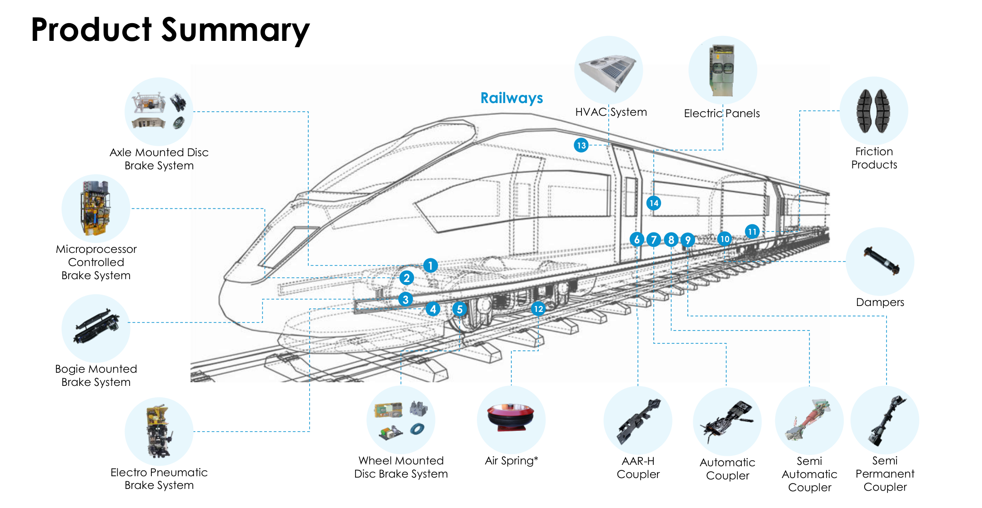
SONA COMSTAR / APPENDIX
A10 Railway products broaden the addressable wallet
Established safety products support entry into additional systems and maintenance.
AMC opportunity
More outsourced maintenance
may improve recurring content
The acquisition diversifies end demand, while tender timing and rail capital spending remain important drivers.
Source: Company railway product materials, supplied model and IR notes
22
Notes:
User-provided Sona October 2026.xlsx. Values read from the saved model, including hidden sheets. Forecasts are analyst assumptions, not company guidance. IR and management notes supplied by Param Shah, undated. Named customer/program details attributed to those notes unless otherwise stated. Data cut-off: 16 October 2026. Latest reported financial quarter: Q1 FY27. All FY labels refer to years ending in March.
https://sonacomstar.com/railway-business. Cropped product imagery from https://sonacomstar.com/files/documents/investor-presentation-q1-financial-results-document-ZXfaAX.pdf, printed p.40. Newproductstatusdiffersbyplatformandapproval;donotassumeentireportfoliocontributesmaterialrevenuetoday. PrivateIRnotesdescribeAMCcontractscombiningproductandlabouraspotentiallymarginaccretive,butnospecificshareormarginquantified. INR12bnrailwayorderbooklargely12monthspurchaseordersvsauto10yearlifetimeprograms. RevenueFY26–30fromAnnualN52:R52. RailriskincludesIndianRailwaycapex/tenderconcentration,productqualification,executionandreceivablecycles.
Presentation units: bulk Indian-currency figures are INR million or billion. Per-share amounts remain INR per share. US-dollar presentation figures use the source model conversion of INR 94 per USD, rather than a current exchange-rate quote.

Slide 23
SONA COMSTAR / APPENDIX
A11 Novelic connects sensing hardware with perception software
In-cabin monitoring, exterior radar and AMR software create several routes to monetization.
Application | Product / service | Monetization
Cabin safety | Occupant and child sensing | Sensors + software
Exterior ADAS | Short-range radar | Hardware + perception
Industrial AMR | Navigation / scene perception | Engineering + software
Safety ratings support adoption
Euro NCAP evaluates direct child-presence sensing.
It does not specify radar as the only qualifying technology.
Source: Novelic acquisition presentation, Euro NCAP protocol and supplied model
23
Notes:
User-provided Sona October 2026.xlsx. Values read from the saved model, including hidden sheets. Forecasts are analyst assumptions, not company guidance. IR and management notes supplied by Param Shah, undated. Named customer/program details attributed to those notes unless otherwise stated. Data cut-off: 16 October 2026. Latest reported financial quarter: Q1 FY27. All FY labels refer to years ending in March.
https://sonacomstar.com/files/documents/investor-presentation-on-acquisition-of-novelic-document-Wnkycf.pdf, Jan2023acquisitionpresentation:54%ownership announced;mmWaveradartechnology,in-cabinsensingandsoftwarecapabilities. https://cdn.euroncap.com/cars/assets/sd_102_cpd_evaluation_v20_3848e8fe35.pdf, Version2.0July2025:directsensingCPDevaluationpermitssensortypesincludingradar,cameraandWi-Fi. ProtocolsupportsdemandforsensingbutdoesnotmandateSona technology or radar specifically. Avoidclaimthatin-cabinradarisuniversallyrequiredfor5stars. ModelAnnualN50:R50:INR889.892mnFY26toINR823.183mnFY30;nospecificroboticsstepup. Futureorderbookconversionisupsideonlyifprofitabilityandownershipsupportattributableearnings.
Presentation units: bulk Indian-currency figures are INR million or billion. Per-share amounts remain INR per share. US-dollar presentation figures use the source model conversion of INR 94 per USD, rather than a current exchange-rate quote.

Slide 24
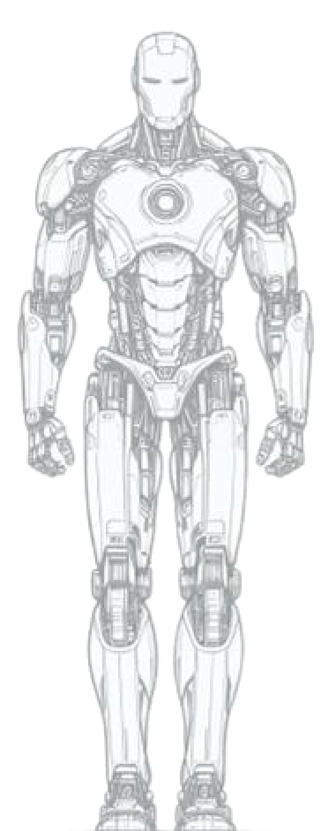
SONA COMSTAR / APPENDIX
A12 Humanoids are one application of a broader robotics portfolio
Sona can supply components and perception across several robot formats.
Capability | Relevant applications
Gears / actuators | Robot joints and motion
Frameless motors | Compact motion systems
Radar / perception | Navigation and obstacle sensing
Drive units | AMRs and mobile platforms
Product illustrations from Sona. Several products remain under development. No separate humanoid revenue or value is assumed.
Source: Company Q1 FY27 product summary and earnings call
24
Notes:
User-provided Sona October 2026.xlsx. Values read from the saved model, including hidden sheets. Forecasts are analyst assumptions, not company guidance. IR and management notes supplied by Param Shah, undated. Named customer/program details attributed to those notes unless otherwise stated. Data cut-off: 16 October 2026. Latest reported financial quarter: Q1 FY27. All FY labels refer to years ending in March.
Source https://sonacomstar.com/files/documents/investor-presentation-q1-financial-results-document-ZXfaAX.pdf, printed p.39 and p.10. Imagesarecompanyillustrations,notphotosofcommercialSona humanoidproducts. ProductsummarymarksAGV/AMRdriveunits,gearboxes,framelessmotors,short-rangeradarandzone-monitoringsensorsasunderdevelopmentwhereasterisksapply. https://sonacomstar.com/files/documents/earning-call-transcript-for-q1-financial-results-document-EtmXYW.pdf,printedpp.12–13:humanoid,AMR,cobotandquadrupedapplicationsshareunderlyingmotor/gear/sensorcapabilities. INR8bnorderbookforentireRobotics&PhysicalAIvertical,notexclusivelyhumanoids. No disclosedhumanoidTAMorunitsused. Commercialconfirmationrequiresplatformqualification,SOP,repeatedordersandunit economics.
Presentation units: bulk Indian-currency figures are INR million or billion. Per-share amounts remain INR per share. US-dollar presentation figures use the source model conversion of INR 94 per USD, rather than a current exchange-rate quote.

Slide 25
SONA COMSTAR / APPENDIX
A13 Execution and margin mix are the near-term tests
A strong pipeline still needs to convert into revenue, cash and attributable earnings.
Risk | What to monitor | What would weaken the thesis
EV programs | SOP and production ramps | Repeated launch delays / volume cuts
Margin mix | Material recovery + traction mix | EBITDA margin below forecast persistently
Denso execution | Orders, JV closing and investment | Slow wins or high funding / royalty burden
Competition | Make versus buy and localization | Share assumptions fail to materialize
Railways / robotics | Tender conversion and repeat wins | Revenue conversion trails order headlines
Source: Supplied model, company Q1 FY27 call and analyst sensitivities
25
Notes:
User-provided Sona October 2026.xlsx. Values read from the saved model, including hidden sheets. Forecasts are analyst assumptions, not company guidance. IR and management notes supplied by Param Shah, undated. Named customer/program details attributed to those notes unless otherwise stated. Data cut-off: 16 October 2026. Latest reported financial quarter: Q1 FY27. All FY labels refer to years ending in March.
FY28EPSsensitivitycalculation:AnnualP67revenue69499.912mn,margins22%,24.5%,26%;D&A3565.064mn,interest266.9535mn,otherincome1300mn,tax25%,shares621.847mn. EPS=(revenue*margin-D&A-interest+otherincome)*.75/shares. NoNCI/JVprofitadjustment. Base17.48275,sensitivities15.387and18.7404. CoreDCFvaluationrisksalsoinclude terminalgrowth,discount rate,capexdeclineandNWCnormalization. Downside triggersarequalitativeanalystjudgment,nottimingguidance.
Presentation units: bulk Indian-currency figures are INR million or billion. Per-share amounts remain INR per share. US-dollar presentation figures use the source model conversion of INR 94 per USD, rather than a current exchange-rate quote.

Slide 26
SONA COMSTAR / APPENDIX
A14 Definitions and forecast boundaries
The pitch separates company disclosures, model estimates and management commentary.
Area | Interpretation used in this deck
Actuals versus estimates | Company Q1 FY27 actuals. Supplied model for forecasts.
BEV mix | Share of automotive product revenue, excludes railways.
Order-book visibility | Auto lifetime programs. Rail purchase orders largely within 12 months.
Earnings attribution | Forecasts precede full Denso JV minority / funding adjustments.
Denso add-on | Discounted terminal enterprise value attributable to Sona’s 49% stake.
Historical PAT | Model FY26 adjusted PAT differs from company adjusted PAT.
Price reference | No live upside shown. Model’s INR 662 stock-price input is stale.
Source: Supplied model, investor presentations, IR notes and analyst calculations
26
Notes:
User-provided Sona October 2026.xlsx. Values read from the saved model, including hidden sheets. Forecasts are analyst assumptions, not company guidance. IR and management notes supplied by Param Shah, undated. Named customer/program details attributed to those notes unless otherwise stated. Data cut-off: 16 October 2026. Latest reported financial quarter: Q1 FY27. All FY labels refer to years ending in March.
Sourcehierarchy:publicreportednumbersfromcompanyQ1FY27presentation;forecastsfromsuppliedmodel;namedcustomerlinkagesfromprivateIRnotes. (1)CompanyFY26revenue44751mnincludingFXvsmodeloperations44494.6mn;companyEBITDA11069mnvsmodel10811.66mn,largelyFXpresentationdifference. (2)CompanyFY26adjustedPAT6703mnvsmodeladjustedPAT5782.09mn;notreconciledinuserworkbook,soFY26EPSnotusedforheadlineEPSCAGR. (3)Annualproductsumrow56doesnotexactlyequaloperationsrow67;differencegrowsfrom40mnFY26to82.94mnFY30;productgrowthattributionusesrow56. (4)Automotiveorderbookisdiscountedexpectedremaininglifetimeprogramrevenue,notfirmannualsales;railPOslargely12months;roboticslifecyclesuncertain. (5)Densoexistingtractionbusinessalreadyincore;NCIandproceedseffectnotfullymodelled. (6)JVadd-on=terminalEVonly,notfullfundingequityvaluation. (7)Modelquote662stale,date23Jul2026,noliveupside. Sources:https://sonacomstar.com/files/documents/investor-presentation-q1-financial-results-document-ZXfaAX.pdf
https://sonacomstar.com/files/documents/earning-call-transcript-for-q1-financial-results-document-EtmXYW.pdf
https://sonacomstar.com/files/documents/investor-presentation-on-q4fy26-earnings-call-document-qlS1bG.pdf
https://sonacomstar.com/files/documents/press-release-sona-comstar-partners-with-denso-corporation-japan-document-r1oK7O.pdf
https://sonacomstar.com/railway-business
https://sonacomstar.com/files/documents/investor-presentation-on-acquisition-of-novelic-document-Wnkycf.pdf
https://cdn.euroncap.com/cars/assets/sd_102_cpd_evaluation_v20_3848e8fe35.pdf
https://sonacomstar.com/investor/board-meetings
Presentation units: bulk Indian-currency figures are INR million or billion. Per-share amounts remain INR per share. US-dollar presentation figures use the source model conversion of INR 94 per USD, rather than a current exchange-rate quote.

Slide 27
SONA COMSTAR / APPENDIX
A15 Core DCF sensitivity highlights the terminal assumptions
A 100bp change in WACC has a large impact because most value lies beyond the explicit forecast.
Core value, INR / share | 4% terminal growth | 5% terminal growth | 6% terminal growth
10% WACC | 698 | 800 | 953
11% WACC | 588 | 655 | 751
12% WACC | 506 | 553 | 616
Source: Recalculation using supplied DCF cash flows and discount convention
27
Notes:
User-provided Sona October 2026.xlsx. Values read from the saved model, including hidden sheets. Forecasts are analyst assumptions, not company guidance. IR and management notes supplied by Param Shah, undated. Named customer/program details attributed to those notes unless otherwise stated. Data cut-off: 16 October 2026. Latest reported financial quarter: Q1 FY27. All FY labels refer to years ending in March.
Sensitivity holds explicit FCFF I19:R19, FY27E net funds17615.889mn and shares621.847mn constant. Discounting preserves source FY28 factor0.9 and then divides by(1+WACC)each year. PVterminal=FY37FCFF*(1+g)/(WACC-g)*FY37DF. Values are unroundedcoreequityvalue/share, excludingtheDensoadd-on. At11%WACC/5%g=655.46,whichmodelroundsto660. Sensitivity is not a revised forecast and does not adjust cash flow for alternativeeconomicconditions. DCFtax/capex/WCmethodologyretainedfromsource. ThisdoesnotresolvefutureJVminority/cashfundingissues.
Presentation units: bulk Indian-currency figures are INR million or billion. Per-share amounts remain INR per share. US-dollar presentation figures use the source model conversion of INR 94 per USD, rather than a current exchange-rate quote.

Slide 28
SONA COMSTAR / APPENDIX
A16 The existing traction JV changes earnings attribution
Revenue can remain consolidated while Denso receives 49% of the existing business’s profit.
Economic item | 2W / 3W business | New 4W / 4+ business
Consolidated sales / EBITDA | 100% while Sona controls | Generally excluded
Profit attributable to Sona | 51% + any royalty income | 49% of JV profit
Main forecast adjustment | NCI, proceeds and royalty | JV earnings and capital funding
Illustrative profit-share effect only. Royalty income, sale proceeds and funding can offset or change the net EPS outcome.
Source: Denso agreement and analytical illustration using the supplied FY28E traction forecast
28
Notes:
User-provided Sona October 2026.xlsx. Values read from the saved model, including hidden sheets. Forecasts are analyst assumptions, not company guidance. IR and management notes supplied by Param Shah, undated. Named customer/program details attributed to those notes unless otherwise stated. Data cut-off: 16 October 2026. Latest reported financial quarter: Q1 FY27. All FY labels refer to years ending in March.
Source https://sonacomstar.com/files/documents/press-release-sona-comstar-partners-with-denso-corporation-japan-document-r1oK7O.pdf. This is an accounting and economics illustration, not an updated pro-forma earnings forecast. Existing2W3Wtractionbusiness51%Sona-controlled:consolidated100%revenueandEBITDAwith49%posttaxprofittakenasNCI,subjecttofinalagreements/accountingassessment. 4WJV49%Sona:equityaccountedprofitexpected,not100%ofJVrevenue. ModelAnnualP46=INR9705.453mntractionrevenue,P125=621.847mnshares. IllustrativeNCIimpactusesnetprofitmargin5/10/15%onthisline*49%/shares=EPS0.382/0.765/1.147. ActualJVperimeterincludescontrollers,generators/eaxlesandmaydifferfrommodelline. Noaddedbackroyalty,interestonproceeds,transactioncosts,ownershipdateorfundingincorporated. ItcannotbeinterpretedasfullEPSdilution. TransactionTEV17500mnnotcashproceeds;netdebt,taxandtermsmatter. SuspensionmotorsremainoutsideJV.
Presentation units: bulk Indian-currency figures are INR million or billion. Per-share amounts remain INR per share. US-dollar presentation figures use the source model conversion of INR 94 per USD, rather than a current exchange-rate quote.

