Slide 1








MEALSTOP
CSCI 5308: ASDC
Client Team - 19
GROUP 1
B00889579: Udit Gandhi
B00889585: Sharad Kumar
B00909477: Parampal Singh
B00886546: Shathish Annamalai
B00910009: Kuldeep Bhimani
Professor: Dr. Tushar Sharma
TA: Mohammed Hamza Jasnak
Dalhousie University is located in Mi’kma’ki, the ancestral and unceded territory of the Mi’kmaq.
We are all Treaty people.
1

Slide 2
SUMMARY
Meal stop has combined a standard meal service delivery with the meal recommendations from different restaurants for the diet they are searching for.
Meal Stop allows customers to search restaurants by availability and recommend meals to customers.
Meal Stop awards Customers with rewards as tokens for their orders.
Meal stop has addressed the Food wastage issue by donating canceled orders to it and NGO has the option to accept the canceled meal or not.

Slide 3
PROJECT DASHBOARD STATS
TOTAL TASKS | 65
UDIT GANDHI | 13
PARAMPAL SINGH | 14
SHATHISH ANNAMALAI | 15
KULDEEP VIRJIBHAI BHIMANI | 11
SHARAD KUMAR | 12

Slide 4
DEMO APP URL: https://mealstop-application.herokuapp.com/

Slide 5
PROJECT STATUS
GOALS | STATUS
Login/Sign Up/Forget password | Completed
Search Restaurant/Place orders | Completed
Favourites/Reviews/Rewards | Completed
Meal plan/Recommendation | Completed
Restaurant/Order details | Completed
NGO notifications | Completed
CI/CD implementation | Completed
NGO Orders | Completed

Slide 6
NOVELTY FEATURES
GOALS | STATUS
Reviews | Completed
Favourite | Completed
Cart | Completed
Verification with email | Completed
Reward | Completed
Yearly report | Completed
Average likes | Completed

Slide 7
Team Practices
Design Principles (SOLID)
Design Patterns (Builder and observer)
TDD (unit tests for service and controller, integration tests)
Clean code practices

Slide 8
LEARNINGS
Refactoring
Design principles and patterns
Version Control (GIT)
Code Smells
Java
TDD
Agile
Spring Boot
Thymeleaf

Slide 9
CHALLENGES
TDD
CI/CD integration
Clean code practices
Version control
Refactoring/Design principles

Slide 10
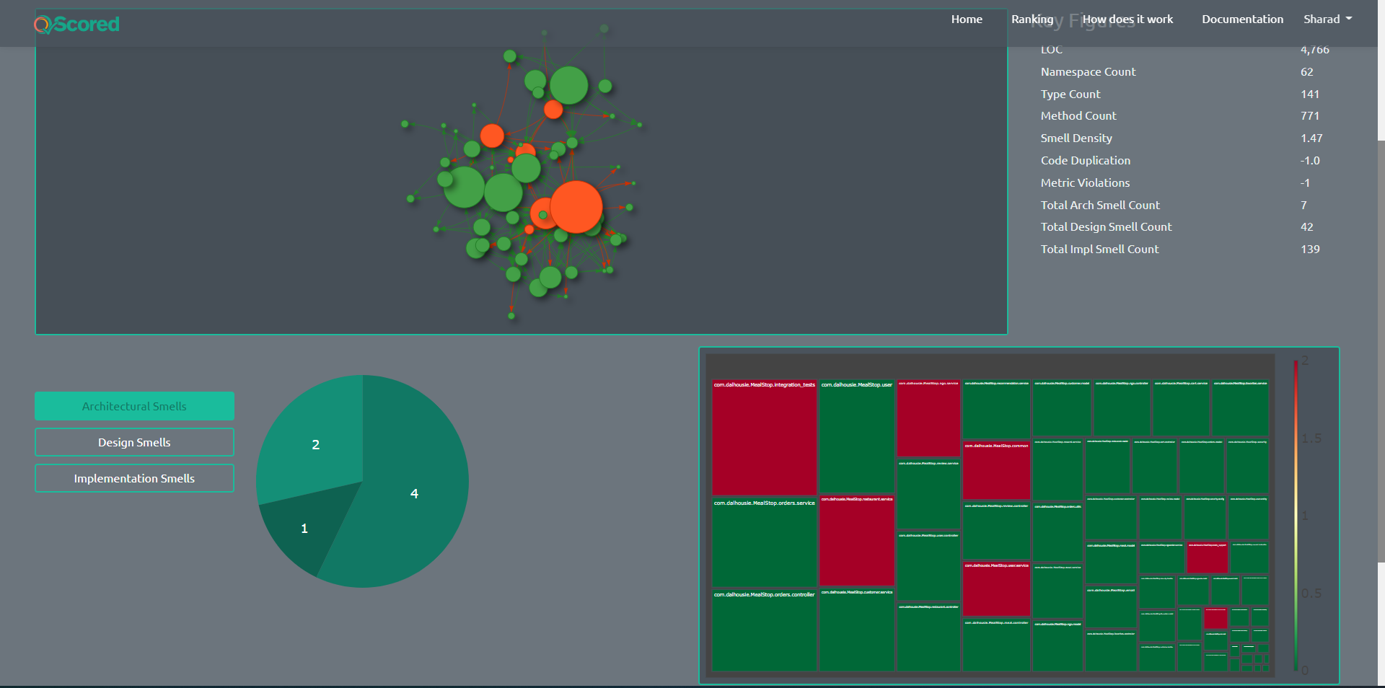
QSCORED

Slide 11
REFERENCES
[1] https://springhow.com/spring-boot-export-to-csv/ ​
​
[2] https://qscored.com/ ​
​
[3] https://www.thymeleaf.org/doc/articles/springmvcaccessdata.html​
​
[4] https://spring.io/projects/spring-boot

Slide 12



