Slide 1
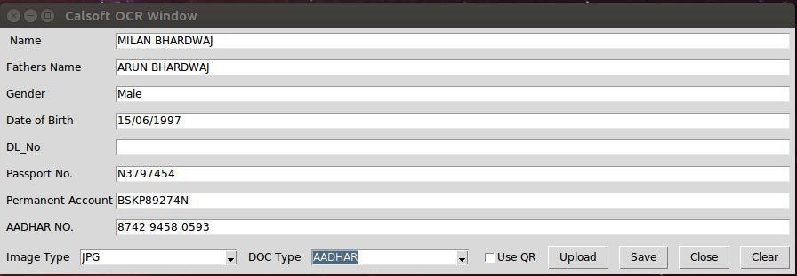
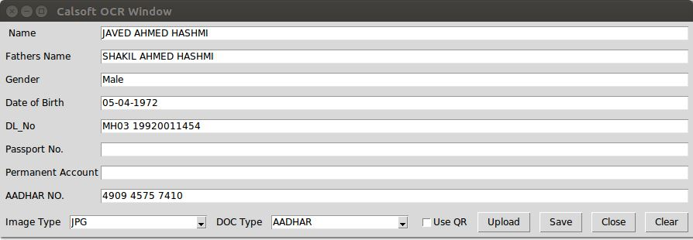
Optical Character Recognition
Objective
Optical Character Recognition(OCR) is a inhouse project of Calsoft. This will scan and extract data from uploaded document by user.
The engagement includes:
Development of data extraction module on the top off OpenCV .
Testing, validation of use cases.
Solution
Each Scan document (Ex. VID,PAN,ADHAR,DL) can be parse to a Data Hash
The final data is a Hash merged form each data hash from scaned document.
Ex.
FinalData{session}
{
Data{PAN}
Data{DL}
Data{Adhar}
}
Benefits
Technology
The Data from OCR can fills web based form without storing any data in background.
Useful to Govt. sectors host computer
Python,OpenCV,YoLo
©2019 Calsoft. All Rights Reserved.
<number>
Notes:
Customer Name: Dell-EMC
Account Manager: Pradipta Mitra
Technical POC: Surendra Joshi
Team size: 7-8
<number>

