Slide 1

Superstore Data Analysis
Retail Insights & Dashboard Development
Paramandla Jayanth kumar

Slide 2

Project Overview
Objective:
To analyze sales and profit data from the Superstore dataset to uncover key business insights that support data-driven decision-making.
Scope:
Study of Sales, Profit, Discounts, and Delivery Performance
Analysis across different Regions, Product Categories, and Customer Segments
Evaluation of factors influencing profitability and operational efficiency
Tools Used:
Python & Pandas – Data cleaning and preprocessing
SQL (MySQL) – Data extraction, joins, and aggregation
Power BI – Interactive dashboard and visualization

Slide 3

Methodology
Project Workflow:
Data Collection
Cleaning
Transformation
Analysis
Visualization
Validation
Dashboard

Slide 4

Explanation
Data Collection: Gathered raw data from Superstore dataset (CSV/Database).
Data Cleaning (Python): Removed duplicates, handled missing values, corrected data types.
Data Transformation (Python & SQL): Created calculated fields like Profit Margin, merged multiple tables.
Data Analysis (Python): Identified trends, patterns, and relationships.
Visualization (Power BI): Built interactive dashboards with charts, maps, and filters.
Validation: Cross-checked results between Python, SQL, and Power BI.

Slide 5

Data Cleaning & Transformation
Data Cleaning Steps:
Removed duplicates and handled missing or inconsistent values
Standardized date formats and corrected category names
Ensured correct data types (numeric, date, text) across all columns
Data Transformation:
Created calculated fields to enhance analysis:
Profit Margin = Profit / Sales
Days to Ship = Ship Date – Order Date
Merged multiple tables (Orders, Products, Customers, Regions) into a single clean dataset
Prepared final dataset for use in SQL analysis and Power BI visualization.
Outcome: A structured, error-free dataset ready for meaningful insights and dashboard creation.

Slide 6
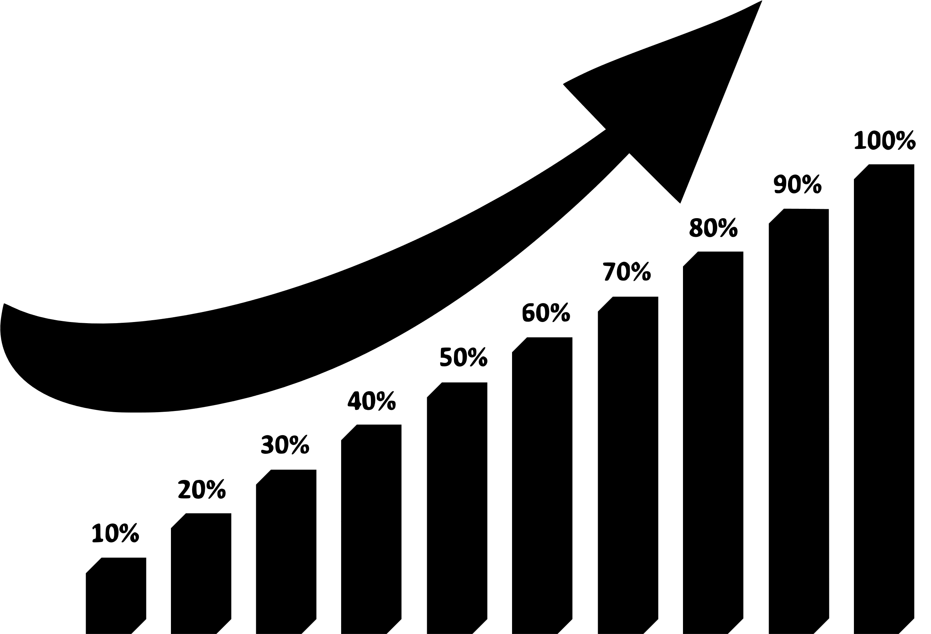
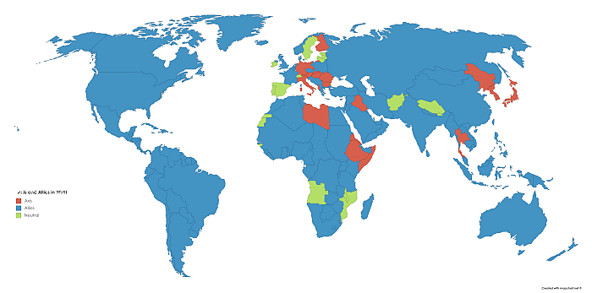
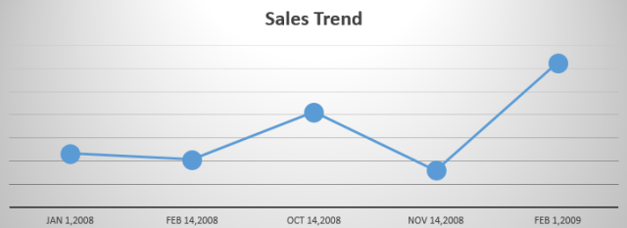
Exploratory Data Analysis
Top-Performing Regions:
West region generated the highest profit.
Central Region showed lower performance due to higher discounts.
Category Analysis:
Office supplies recorded the largest number of orders.
Technology yielded the highest profit margin.
Discount vs Profit Relationship:
High discounts increased sales volume but reduced overall profit margins.
Visual Representations:
Bar chart : Sales by Product Category
Map chart : Profit by region
Line chart : Monthly sales trend
Scatter chart : Discount vs profit

Slide 7

Key Insights
Regional Performance:
“West Region” achieved the highest overall profit.
“Central Region” underperformed due to excessive discounting.
Discount Impact:
Higher discount rates led to increased sales volume but lower profitability.
Overall Observation:
Profitability is influenced more by discount strategy and category type than by sales volume alone.

Slide 8
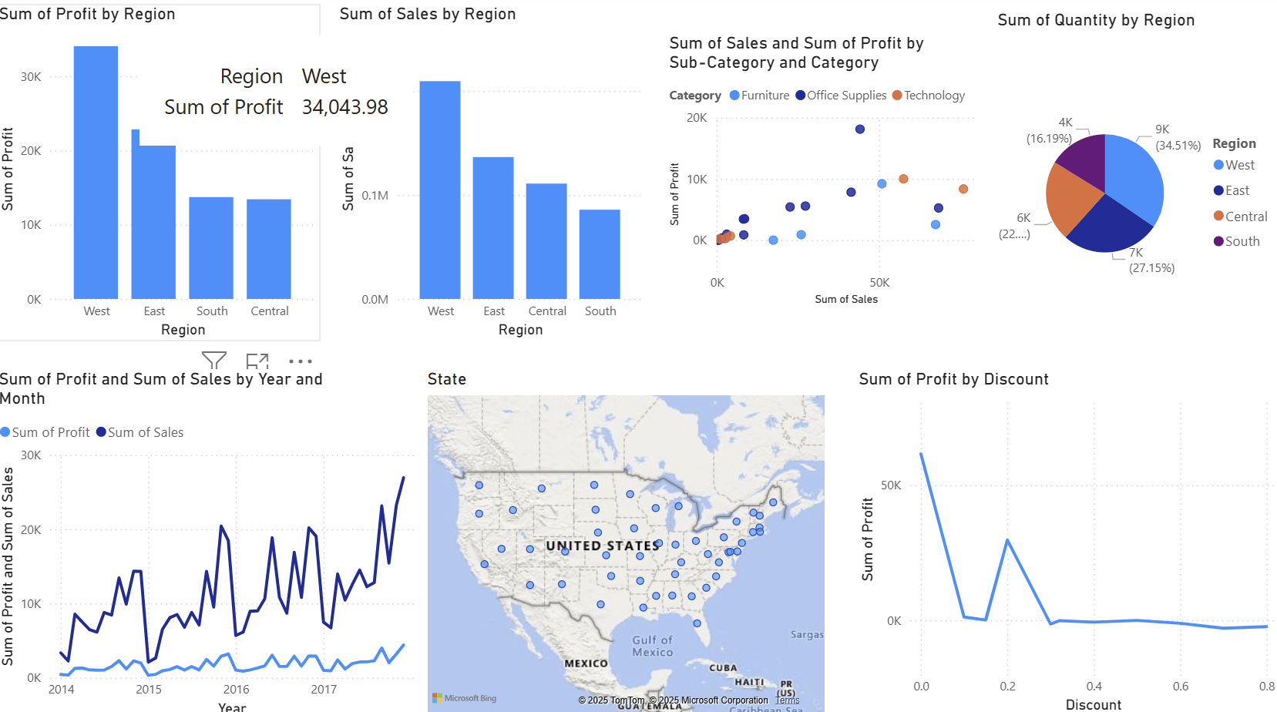
Power BI Dashboard
Dashboard Overview:
An interactive Power BI dashboard was developed to visualize business performance and uncover key insights from the Superstore dataset.
Sales by Category
Displays total sales for Furniture, Office Supplies, and Technology categories.
Helps identify top-selling product segments.
Profit by Region
Shows profit distribution across regions.
West Region stands out as the most profitable area
Monthly Sales Trend
Tracks sales growth and seasonal fluctuations over time.
Useful for forecasting and planning.

Slide 9


Validation & Comparison
To ensure that results derived from different tools (Python, SQL, and Power BI) are consistent and accurate.
Validation Process:
Cross-checked total Sales and Profit values calculated in Python and SQL with those visualized in Power BI.
Verified data consistency after cleaning and transformation.
Ensured all calculated metrics (Profit Margin, Days to Ship, etc.) produced identical results across platforms.
Result:
The totals for Sales and Profit matched exactly in all tools.
Confirms data integrity, accuracy, and reliability of the analysis process.

Slide 10


Business Recommendations
Optimize Discounts:
Reduce excessive discounting in Central Region to improve profit margins.
Focus on High-Profit Categories:
Increase marketing for Technology products to maximize profit.
Inventory Optimization:
Monitor “Furniture” stock levels to reduce low-margin inventory.
Regional Strategy:
Replicate “West Region’s” successful sales strategies in Central and East regions.
Delivery Performance:
Streamline shipping in delayed regions to boost customer satisfaction.

Slide 11


