Slide 1
WELCOME

Slide 2
TITLE OF THE PROJECT
DHARWAD ARMY WELFARE DEPARTMENT

Slide 3
INTRODUCTION
This project is aimed at developing a web application for the Army Welfare Department. The system is an web application that can be accessed throughout the Army Welfare Department with proper login provided. This system can be used as an web application for post the jobs and to manage the bio data of army persons. Army persons logging should be able to upload their bio data. The key feature of this project is that it is a onetime registration. Our project provides the facility of maintaining the details of the army persons. It also provides a requested list of candidates to recruit the students based on given query. Administrator logging in may also search any information put up by the army persons. This project will aid Army Welfare Department.

Slide 4
DEFINITION
This project is a web application for the Army Welfare Department.. It is used to post the all kind of jobs for Ex-army person and to manage the profile of army persons. Army persons login should be able to upload their profile. It is used to post a notice for user.

Slide 5
ANALYSIS

Slide 6
EXISTING SYSTEM
In this type this may new one web service portal for Karnataka army welfare department. This existing system is based on army well fare, this project not yet implemented for army based pension and after retirement job offers information’s. This is maintained by army welfare department in Dharwad, as they say its need to be made available to online to register for updates and pension and new government schemes and news. Existing system was completely based on paper work based and still it needs to be updated..

Slide 7
DISADVANTAGES OF EXISTING SYSTEM
Paper based information collection by army.
Job information’s will be posted on only office notice boards.
Government offices need to post army jobs needs in paper only.
Army welfare department needs to be made online so that all works get done faster because work process here slow.
Government jobs and schemes will only be updated in newspapers by paid.

Slide 8
PROPOSED SYSTEM
Using this web application we can help track of army retired peoples information and their current status. This web application is will be helpful for admin or head offer at army welfare department in Dharwad. Basically they collect army info through papers , jobs and news updates posted on notice boards will be avoided by using this applications. It is used to post the jobs and their requirements to Ex-army people. It provide the army employment news for user. There type users may get benefits out of it.

Slide 9
ADVANTAGES OF PROPOSED SYSTEM
Retired army persons can get all information about jobs easily.
Reduced the paper work save the time.
Government jobs and schemes will only be updated in side web portal.
Army welfare department made online so that all works get done faster.

Slide 10
MODULES
1.ADMIN
Admin is the high level administrative person who will be responsible to maintain data in the database. If need he can make query using SQL language. He can check the reports and make their final decision. He can update post the jobs and their requirements and updates. Even he can have direct contact with the officers and Ex-army people.

Slide 11
2.OFFICE
Army welfare department Officers can provide the information about jobs and their requirements for Ex-army persons. He can also view and delete the posted jobs. Registration is compulsory for Government Office. Government Office module will also update their information and profile.

Slide 12
3.ARMY SEEKER
Ex-army Persons can view the all information about the jobs and their requirement. Registration is compulsory for Ex-army Person. Ex-army Person can also update their information and profile. They can send feedback. He can view the notices.

Slide 13
SOFTWARE AND HARDWARE REQUIREMENTS

Slide 14
SOFTWARE REQUIREMENTS
Operating System : Windows 98/2000/XP/NT
Font-End Tool : HTML, CSS
Web browser : Mozilla Firefox/ Google chrome/ Opera
Client side script : JavaScript
Server side script : PHP
Back-End Tool : MySQL
Language : PHP

Slide 15
HARDWARE REQUIREMENTS
Pentium processor : Intel Pentium or Greater
Processor speed : 250MHz to 667MHz
RAM Capacity : 512MB or Greater
Hard Disk : 20GB or­­ Higher

Slide 16
DESIGN

Slide 17
0 LEVEL DATA FLOW DIAGRAM
Admin
DHARWAD ARMY WELFARE DEPARTMENT
Officer
Ex-army

Slide 18
1ST LEVEL DATA FLOW DIAGRAM
Admin :
View/update
Seeker
View/update
Company
Admin
Login
View/update
Vacancy
View/update
Notice
View/update
Feedback

Slide 19
Ex-army:
Update assword
Company
Officer
Login
View/update
Vacancy
View
Notice

Slide 20
Officer :
Update password
Seeker
View/search
Vacancy
Ex-army
Login
View
Notice
Give
Feedback

Slide 21
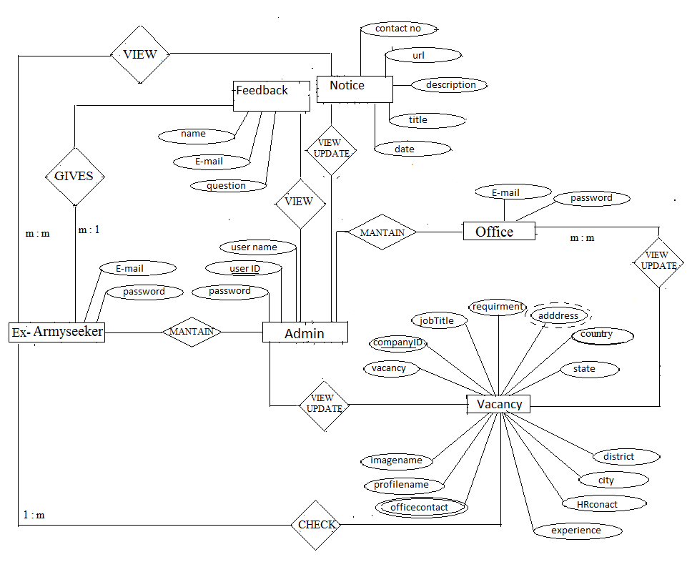
ENTITY – RELATION DIAGRAM

Slide 22
IMPLIMENTATION

Slide 23
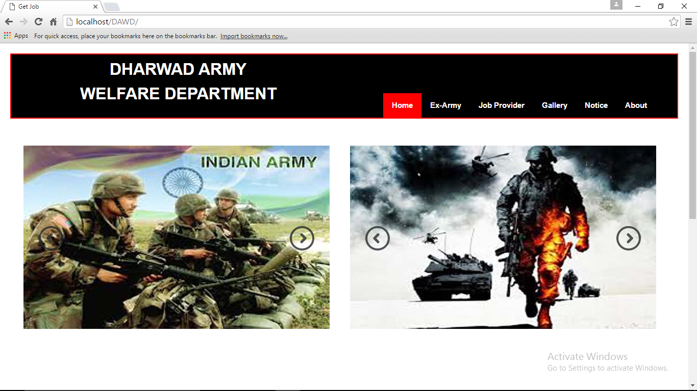
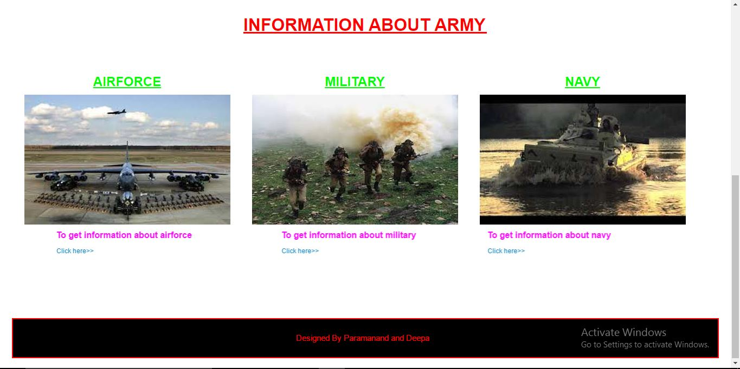
FRONTEND
HOME PAGE

Slide 24
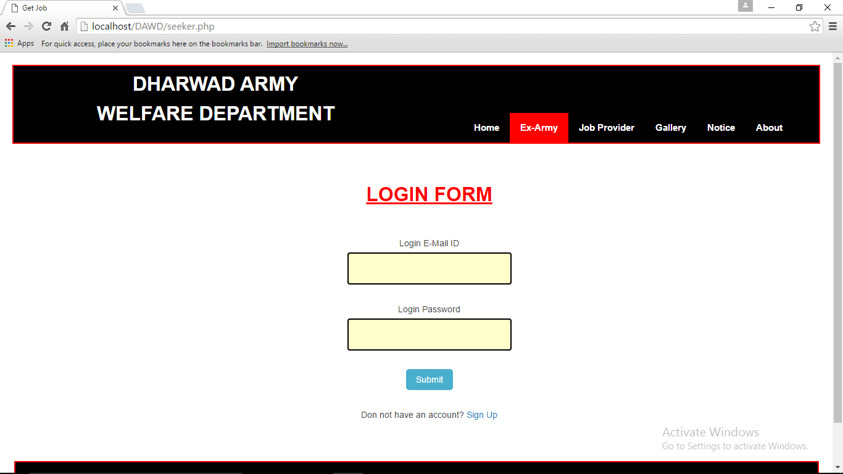
REGISTRATION PAGE FOR Ex-ARMY

Slide 25
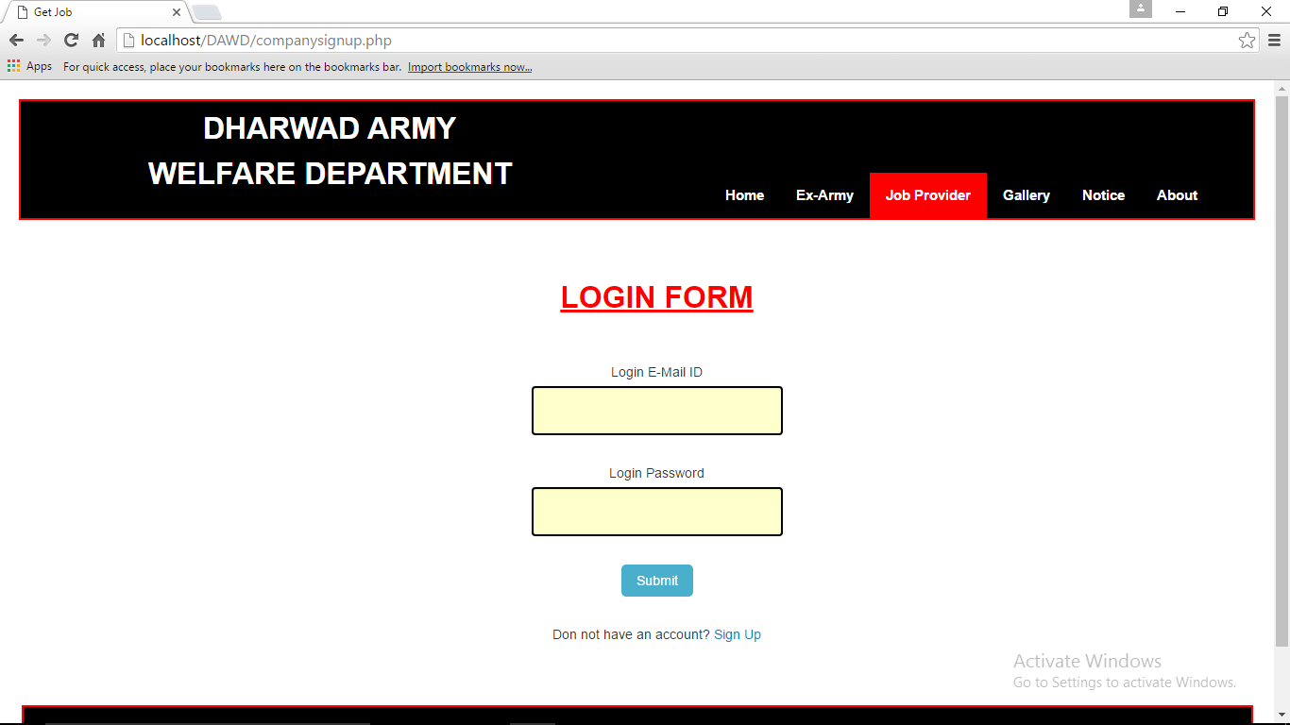
REGISTRATION PAGE FOR OFFICE

Slide 26
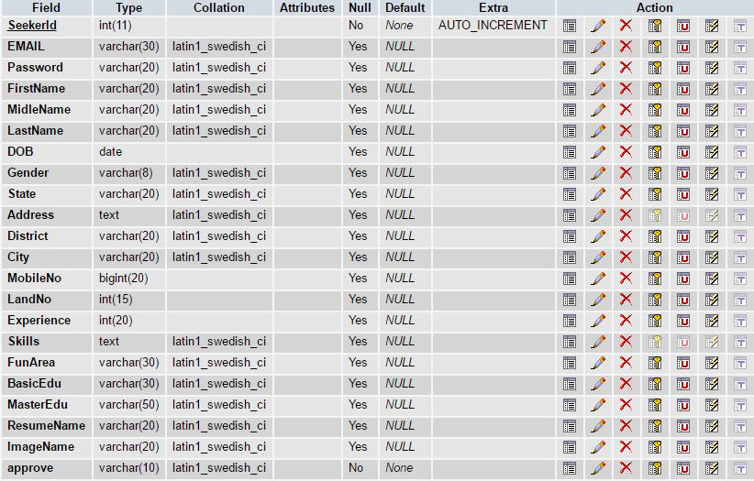
BACKEND
SEEKER TABLE

Slide 27
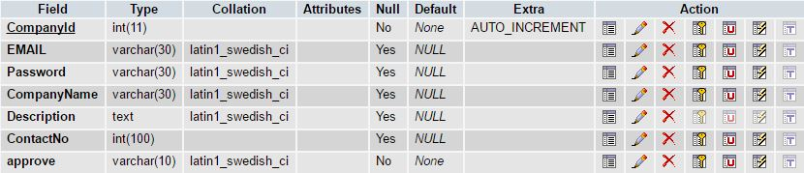
COMPANY TABLE

Slide 28
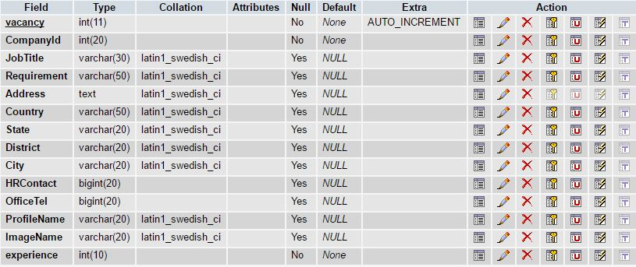
VACANCY TABLE

Slide 29
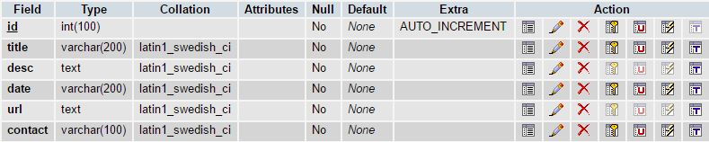
NOTICE TABLE

Slide 30

FEEDBACK TABLE

Slide 31
THANK YOU
Presented by :
Paramanand (14M10014)
Deepa (14M10004)

