Slide 1


पेटBOT
AI-Powered Restaurant Revenue Intelligence Platform
Team Name : Cosmosapiens
Notes:
1

Slide 2



Restaurants Are Flying Blind on Revenue
Without real-time intelligence, restaurant owners make critical pricing and menu decisions based on gut feel rather than data. This creates missed revenue opportunities every single day.
Menu Underperformance
No Real-Time Intelligence
Missed Revenue Moments
Owners don't know which items generate the most margin per minute of kitchen time
Pricing and promotion decisions are made on gut feel, not data
Peak hours, trending items, and high-margin underordered items go unnoticed
Notes:
2

Slide 3
पेटBOT — A Three-Module Revenue Intelligence Stack
Three integrated modules working together to transform raw orders into actionable revenue intelligence.
1
2
3
Revenue Intelligence Dashboard
AI Voice Ordering Agent
Revenue Copilot Chatbot
Real-time voice calls with STT/TTS, multilingual support, and upsell logic
Natural language Q&A grounded in the restaurant's real order and menu data
Live analytics with KPI cards, 8 charts, and AI-generated insights per chart
Notes:
3

Slide 4




Full-Stack AI Architecture
A layered architecture combining data infrastructure, AI intelligence, and intuitive interfaces to deliver real-time revenue insights.
Intelligence Layer
Data Layer
LLM (OpenAI/Groq) · NL-to-SQL Engine · RAG Service · Language Detector · Prompt Templates
PostgreSQL · Redis · RAG Vector Store
Interface Layer
Brain Layer
Next.js Dashboard · Voice Agent (Python/WebSocket) · Revenue Copilot Chat · POS Adapter
Orchestrator Service · Revenue Engine · Upsell Rules · Context Summarizer · Conversation State Machine
Notes:
4

Slide 5
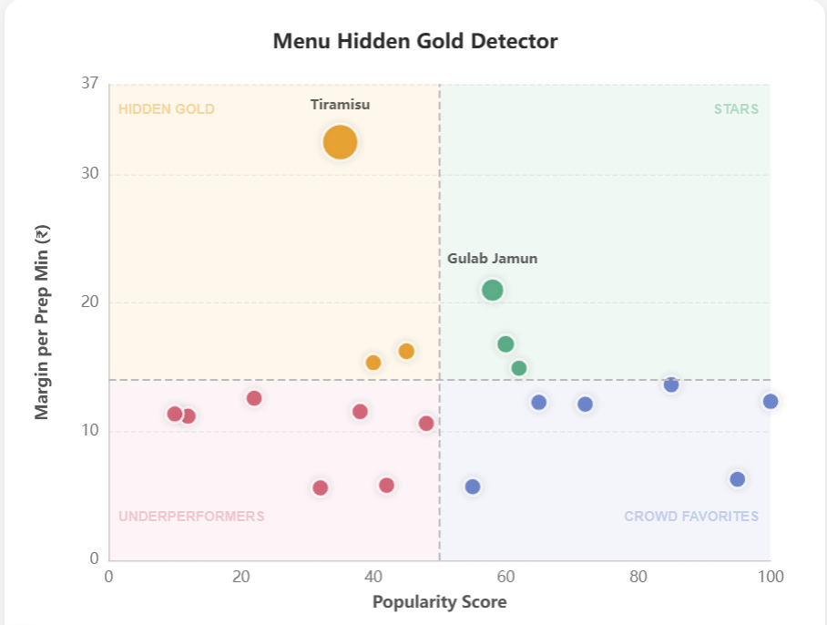
Every Revenue Signal — At a Glance
The Revenue Intelligence Dashboard surfaces every critical metric and trend, powered by 8 charts with AI-generated "Intelligence Signals" — plain-language actions the owner can take today.
5 KPI Cards
6 Analytics Charts
Total Revenue
Best Day
Peak Hour
Hidden Gold Item Count
Top Trending Item
Menu Position Matrix
Daily Revenue Trend
Revenue by Day of Week
Item Revenue Contribution
Trending Items Top 5
Peak Order Hours
Notes:
5

Slide 6
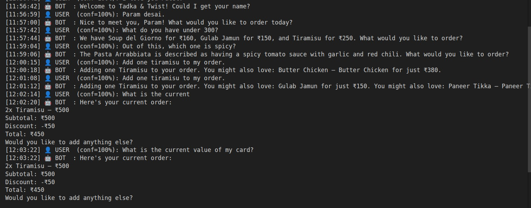
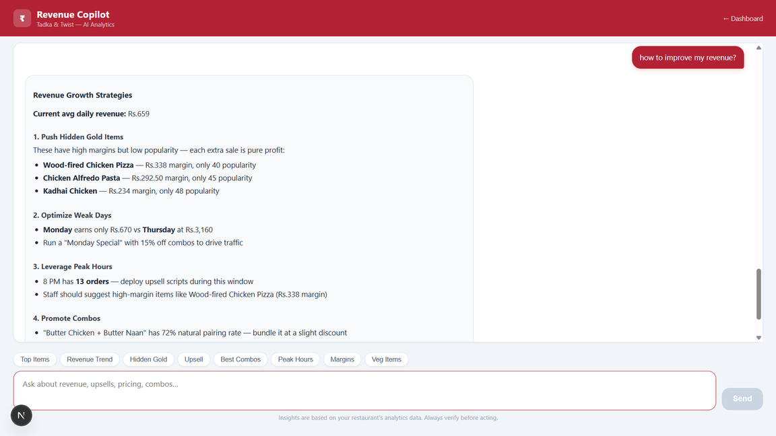
Talk to Your Restaurant. Ask Anything.
AI Voice Ordering Agent
Revenue Copilot Chatbot
Handles inbound calls end-to-end
Speech-to-Text and Text-to-Speech pipeline
Multilingual (Hindi, English, mixed)
Fuzzy menu item matching
Mid-call upsell logic based on revenue rules
Full call logging
Natural language Q&A over live analytics data
RAG-powered — answers grounded in real data, not guesses
NL-to-SQL for direct database queries
Example: "Which items have highest margin per prep minute?"
Example: "Which combos should I promote tonight?"
Example: "Why are Monday revenues low?"
Notes:
6

Slide 7
What Makes पेटBOT Different
Four technical differentiators that transform raw orders into revenue intelligence.
Hidden Gold Detection
RAG-Powered Copilot
Identifies high-margin, low-visibility items using a CM-per-prep-minute algorithm. Tiramisu: ₹32.50/min but only 35 popularity score.
Retrieval Augmented Generation grounds every answer in the restaurant's actual data — no hallucinations.
Real-Time Voice Upsell
NL-to-SQL Engine
The voice agent applies revenue-aware upsell scripts mid-call, increasing average order value automatically.
Owners query their own database in plain English without writing a single line of SQL.
Notes:
7

Slide 8

Revenue Outcomes, Not Just Features
Three quantified impact scenarios showing how पेट-bot drives measurable revenue increases.
₹4,875
₹4,500+
₹740
Hidden Gold Promotion
Price Optimisation
Peak Hour Readiness
Pushing Tiramisu (₹32.50/prep-min) into 5 extra daily upsells = additional monthly margin
Raising Makki di Roti by ₹15 (lowest elasticity item) = incremental monthly revenue with near-zero demand loss
Preventing one Butter Chicken (₹247 CM) stockout during 20:00 peak = up to saved per service
Notes:
8

Slide 9
Built for Every Restaurant
Frontend & Backend
AI & Voice
Next.js 16
React 19
TypeScript
Node.js
PostgreSQL
Redis
BullMQ
Docker
OpenAI / Groq LLM
RAG + Vector Store
NL-to-SQL
Python STT/TTS Pipeline
Fuzzy Matching
WebSocket Voice Server
Every chart. Every insight. Every rupee — tracked.
Notes:
9

Slide 10
THANK YOU!
Notes:
9

