Slide 1
Real Time Data
Grocery Bills
Medical Reports
Employee database
Postal Address
Stock Market data
…

Slide 2
How did computer knows these data ?
Isn’t it only read 0 and 1s ?

Slide 3
Yes, only binaries
But using binaries we can create alphabets and numbers, decimals and so on…
To reduce the workload and repeated process,
These basic data types are created and will be available for us to use.
These are basic data types

Slide 4
Basic Data Types
Int
Float
String
Boolean

Slide 5
But wait...
I have heard something link lists, tuples, dictionaries and so on.., these are also similar data types ????

Slide 6
Actually, Not the same
Those are data structures and these are data types.
Let me tell you the difference with some examples

Slide 7
Data Types vs Structures
Data Types
These are fundamental type of data
Single entity
Ex
Bricks
Coconuts
...
Data Structures
These are organizers of fundamental data types
Contains multiple small units to form single entity
Ex
Wall
Sack
...

Slide 8
Let’s come back to our story
Int
  Whole numbers (ex. 0, 1,2,3,-1,-2,-3...)
Float
  Decimal numbers (ex. 1.1, 2.34, ….)
String
  Any Language alphabets and sentences (a, b, c,….)
Boolean
  On and Off states (basically switches 0 and 1)

Slide 9
We can cover all
Using these basic data types and help from our data structure friends we can cover most of real time scenarios
Let’s do a exercise to divide each elements of medical report to analyze the real process

Slide 10
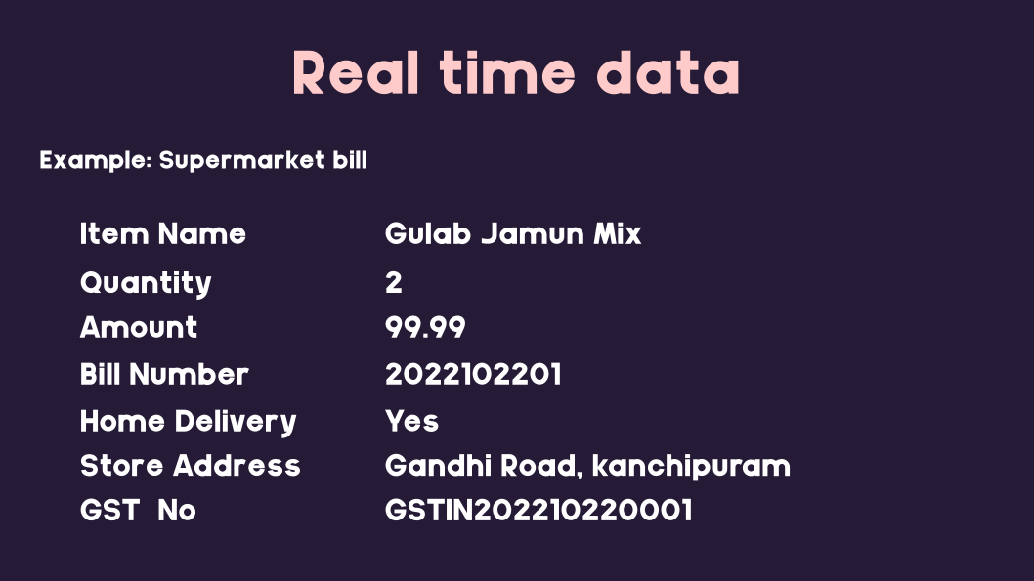
Sample Bill

Slide 11
Python is dynamically typed lang
Static typed and dynamic typed
Static typed means you need to declare the type of data you need to store before creating a var for it
Dynamically typed will find the type of the data based on the input. No need to specify.
It automatically does that for you!

Slide 12
Type function
Type(1)
Type(1.2)
type(True)
type(“welcome”)

