Slide 1
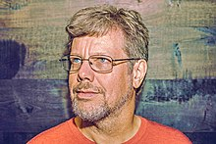
Founded by
Guido Van Rossum
https://en.wikipedia.org/wiki/Guido_van_Rossum

Slide 2
About Python
Another language used to talk with computers
It is a general purpose language
Open source
Since open source we have the largest library of packages and frameworks
Easy syntax

Slide 3
Some Use Case
Automation
Best for scripting
Even in space and Now in MARS python is used
Cyber exploits
Web development
DevOps Integration
Data Science
Data Analytics
Machine learning
AI
Language processing
Scraping

Slide 4
Additional Resources
https://en.wikipedia.org/wiki/Python_(programming_language)
https://www.geeksforgeeks.org/history-of-python/
https://www.youtube.com/watch?v=J0Aq44Pze-w
https://learnpython.com/blog/python-on-mars/

