Slide 1
Data Structures
Data structures are group of basic data types stored in particular manner to use it
Remember the example of brick in a wall
Brick is the basic data type
Where wall is the data structure which tells how bricks are aligned

Slide 2
Default data structures in python
List
Tuple
Dict
Set

Slide 3
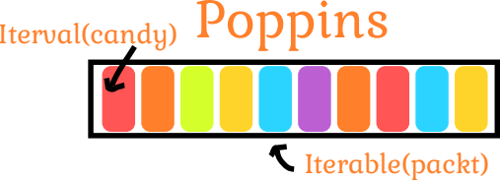
List
Ordered
Mutable
Allow duplicates

Slide 4
List
Ordered
  List elements are ordered they maintain a index value and retrieved based on the order
Mutable
  You can add or remove or modify elements of the list
Allow duplicates
  List can have duplicate values inside thema

Slide 5
Syntax of list
You can name a list
The elements of list must be enclosed in a square brackets
Each element of the list should be seperated by commas
Index starts with 0 and negative index are also allowed. Indexing is similar to Strings
name_list = [“Paramesh”, “Ramesh”, “Suresh”, “Prakash”]

Slide 6
Loops with list
Since list has multiple values you have to use loops to move around the list values
Only accessing one list value doesn’t require loops but working on multiple items you need a loop
for name in name_list:
print(f”Welcome {name}”)

