Slide 1
Sets

Slide 2
My Requirement
We have two list, one for devOps Engineers and another for core developers
Some people are both devOps Engineer and also a core developer.
My need to find those who are both from the name list given.
devOps_list = [ Lokesh, Vetrimaran, Selvaragavan, Thayagaraja]
core_list = [ Selvaragavan, Ajith, Vijay]

Slide 3
Using conditionals ?
Using Loops ?
How will you solve it ?
Using all of them ?
Or is there any special method for this ?
Using list ?

Slide 4
Sets
Mutable
Unordered
Doesn’t allow duplicates
Works same as math sets

Slide 5
Syntax of sets
You can declare a empty set by using set method only
  set()
But you can create a non empty set by either directly adding elements in {}
or
By passing a iterable in set() method

Slide 6
Sample set
data_list = {1, 2, 3, “myname”, 4.0}
  Note: *Make sure you use correct variable naming convention
  Putting curly braces is the syntax of sets
  You can seperate elements using a comma

Slide 7
Set associated methods
Sets have around 17 associated methods with it
'add'
'clear'
'copy',
'difference',
'difference_update',
'discard',
'intersection',
'intersection_update',
'isdisjoint',
'issubset',
'issuperset',
'pop',
'remove',
'symmetric_difference',
'symmetric_difference_update',
'union',
'update'

Slide 8
Common methods with list
Add
Clear
Copy
Pop
Update
Remove

Slide 9

Union

Slide 10
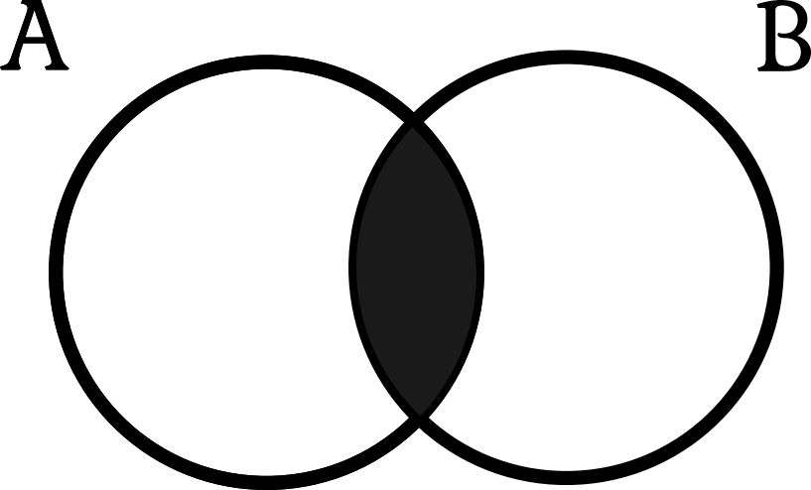
Intersection

Slide 11

Difference

Slide 12

Symmetric Difference

Slide 13
Set associated methods
So far we have covered...
'add'
'clear'
'copy',
'difference',
'difference_update',
'discard',
'intersection',
'intersection_update',
'isdisjoint',
'issubset',
'issuperset',
'pop',
'remove',
'symmetric_difference',
'symmetric_difference_update',
'union',
'update'

Slide 14
*_update related functions
They are simple, after the perform the pre-task they will update the values in the called dataset
For example,
a = {1, 2, 3}
b = {2, 4, 6}
a.intersection_update(b) is equal to a = a.intersection(b)

Slide 15
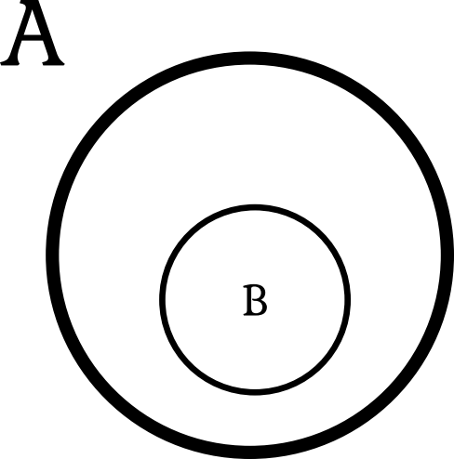
Subsets and Supersets

Slide 16

Disjoint

Slide 17
Set methods which gives bool output
Issuperset
  Returns true if called set is superset of passed set
Issubset
  Returns True if called set is a subset of passed set
Isdisjoint
  Returns true if the two sets are disjoint

Slide 18
Great!
Now you know all about sets in python
Go practice them to Master it
...Happy Coding...

