Slide 1
Data Structures
Data structures are group of basic data types stored in particular manner to use it
Remember the example of brick in a wall
Brick is the basic data type
Where wall is the data structure which tells how bricks are aligned

Slide 2
Default data structures in python
List
Tuple
Dict
Set

Slide 3
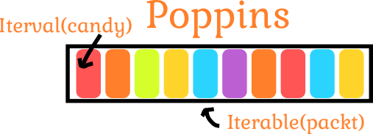
Tuple
Ordered
Immutable
Allow duplicates

Slide 4
Tuple
Ordered
  Tuple elements are ordered they maintain a index value and retrieved based on the order
Immutable
  You cannot add or remove or modify elements of the list
Allow duplicates
  Tuple can have duplicate values inside thema

Slide 5
Syntax of list
You can name a tuple
The elements of tuple must be enclosed in a parentheses
Each element of the tuple should be seperated by commas
Index starts with 0 and negative index are also allowed. Indexing is similar to Strings
name_list = (“Paramesh”, “Ramesh”, “Suresh”, “Prakash”)

Slide 6
Loops with list
Since tuple has multiple values you have to use loops to move around the list values
Only accessing one tuple value doesn’t require loops but working on multiple items you need a loop
for name in name_list:
print(f”Welcome {name}”)

Slide 7
Use Case
We use tuple for storing constant values
To store fixed options like dropdown menu
Because these values should not be overwritten by user

