Slide 1
Loops

Slide 2
What are loops ?
The repetitive control structure is the loops.
Humans are not so good at repeating stuff and we don’t want to do stuffs again and again.
But computers are good at doing what we instruct.
So we make computers do the repetitive stuff and we do the creative stuff

Slide 3
Repetition is everywhere
We all do repetitive stuff everyday. Some are worth it. But some are only consuming time
Example:
  Let’s say a jewelry shop will regularly follow the good rates very closely.
  Imagine the owner/employee need to update the gold date everyday from the sensex.
  This will be repetitive
  Imagine if I made a minute mistake on this, the entire shop’s profit and loss depends on it.
  We know humans do errors if we are bored and doing same stuff yesterday. We crave for challenges and new things

Slide 4
Loops in Python
For Loops
While Loops
Each have a specific criteria to be used in the logic.

Slide 5
For Loops
When we know exactly how many times we need to do some stuff
When we know there is a list of items to be done
Like Running for 365 days or Like doing task in the checklist

Slide 6
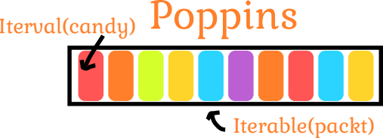
Let’s see the syntax of For Loop
for itervar in iterable:
    Content of loop
    Content of loop
[1,2,3,4,5,6,7,8,9,10]
Similar to poppins right

Slide 7
Let’s see the syntax of For Loop
for num in numbers:
    print(num)
For loops take the whole packet and feed us one by one
Each and every item can be of different flavours but all items
will be referenced with iter variable everytime
That’s all, It is that simple!

Slide 8
Let’s see some practial examples!

Slide 9
While loops
When we know the condition needs to satisfy. (But we don’t know how many times we need to do)
When we know what success looks like but not steps
Escaping a maze
Learning to play a serve in badmiton
Hunting
Lottery

Slide 10
Let’s see the syntax of while Loop
While condition:
    Content of loop
    Content of loop
As long as the condition satisfies the loop will continue
to execute
When condition fails, the loop breaks!

Slide 11
Some example for while loop
While trial_day<30:
    Content of loop
    Content of loop
Almost all products/services are having trials which you can
Use for particular period of time. This logic of restricting the
Access to the account can be done by while loops

