Slide 1
Parami Protocol Lightpaper
Building Ad 3.0 For Web 3.0
Version: 1.0.0
2021-01-20

Slide 2
Definition & Motivation
“AD 3.0 is a human-centric and privacy-preserving network powered by blockchain, where users are smart-rewarded for attention and data while their self-sovereign identity is protected on a trust-free basis.”
AD 1.0: Era of Slavery
AD 2.0: Era of Feudalism
AD 3.0: Era of Democracy
The AD model is inefficient and not transparent. Advertisers are faced with ambiguousness and fraud while users’ data are being monetized without consent. Users become DATA SLAVES when they have no right over their data and cannot benefit from their engagement.
Incentive AD return parts of profits back to users but users are still not in charge of their own identity and data.
Data are dispersed and isolated in various apps and websites where they can not be aggregated and utilized.
The AD network is democratic and governed by all token holders. The future network traffic is directly generated from the influence of each creator and token holders, instead of being acquired from a certain website or application.
Users have absolute sovereignty over their own identity and data. They will receive smart-reward based on their attention paid and relevance score.
Definition of Important Terms: 1. AD: Advertisement; Ads: Advertisements 2. Smart-Reward: A reward given to users automatically based on their behaviour, attention paid and data contributed in the network/online.

Slide 3




Protocol Overview
Parami Protocol proposed an AD 3.0 paradigm powered by blockchain for Web 3.0. It provides a protocol stack for building a user-centric, tokenized advertising economy. As a parachain built on Substrate, it serves all the other parachains in Polkadot/Kusama through relaychain.
Application Layer
DID Layer: Decentralized Identity management including registry, update and revoke. DID aggregates both social media identities and blockchain identity.
AD Privacy Layer: Privacy on advertising, including private file bonding, updating and monetization.
Application Layer: Tokenized activities such as SmartDrop, Yield Farming, Social Coin Generation and NFT
AD Privacy Layer
Social NFT
Social Coin
DID Layer
SmartDrop
Yield Farming

Slide 4
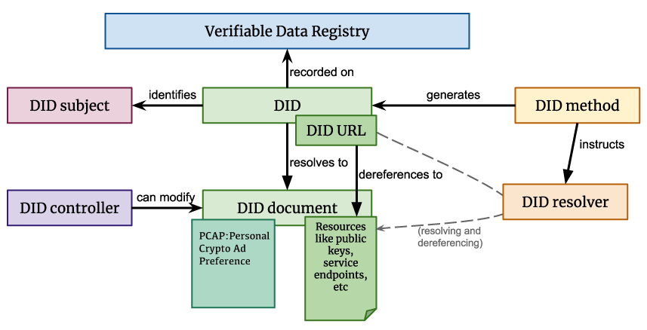
Protocol: DID
Parami Protocol provides a complete set of PDID (Parami DID) solutions compatible with W3C DID standard on Parami Node, and expands its business on the basis of DID standard. Parami Protocol will also provide DID aggregators for other DID standards.
Web2.0 Compatible: Parami DID provides a verification method that can connect to users’Web 2.0 social media identities.
NO KYC: PDID allows users to verify DID uniqueness by building social graphs and running anti-sybil analysis without any KYC process.
Parami DID extension

Slide 5
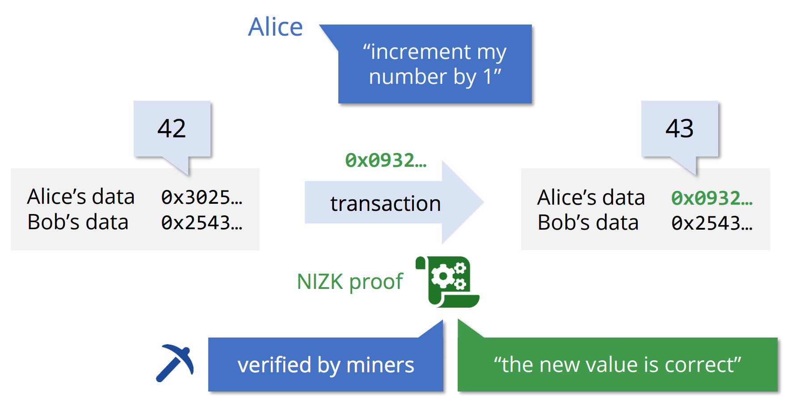
Protocol: AD Privacy
The AD Privacy Layer provides a personal crypto advertising preference (PCAP) document attached to user DID, which contains user advertising privacy management service. The PCAP document works not only for payment but also for user preference data. The preserved data can be used but can not be seen.
Blind Signature
Advertisers use blind signature to prove they have confirmed user interaction with AD, which avoid further malicious behavior.
Homomorphic Encryption
User crypto advertising preference (PCAP) data is homomorphic encrypted so that advertisers could update users’PCAP in an encrypted way.
ZKP based
ZKP based User Privacy Update
The Zero-Knowledge Proof （ZKP）algorithm is used so that users can get the reward he/she deserves. The ZKP generates the corresponding proof and verifiy it on-chain to determine the reward.

Slide 6
Protocol: Application layer
The application layer provides decentralized oracle to collect data from conventional Internet for Ad verification. It also defines the interfaces for tokenized advertising dapp to get AD privacy support.
Parami Node
Parami Node
On-chain
On-chain
PCAP data fetch: Dapp can fetch PCAP data (ZKP) of some DID to determine and verify the user reward he/she deserves.
PCAP data update: Dapp can update (scoring some tags) PCAP data each time it sends reward to users, with updated data encrypted homomorphically.
Off-chain Oracle
Aggregation
Off-chain Oracle
Ad Runtime
Deploy job
Deploy job
De-oracle for Ad verification

Slide 7
More Highlights
IM support
DAO support
Governance support
Parami is designed for IM apps. The Parami SDK will support users to participate in Ad interaction in IM explorer or MiniApps.
Parami will support other DAOs as seed groups to expand DID ecosystem. Other DAOs can register on Parami and manage their DAOs on it for extra incentive.
Parami Protocol is fully governed by all token holders. They can vote for the council and all the proposals to optimize the network.
NFT support
Yield Farming support
Parami Protocol supports NFT as ticket, badge or collector for advertising campaign.
Parami supports liquidity mining (Yield Farming) so that users are able to exchange rewarded token to stable coins and advertisers can easily build an advertising fund.
…

Slide 8
Token Economic Model
The native token on Parami Protocol is AD3. It is an UTILITY TOKEN that can be used in 5 scenarios:
Settlement: The price of the Ad and the price of the token will jointly determine the number of rewards the user will receive for a single advertising campaign.
Bidding: Use tokens to bid for advertising opportunities.
Synthesizing: Use AD3 to generate social coins and NFT.
Paying: AD3 will be used to pay operation fee.
Governance: Vote and adjust the chain parameter.
Staking: Stake tokens for mining and community development.
Synthesizing
Settlement
Bidding
Staking
AD3
Paying
Governance
AD3 usage scenarios

Slide 9
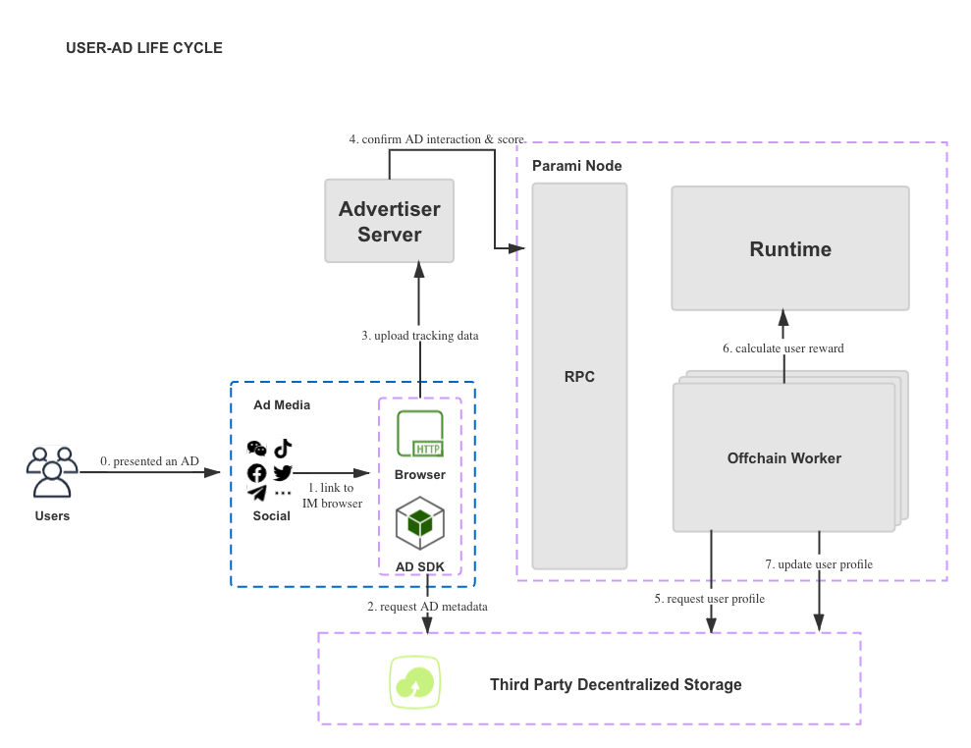
Use Case
0. Users are shown an Ad, which is published by other user’s community through IM apps.
1. The advertiser gets user’s DID according to platform ID hash.
2. The SDK requests AD content from Decentralized Storage. 3. The SDK tracks user Ad action data.
4. The advertiser tags and scores the DID with encrypted data after evaluating user’s action.
5. OCW requests PCAP from Decentralized Storage.
6. Ad Runtime calculates the reward of user.
7. OCW updates PCAP

Slide 10
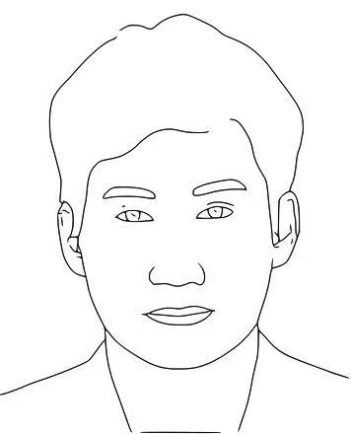
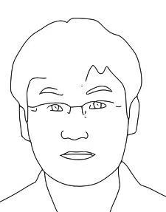
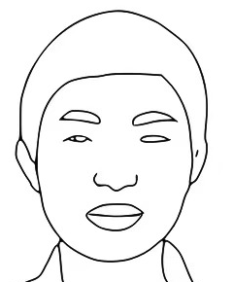
Team
Dorian
Core Architect
Mono Wang
Core Dev
Edison
Core Dev
Dorian was the senior architect of DCEP (Digital Currency Electronic Payment), the core architect & technical leader of TRON and has rich practical experience in consensus mechanism, privacy calculation, cross-chain mechanism, etc. He is an early evangelist and investor of BTC.
Full-stack engineer; senior rust engineer with 6 years‘ experience; Core Rust Chinese community evangelist; Open Tron independent developer; former Core dev of Ledger.
Edison was the core architect of TRON‘s TRONZ team, and is the core developer of the zero-knowledge proof virtual machine. He has deep research in the fields of zero-knowledge proof, MPC, and homomorphic encryption, and is committed to solving Web 3.0 data privacy problems.

Slide 11
Roadmap
2021 Q2
MainNet V1: śīla
NPOS mining
AD platform
Mobile wallet
2021 Q4
MainNet V3: dhyāna
Privacy Computing(ZKP)
Monetization
On-chain analyzer
2021 Q1
TestNet: Dāna
PoC and code security audit
WeChat wallet
Web SDK
2021 Q3
MainNet V2: Vīrya
Governance
Decentralized oracles
NFT support
2022 Q1
MainNet V4: Prajñā
Parachain to plug in
Cross chain AD

Slide 12





Parami Protocol
parami.io
info@parami.io
Github
Twitter
Building AD 3.0 for Web 3.0
Medium

