Slide 1

GRADVISOR
Mohit Sarin
Pankaj Kumar Tiwari
Shaunak Hemant Joshi
Shwetima Sakshi

Slide 2

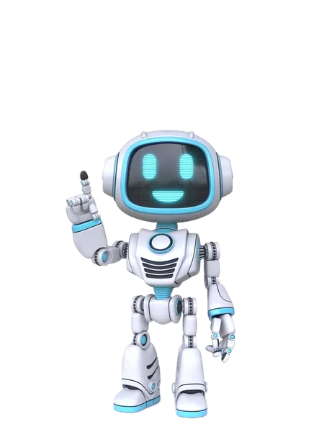
Motivation
Choosing university requires extensive research. Gradvisor empowers students to make decisions aligned with their academic profile.
Solution:
Personalized recommendations based on student's academic profile.
Build connections with similar users for better interactions.
Impact:
Gradvisor predicts suitable universities for each student, saving valuable time.
Enhanced satisfaction and success in their higher education journey.

Slide 3

Challenges
Sparse and inconsistent Data:
Users create incomplete profiles resulting in limited data availability.
Data inconsistency is a challenging factor which impacts the accuracy of the predictions.
Analysis of Techniques:
Difficulty in analysing the effectiveness of different techniques due to the absence of proper data.
Unquantifiable Factors:
Factors such as Letters of Recommendation, Statement of Purpose, Research and Industry Experience etc., are crucial in admission process but are difficult to quantify.

Slide 4
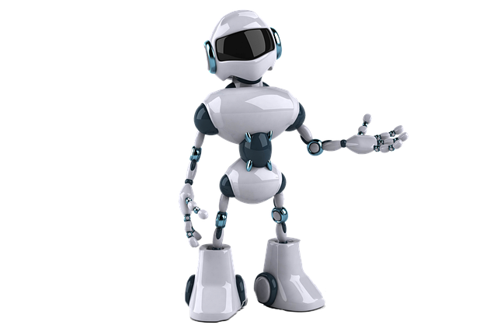
Approach
KNN
Similar Users Identification:
Using K-Nearest Neighbours (KNN) and Pearson Correlation Coefficient to calculate similarity scores of profiles.
KNN is selected for its effectiveness in finding similar user profiles.
Prediction Process:
Several machine learning algorithms were tested for prediction including Random Forest, AdaBoost, and Artificial Neural Networks.
Final Recommendations:
Applying AdaBoost algorithm for university recommendation.
Applying KNN to find similar user profiles.
USER-USER
AdaBoost
ANN
Random Forest

Slide 5
Performance comparison
Method | Top-5 Accuracy
Random Forest | 86.08 %
ANN | 52.79 %
Adaboost | 78 % (Final Accuracy 91.93 %)

Slide 6
Metrics
AdaBoost
Recall
0.78
MRR@5
0.73
HIT@5
0.78
Precision@5
0.156

Slide 7
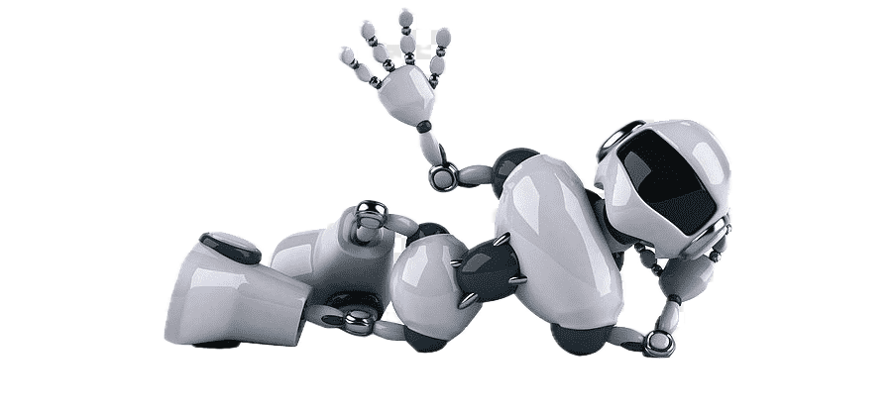
Thank You

