Slide 1


TODOIT
By:
Param Jani (19dcs042) ,
Ishaan Padmashali (19dcs069) ,
Alap Pandya (19dcs073)
3rd Semester , Computer Science
Domain : Android Development
Supervisors :
Prof. Aishwariya Budhrani,
Prof. Chandrashekhar Pawar

Slide 2
Outline
Introduction
Problem statement
Project Definition
Requirement Gathering Techniques
Consolidated list of requirements
Hardware and Software requirements
Flowchart
Implementation
Snapshots
Limitations and Future Scope
Conclusion
References

Slide 3
Introduction
ToDoit is software in the category of Task Management, Project Management, Productivity, “Getting Things Done”, Scheduling, and Collaboration.
ToDoit is general-purpose, Android-based application, which can be used for simple home lists or to manage complex multi-user projects for business.
A list of things that one wants to get done or that need to get done.
Making a to-do list is an important first step but prioritizing that list ensures that you focus on the most important items rather than giving in to the temptation of working on less important items because they may stand out more or because they are easier to do.

Slide 4
Problem statement
To make a To-Do list for organising tasks
Organizing your tasks with a list can make everything much more manageable
Seeing a clear outline of your completed and pending work
Remind you about your incomplete tasks
Make bucket list or wish list
It can also be used as precise note maker
Check lists can also be made

Slide 5
Project Definition
In this fast moving life a person cannot remember all the things he or she has to perform. Our app Todoit, helps you manage your tasks efficiently.
Todoit helps you make on the go crisp notes and plans about your tasks so that you can avoid carrying a pen and paper in this booming generation of technology.
Travel enthusiasts can make awesome bucket lists and plan their next trips.
The user can list down their long and short term goals and work accordingly and keep on updating the list as and when required.

Slide 6
Requirement Gathering Techniques
Android License Agreement Requirements
Third-Party API Requirements
SQLite Database
Recycler View
Card View

Slide 7
Consolidated list of requirements
A flexible Gradle-based build system
A fast and feature-rich emulator
A unified environment where you can develop for all Android devices
Apply Changes to push code and resource changes to your running app without restarting your app
Code templates and GitHub integration to help you build common app features and import sample code
Extensive testing tools and frameworks
Lint tools to catch performance, usability, version compatibility, and other problems

Slide 8
HARDWARE AND SOFTWARE REQUIREMENTS
Hardware
Minimum API Level Android 4.0.3(Ice Cream Sandwich)
Minimum 8 GB RAM
Core i3 processor
Software
Android Studio
Android OS
SQLite

Slide 9
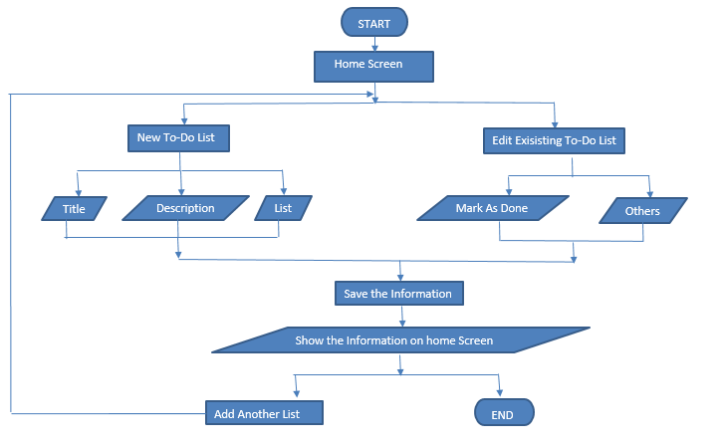
Flowchart

Slide 10
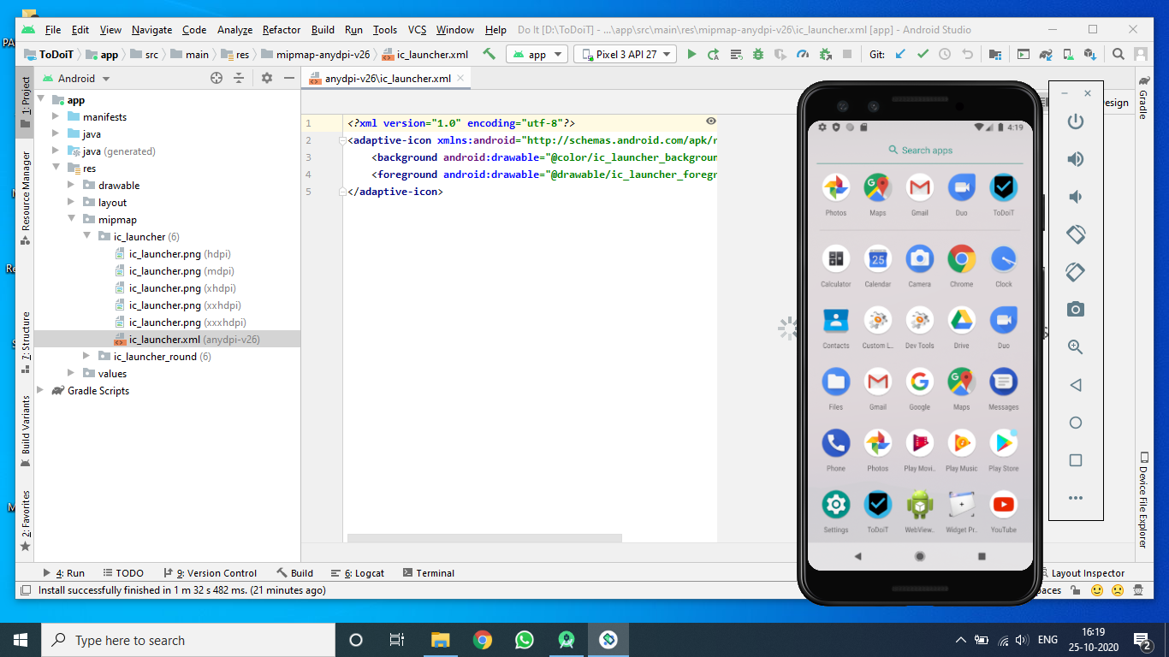
How the app logo looks like !

Slide 11
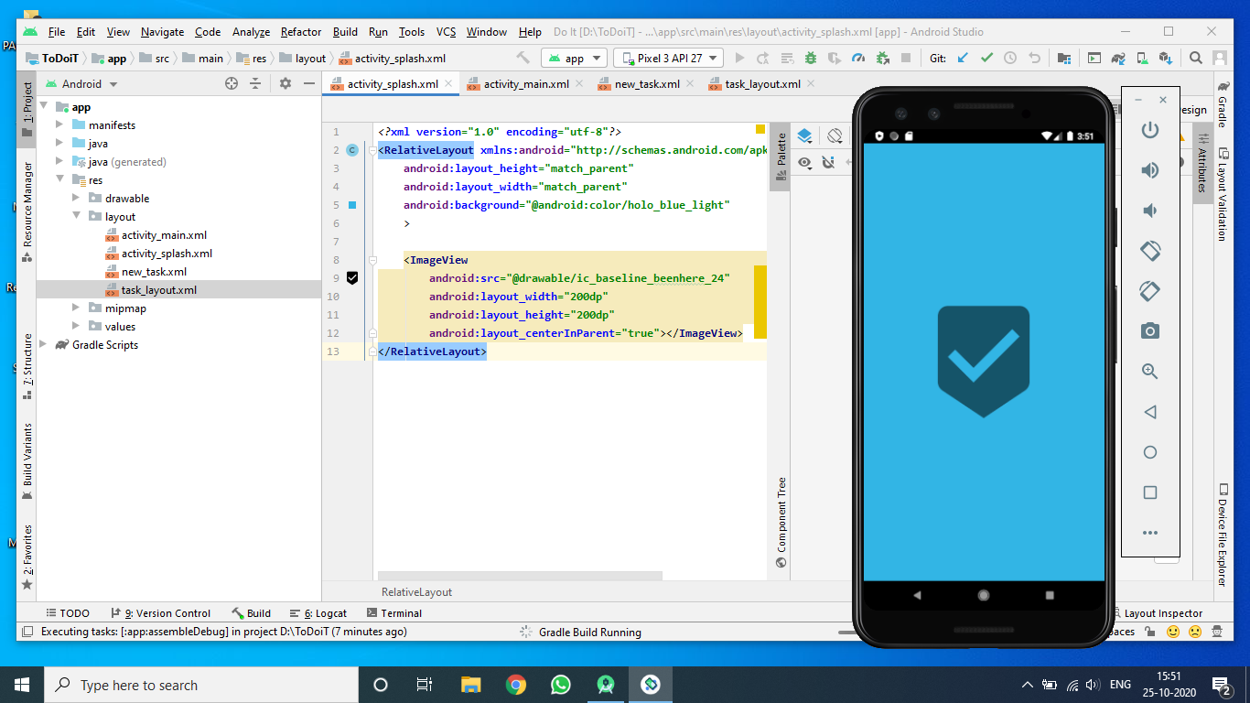
Opening the application !

Slide 12
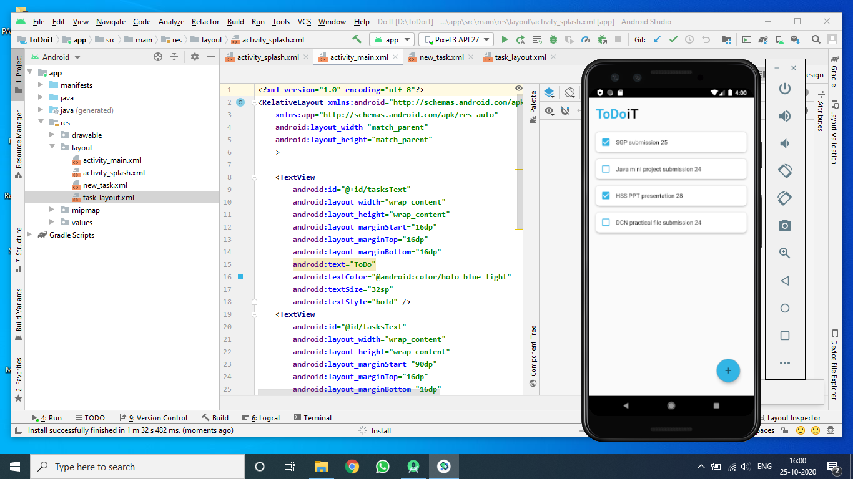
Main Screen of the application !

Slide 13
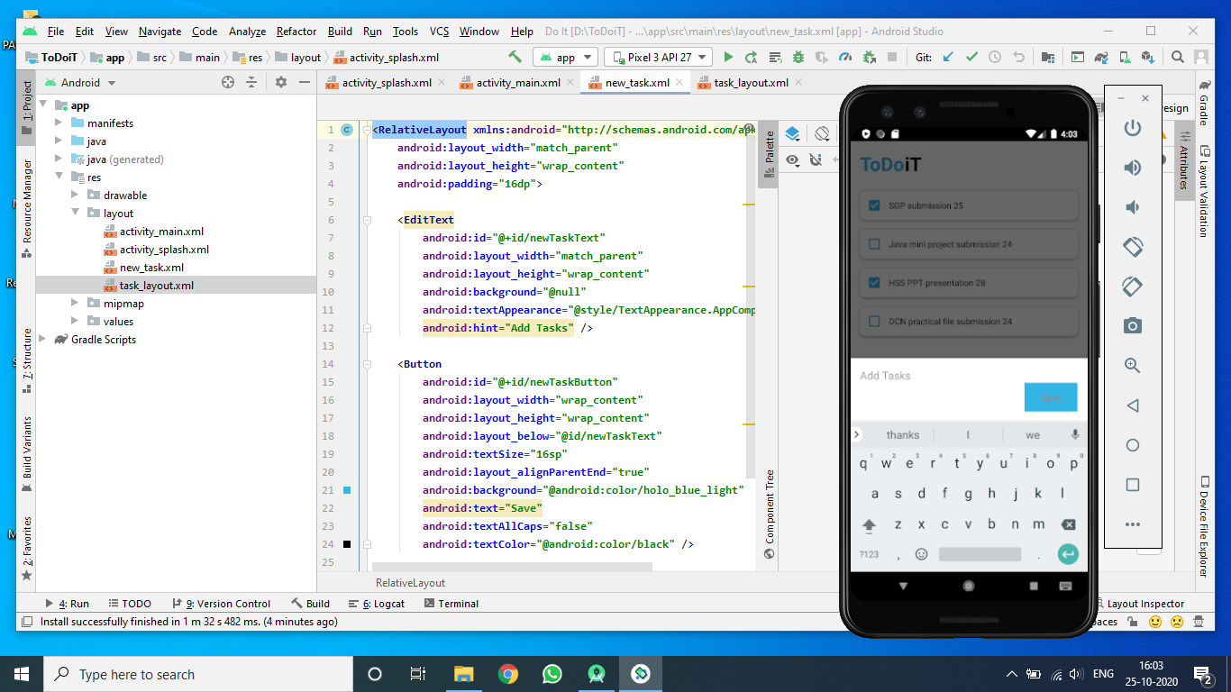
Adding a new task !

Slide 14
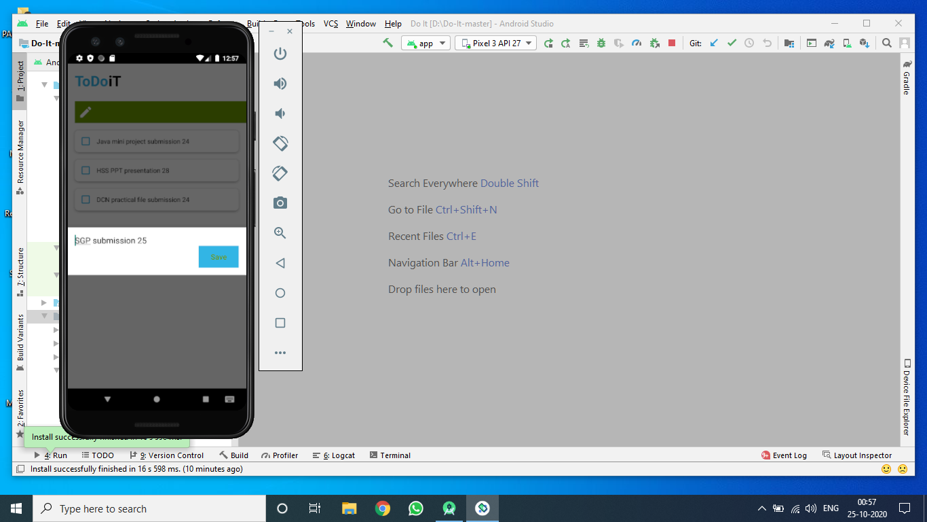
Editing the already made task !

Slide 15
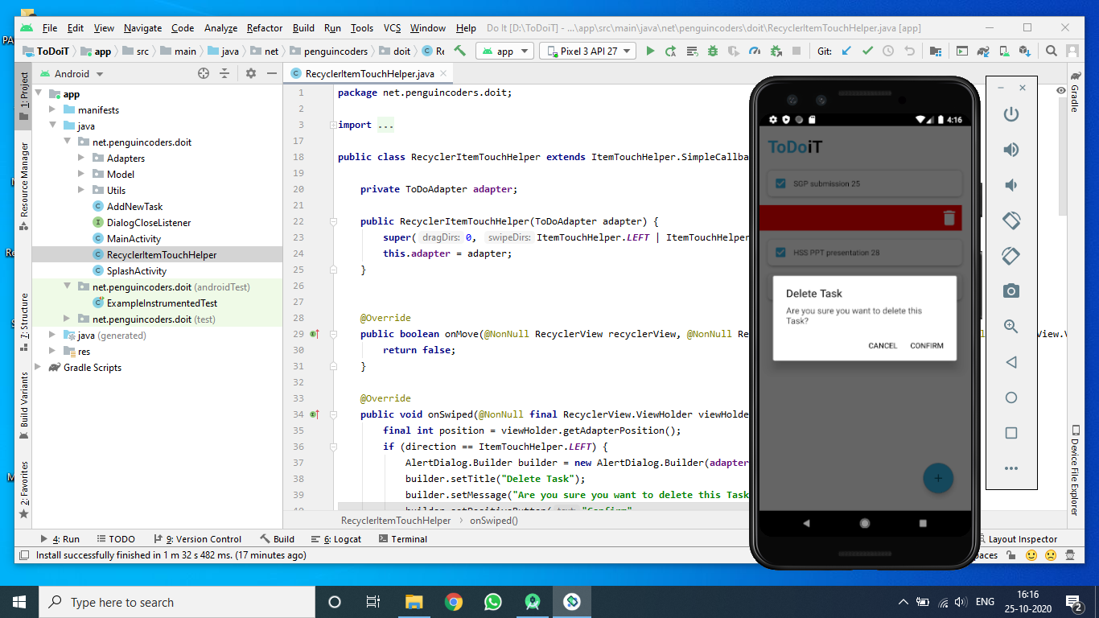
Delete a task with the confirmation !

Slide 16
Limitations
Gives you an excuse to remove tasks from your to-do list that you SHOULD do, but CAN put off
No built-in alarm features
Allows you to avoid these tasks as long as possible
No reminders are given on a timely basis with the help of a calendar
Promotes procrastination and task avoidance
A lengthy running to-do list can be intimidating and cluttered

Slide 17
Conclusion
We developed this project for the main purpose of helping people from all strata of society to use an efficient and very easy to use to-do list app so that they can make and maintain an order of their tasks.
By keeping such a list, you make sure that your tasks are written down all in one place so you don't forget anything important.
User can organize their tasks with the most important tasks at the top of the list, and the least important tasks at the bottom
Use of CRUD (Create, Read, Update, Delete) function.

Slide 18
REFERENCES
https://www.tutorialspoint.com/android/android_environment_setup.htm
https://www.javatpoint.com/android-what-where-and-why
https://www.youtube.com/watch?v=aS__9RbCyHg&t=29277s
https://youtu.be/1ukSR1GRtMU

Slide 19
THANK YOU!

