Slide 1
Blazor WebAssembly And SignalR
Kamran Ellahi
15/06/2022

Slide 2

Kamran Ellahi
Software Engineer
.Net Developer
Team MED (DTX)

Slide 3
Disclaimer
I’m not an expert.
I’m still in learning phase.

Slide 4
Blazor is a SPA framework using WebAssembly to build client-side web UIs
Create
Create rich interactive UIs using C# instead of JavaScript.
Share
Share server-side and client-side app logic written in .NET.

Slide 5
What is a SPA (Single-page application)?
Single Page Applications are web applications that load a single HTML page and only a part of the page is updated instead of the entire page. The page does not reload or transfer control to another page during the process. This ensures high performance and faster page loading.
It also gives us Desktop application like Experience.
React, Angular, Vue are all examples of SPA frameworks written in JavaScript/TypeScript.

Slide 6
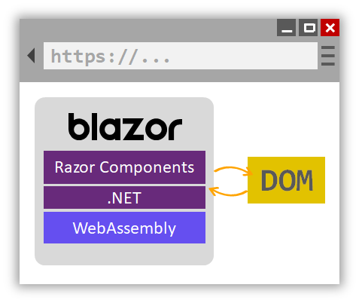
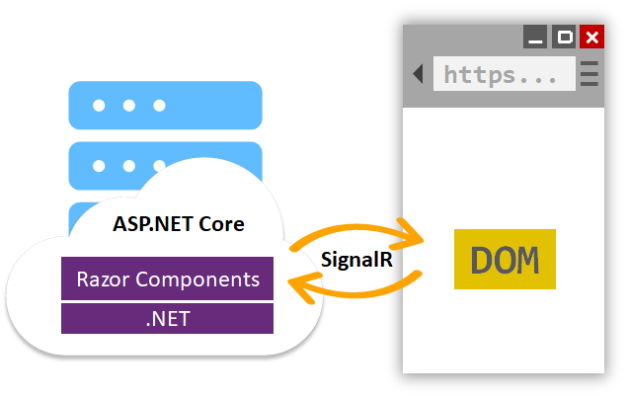
Hosting Models Blazor in two forms
WebAssembly
Server
Production ready
Production ready

Slide 7
What is WebAssembly?
WebAssembly (abbreviated Wasm) is a new type of code that can be run in modern web browsers — it is a low-level assembly-like language with a compact binary format that runs with near-native performance and provides languages such as C/C++, C# and Rust with a compilation target so that they can run on the web. It is also designed to run alongside JavaScript, allowing both to work together.
Chrome, Edge, Firefox, and WebKit all support WebAssembly 1.0

Slide 8
WebAssembly – Supported Browsers
Microsoft Edge | Current
Mozilla Firefox | Current
Google Chrome, including Android | Current
Safari, including iOS | Current

Slide 9
Blazor WebAssembly Workflow
C# code files and Razor files are compiled into .NET assemblies.
The assemblies and the .NET runtime are downloaded to the browser.
Blazor WebAssembly bootstraps the .NET runtime and loads the assemblies for the app.
Blazor WebAssembly runtime uses JavaScript interop to handle DOM manipulation.

Slide 10
WebAssembly
Pros
Cons
There's no .NET server-side dependency. The app is fully functioning after downloaded to the client.
Client resources and capabilities are fully leveraged.
Work is offloaded from the server to the client.
Download size is larger, and apps take longer to load(first time).
Tooling support is less mature.

Slide 11
Create your first app

Slide 12
Prerequisites
.NET Core 5 SDK
Blazor WebAssembly template
From command line run the following
dotnet new -i Microsoft.AspNetCore.Blazor.Templates::3.1.0-preview4.19579.2
Visual Studio 2019 (v16.3.0+)
https://docs.microsoft.com/en-us/visualstudio/releases/2019/release-notes-v16.3#16.3.0
https://dotnet.microsoft.com/download/dotnet-core/5

Slide 13
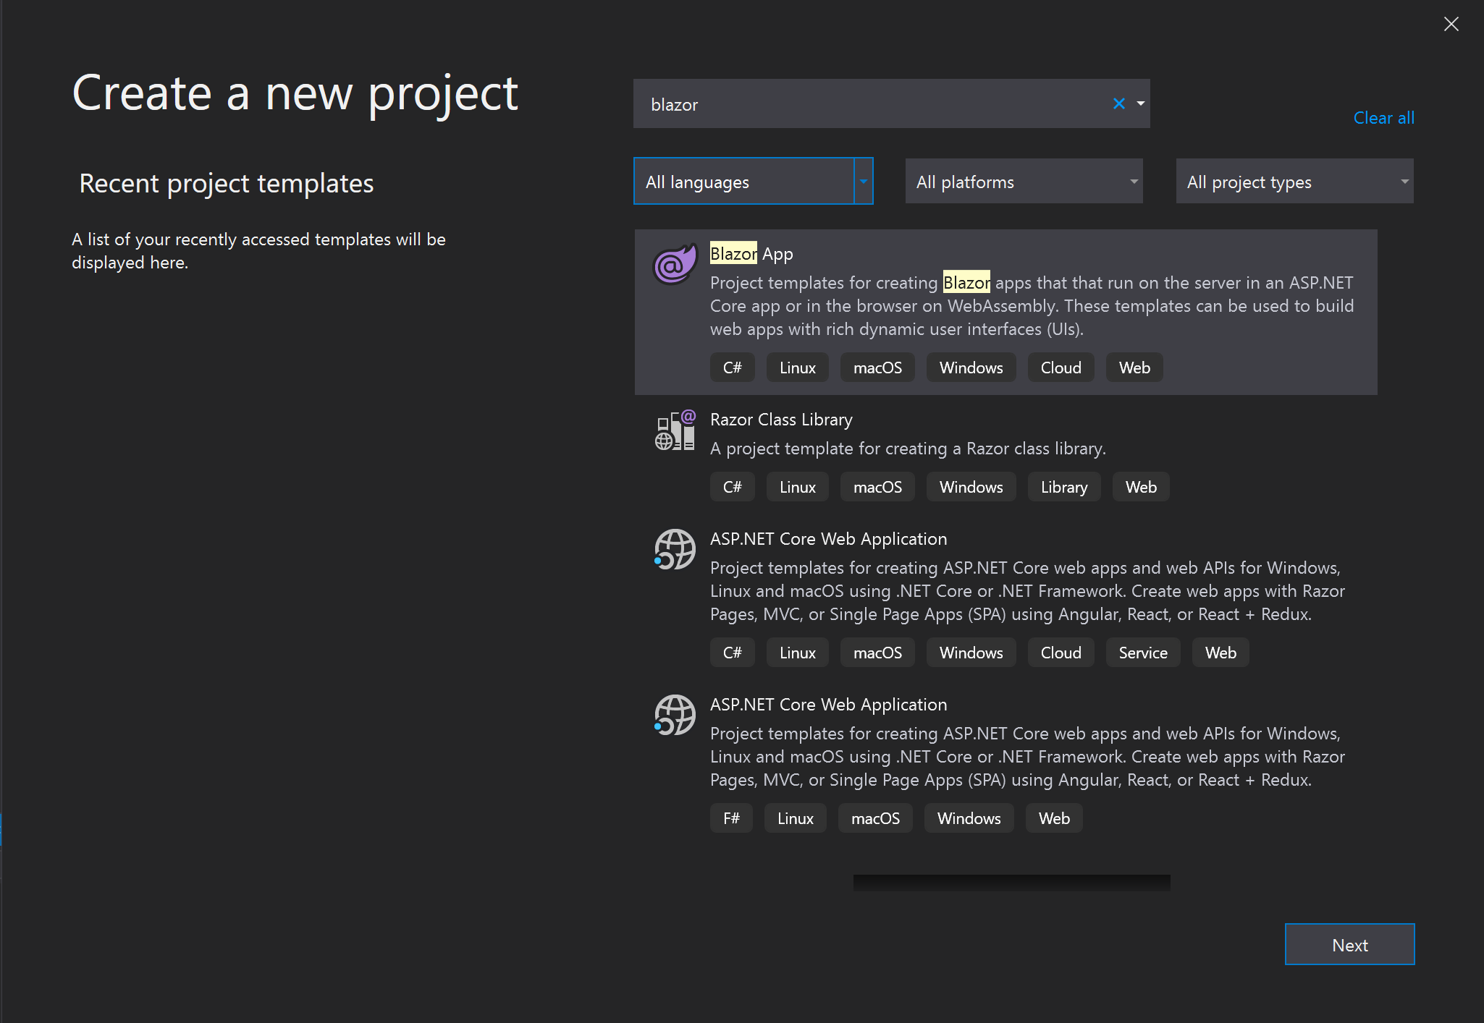

Slide 14
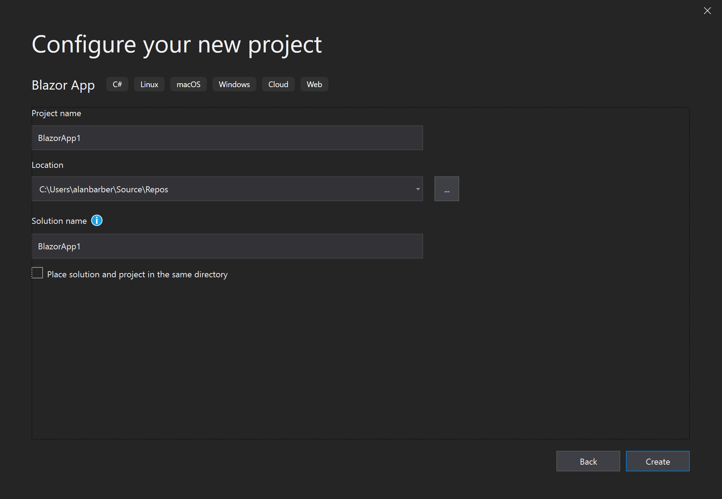

Slide 15
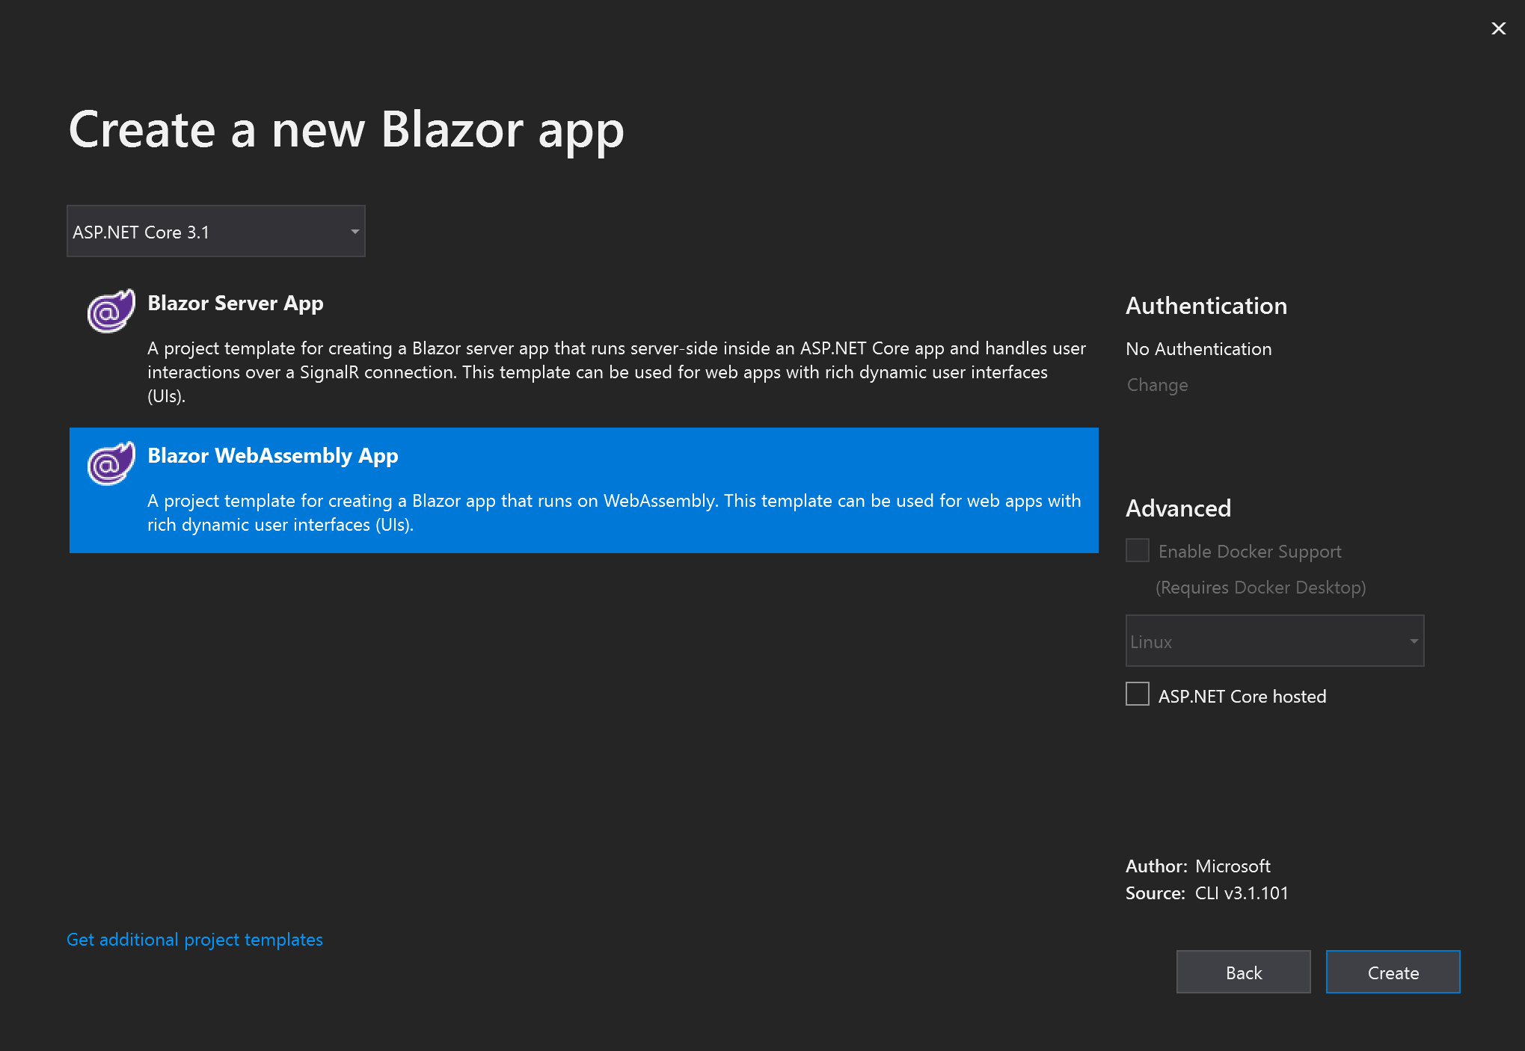

Slide 16
Components

Slide 17
Components
Component is a combination of C#(razor) and HTML markup. A component in Blazor is formally referred to as a Razor component.
A component's name must start with an uppercase character. For example, MyCoolComponent.razor is valid, and myCoolComponent.razor is invalid.
The UI for a component is defined using HTML. Dynamic rendering logic (for example, loops, conditionals, expressions) is added using an embedded C# syntax called Razor. When an app is compiled, the HTML markup and C# rendering logic are converted into a component class. The name of the generated class matches the name of the file.
Members of the component class are defined in an @code block. In the @code block, component state (properties, fields) is specified with methods for event handling or for defining other component logic.
More than one @code block is permissible.

Slide 18
Components
<h1 style="font-style:@_headingFontStyle">@_headingText</h1>
@code {
private string _headingFontStyle = "italic";
private string _headingText = "Put on your new Blazor!";
}

Slide 19
Components – With Parameter(s)
<h1>@Title</h1>
@code {
[Parameter]
public string Title { get; set; }
}

Slide 20
Pages

Slide 21
Pages
A page just like a layout is just a special type of component.
To make a component into a page:
Place a @Page property at the top of the component

Slide 22
Pages
@page "/"
<h1>Hello, world!</h1>
Welcome to your new app.
<MyComponent Title="How is Blazor working for you?"/>

Slide 23
Pages – With Parameters
@page "/user/{Id:int}"
<h1>Hello, User #@Id!</h1>
@code
{
[Parameter]
public int Id { get; set; }
}

Slide 24
Forms and validation

Slide 25
Forms and validation
Forms and validation are supported in Blazor using data annotations.

Slide 26
Forms and validation – model
using System.ComponentModel.DataAnnotations;
public class ExampleModel {
[Required]
[StringLength(10, ErrorMessage = "Name is too long.")]
public string Name { get; set; }
}

Slide 27
Forms and validation – form component
<EditForm Model="@exampleModel“ OnValidSubmit="@HandleValidSubmit">
<DataAnnotationsValidator />
<ValidationSummary />
<InputText id="name" @bind-Value="@exampleModel.Name" />
<button type="submit">Submit</button>
</EditForm>
@code {
private ExampleModel exampleModel = new ExampleModel();
private void HandleValidSubmit() {
Console.WriteLine("OnValidSubmit");
}
}

Slide 28
Forms and validation build-in input components
Input component | Rendered as HTML
InputText | <input>
InputTextArea | <textarea>
InputSelect | <select>
InputNumber | <input type="number">
InputCheckbox | <input type="checkbox">
InputDate | <input type="date">

Slide 29
Now SignalR

Slide 30

What is signalR?
SignalR is a library for ASP.NET developers that simplifies the process of adding real-time web functionality to applications.
It has been built on top of WebSockets.
SignalR can be used to add any sort of "real-time" web functionality to your ASP.NET application. While chat is often used as an example.

Slide 31
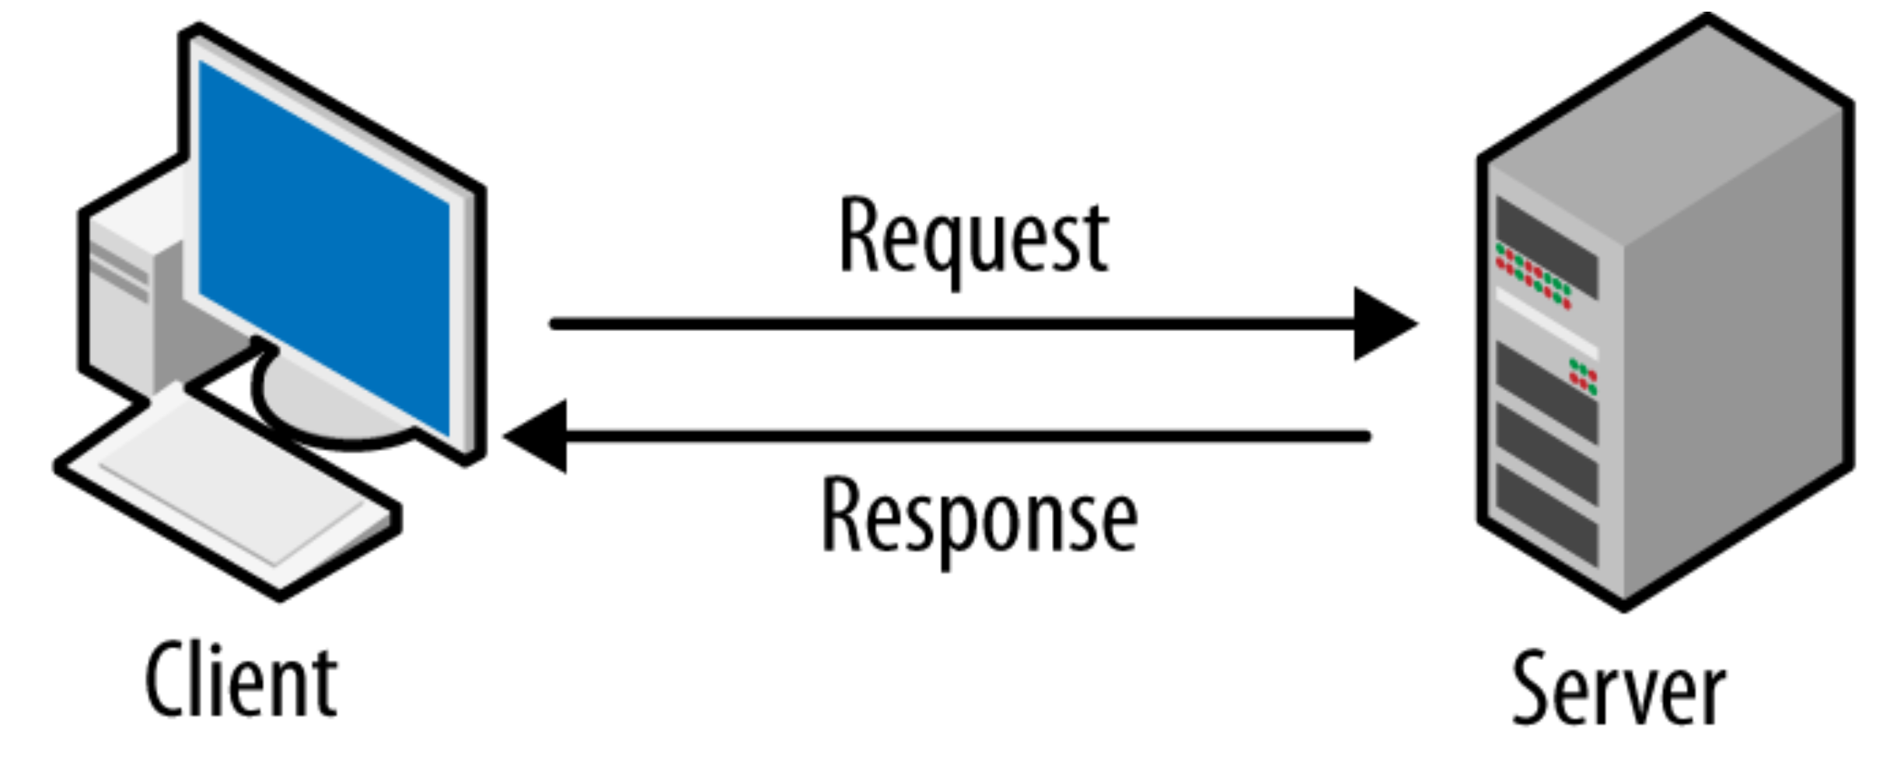
How Signalr works?

Slide 32
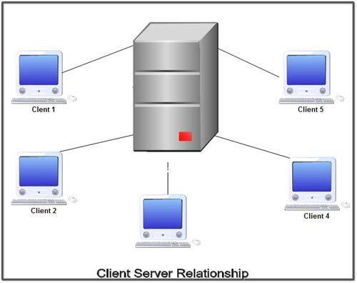

Slide 33
Establishing Full Duplex Communication
Server
Client 1
Client 3
Client 2
SignalR gives us the ability to have server code push content to connected clients instantly as it becomes available, rather than server waiting for a client to request for new data.

Slide 34
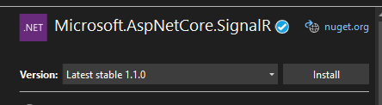
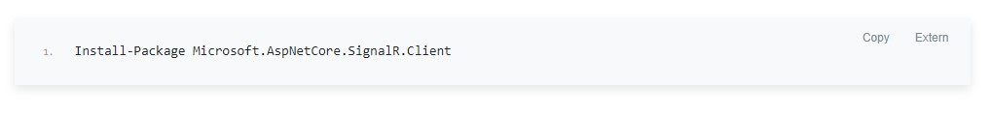
To be able to use signalr we need to install SignalR nuget pakage on the server side as well as on the client side

Slide 35

Time For Demo

Slide 36
Questions

Slide 37

Thank you!

