Slide 1
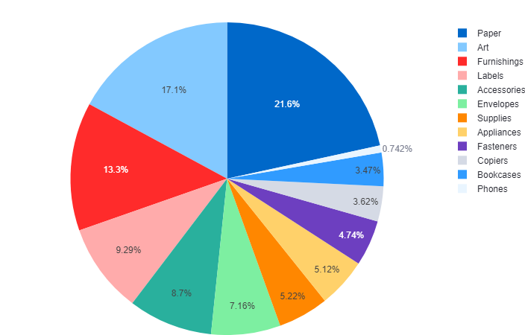
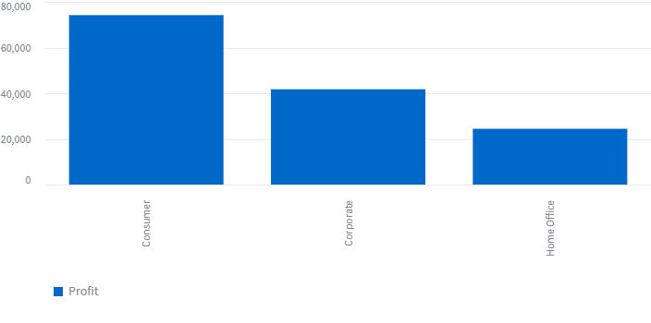
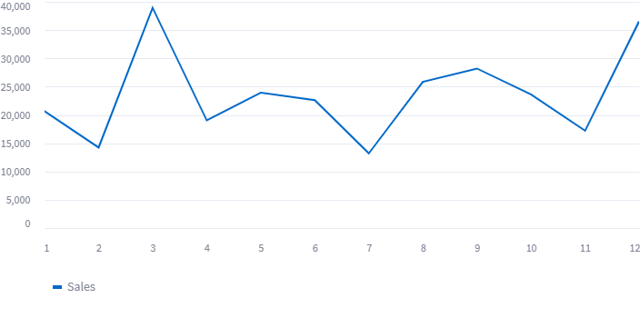
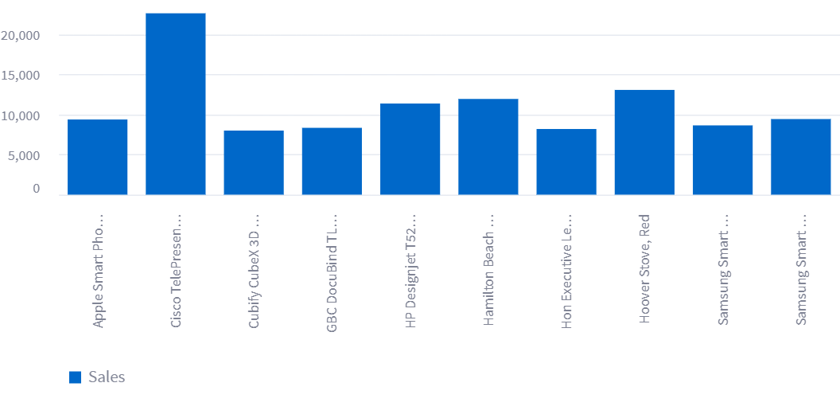
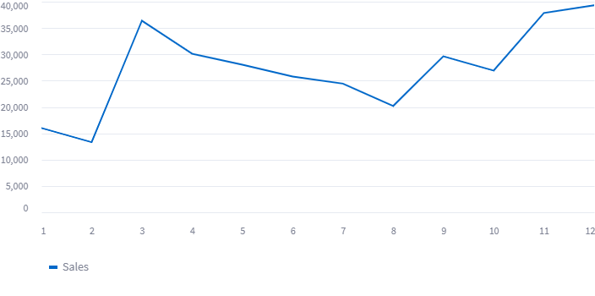
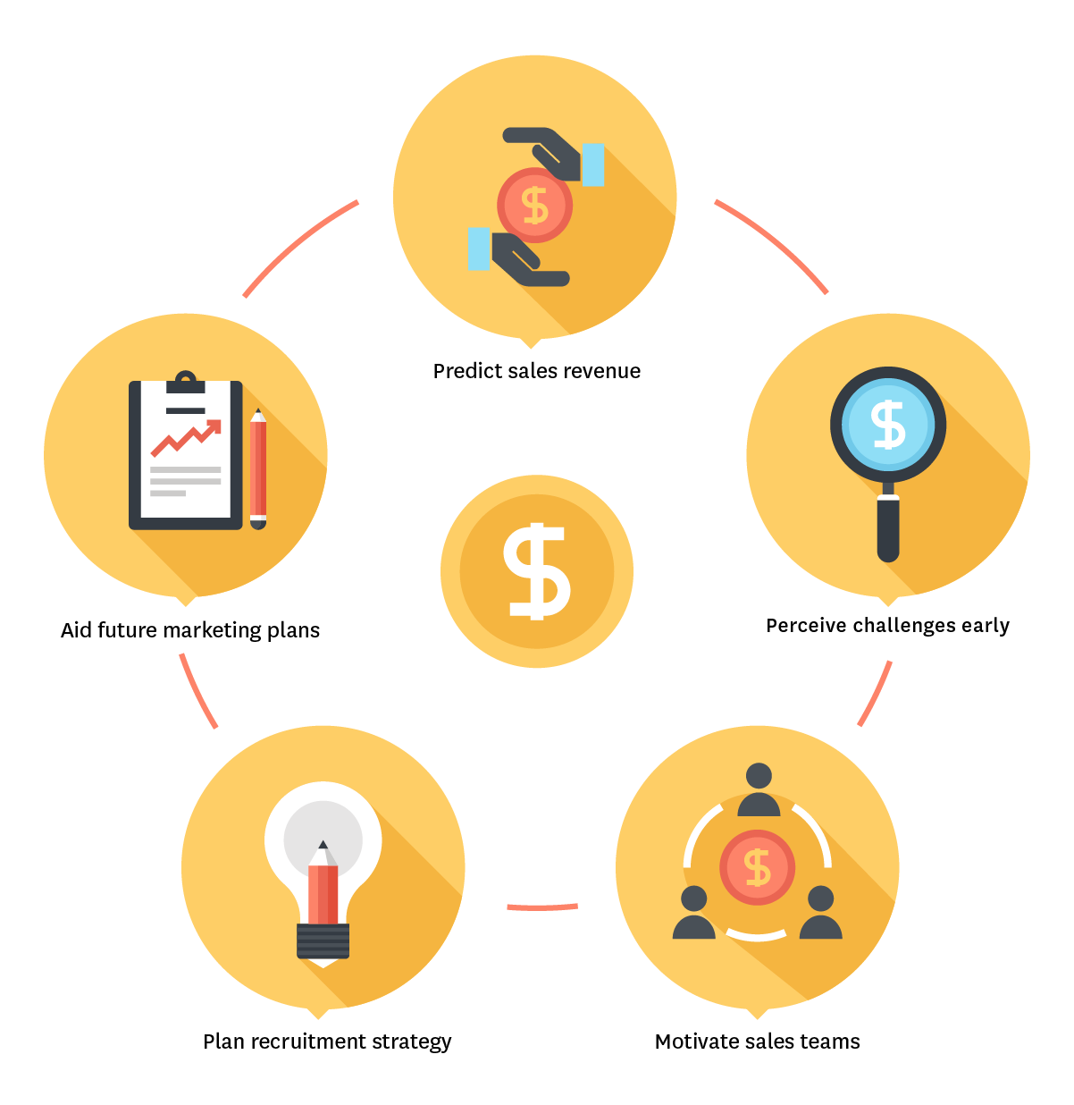
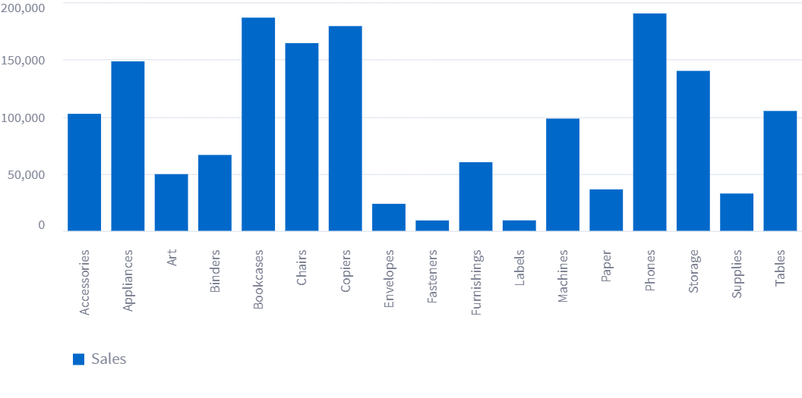
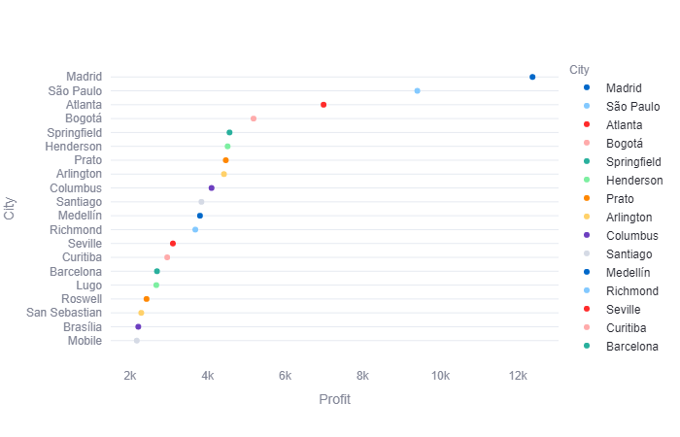
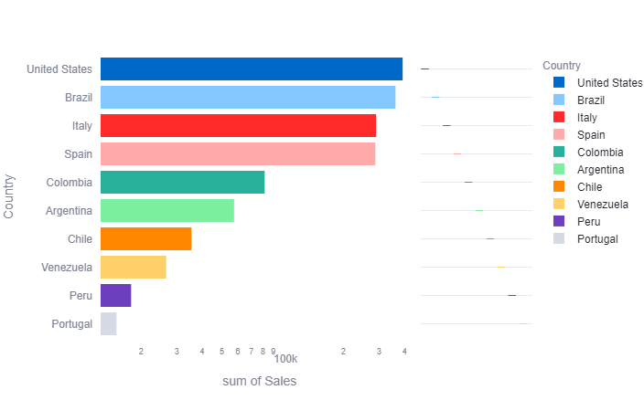
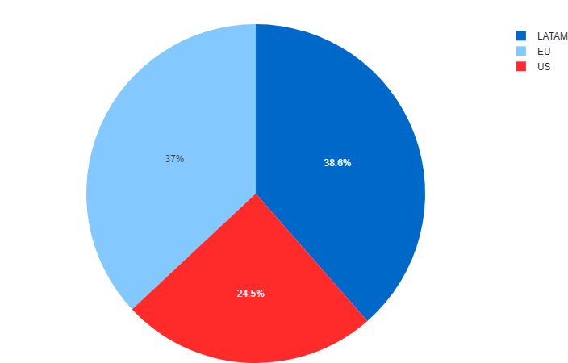
Insightful Sales Projections: A Dynamic Forecast Dashboard
Maximizing Revenue through Strategic Product Bundling and Targeted Customer Segmentation By Paramkumar Patel, Ritu Barot & Shaily Sheth
Purchase History | Recommendation 1 | Recommendation 2 | List
"While you Were Out" Message Book, One Form per Page | Sauder Library with Doors, Metal | Deflect-O Door Stop, Black | ["Sauder Library with Doors, Metal","Deflect-O Door Stop, Black"]
#10 Self-Seal White Envelopes | Canon PC-428 Personal Copier | Hamilton Beach Microwave, White | ["Canon PC-428 Personal Copier","Hamilton Beach Microwave, White"]
#10 White Business Envelopes,4 1/8 x 9 1/2 | Maxell 4.7GB DVD-R 5/Pack | Ampad Phone Message Book, Recycled, 400 Message Capacity, 5 ¾ x 11 | ["Maxell 4.7GB DVD-R 5/Pack","Ampad Phone Message Book, Recycled, 400 Message Capacity, 5 ¾ x 11"]
#10- 4 1/8" x 9 1/2" Recycled Envelopes | DataProducts Ampli Magnifier Task Lamp, Black, | Hewlett Wireless Fax, High-Speed | ["DataProducts Ampli Magnifier Task Lamp, Black,","Hewlett Wireless Fax, High-Speed"]
#10- 4 1/8" x 9 1/2" Security-Tint Envelopes | Novimex Color Coded Labels, Adjustable | Logitech Numeric Keypad, Programmable | ["Novimex Color Coded Labels, Adjustable","Logitech Numeric Keypad, Programmable"]
Forecasting Future Sales Revenue: When it comes to retail sales, it is difficult to compete with the market and the number of options available for customers to purchase from at a very competitive price. Predicting the sales for the South region for all the customer segments will help us narrow down the targeted group and what categories they are willing to buy.
These graphs show south region sales segmented by month. So, organizations can build their strategies for dealing with issues by assessing these trends. This will assist them in making decisions about the budget, hiring, and production for a specific month.
The bar chart of products below and the table above, which displays suggested product bundles and a list of products based on purchasing history in the south region, are intended to support upcoming marketing strategies.
Monthly revenue generated for the year 2011
Monthly revenue generated for the year 2012
Building a Winning Sales Team: Developing an Effective Recruitment Strategy to Drive Revenue Growth for Every Country and City is a Major Target Goal. Every market type and country will have its team to drive revenue and generate gross margin. Based on the history of country-wise sales and profit generated by the city growth of the sales team, a conclusion can be drawn.
The bar chart showing product sales by subcategory will make it easier to comprehend the sales statistics in the south region and will assist to inspire the sales team. Fasteners and labels should be targeted because they are the least popular sub-categories which can boost sales. In addition, the pie chart can be used to comprehend the sales by market and inspire the team to concentrate on markets other than the three shown in the graph.
Reference : https://www.freshworks.com/crm/sales/sales-forecast/

