Slide 1
Americans are far gloomier
than the economy explains
Five questions about the 2026 sentiment gap — and one practical implication for forecasting and risk management.
AI Applications in Finance · analysis cutoff 2026-10-16 · no post-election data
Notes:
One argument in seven minutes, built as five questions.
Here is the shape. First, what we were asked. Second, what we found. Third,
which of the three candidate explanations the evidence supports. Fourth, why
the result that did not appear is the most useful one in the project. And
fifth, what any of you should actually do differently on Monday.
The one thing to carry out of the room is a decision rule about broken models.
I will give it on the last slide, and everything before it is the evidence
that earns it.

Slide 2
Q1. What exactly were we asked to find out?
Consumer sentiment sits near record lows while unemployment and inflation look ordinary. Something has to give: either the indicators, the people, or the measurement.
Whether US consumers are more pessimistic than the economy justifies — and if so, why.
Three candidate explanations. The whole task is to tell them apart.
A Real economic pressure that the headline indicators miss.
B A distorted picture of the economy: selection, framing, negativity.
C Measurement: the survey changed, or our own model is too simple.
The brief forbids three assumptions: that pessimism is irrational, that negative coverage is biased coverage, and that coverage causes the mood. All three are hypotheses to test, and that is why a null result counts here.
1 / 5
Notes:
The question is not whether people feel bad. We know they do. The question is
whether the economy explains it, and if not, what does.
Three candidates. A: the indicators miss something real. B: people see a
distorted picture. C: the measuring instrument changed, or our model is too
simple.
Read the orange line out loud, because it is the discipline of the whole
project. We were told not to assume pessimism is irrational, not to assume
negative coverage is biased, and not to assume coverage causes the mood. Those
are the three comfortable assumptions, and all three are testable. Pre-registering
that is what makes the later null worth anything.

Slide 3
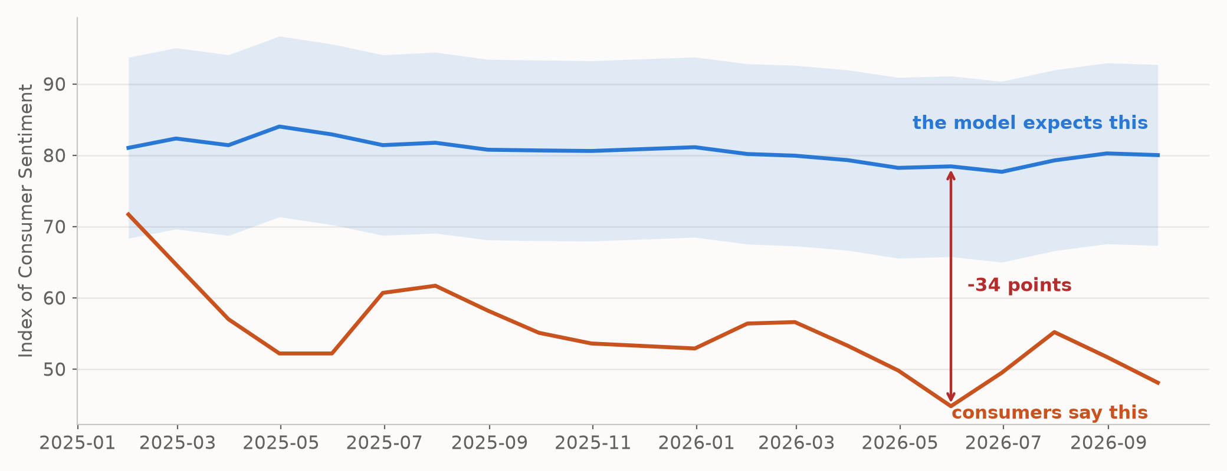
Q2. How big is the gap, and how do we know it is real?
Fit the three standard indicators on 2010 to 2024. Then ask the fitted model about months it has never seen. The shaded band is the model's own 95% range.
A model that explains fifteen years of sentiment misses 2026 by 25 points, always downward.
76%
of sentiment explained,
2010 to 2024
-25
average miss, index points,
2025 to 2026
19 of 20
months outside the model's
own 95% interval
2 / 5
Notes:
Fit on fifteen years, 2010 to 2024, using the three indicators everyone uses:
unemployment, inflation, GDP growth. It works. It explains about three quarters
of the variation, and inflation matters roughly two and a half times as much as
unemployment, which is worth knowing on its own.
Then show it months it has never seen. In 2026-05 it expects
78 and the survey comes in at 45.
That is the red arrow.
But the number that matters is the bottom one. A ninety five per cent interval
is supposed to be breached about one month in twenty. Ours is breached
19 times in 20, every single time downward. That
is not an unlucky run. That is a missing variable, and the next slide asks
which one.

Slide 4
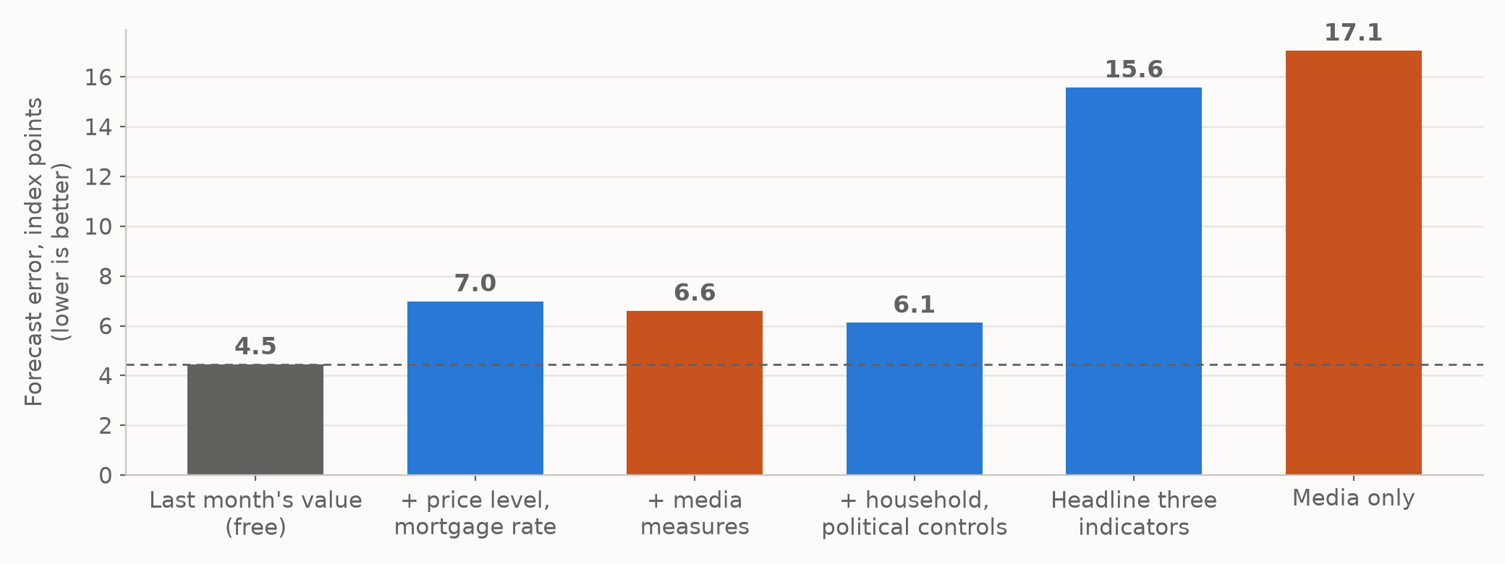
Q3. Which of the three explanations does the evidence support?
Judge each one by whether it helps predict a month the model has not seen, not by whether it raises R-squared. More regressors always raise R-squared.
The cost of money, mostly. Not the news.
A Mostly right.
Adding the price level and the
mortgage rate absorbs 27.6%
of the gap. The mortgage rate
does the work.
C Partly, and smaller.
A real break at the survey's
method change, but an
independent survey is gloomy
too.
B Fails.
The attractive story did not
survive its own test.
Inflation falling is news about a RATE. A household pays a LEVEL. Prices stopped rising fast; they did not come down.
3 / 5
Notes:
The chart is the honest version of model comparison: forecast errors on months
each model had never seen.
Three things in it. Adding the price level and the mortgage rate cuts the error
by more than half, which is candidate A. Adding the media measures on top
changes almost nothing. And the grey bar on the left is just last month's value
with no model at all, and nothing beats it. If I showed you only R-squared,
every model would look better than it is.
Then the green line, which is the intuition for A. Inflation falling is a
statement about a rate. A household pays a level. Prices stopped rising
quickly; they never came down. A smaller increase on an already high price is
not relief, and our indicators report the rate because a rate is what policy
targets.

Slide 5
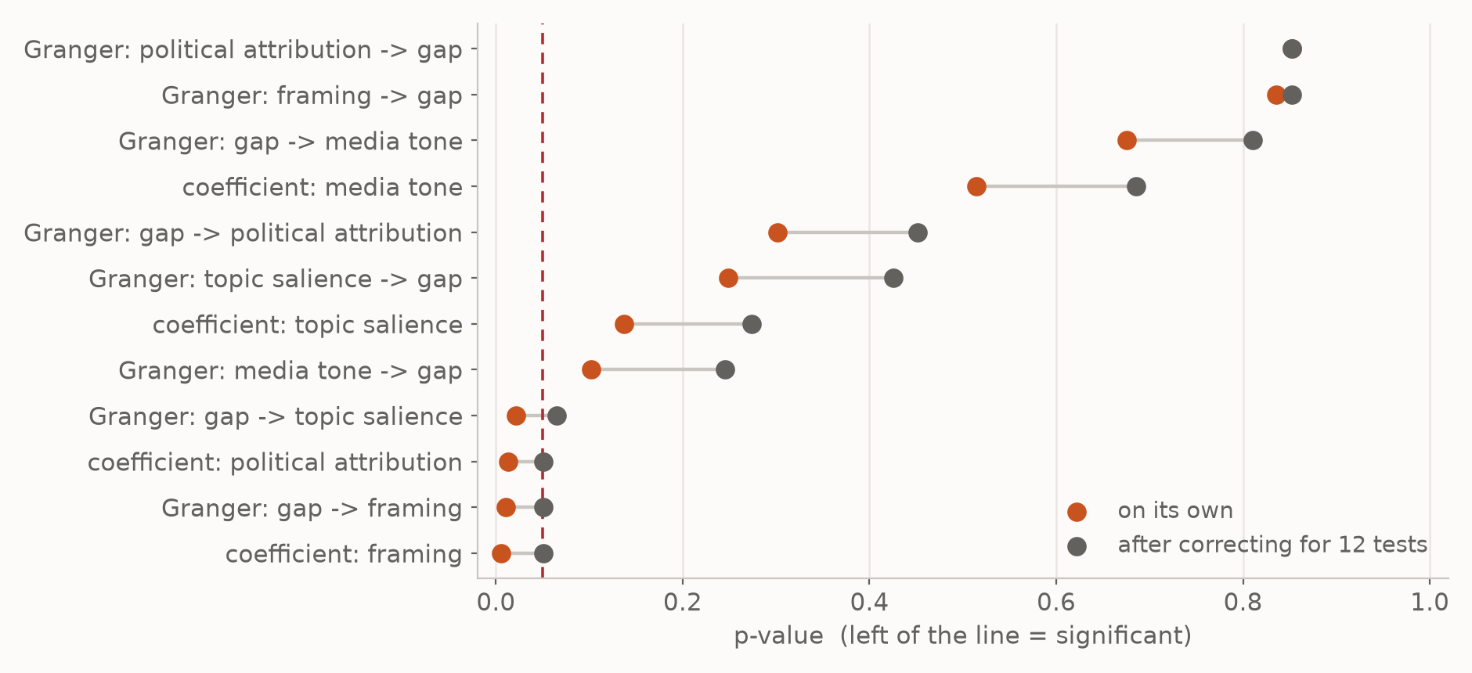
Q4. Why is “the media explanation fails” a finding and not a dead end?
We ran 12 tests on the media block. Run enough tests and something always reaches 5% by luck, so the chart corrects for how many we ran.
Because the conditions that would kill it were fixed before the corpus existed — and they held.
4 of 12 tests reach 5% raw.
0 survive the correction.
The media block did not improve a
forecast of an unseen month.
Both coefficients died in 24 of 24
specification variants once
household controls entered.
The only timing signal runs
BACKWARDS: mood first,
coverage after.
The sharpest finding is about the instrument, not the economy: FinBERT changes its verdict on 5.8% of byte-identical texts when only the outlet's name changes, where the word list changes on 0%. A classifier that reads the label would have manufactured the bias we went looking for.
4 / 5
Notes:
Four reasons the null is solid.
Two of the four media measures did reach five per cent. Correct for how many
tests you ran and none survives. We declared that family in advance and counted
every test, including the boring directions: a narrower family would have let
two results through, and I am telling you that rather than choosing the family
that flatters us.
It also fails to forecast, it dies in all twenty four specification variants
once household controls are present, and the only timing signal points the
wrong way — mood first, coverage after.
Then the red paragraph, which is the finding I would publish. Swap only the
outlet's name in front of an identical sentence and the neural classifier
changes its answer on one text in seventeen. The word list never moves. That
model would have produced the result we were hunting for, and we would not have
known.

Slide 6
Q5. So what should I do differently with a model that misses?
This generalises past consumer sentiment. Any model you own will start missing. The question is how you tell a drifted level from a missing variable.
Treat a one-sided breach as a specification failure. Rebuild — do not recalibrate.
Recalibrate when
errors are large but BALANCED.
The relationship holds and the
level has drifted.
Rebuild when
errors are ONE-SIDED and outside
the interval. Something the model
cannot see is moving the outcome.
Re-fit this model on the new level and it tracks the new level beautifully — and keeps exactly the blindness that caused the breach. You have silenced the alarm, not put out the fire.
Then diagnose before you fix. Unmeasured pressure: add the level variables — cumulative prices, the mortgage rate, debt service. A changed instrument: re-base the series before it enters anything. An information driver: no macro variable helps, and a text feed becomes necessary.
5 / 5
Notes:
This is the slide to remember, and it generalises past consumer sentiment.
When your model misses, the instinct is to re-fit it. Sometimes that is right:
if the errors are large but balanced, the relationship still holds and the
level has drifted. Recalibrate.
But if the errors are one-sided and outside the interval, a variable that
matters is missing, and re-fitting is the expensive mistake. The re-fitted model
will track the new level beautifully and carry exactly the blindness that caused
the breach. You have silenced the alarm and left the fire.
And diagnose before you fix, because the three candidates need three different
fixes and the wrong fix ships with new confidence attached. Unmeasured
pressure: add the level variables. Changed instrument: re-base the series
before it enters anything. Information environment: no macro variable will
help you.

Slide 7
In one line
A one-sided breach of a prediction interval is a specification
failure, not a run of bad luck.
The gap is real and large. The cost of money explains a good part of it. The survey's method explains a smaller part. The tone of the news explains none of it, on four separate tests fixed in advance.
Knowing where not to spend is worth as much as knowing where to spend.
No exposure data, so no causal claim about readers. Limits are stated in the report, not buried.
Notes:
One line, then I stop.
A one-sided breach of a prediction interval is a specification failure, not a
run of bad luck. Rebuild rather than recalibrate, and diagnose before you
choose the fix.
The summary underneath: the gap is real and large, the cost of money explains a
good part of it, the survey's method a smaller part, and the tone of the news
none of it on four separate pre-registered tests.
And the grey line matters. We have no exposure data at all, so nothing here is
a causal claim about what any reader read. That limit is in the report rather
than buried, which is the only reason the rest of it is worth your trust.
Questions.

