Slide 1

Project Title - Car Data Analysis using Python
AICTE STU ID :STU684037216b0e91749038881
NAME : Parmanand Singh

Slide 2

PROBLEM STATEMENT
The CarDekho dataset contains information about used vehicles, but raw data is difficult to understand and analyze. This project was created to convert the raw vehicle data into meaningful insights about pricing, depreciation, ownership, and resale trends.

Slide 3
PROJECT DESCRIPTION
This project analyzes the CarDekho used vehicle dataset using Python, Pandas, NumPy, Matplotlib, and Seaborn. A total of 25 analytical questions were solved by performing data filtering, grouping, statistical analysis, and visualization to understand vehicle resale trends and depreciation.

Slide 4

WHO ARE THE END USERS?
Used Car Dealers – To understand vehicle resale prices and depreciation.
Individual Buyers – To compare vehicles before purchasing a used vehicle.
Individual Sellers – To estimate a fair selling price for their vehicle.
Data Analysts – To analyze market trends and generate business insights.

Slide 5

TECHNOLOGY USED
Programming Language : Python
Libraries : Pandas, NumPy
Visualization : Matplotlib, Seaborn
IDE : VS Code + Jupyter Notebook

Slide 6
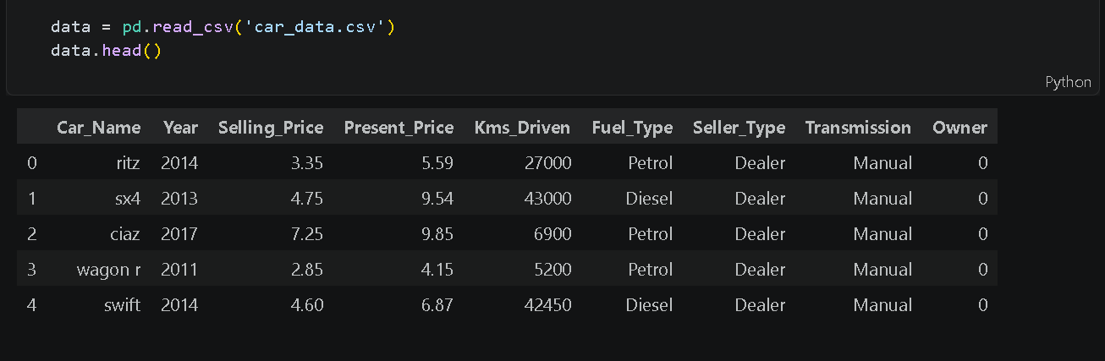
RESULTS
Dataset Loading
The CarDekho CSV file was successfully imported into a Pandas DataFrame, and the first five records were displayed using head() .
https://github.com/paramsinghania782-coder/Car-Data-Analysis.git

Slide 7
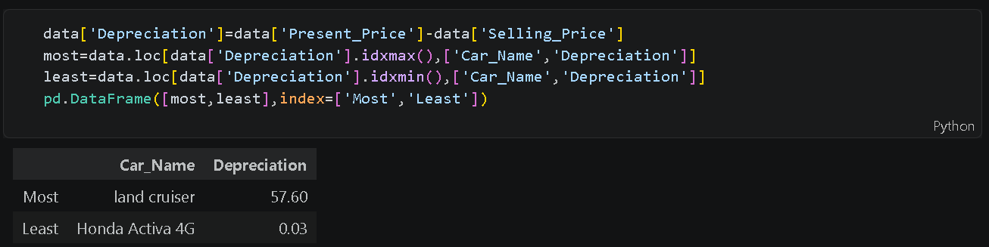
2. Depreciation Analysis
Calculated vehicle depreciation using Present Price – Selling Price and Identified the most and least depreciated vehicles.

Slide 8
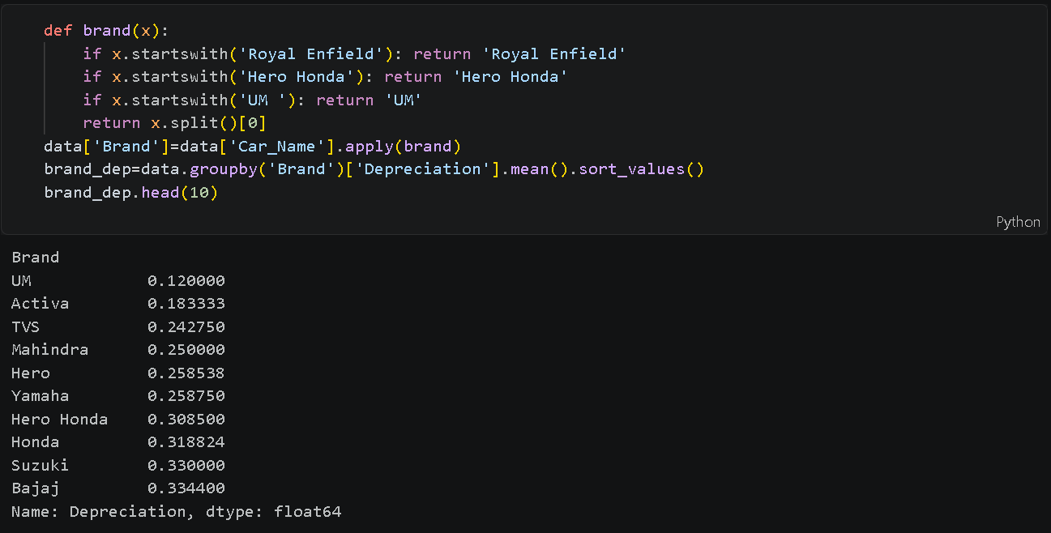
3. Brand-wise Analysis
Used groupby() to calculate the average depreciation for each vehicle brand and compare resale performance.

Slide 9
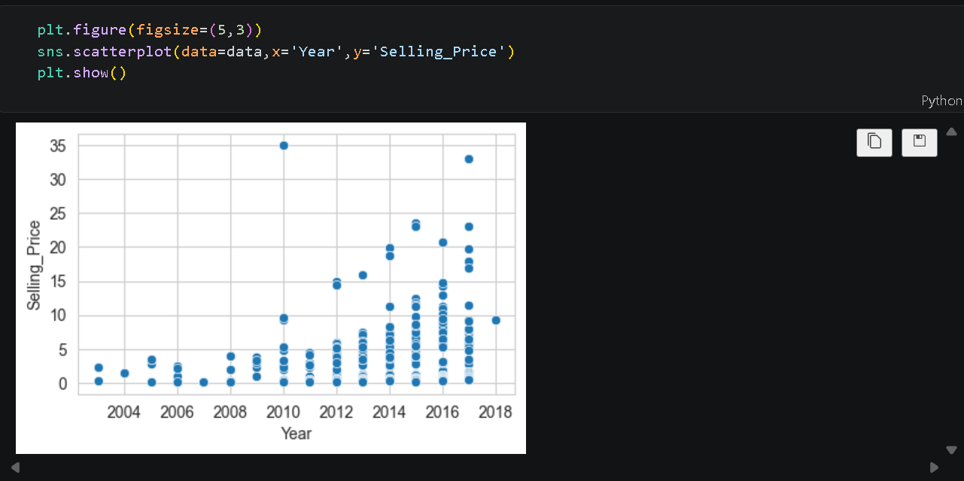
4. Age vs Selling Price Visualization
The scatter plot shows that newer vehicles generally have higher selling prices, while older vehicles tend to have lower resale values.

Slide 10
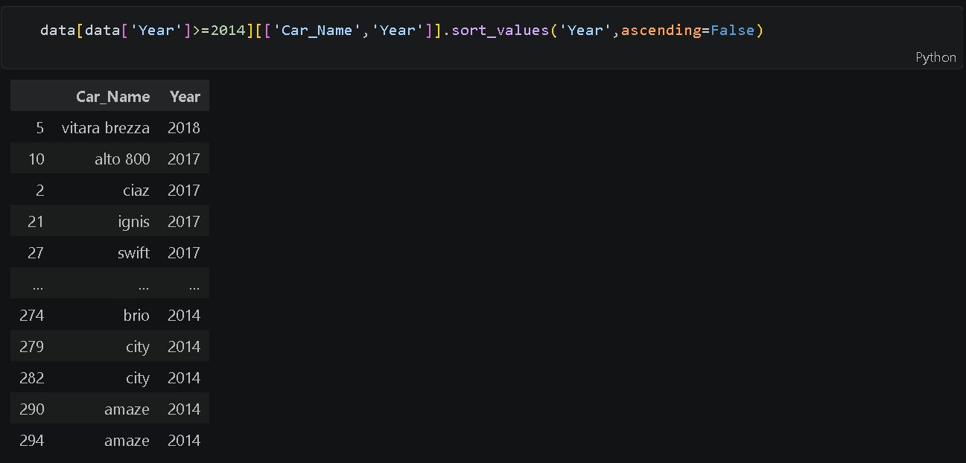
5. Newest Vehicles (2014+)
Filtered the dataset to display vehicles manufactured in 2014 and later, sorted by year in descending order.

Slide 11
Thank you
.

