Slide 1
AI26501 • MODERN AI ASSIGNMENTS • SP-2026
Robustness of AI-Text Detection
Under Text Editing and Paraphrasing
Assignment 16 | Group 16
Extended evaluation: verified light edits, T5 paraphrases,
and a length-matched truncation control
Revised 12 October 2026 • Add presenter names before submission

Slide 2
2. Problem and research question
Core question
Why it matters
How much does AI-text detection change when held-out AI passages are edited, paraphrased, or shortened?
False positives can mislabel human writing. False negatives can let AI-origin text pass undetected. A detector score is not proof of authorship.
300
5
600
paired topics
AI conditions
texts per condition
AI26501 • Assignment 16 • Group 16
2

Slide 3
3. Dataset and leakage control
HC3 prepared subset
Split design
60,955 training passages
15,157 test passages
17,528 training topics • 4,383 held-out topics
GroupShuffleSplit
Test size = 0.20 • random_state = 42
Grouped by topic_id
Observed train/test topic overlap = 0
Paired sample: 300 held-out topics. Each condition uses the same 300 human controls plus 300 AI texts. Source distribution is imbalanced; Reddit ELI5 dominates.
AI26501 • Assignment 16 • Group 16
3

Slide 4
4. Conditions and controls
Each condition: 300 human controls + 300 AI passages
Original AI
Unchanged held-out AI passage
Legacy edit
Phrase-removal function; changed 0/300 passages
Verified light edit
Changed 104/300 passages; mean length ratio 0.999
T5 paraphrase
Generated rewrite; mean length ratio 0.561
Truncation control
Original prefix truncated to paraphrase word count; one shorter original remains unchanged
AI26501 • Assignment 16 • Group 16
4

Slide 5
5. Detector and evaluation protocol
1
Prepare HC3 and group topics
2
Train TF–IDF word uni/bi-grams + LinearSVC on original training text
3
Apply each edit to held-out AI texts only
4
Reuse identical human controls across conditions
5
Report metrics, Wilson CIs, and paired exact McNemar tests
AI26501 • Assignment 16 • Group 16
5

Slide 6
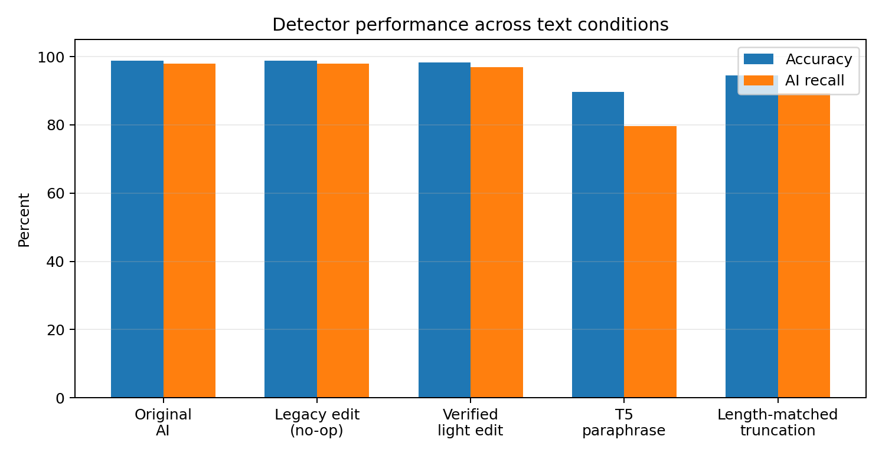
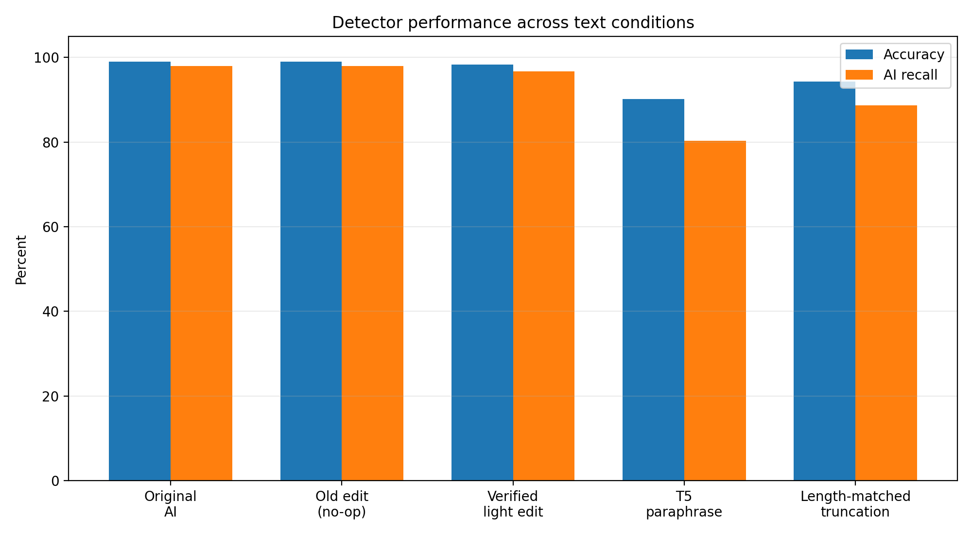
6. Results: overall metrics
Wilson 95% confidence intervals shown in report; paired test results on next slide
AI recall (FPR = 0.33% in every condition)
Original: 98.00%
Verified light edit: 97.00%
T5 paraphrase: 79.67%
Truncation: 89.33%
The legacy edit changed no text and is a no-op diagnostic.
AI26501 • Assignment 16 • Group 16
6

Slide 7
7. Paired changes and statistical tests
Paired comparison | Direction of changes | Exact McNemar p
Original → light edit | 3 detected→missed; 0 reverse | p = 0.250
Original → T5 paraphrase | 57 detected→missed; 2 reverse | p = 6.14e−15
Original → truncation | 26 detected→missed; 0 reverse | p = 2.98e−08
Truncation → T5 paraphrase | 38 detected→missed; 9 reverse | p = 2.49e−05
A paired test assesses prediction changes, not whether paraphrases preserve meaning or whether compression explains all effects.
AI26501 • Assignment 16 • Group 16
7

Slide 8
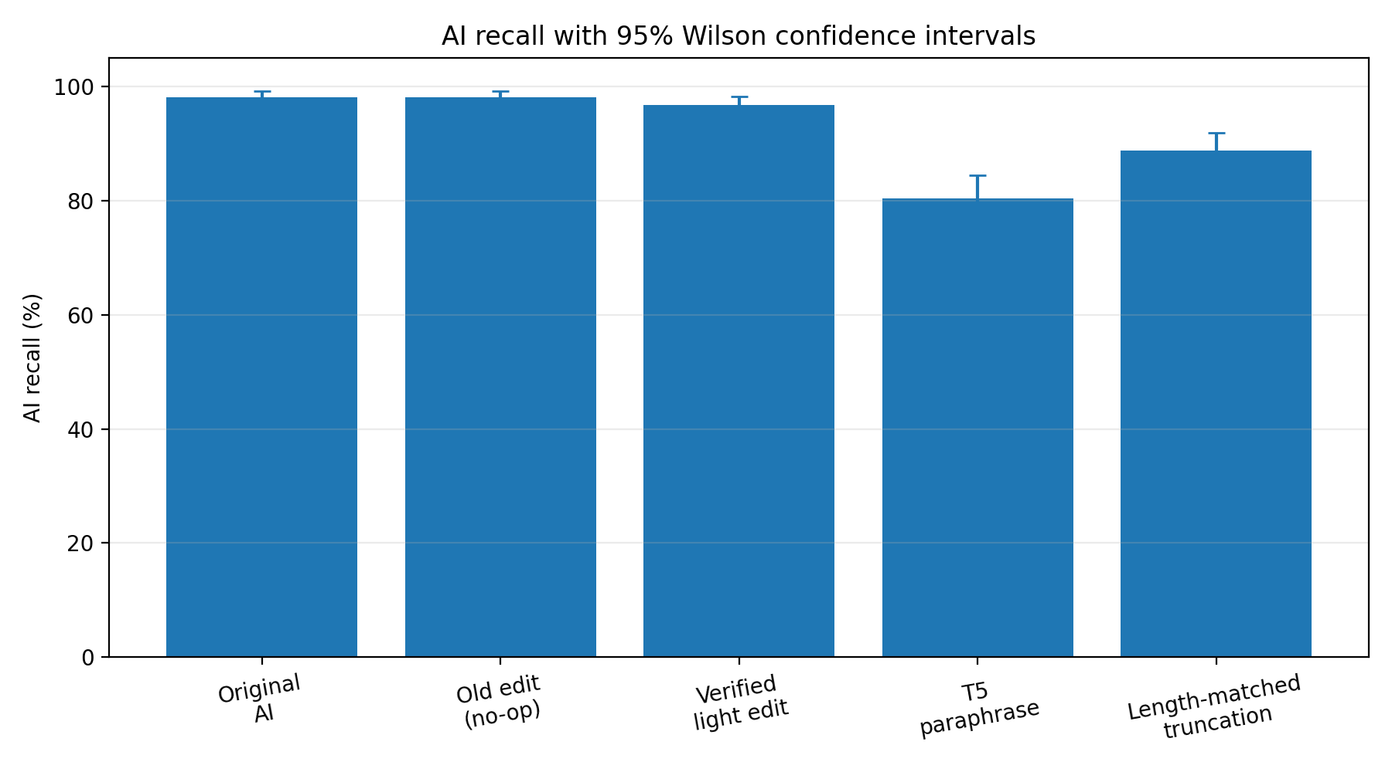
8. Length is a confound
Mean length ratio vs original
Interpretation
T5 paraphrase: 0.561
Truncation control: 0.561
Verified light edit: 0.999
Truncation reduced recall to 89.33%. T5 paraphrases reduced it further to 79.67%. The paraphrase-versus-truncation paired test was significant (p = 2.49e-5), but the experiment does not isolate a pure semantic effect.
AI26501 • Assignment 16 • Group 16
8

Slide 9
9. Supplementary larger-sample light-edit test
All held-out AI passages (n = 4,959)
Human-only held-out group
Original detection: 98.37%
Light-edited detection: 98.02%
17 AI predictions changed
Detection-rate change: −0.34 pp
75/10,198 false positives
FPR = 0.74%
95% Wilson CI ≈ 0.59–0.92%
This supplementary deterministic edit uses a different procedure and sample from the 300-topic paired pilot. Do not merge the estimates.
AI26501 • Assignment 16 • Group 16
9

Slide 10
10. Limitations and conclusion
What the results support
What remains uncertain
• Verified light edit: 104/300 passages changed; recall 97.00%; p = 0.25.
• T5 paraphrase: recall 79.67%, below original and truncation.
• Length/compression contributes to the observed drop.
• Paraphrase meaning preservation
• Generalization beyond HC3 and this detector
• Source imbalance and small subgroups
• Robustness to human edits and other models
Conclusion: report robustness to these specific transformations, not a universal detector capability.
References: HC3 (Guo et al., 2023) • Hugging Face paraphraser model • scikit-learn
AI26501 • Assignment 16 • Group 16
10

