Slide 1
Revolutionizing Educational Assessment Using Bloom’s Taxonomy Bot
Dr. Minakshi Atre, Sarthak Karandikar, Kabeer Ahmed Merchant, Abhijeet Suryawanshi, Heramb Patil

Slide 2
Table of contents
01
03
02
04
Aim
Introduction
Objectives
The Problem

Slide 3
Table of contents
05
07
06
08
The Solution
Demonstration
Methodology
Result Analysis

Slide 4




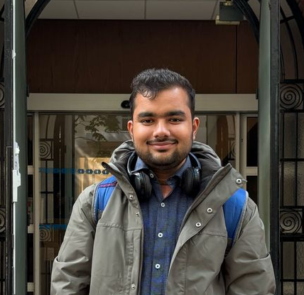
Team
Dr. Minakshi Atre
Sarthak Karandikar
Kabeer Ahmed Merchant
Abhijeet Suryawanshi
Heramb Patil

Slide 5
Aim
To provide a transformative solution to the educators for assessment creation and help them set a balanced Bloom’s Taxonomy based question paper

Slide 6
Objectives
Classify assessment questions into Bloom’s Taxonomy levels.
Automate transformation of questions across Bloom’s levels.
Generate syllabus-aligned assessments using Bloom’s Taxonomy.

Slide 7
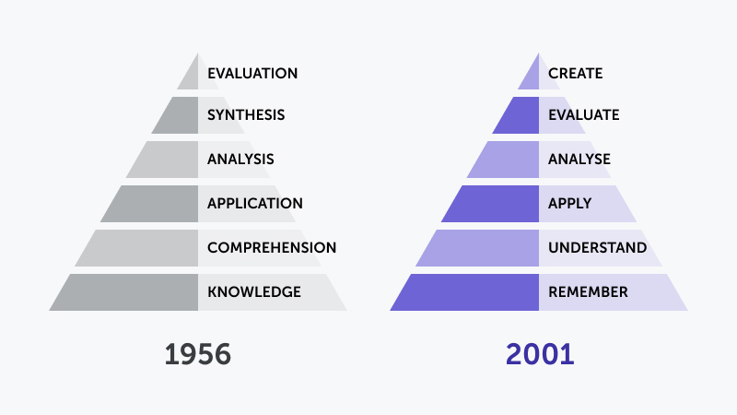
Introduction
Overview of Bloom’s Taxonomy and its role in assessing cognitive skills.
Introduction to the revised Bloom’s Taxonomy by Anderson and Krathwohl (2001).
Role of AI and chatbots (e.g., ChatGPT) in modern education.

Slide 8
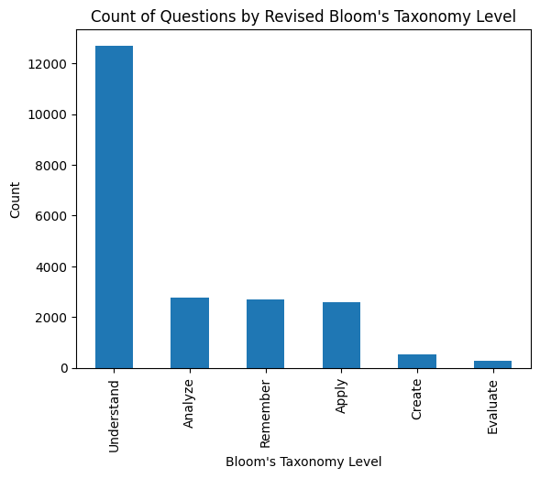
The Problem
Misalignment between syllabi and question papers, promoting rote learning.
Manual creation of balanced question papers is time consuming and fatiguing.
Educators’ naïve approach to Bloom’s Taxonomy levels hinders effective assessment.

Slide 9
The Solution
Classification
Suggestion
Generation
Classifies questions into Bloom’s Taxonomy levels.
Suggests question transformations across cognitive levels.
Generates entire question papers based on syllabus and criteria.

Slide 10
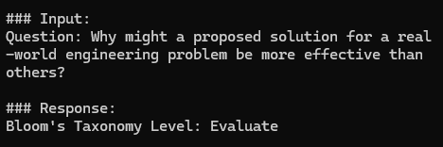
Classification
Classifies questions using NLP and fine-tuned Mistral 7B model.
Trained on a 1200-question dataset with LoRA hyperparameters (rank=16, alpha=16, dropout=0.05)

Slide 11
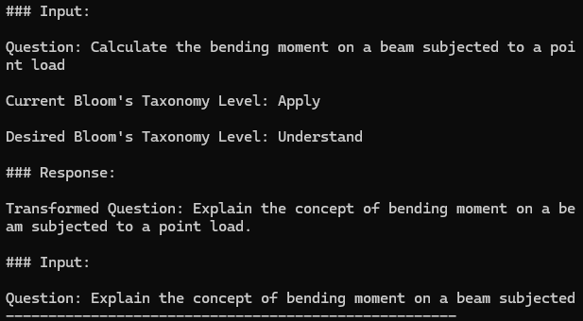
Suggestion
Suggests transformations of questions across Bloom’s levels.
Uses QLoRA fine-tuning on a 600-question dataset.

Slide 12
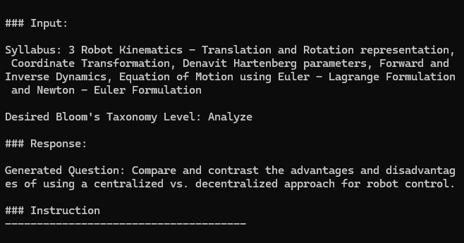
Integrates advanced LLMs for enhanced generation.
Generation
Generates question papers based on syllabus, marking scheme, and desired Bloom’s Score.
Uses an efficient system to combine questions
generated for different syllabus units

Slide 13
Methodology
01
02
Data Collection
Data Analysis
03
04
05
Model Selection
Fine Tuning
Evaluation

Slide 14
Demo

Slide 15
Result Analysis
97% Accuracy
9.5 MOS
8 MOS
Classification
Suggestion
Generation
Evaluated on 600 referential questions; high accuracy achieved with fine-tuned Mistral 7B.
Effectiveness validated by manual labeling from subject matter experts.
Evaluated manually by expert assessment creators

Slide 16
Conclusion
In conclusion, we have implemented Bloomify, a chatbot-based solution for creating assessments that are balanced across various cognitive levels of the Bloom’s Taxonomy.
We conducted a study on real-world assessment data that shows a bias in current assessment methods towards questions that test lower cognitive levels.
We solved this problem by developing 3 features in Bloomify – Classify, Suggest and Generate.
The implementation was tested for real-world application and received a good MOS.
There is also great potential for future enhancements that can be added to this project.

Slide 17
Thanks!
Do you have any questions?
existence.bloomify@gmail.com
+918484008376
https://existence-bloomify.vercel.app/
Please keep this slide for attribution

Slide 18
Challenges
The model needs to have a nuanced understanding of the questions and subject material.
There needs to be better ways of adding the input subject matter that Bloomify will use to create the assessments.
Evaluation of assessments is still manual work and also requires deep understanding of Bloom’s levels to check whether or not the answer meets the cognitive level that the question was trying to assess.

Slide 19
Future Scope
Improvements
Syllabi context can be added using RAG
Tie-ups with universities to preload their syllabi
AI based assessment evaluation

