Slide 1

BACHELOR OF TECHNOLOGY DEPARTMENT OF
ELECTRONICS & TELECOMMUNICATION ENGINEERING
AN PRESENTATION
ON
MACHINE LEARNING AND IOT-BASED SUGAR CANE EYE DETECTION AND CLASSIFICATION SYSTEM
BY
Mr. Gurudatta Jadhav 24
Mr. Shubham Jamdade 27
Mr. Param Pise 57
Under guidance of
Mr. Vinay S. Mandlik
Year 2024-25

Slide 2
Machine Learning and IoT-Based Sugar Cane Eye Detection and Classification System

Slide 3
01
Introduction

Slide 4
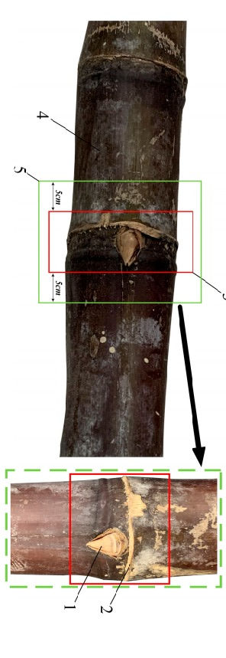
Sugarcane is an essential crop globally, particularly in tropical and subtropical regions.
The productivity and quality of sugarcane crops depend heavily on the planting material, specifically the health and viability of the sugarcane 'eyes' or buds.
Traditionally, the process of selecting viable sugarcane eyes has been done manually by skilled labourers.
Modern technologies such as Machine Learning (ML) and the Internet of Things (IoT) offer promising solutions to these challenges by automating the detection and classification of sugarcane eyes.

Slide 5
Problem Analysis
Challenges of Manual Inspection
Labour-intensive
Time-consuming
Manual inspection requires a significant amount of human labour.
The process of manually identifying viable sugarcane eyes is slow.
Economic Impact
Prone to Errors
Inconsistent results can lead to significant economic losses.
Human error can result in the selection of non-viable or diseased eyes.

Slide 6
Literature Review
Research Insights
Manual Inspection Techniques
Machine Learning in Agriculture
Studies show that manual inspection is prone to inconsistencies due to human error, fatigue, and varying expertise.
CNNs have proven effective in crop disease detection, yield prediction, and soil analysis.
IoT in Precision Agriculture
Research Gaps
IoT devices improve agricultural practices by enabling real-time monitoring and data-driven decision-making.
There is a gap in research focusing on the automation of sugarcane eye detection using ML and IoT.

Slide 7
Proposed Work

Slide 8
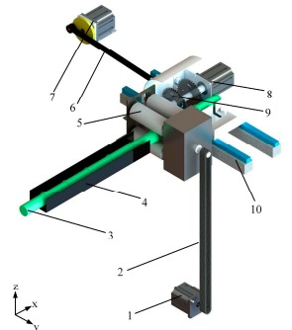
Develop an ML and IoT-based system to automate the detection and classification of sugarcane eyes.
Aim to improve accuracy, reduce manual labour, and provide real-time data and analytics for better decision-making.
IoT-enabled cameras and environmental sensors for data collection, preprocessing pipelines for image segmentation and noise reduction
CNN for image recognition, and a user-friendly interface for real-time monitoring and control.

Slide 9
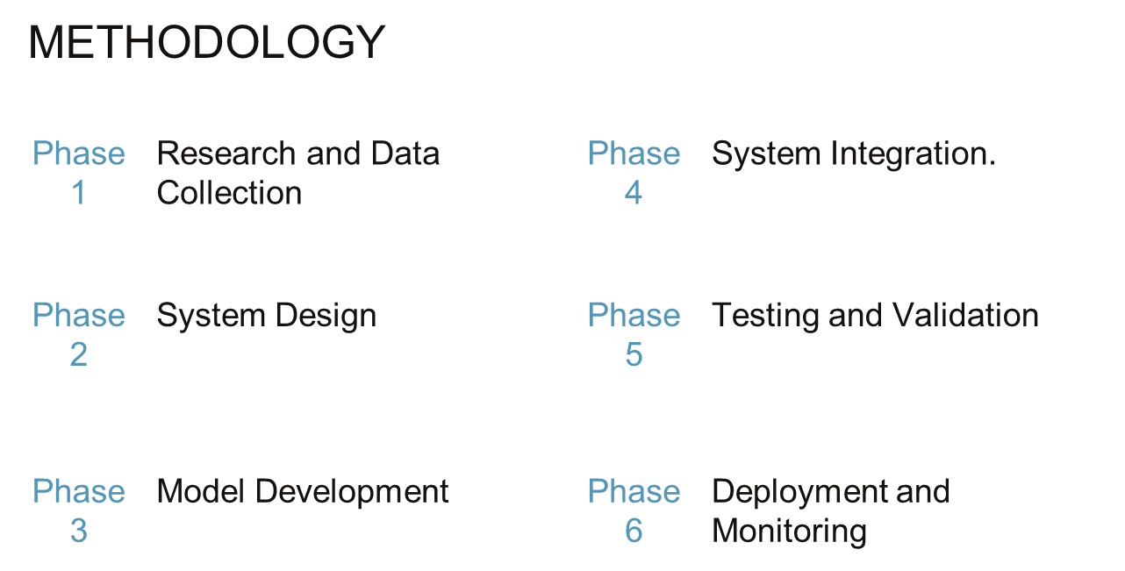

Slide 10
Expected Outcomes
Benefits of the Proposed System
Improved Accuracy
Machine Learning in Agriculture
Significantly better detection and classification of sugarcane eyes.
Reduction in manual labour and associated costs.
Enhanced Decision-Making
Scalability and Adaptability
Real-time data and analytics for optimized planting practices.
Can be deployed in various field sizes and environmental conditions.

Slide 11
System Architecture
Components and Processes
Data Collection
Data Preprocessing
IoT-enabled cameras and environmental sensors capture images and monitor conditions in real-time..
Image segmentation isolates sugarcane eyes, and noise reduction enhances image quality.
Machine Learning Model
IoT Integration
A CNN is trained on labelled images to classify sugarcane eyes as healthy or defective.
Real-time data transmission and remote monitoring capabilities.

Slide 12
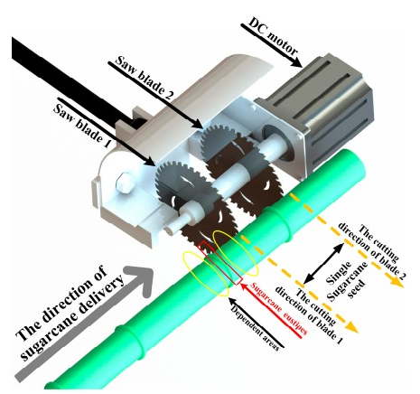
Facilities Required
Hardware Components
IoT-enabled cameras, environmental sensors, edge computing devices, wireless communication modules, central server.
Software Components
Machine learning frameworks, image processing tools, IoT platform, data analysis tools, UI development frameworks.

Slide 13
Thank You

