Slide 1
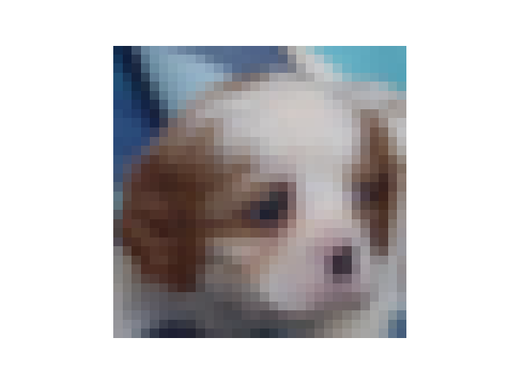
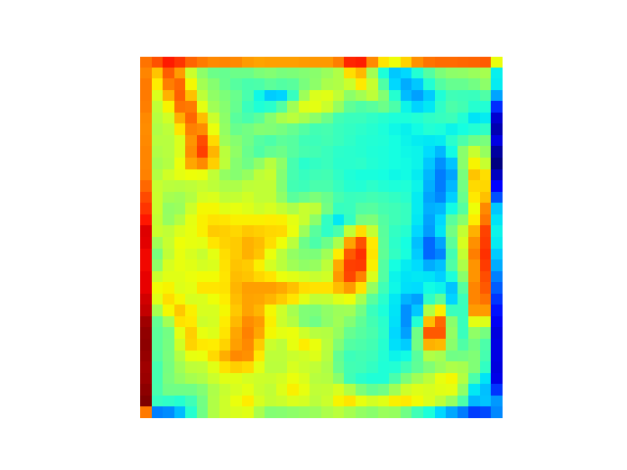
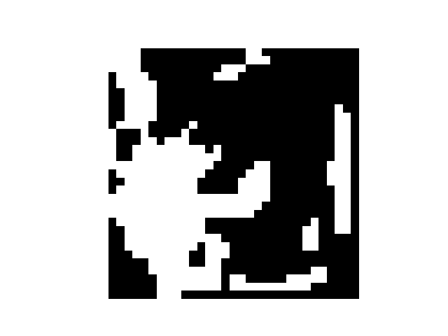
Spiking neuron
Spikes

Slide 2
Spiking neuron
Spikes

Slide 4
Spiking neuron
Spikes

Slide 5
Spiking neuron
Spikes

Slide 6
Spiking neuron
Spikes

Slide 7
Pre-spike
0110
1101
Weight
Matrix
0010

Slide 8
Pre-spike
0110
Spike activation function
1101
Weight
Matrix
Adaptive and Lightweight Surrogate Gradients
0010
Epoch 1
Epoch 2
Epoch k

Slide 9
Pre-spike
Post-spike
0110
Spike activation function
1101
Weight
Matrix
Adaptive and Lightweight Surrogate Gradients
Classification loss
0010
Epoch 1
Epoch 2
Epoch k

Slide 10
Pre-spike
Post-spike
0110
Spike activation function
1101
Weight
Matrix
Adaptive and Lightweight Surrogate Gradients
Classification loss
0010
Epoch 1
Epoch 2
Epoch k

Slide 11
Pre-spike
Post-spike
0110
Spike Activation Function
1101
Weight
Matrix
Adaptive and Lightweight Surrogate Gradients
Classification loss
0010
Epoch 1
Epoch 2
Epoch k
Forward
Backward

Slide 12
Pre-spike
Post-spike
0110
Spike Activation Function
1101
Weight
Matrix
AdaLi Surrogate Gradients
Classification loss
0010
Epoch 1
Epoch 2
Epoch k
Forward
Backward

Slide 13
Pre-spike
Post-spike
0110
Spike Activation Function
1101
Weight
Matrix
AdaLi Surrogate Gradients
Classification loss
0010
Epoch 1
Epoch 2
Epoch k
Forward
Backward

