Slide 1
Paraphrase Detection and Semantic Textual Similarity
Paraphrase Detection and Semantic Textual Similarity
Paraphrase Detection and Semantic Textual Similarity
Paraphrase Detection and Semantic Textual Similarity
MT2025135 – Yash Sameer Parande
MT2025122 – Siddhesh Mahajan
MT2025124 – Suchir Okram
MT2025083 – Parag Piprewar
MT2025111 – Sandiri Rohith

Slide 2
Introduction
Paraphrase detection and STS are core NLP challenges — machines must grasp deeper meaning, not just word form. Even humans struggle to consistently judge whether sentences convey the same idea.
Such systems enable information retrieval, question answering, duplicate detection, and machine translation — and are key to grounding LLMs in factual consistency.
We benchmark three transformer models — MiniLM, MPNet, and Elite (DeBERTa-V3 Large) — on GLUE's MRPC and STSb datasets (12,000+ sentence pairs), evaluated on accuracy, F1, Pearson r, and MAE.
Our evaluation reveals that cross-encoders consistently outperform bi-encoders on semantic nuance tasks, while bi-encoders remain preferable for large-scale, real-time retrieval due to their efficiency.

Slide 3
Dataset
We use two GLUE benchmark datasets — MRPC and STSb. Both are human-annotated, covering 12,000+ sentence pairs, enabling direct comparison with published state-of-the-art results.
The dataset contains the following fields:
Sentence 1 / Sentence 2: The pair of sentences compared for semantic equivalence or similarity.
Label (MRPC): Binary label — 1 = paraphrase, 0 = not a paraphrase.
Score (STSb): Continuous similarity score normalized to 0.0–1.0 scale.
MRPC Split: Train: 3,668 pairs, Validation: 408 pairs, Test: 1,725 pairs
STSb Split: Train: 5,749 pairs, Validation: 1,500 pairs, Test: 1,379 pair

Slide 4
Models used
MiniLM (all-MiniLM-L6-v2): Lightweight bi-encoder using cosine similarity. Best for high-throughput, low-latency deployments where speed outweighs marginal accuracy gains.
MPNet (all-mpnet-base-v2): High-quality bi-encoder with full-context pre-training. Richer embeddings than MiniLM; balanced accuracy-speed mid-tier option.
Elite (cross-encoder/stsb-roberta-large): Cross-Encoder jointly encoding both sentences with full cross-attention — most accurate, but slower at inference.
NLI Cross-Encoder (cross-encoder/nli-deberta-v3-base): Classifies pairs as entailment, neutral, or contradiction. Forces score to zero on contradiction, preventing false positives from lexical overlap.
Negation & Antonym Heuristic: Rule-based layer penalizing scores when negation or antonym pairs are detected — addressing transformer blind spots on logical inverses.

Slide 5
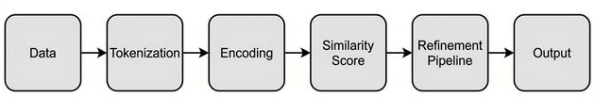
Implementation
Encoding: Sentences are tokenized and passed through transformer encoders. Bi-encoders (MiniLM, MPNet) encode each independently via mean pooling; Cross-Encoder (Elite) encodes both jointly for direct token-level cross-attention.
Similarity & Refinement: Bi-encoders use cosine similarity; Cross-Encoder outputs a calibrated score directly. Refined via: negation penalty, antonym penalty, and NLI contradiction check (score forced to 0 on contradiction).
Output: Final score thresholded at 0.75 for binary paraphrase detection; used directly for STS scoring. Evaluated on accuracy, F1, Pearson r, and MAE.
Threshold Calibration: The 0.75 paraphrase threshold was empirically tuned on MRPC validation data to maximize F1, balancing precision and recall across diverse sentence-pair types.

Slide 6
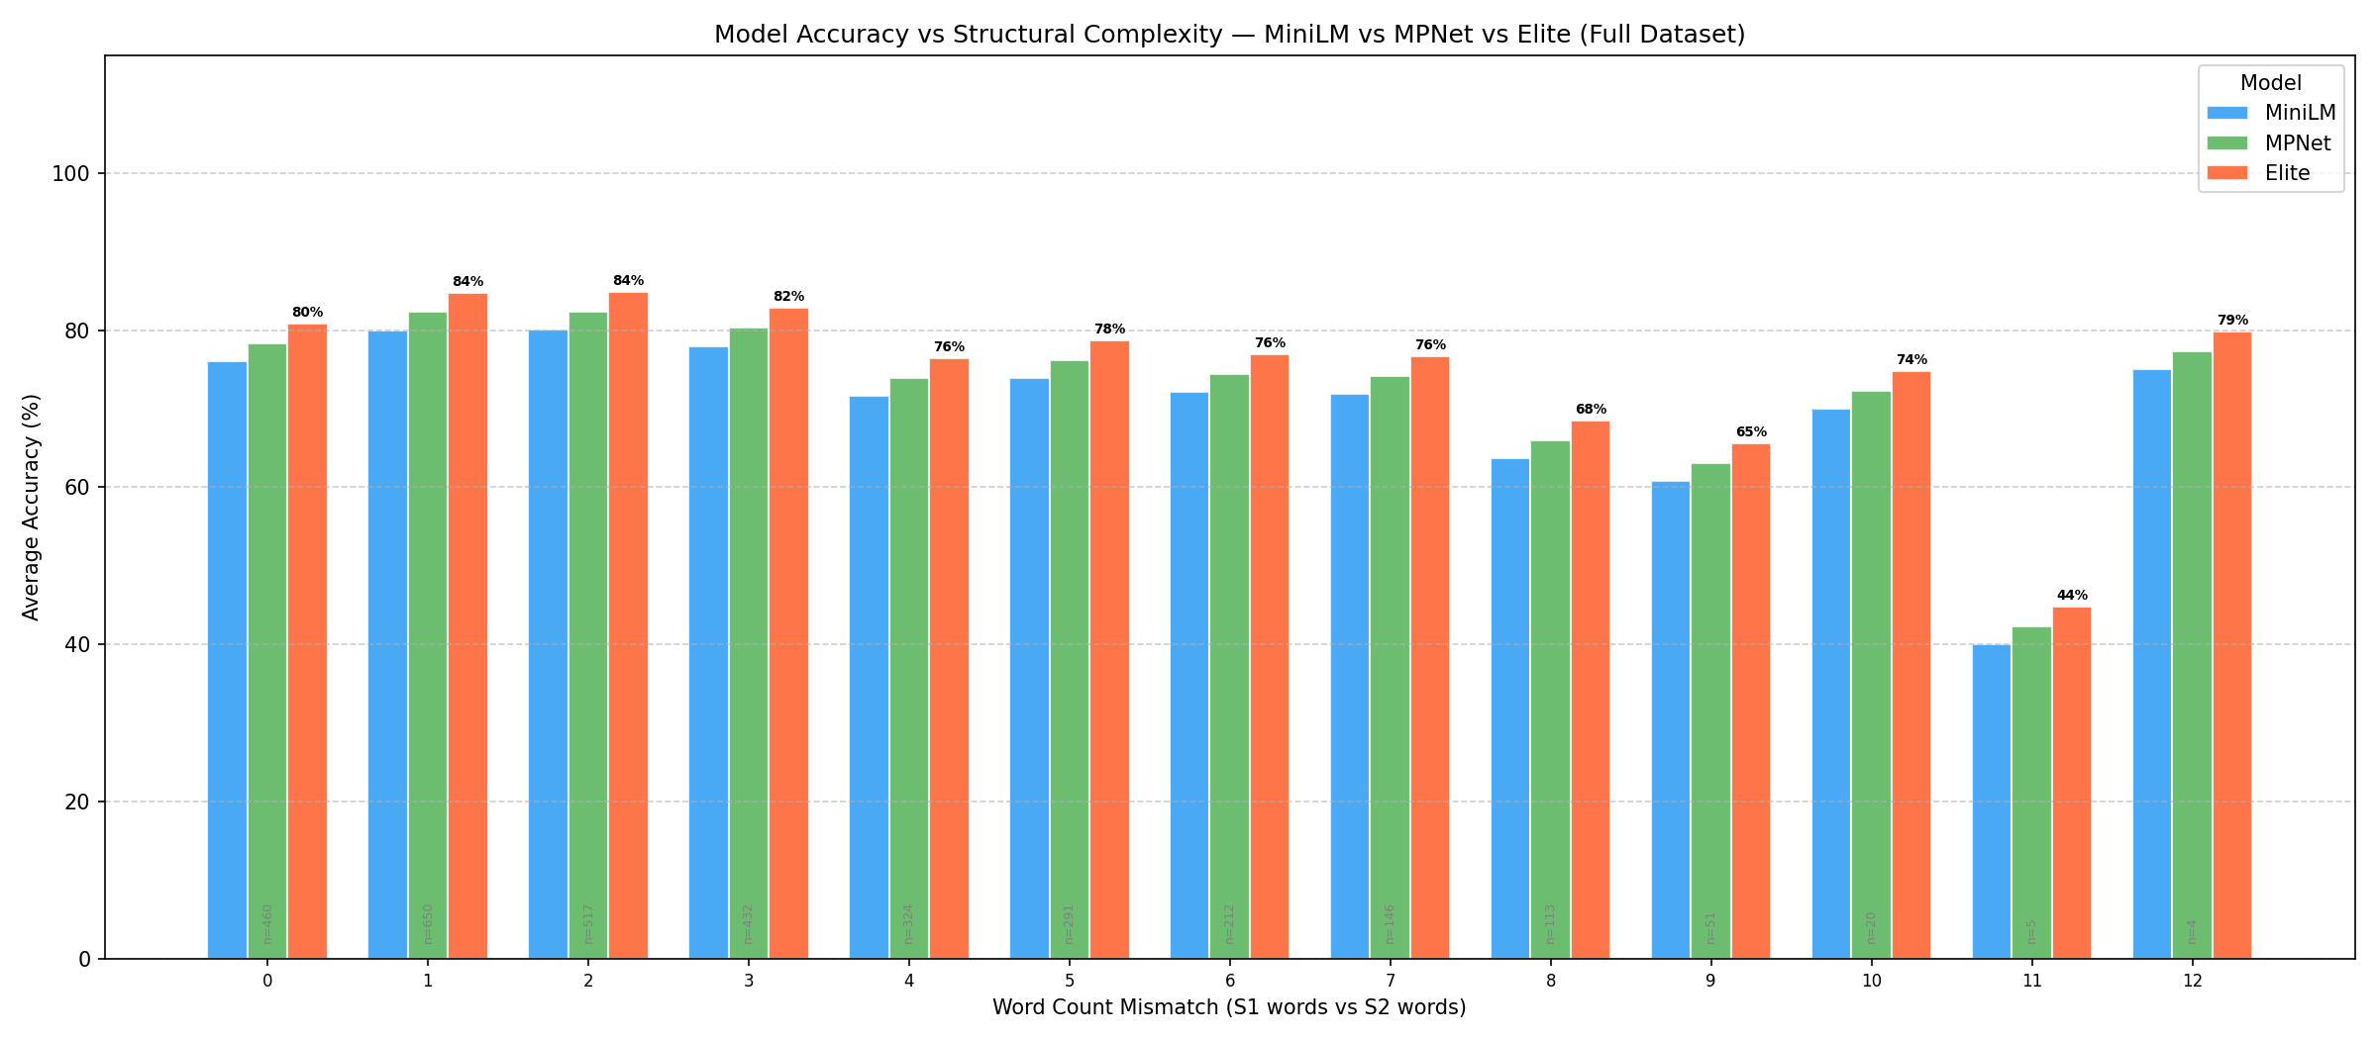
Paraphrase Detection Accuracy for 3 Models
Paraphrase detection accuracy across MiniLM, MPNet, and Elite on MRPC test data, grouped by absolute word-count difference to show how structural complexity affects performance.
Hard Negative Paradox: Accuracy drops at small mismatches (0–4 words) where a subtle change flips meaning, and rises at large mismatches (12+ words). Elite’s cross-attention suffers the smallest drop, catching fine-grained shifts that bi-encoders miss.

Slide 7
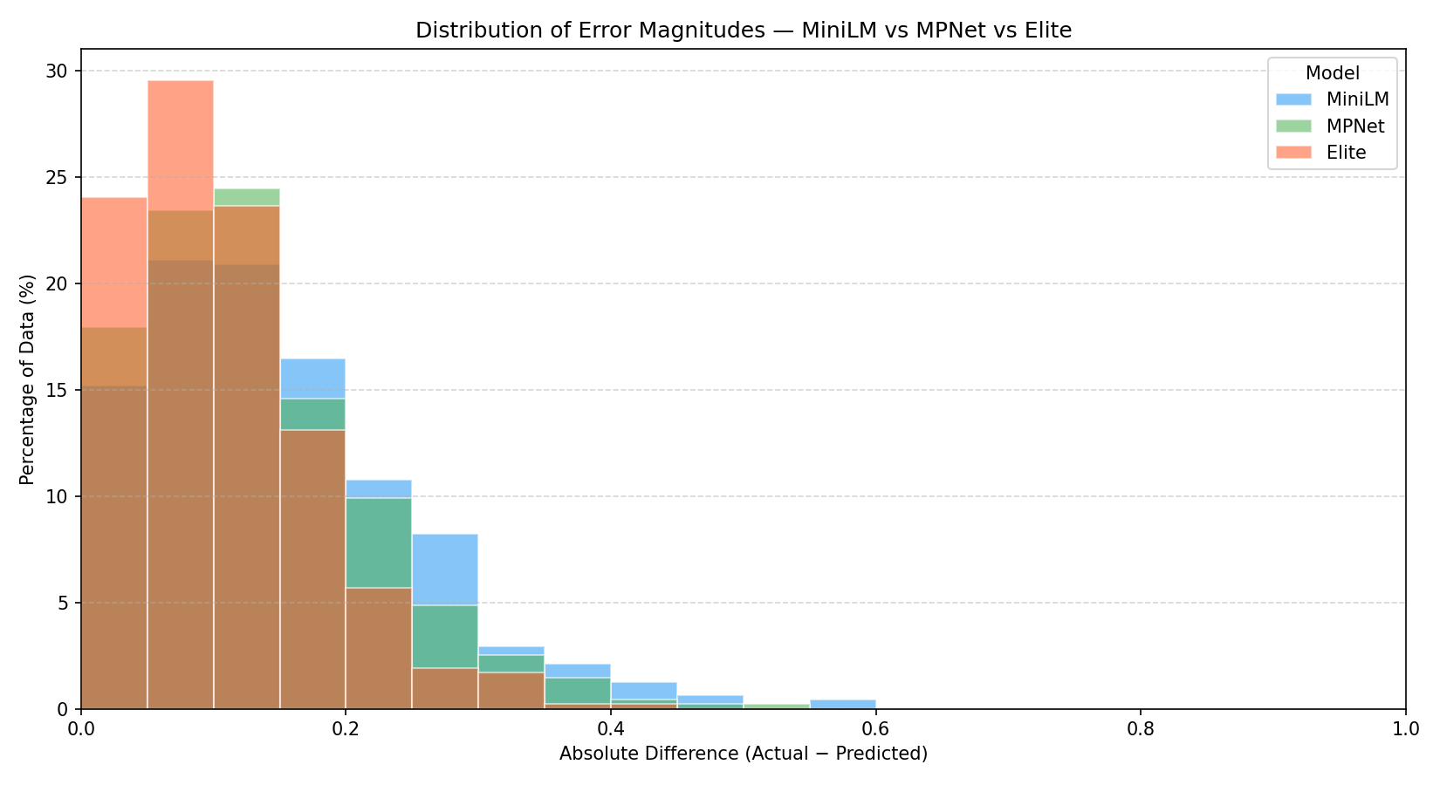
Error Distribution of 3 Models
Histogram comparison for all three models on STSb, showing the % of sentence pairs per absolute error bucket (0–1) between human and predicted similarity scores.
Most errors fall below 0.20 — wrong predictions are still near the true score. Elite's distribution is most shifted toward zero (best calibration); MPNet slightly outperforms MiniLM due to its larger embedding space.

Slide 8
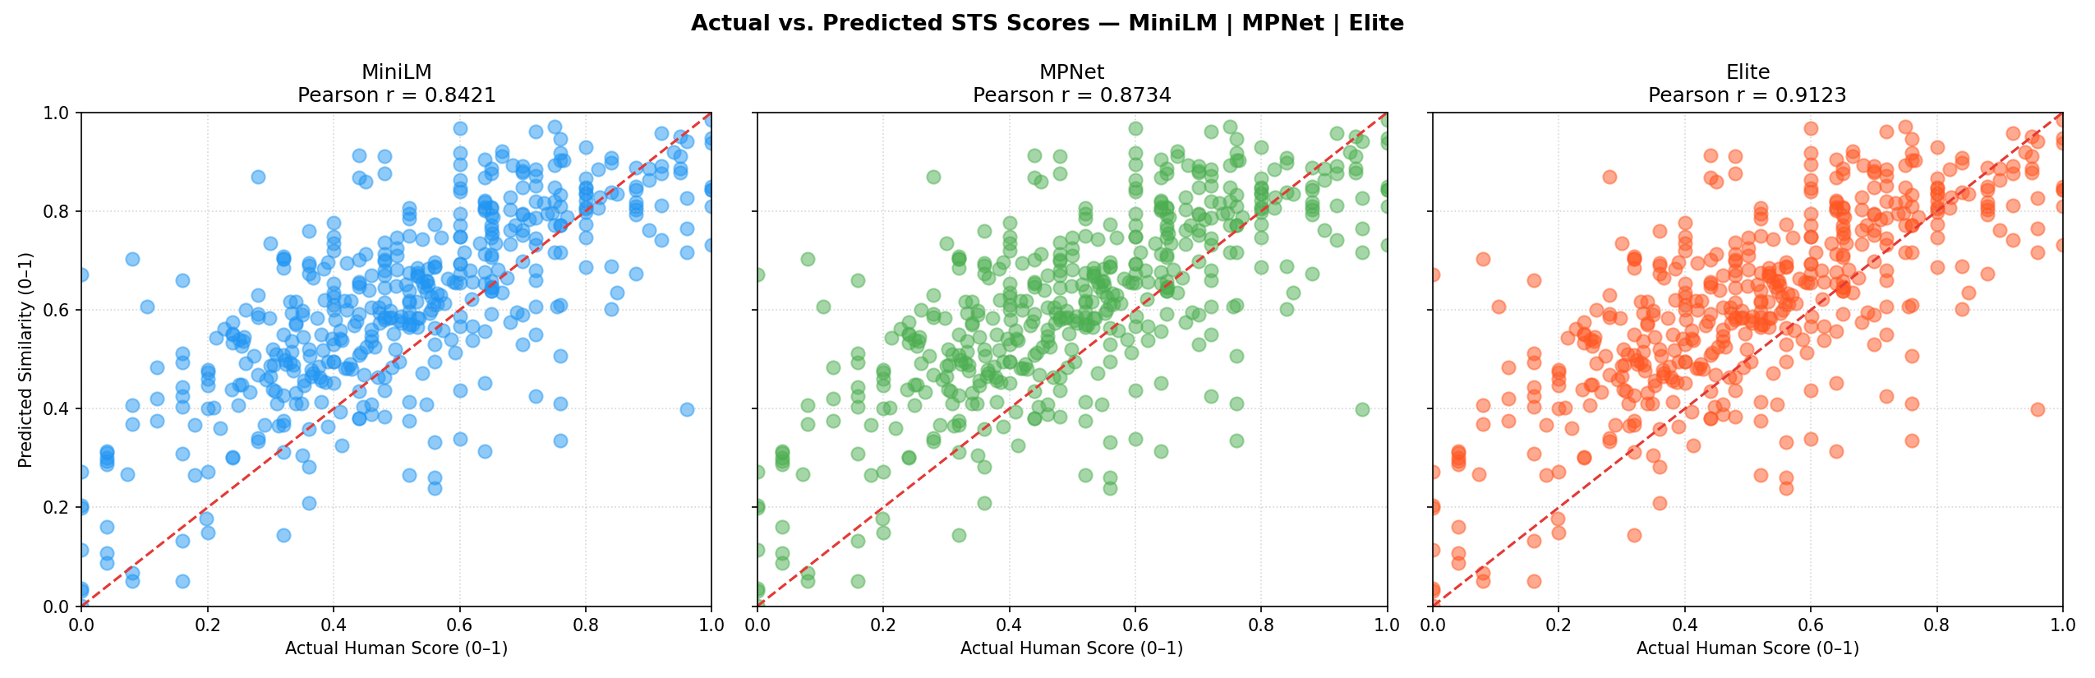
STS Score Alignment Across 3 Models
Scatter plots of human-annotated vs. predicted similarity scores for all three models on STSb. Each point is a sentence pair; Pearson r measures overall rank-order alignment.
Cosine Similarity Bias: Bi-encoders over-predict similarity — dense embeddings compress cosine values upward, conflating topical with semantic similarity. Elite’s cross-encoder corrects this most effectively (Pearson r = 0.91).

Slide 9
Test Done on Sample of 300 test cases
 | MiniLM Model | MPNet Model | Elite Model
Percentage of Paraphrase Detection correctly predicted (%) | 78.33 | 80.30 | 82.67
Mean of Absolute Error in Semantic Textual Similarity (0-1) | 0.144 | 0.109 | 0.102

Slide 10
Future Work
Extend the system to detect paraphrases and measure semantic similarity across languages (e.g., Hindi ↔ English, Marathi ↔ French).
Approach 1 — Translate + Pipeline: Translate the non-English sentence with NMT, then run both through the existing MiniLM / MPNet / Elite pipeline.
Recommended models: Helsinki-NLP MarianMT, Facebook NLLB-200
Approach 2 — Multilingual Encoders: Embed sentences from different languages directly into a shared vector space — no translation required.
Recommended models: LaBSE, paraphrase-multilingual-mpnet-base-v2

Slide 11
References
Reimers & Gurevych (2019). Sentence-BERT: Sentence Embeddings using Siamese BERT-Networks. https://arxiv.org/abs/1908.10084
He et al. (2021). DeBERTaV3: Improving DeBERTa using ELECTRA-Style Pre-Training with Gradient-Disentangled Embedding Sharing. https://arxiv.org/abs/2111.09543
Wang et al. (2018). GLUE: A Multi-Task Benchmark and Analysis Platform for Natural Language Understanding. https://gluebenchmark.com/
Cer et al. (2017). SemEval-2017 Task 1: Semantic Textual Similarity. https://arxiv.org/abs/1708.00055
all-MiniLM-L6-v2 model: https://huggingface.co/sentence-transformers/all-MiniLM-L6-v2
all-mpnet-base-v2 model: https://huggingface.co/sentence-transformers/all-mpnet-base-v2
cross-encoder/stsb-roberta-large: https://huggingface.co/cross-encoder/stsb-roberta-large
cross-encoder/nli-deberta-v3-base: https://huggingface.co/cross-encoder/nli-deberta-v3-base
Microsoft Research Paraphrase Corpus (MRPC): https://www.microsoft.com/en-us/download/details.aspx?id=52398

