Slide 1
MACHINE LEARNING FOR MOTOR CONTROL
Omkar Parange
(M.Tech., NIT Karnataka)

Slide 2
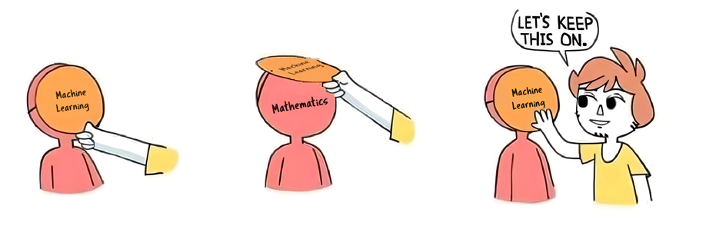

Slide 3
OUTLINE
AI vs. ML
Interesting history of AI
ML for Motor Control
ANN
Genetic Algorithms

Slide 4
AI
ML

Slide 5
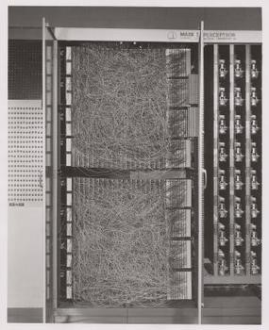
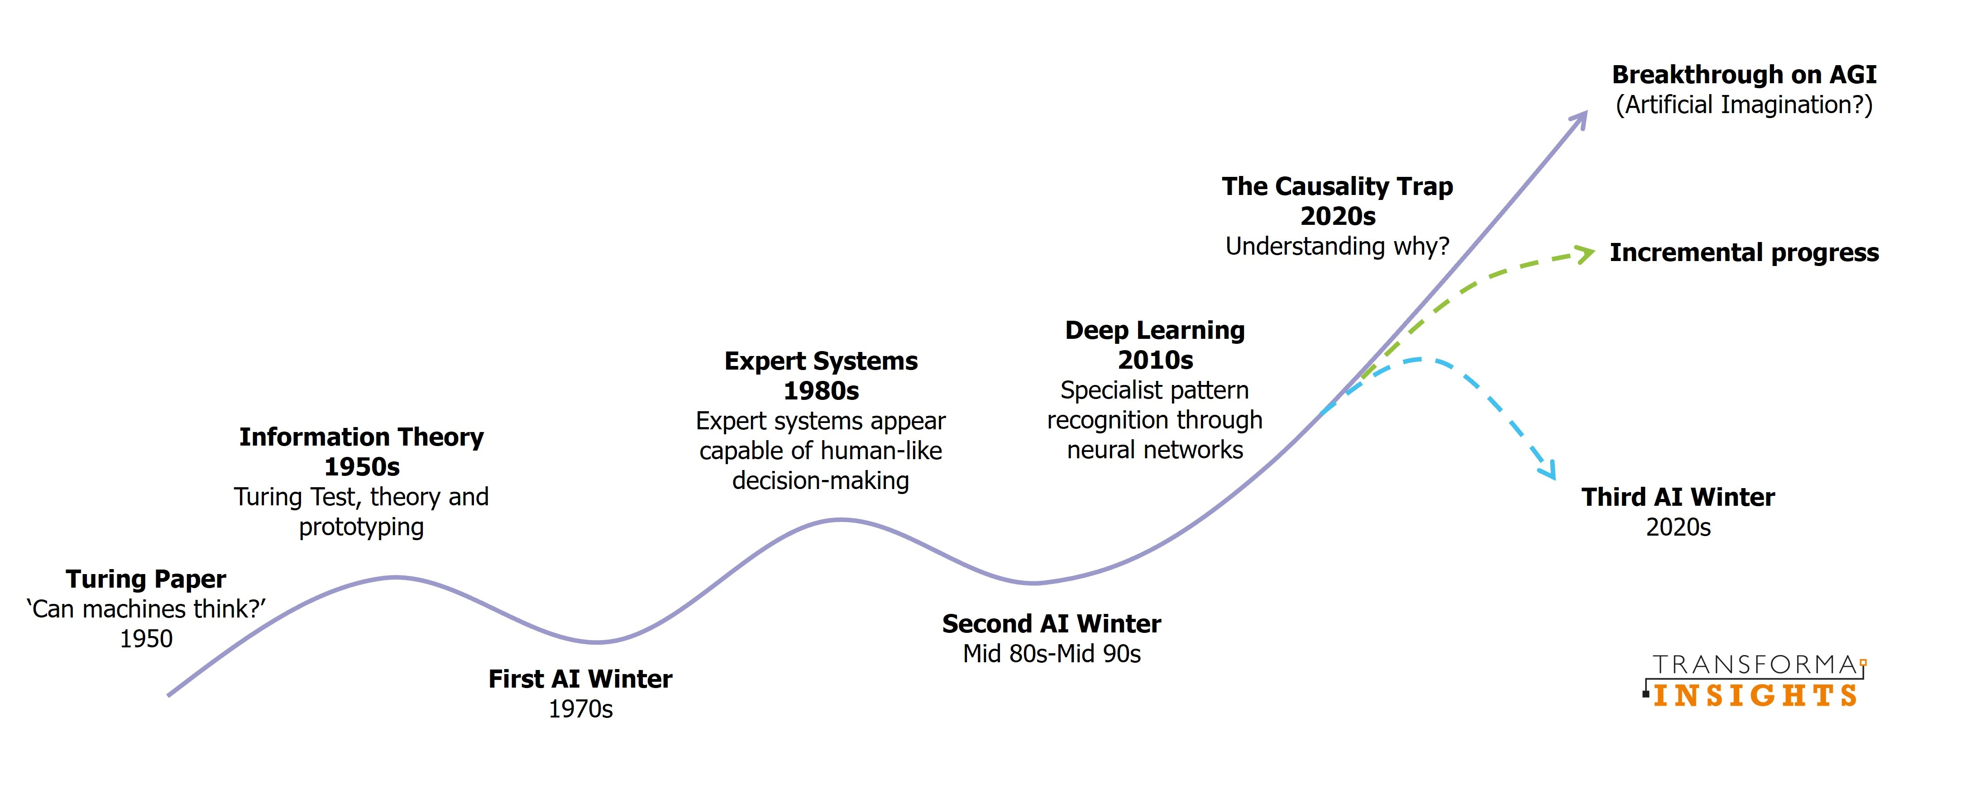

Slide 6
ML & MOTOR CONTROL

Slide 7
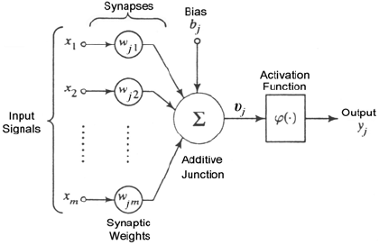
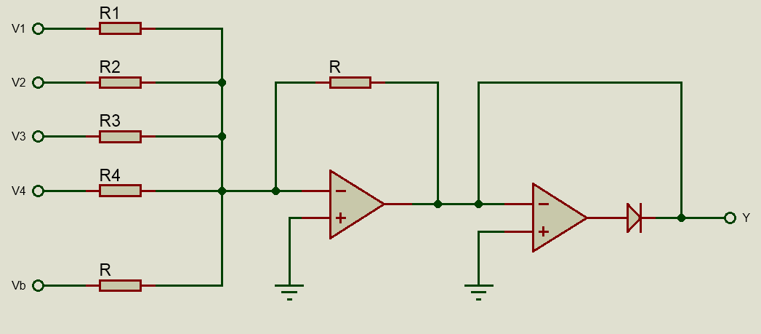
ARTIFICIAL NEURON

Slide 8
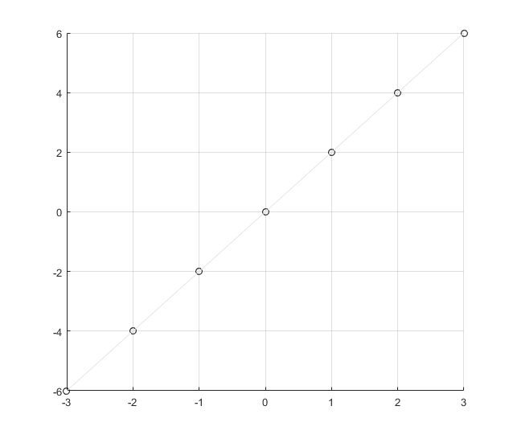






Regression
$$y=2x$$
$$w$$
$$w∙x$$
$$x$$
$$y=w∙x$$

Slide 9
Back-Propagation

Slide 10
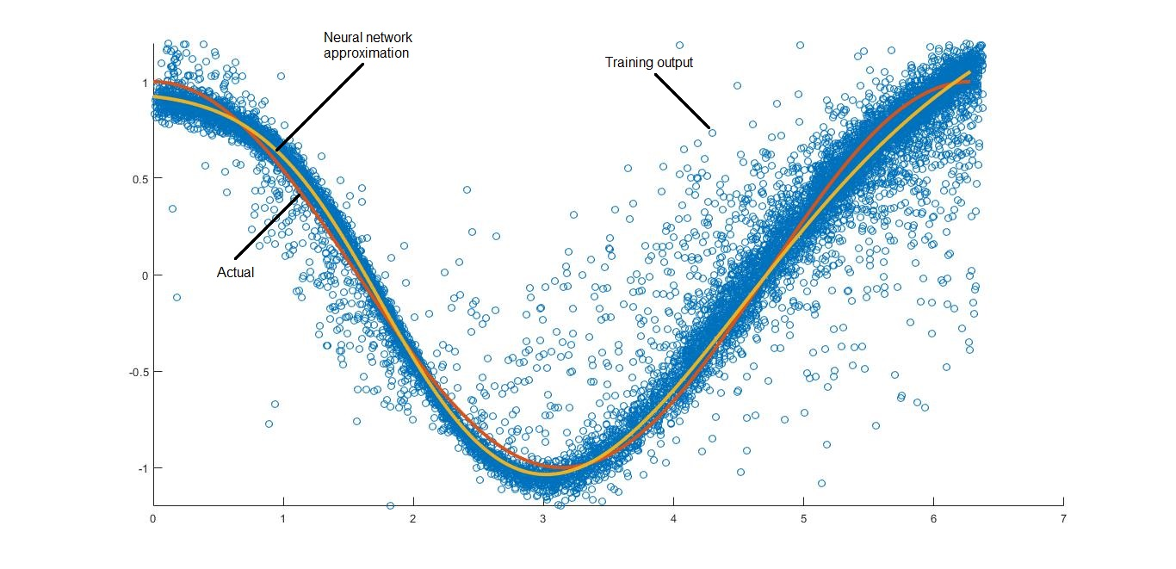
Nonlinear Approximation

Slide 11
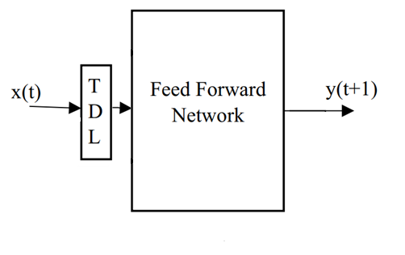
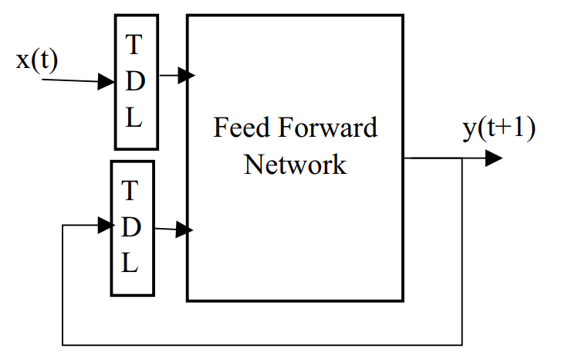
System Identification Models

Slide 12
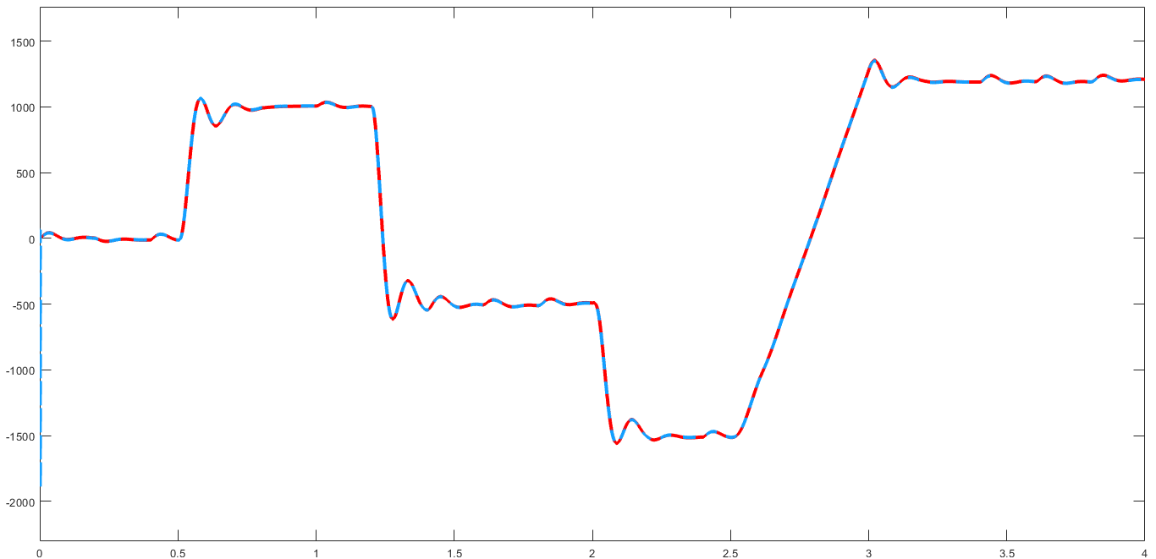
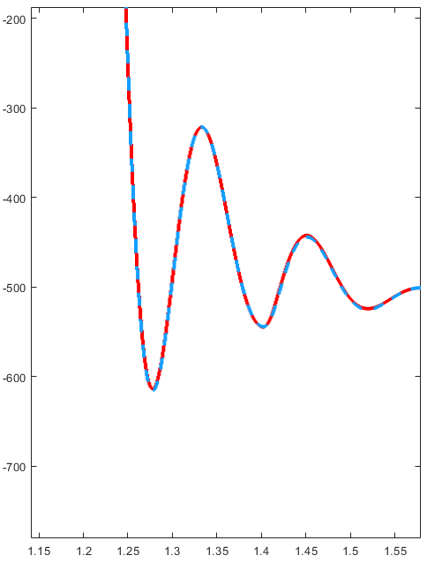
DC Motor vs. ANN

Slide 13
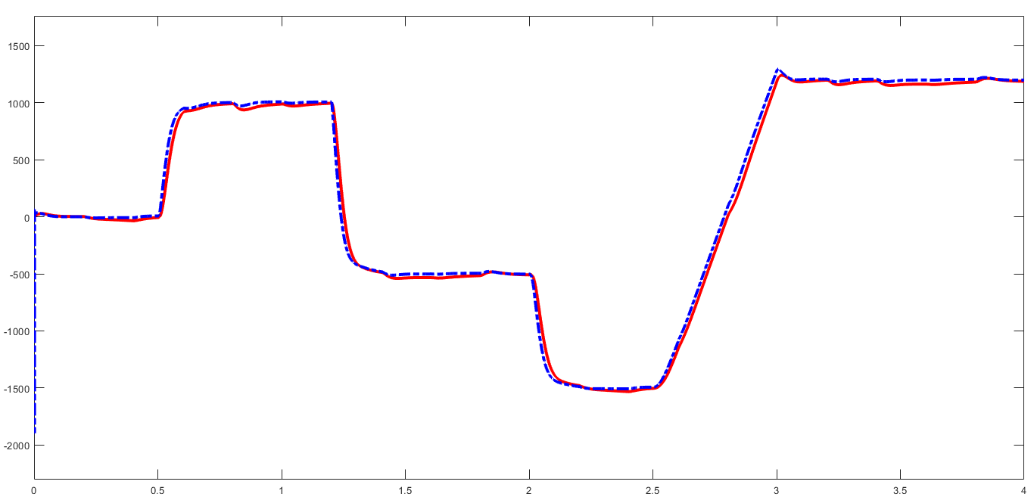
ROBUSTNESS

Slide 14
