Slide 1
MACHINE LEARNING FOR MOTOR CONTROL
Omkar Parange
(M.Tech., NIT Karnataka)

Slide 2
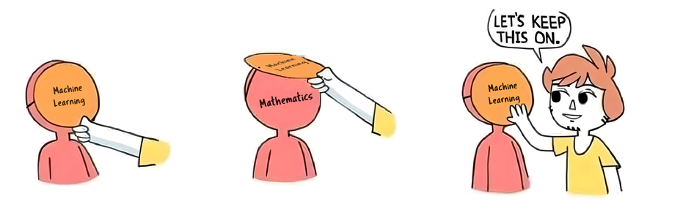

Slide 3
OUTLINE
AI vs. ML
Interesting history of AI
ML for Motor Control
ANN
Genetic Algorithms

Slide 4
AI
ML

Slide 5
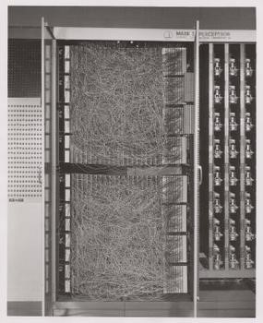
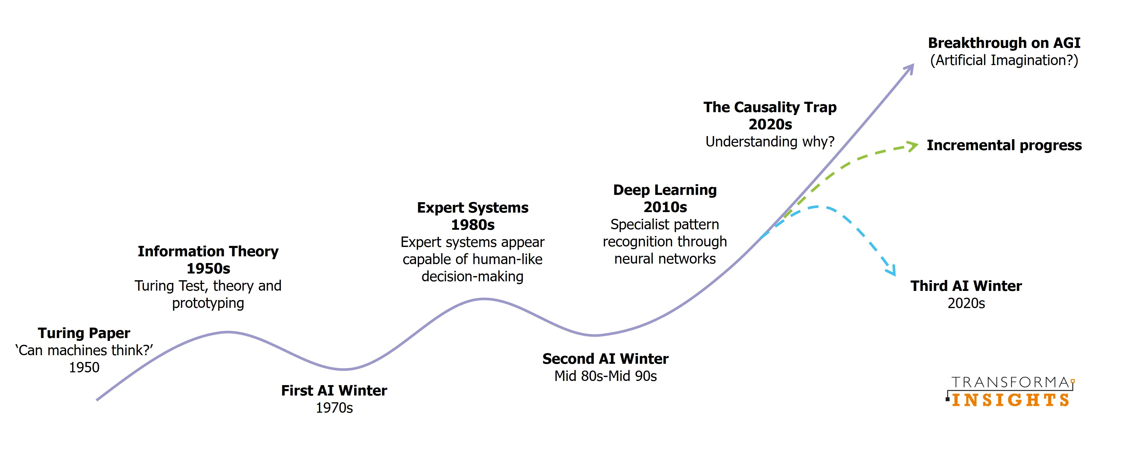

Slide 6
ML & MOTOR CONTROL

Slide 7
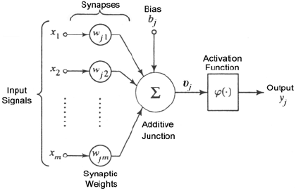
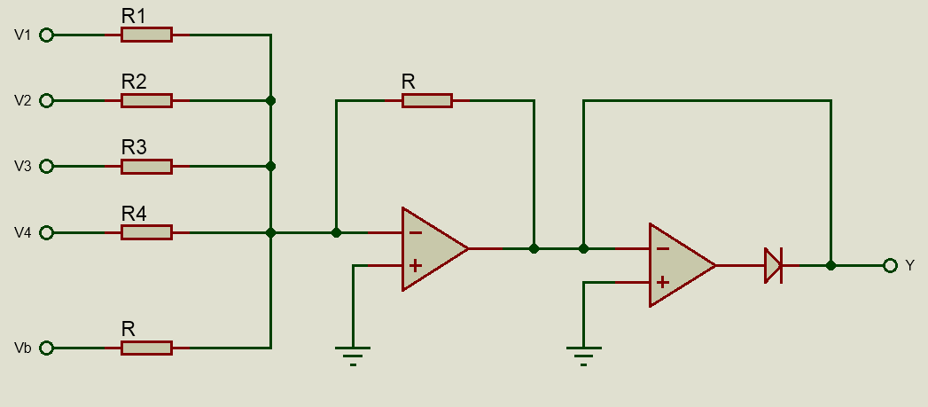
ARTIFICIAL NEURON

Slide 8
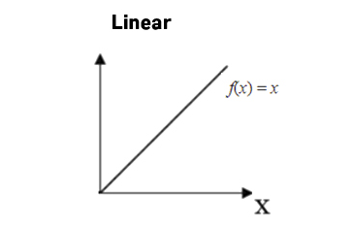
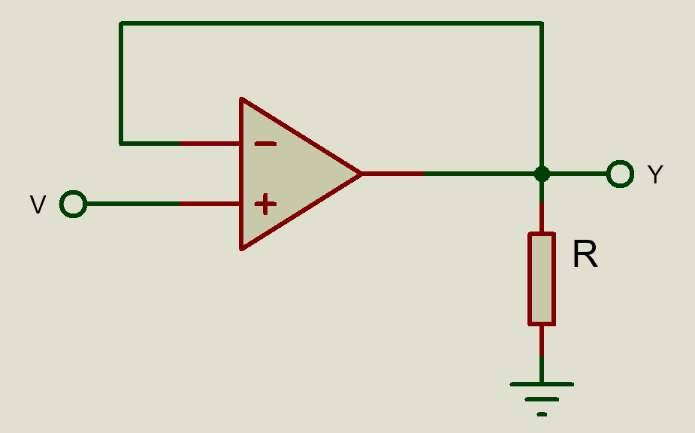
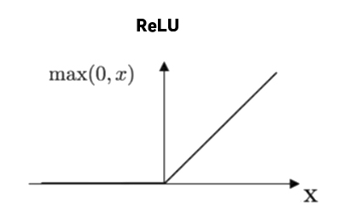
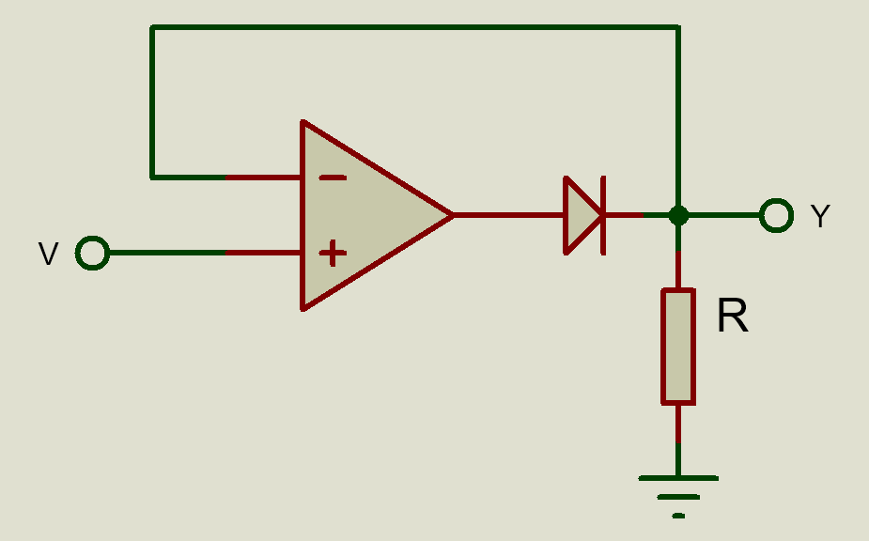
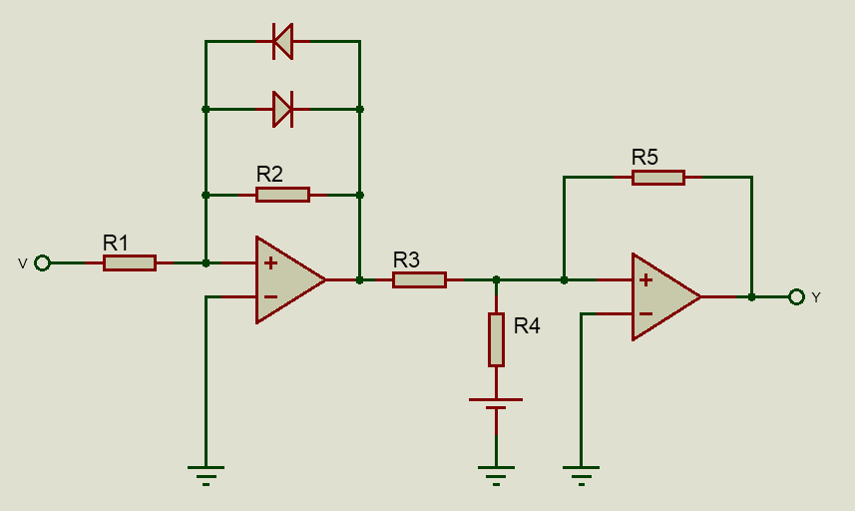
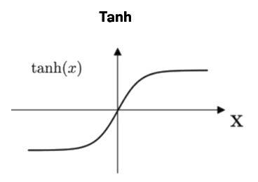
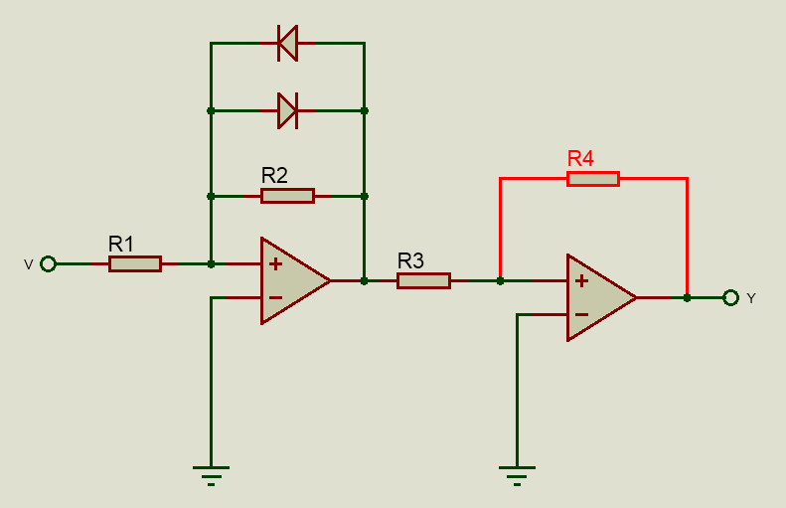
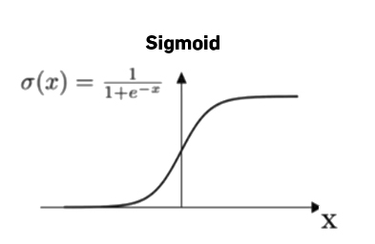
Activation Functions

Slide 9
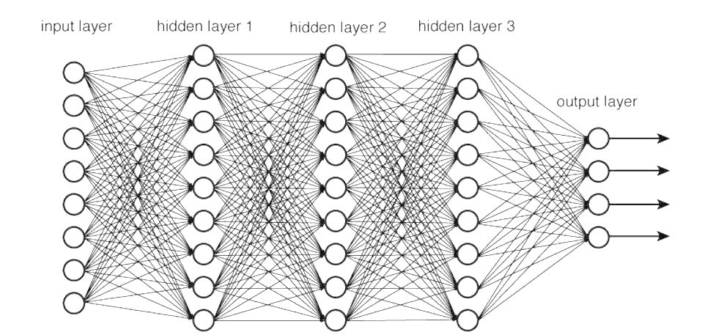
A Neural Network

Slide 10
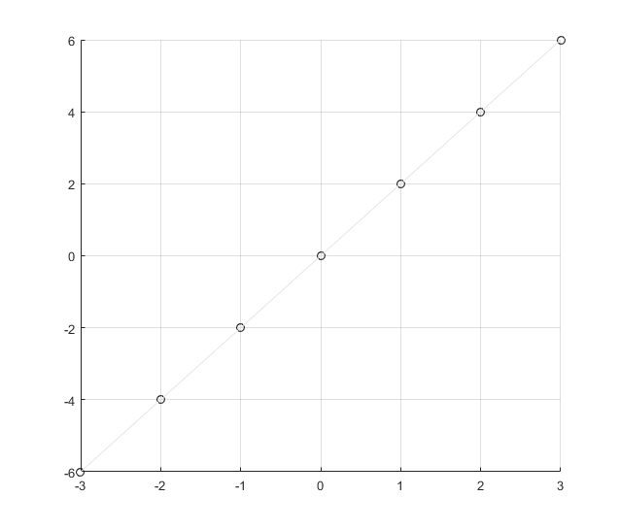






Regression Problem
$$y=2x$$
$$w$$
$$w∙x$$
$$x$$
$$y=w∙x$$

Slide 11
Back-Propagation

Slide 12
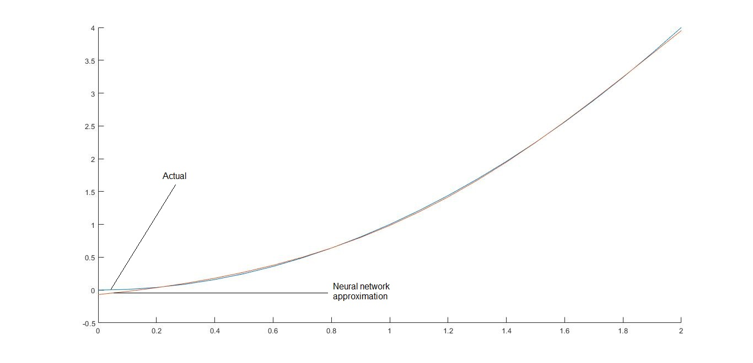
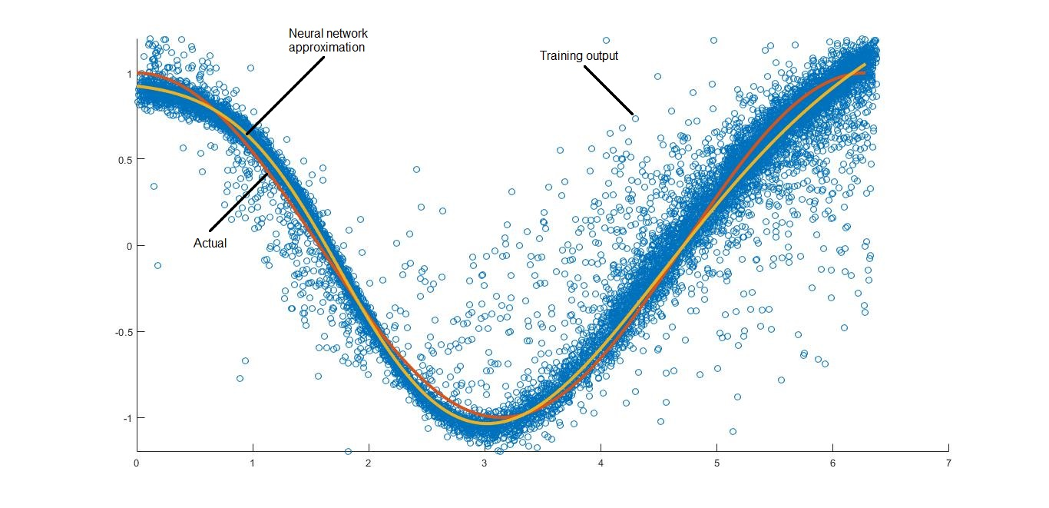
Nonlinear Approximation

Slide 13
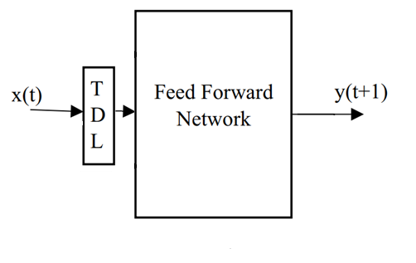
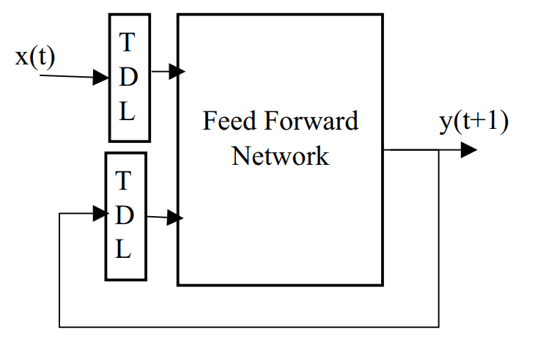
System Identification Models
Nonlinear Input-output model
Nonlinear Autoregressive Exogenous (NARX)

Slide 14
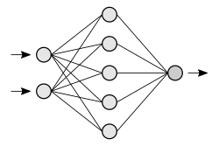


DC Motor Speed Observer
DC Motor
Load
Controller
I
I = ${[i}_{k},i_{k−1},i_{k−2}]$
Speed
V
V = ${[v}_{k},v_{k−1},v_{k−2}]$

Slide 15
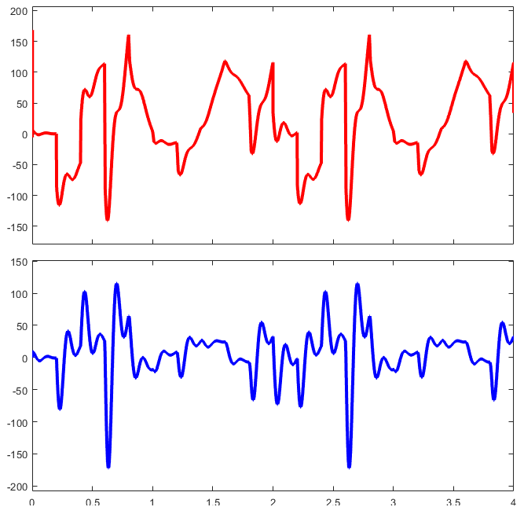
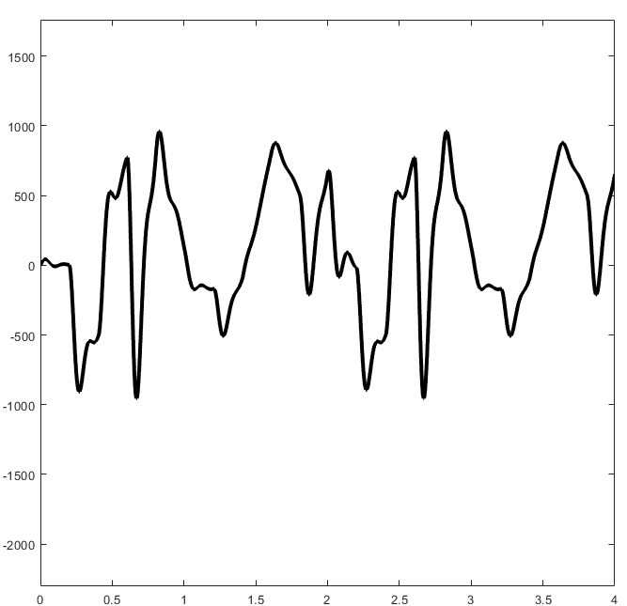
Training Data
Voltage
Speed
Current

Slide 16
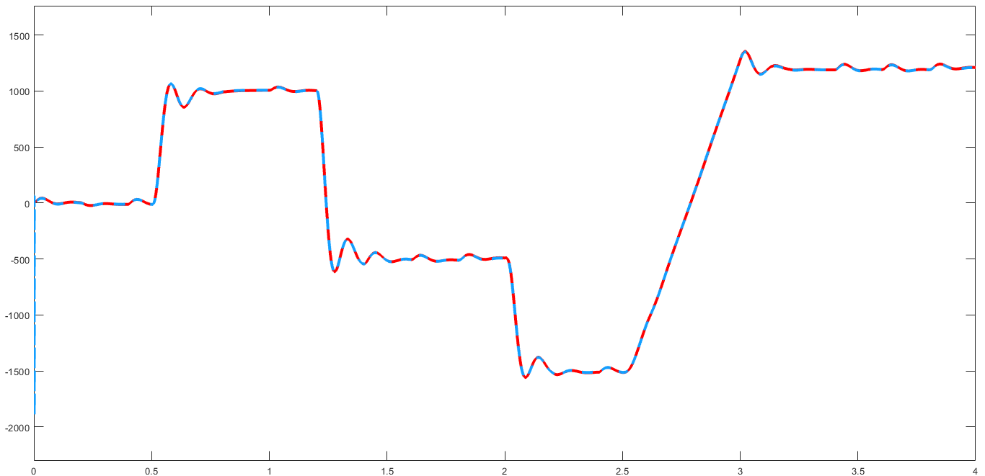
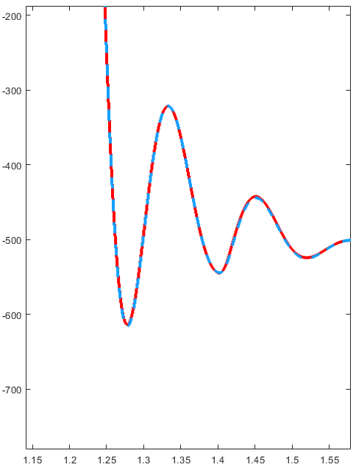
ANN Speed Observer

Slide 17
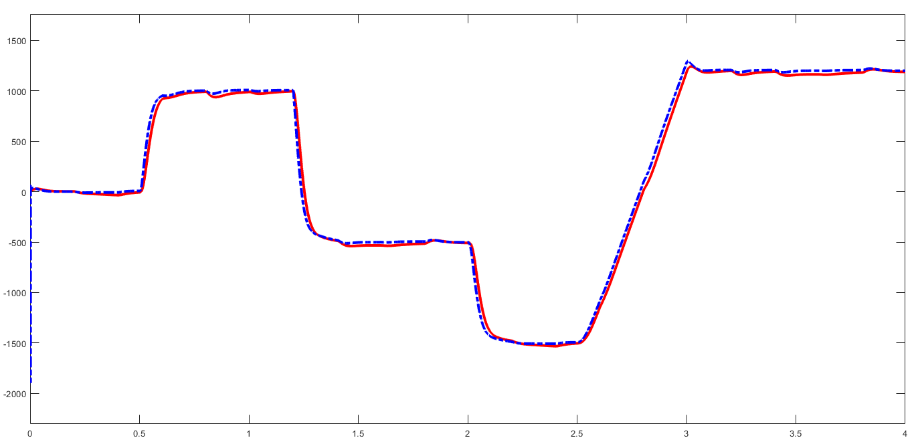
ROBUSTNESS

Slide 18
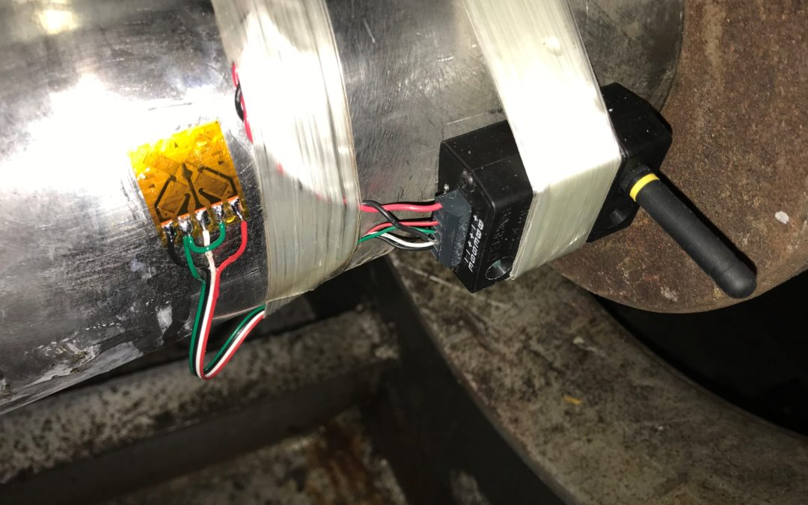
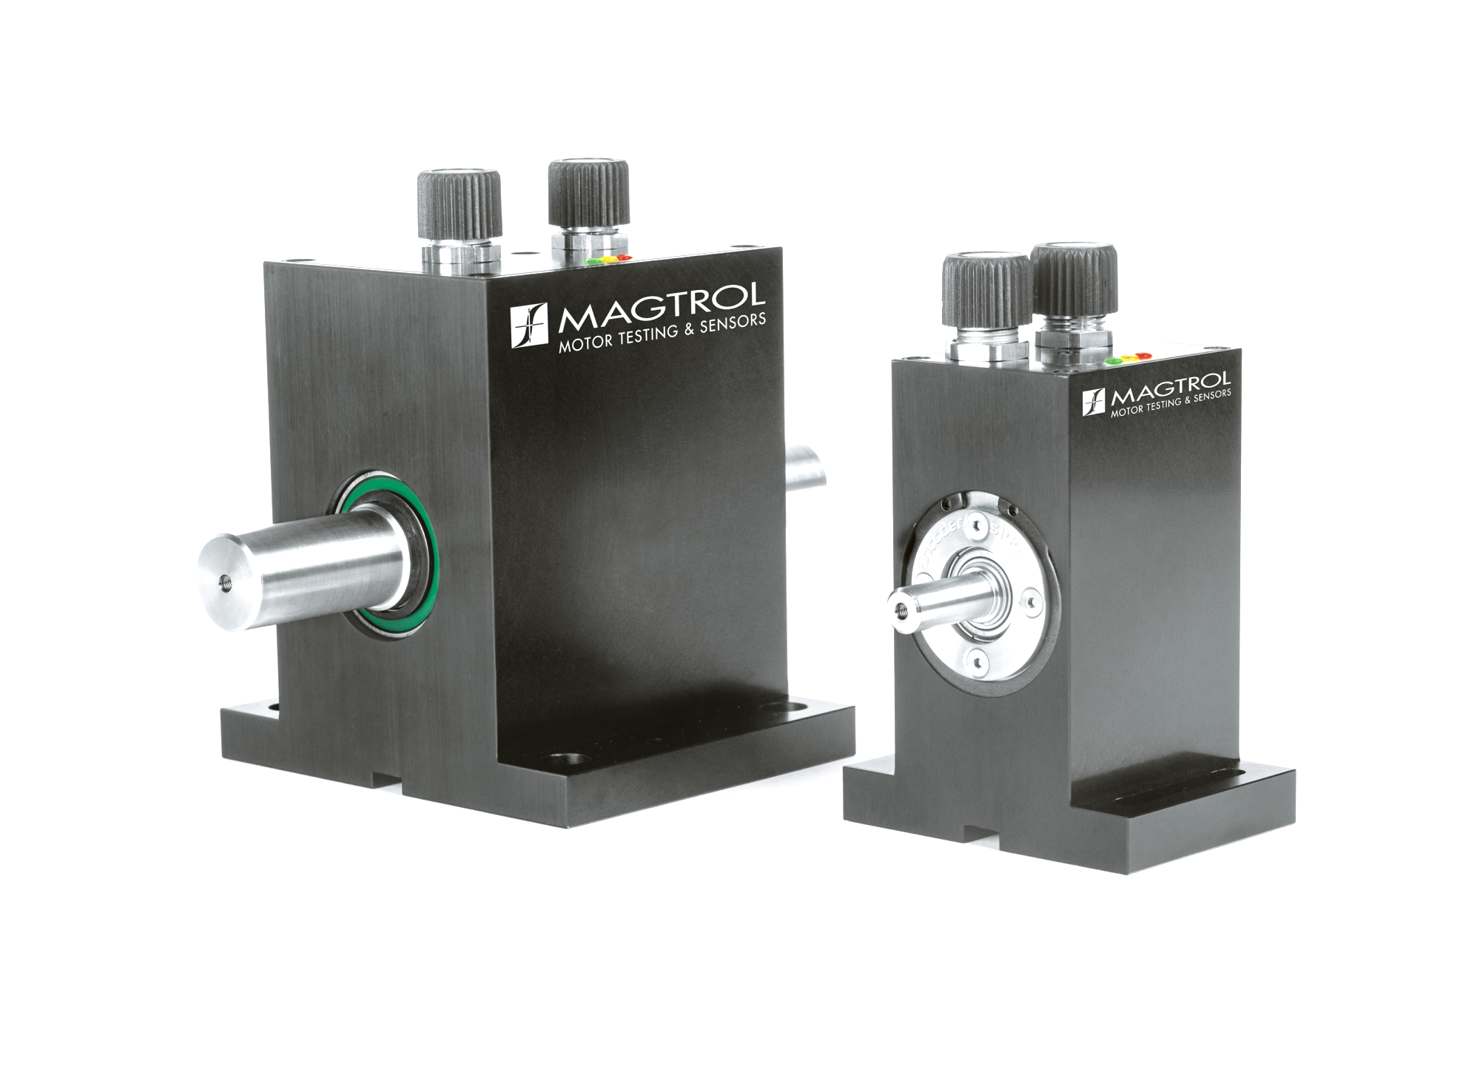
For जुगाड़? Yes, you can!
+
Torque!!!

Slide 19
