Slide 1
MACHINE LEARNING FOR MOTOR CONTROL
Omkar Parange
(M.Tech., NIT Karnataka)

Slide 2
OUTLINE
AI vs. ML
History of AI
ML for Motor Control?
ANN
Genetic Algorithms

Slide 3
AI
ML

Slide 4
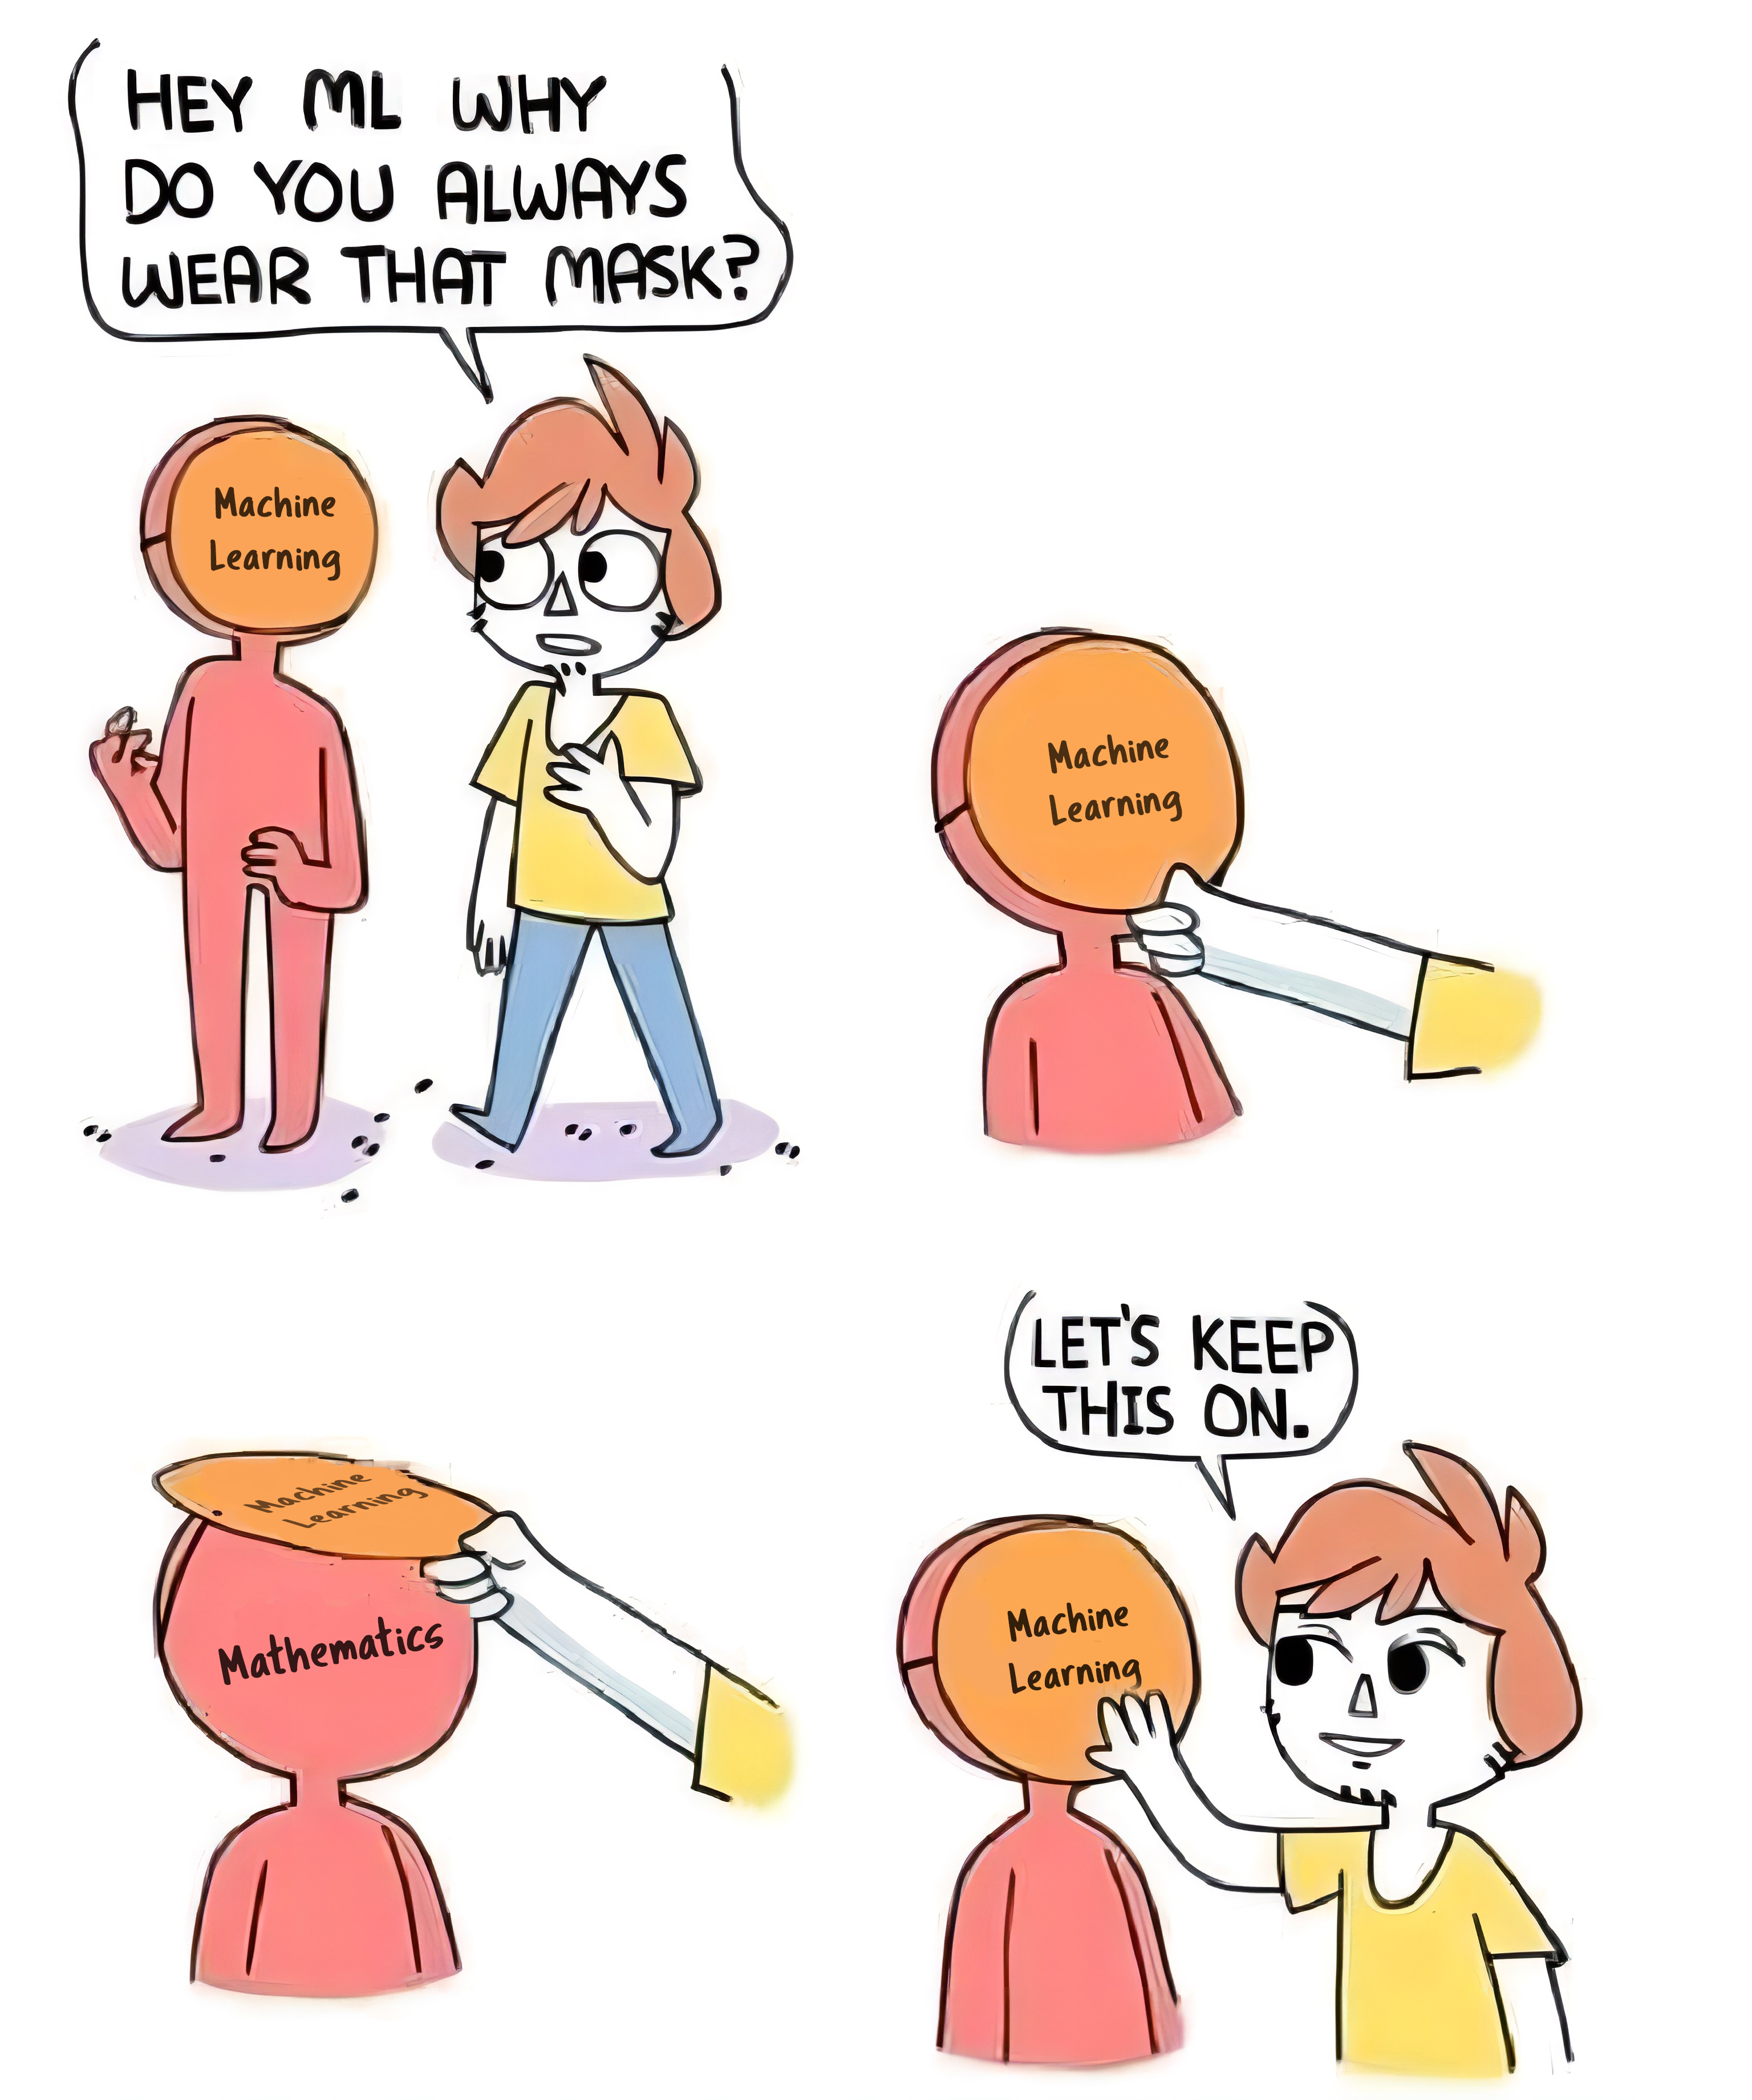

Slide 5
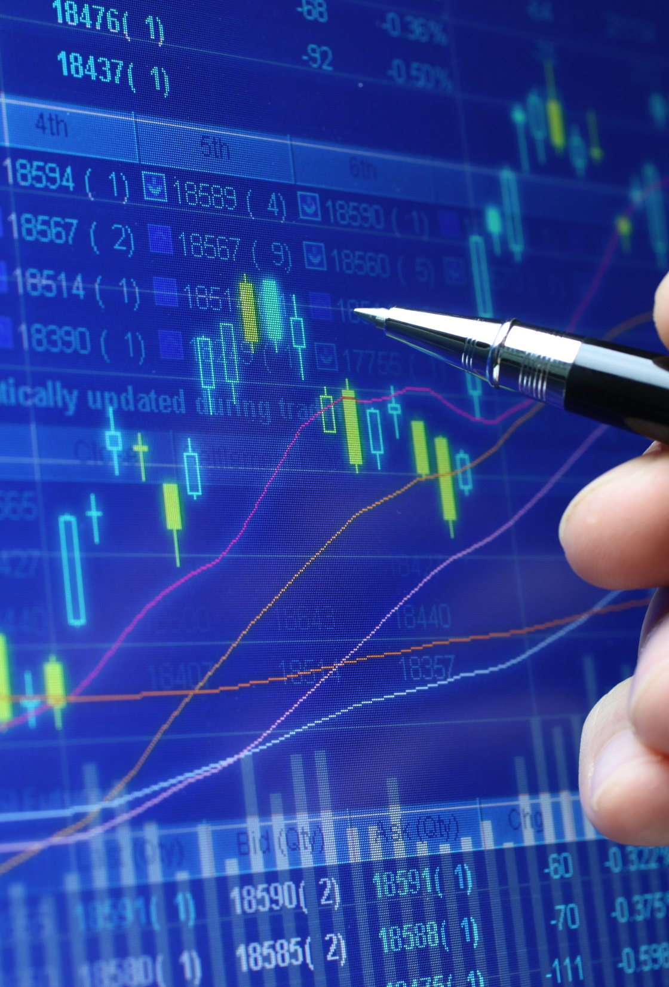
Thank you
someone@example.com

