Slide 1
Database Architecture and ASM

Slide 2
Objectifs
Après ce cours vous serez en mesure de :
  Décrire l’architecture des bases de données Oracle.
  Décrire le système « Automatic Storage Management » (ASM)
  Paramétrer les fichiers d’initialisation pour ASM et les instances de bases de données.
  Démarrer et arrêter les instances ASM.
  Administrer les groupes de disques pour ASM.
Notes:
Oracle Database 11g: Administration Workshop II 1 - <number>

Slide 3


Oracle Database
Le système de gestion de base de données relationnelles Oracle (RDBMS) est un système qui fourni une gestion des informations de gestion:
Ouverte.
Complète.
Intégrée.
Notes:
Oracle Database 11g: Administration Workshop II 1 - <number>

Slide 4
Architecture Oracle Database : Vue d’ensemble
Instance
SMON
PMON
Others
SGA
Shared pool
Database
buffer
cache
Redo log
buffer
Library
cache
Data dictionary
cache
PGA
Server
process
DBWn
CKPT
LGWR
ARCn
Database
User
process
Archived
log files
Control files
Online redo log files
Data files
Notes:
Oracle Database 11g: Administration Workshop II 1 - <number>

Slide 5

Connexion à la base de données
  Connexion: Communication entre un process utilisateur et une instance.
  Session: Connexion Spécifique d’un utilisateur à une instance à travers un process.
SQL> Select …
Session
User
USER
Connection
Notes:
Oracle Database 11g: Administration Workshop II 1 - <number>

Slide 6

Structures du Serveur Oracle Database
Structures Mémoires
Instance
SGA
Shared pool
Database
buffer
cache
Redo log
buffer
Library
cache
User
process
Server
process
Data dict.
cache
Process (PGA)
DBWn
CKPT
LGWR
SMON
PMON
ARCn
Others
Database
Structures de Stockage
Control files
Online redo log files
Data files
Notes:
Oracle Database 11g: Administration Workshop II 1 - <number>

Slide 7

Architecture Mémoire d’Oracle
Server
process 1
Server
process 2
Background
process
PGA
PGA
PGA
Shared
SQL area
Data Dictionary cache
SGA
Library cache
Other
Redo log buffer
Shared pool
I/O Buffer
Free memory
Database buffer
cache
Response queue
Request queue
Java pool
Streams pool
Large pool
Notes:
Oracle Database 11g: Administration Workshop II 1 - <number>

Slide 8
Process Architecture
  User process
    Il démarre lorsqu’un utilisateur ou une tâche se connectent à Oracle Database
  Database processes
    Server process: Il se connecte à une instance Oracle et débute avec l’ouverture de session d’un utilisateur.
    Background processes: Ils débutent lorsqu’une instance Oracle est démarrée.
Instance
SGA
Shared pool
Database
buffer
cache
Redo log
buffer
Library
cache
PGA
Data dictionary
cache
User
process
Server
process
Background processes
DBWn
CKPT
LGWR
SMON
PMON
ARCn
Others
Notes:
Oracle Database 11g: Administration Workshop II 1 - <number>

Slide 9
Process Structures
Server
Server
Server
Server
Server
…Server n processes
SGA
Shared pool
Database
buffer
cache
Redo log
buffer
Library
cache
SGA
Data dict.
cache
CKPT
RECO
PMON
SMON
DBWn
LGWR
ARCn
Others
…Oracle background processes
Notes:
Oracle Database 11g: Administration Workshop II 1 - <number>

Slide 10




Architecture de stockage
Control files
Data files
Online redo log files
Parameter file
Backup files
Archived redo log files
Password file
Alert log and trace files
Notes:
Oracle Database 11g: Administration Workshop II 1 - <number>

Slide 11
Structures Logique et Physique de la Database
Logique
Physique
Database
Schema
Tablespace
Data file
Segment
Extent
Oracle data
block
OS block
Notes:
Oracle Database 11g: Administration Workshop II 1 - <number>

Slide 12
Tablespaces et Data Files
  Les Tablespaces consistent en un ou plusieurs fichiers (data files).
  Les “Data files” n’appartiennent qu’à un seul tablespace.
Data file 1
Data file 2
USERS tablespace
Notes:
Oracle Database 11g: Administration Workshop II 1 - <number>

Slide 13
Les Tablesapces SYSTEM et SYSAUX
  Les tablespaces SYSTEM et SYSAUX tablespaces sont des tablespaces mandataires.
  Ils sont créés lors de la création de la base.
  Le Tablespace SYSTEM est utilisé les fonctionnalités du cœur (par example, data dictionary tables).
  Le Tablespace auxiliaire SYSAUX est utilisé pour les composants additionnels (tels que Enterprise Manager Repository).
Notes:
Oracle Database 11g: Administration Workshop II 1 - <number>

Slide 14




Segments, Extents, et Blocks
  Les Segments existent dans un tablespace.
  Les Segments sont constitués d’une collection d’ extents.
  Les Extents sont une collection de data blocks.
  Les Data blocks sont construits à partir des “disk blocks” (clusters).
Segment
Extents
Data blocks
Disk blocks
Notes:
Oracle Database 11g: Administration Workshop II 1 - <number>

Slide 15
Database Architecture:
Résumé des Composants Structurels
  Structures de Mémoire:
    System Global Area (SGA): Database buffer cache, redo buffer, and various pools
    Program Global Area (PGA)
  Structures de Process:
    Process Utilisateurs et Process Serveurs
    Background processes: SMON, PMON, DBWn, CKPT, LGWR, ARCn, ….
  Structures de Stockage:
    Logique: Database, schema, tablespace, segment, extent, et Oracle block
    Physique: data files, control files, et redo log files
Notes:
Oracle Database 11g: Administration Workshop II 1 - <number>

Slide 16
Automatic Storage Management (ASM):
Revue
  Portable et fourni un système de fichiers en cluster à haute performance.
  Gère les fichiers de bases de données Oracle.
  Répartition des données sur plusieurs
  disques pour équilibrer la charge.
  Intègre le mirroring de disques.
  Propose de nombreuses
  solutions de Stockage.
Application
Database
File
system
ASM
Volume
manager
Operating system
Notes:
Oracle Database 11g: Administration Workshop II 1 - <number>
.

Slide 17
ASM: General Architecture
DB instance
SID=SALES
ASM
instance
SID=+ASM
RBAL
DBW0
ASMB
FG
ARB0
…
RBAL
ARBA
GMON
ASM disks
ASM disks
ASM disks
ASM disks
ASM disks
ASM disks
ASM disk group 1
ASM disk group 2
Notes:
Oracle Database 11g: Administration Workshop II 1 - <number>

Slide 18
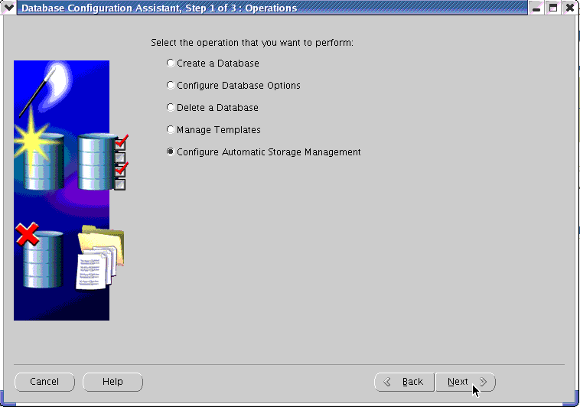
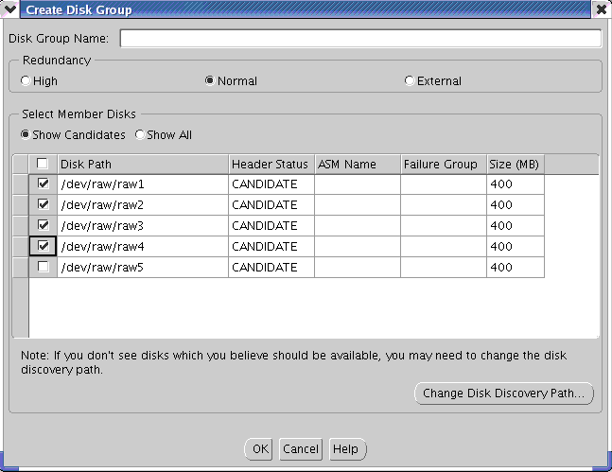
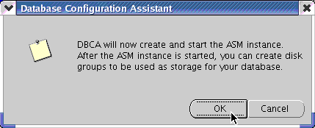
Création d’une Instance ASM
Notes:
Oracle Database 11g: Administration Workshop II 1 - <number>

Slide 19
ASM Instance Initialization Parameters
INSTANCE_TYPE = ASM
DB_UNIQUE_NAME = +ASM
ASM_POWER_LIMIT = 1
ASM_DISKSTRING = '/dev/rdsk/*s2', '/dev/rdsk/c1*'
ASM_DISKGROUPS = dgroupA, dgroupB
SPFILE = '$ORACLE_HOME/dbs/spfile+ASM.ora'
Notes:
Oracle Database 11g: Administration Workshop II 1 - <number>

Slide 20
Starting Up an ASM Instance
$ export ORACLE_SID='+ASM'
$ sqlplus /nolog
SQL> CONNECT / AS sysasm
Connected to an idle instance.
SQL> STARTUP;
Total System Global Area 284565504 bytes
Fixed Size 1299428 bytes
Variable Size 258100252 bytes
ASM Cache 25165824 bytes
ASM diskgroups mounted
Notes:
Oracle Database 11g: Administration Workshop II 1 - <number>

Slide 21
Role de SYSASM
  SYSASM role to manage ASM instances avoids overlap between DBAs and storage administrators
  For ASM instances, SYSDBA will be deprecated in the future:
    Oracle Database 11g Release 1 behaves as in 10g
    In future releases SYSDBA privileges restricted in ASM instances
SQL> CONNECT / AS SYSASM
SQL> CREATE USER ossysasmusername IDENTIFIED by passwd;
SQL> GRANT SYSASM TO ossysasmusername;
SQL> CONNECT ossysasmusername / passwd AS SYSASM;
SQL> DROP USER ossysasmusername;
Notes:
Oracle Database 11g: Administration Workshop II 1 - <number>

Slide 22
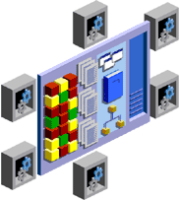
Accessing an ASM Instance
As SYSASM or SYSDBA
ASM
instance
As SYSOPER
All operations
Limited
operations
Disk group
Disk group
Storage system
Notes:
Oracle Database 11g: Administration Workshop II 1 - <number>

Slide 23
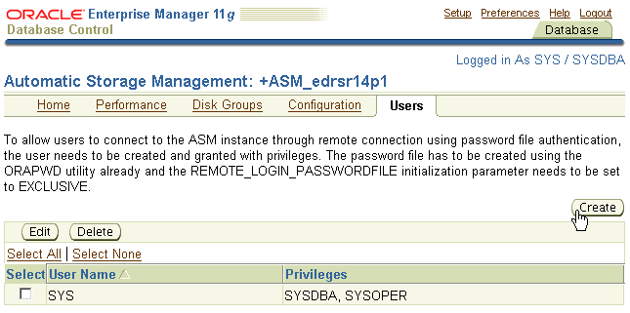
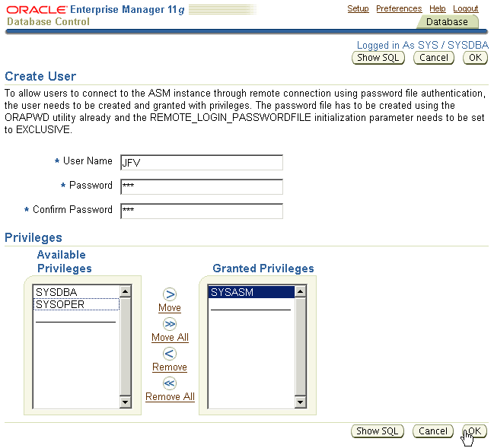
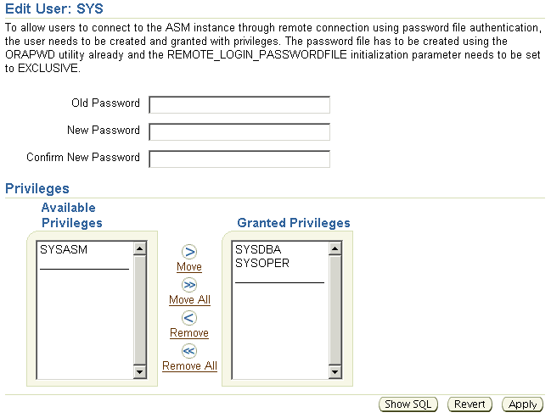
Using Enterprise Manager to Manage ASM Users
Notes:
Oracle Database 11g: Administration Workshop II 1 - <number>

Slide 24

Shutting Down an ASM Instance
Database instance A
Database instance B
2
ASM instance
3
SHUTDOWN NORMAL
1
1
Notes:
Oracle Database 11g: Administration Workshop II 1 - <number>

Slide 25
ASM Storage: Concepts
Database
ASM
disk group
Tablespace
Data file
ASM file
Segment
ASM disk
Extent
File-system
file
or
raw device
Allocation unit
Oracle
block
Physical
block
Notes:
Oracle Database 11g: Administration Workshop II 1 - <number>

Slide 26

ASM Disk Group
  Is a pool of disks managed as a logical unit
  Partitions total disk space into
  uniform sized units
  Spreads each file evenly
  across all disks
  Uses coarse- or fine-grain striping
  on the basis of file type
  Administers disk groups, not files
ASM
instance
Disk group
Notes:
Oracle Database 11g: Administration Workshop II 1 - <number>

Slide 27

Failure Group
Controller 1
Controller 2
Controller 3
6
5
4
3
2
1
7
13
1
7
13
1
7
13
1
7
13
1
7
13
1
7
13
1
7
13
1
7
13
1
7
13
Failure group 1
Failure group 2
Failure group 3
Disk group A
Notes:
Oracle Database 11g: Administration Workshop II 1 - <number>

Slide 28

Disk Group Mirroring
  Mirror at extent level
  Mix primary and mirror
  AUs on each disk
  External redundancy:
  Defers to hardware
  mirroring
  Normal redundancy:
    Two-way mirroring
    At least two failure groups
  High redundancy:
    Three-way mirroring
    At least three failure groups
Notes:
Oracle Database 11g: Administration Workshop II 1 - <number>

Slide 29
Disk Group Dynamic Rebalancing
  Automatic online
  rebalance whenever
  storage configuration
  changes
  Moving only the
  amount of data
  that is proportional to
  the storage added
  No need for manual
  I/O tuning
  Online migration to
  new storage
  Configurable load
  on system using ASM_POWER_LIMIT
Notes:
Oracle Database 11g: Administration Workshop II 1 - <number>

Slide 30
Managing Disk Groups
CREATE DISKGROUP
ASM
instance
DROP DISKGROUP
Database
instance
ALTER DISKGROUP
Notes:
Oracle Database 11g: Administration Workshop II 1 - <number>

Slide 31
Creating and Dropping Disk Groups
CREATE DISKGROUP dgroupA NORMAL REDUNDANCY
FAILGROUP controller1 DISK
'/devices/A1' NAME diskA1 SIZE 120G FORCE,
'/devices/A2',
'/devices/A3'
FAILGROUP controller2 DISK
'/devices/B1',
'/devices/B2',
'/devices/B3';
DROP DISKGROUP dgroupA INCLUDING CONTENTS;
Notes:
Oracle Database 11g: Administration Workshop II 1 - <number>

Slide 32
Adding Disks to Disk Groups
ALTER DISKGROUP dgroupA ADD DISK
'/dev/rdsk/c0t4d0s2' NAME A5,
'/dev/rdsk/c0t5d0s2' NAME A6,
'/dev/rdsk/c0t6d0s2' NAME A7,
'/dev/rdsk/c0t7d0s2' NAME A8;
ALTER DISKGROUP dgroupA ADD DISK '/devices/A*';
Disk formatting
Disk group rebalancing
Notes:
Oracle Database 11g: Administration Workshop II 1 - <number>

Slide 33
ASM Disk Group Compatibility
  Compatibility of each disk group is separately controllable:
    ASM compatibility controls ASM metadata on-disk structure
    RDBMS compatibility controls minimum consumer client level
    Useful with heterogeneous environments
  Setting disk group compatibility is irreversible.
DB
instance
ASM disk
group
ASM
instance
COMPATIBLE
>=
COMPATIBLE.RDBMS
<=
COMPATIBLE.ASM
<=
COMPATIBLE
Notes:
Oracle Database 11g: Administration Workshop II 1 - <number>

Slide 34
ASM Disk Group Attributes
Name | Property | Values | Description
au_size | C | 1|2|4|8|16|32|64MB | Size of allocation units in the disk group
compatible.rdbms | AC | Valid database version | Format of messages exchanged between DB and ASM
compatible.asm | AC | Valid ASM instance version | Format of ASM metadata structures on disk
disk_repair_time | AC | 0 M to 2³² D | Length of time before removing a disk once OFFLINE
template.tname. redundancy | A | UNPROTECT|MIRROR|HIGH | Redundancy of specified template
template.tname. stripe | A | COARSE|FINE | Striping attribute of specified template
C: CREATE
A: ALTER
CREATE DISKGROUP DATA NORMAL REDUNDANCY
DISK '/dev/raw/raw1','/dev/raw/raw2'
ATTRIBUTE 'compatible.asm'='11.1';
Notes:
Oracle Database 11g: Administration Workshop II 1 - <number>

Slide 35
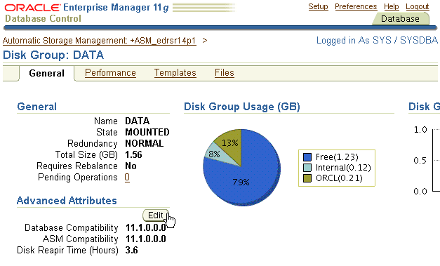
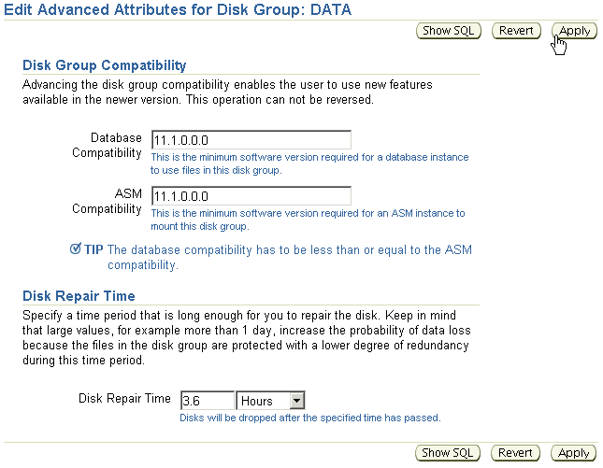
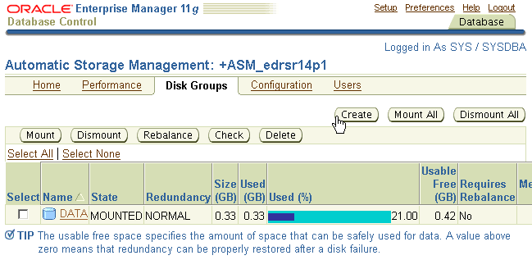
Using Enterprise Manager to
Edit Disk Group Attributes
Notes:
Oracle Database 11g: Administration Workshop II 1 - <number>

Slide 36




ASM Fast Mirror Resync Overview
1
ASM redundancy is used
2
Disk access failure
Primary
extent
Secondary
extent
Oracle Database 11g
Disk again accessible:
Only need to resync modified extents
4
3
Failure time < DISK_REPAIR_TIME
Notes:
Oracle Database 11g: Administration Workshop II 1 - <number>

Slide 37
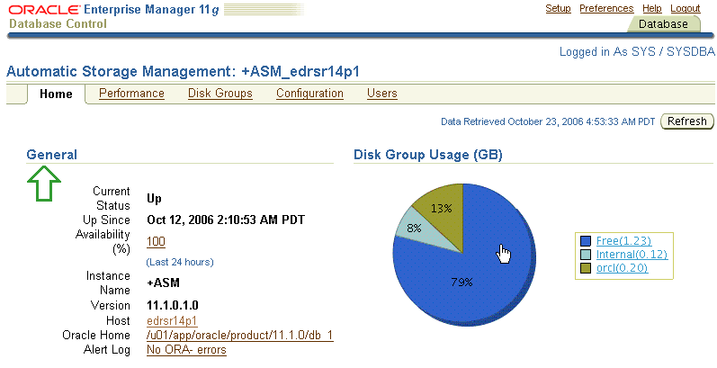
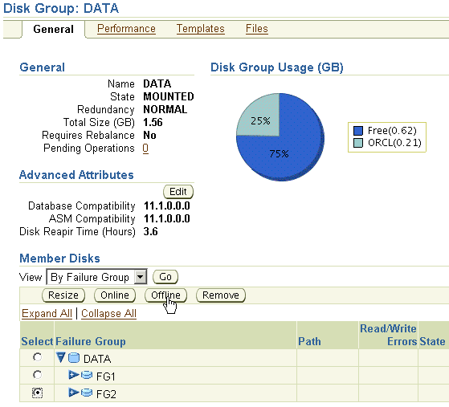
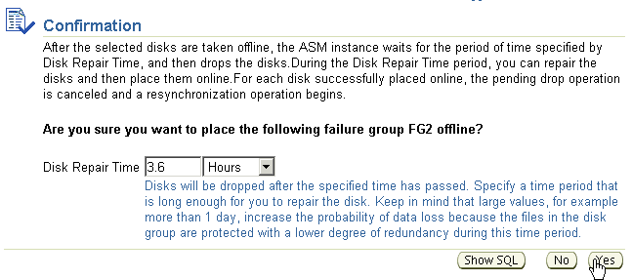
Using EM to Perform Fast Mirror Resync
Notes:
Oracle Database 11g: Administration Workshop II 1 - <number>

Slide 38
Miscellaneous ALTER Commands
Remove a disk from dgroupA:
Add and drop a disk in a single command:
Cancel a disk drop operation:
ALTER DISKGROUP dgroupA DROP DISK A5;
ALTER DISKGROUP dgroupA
DROP DISK A6
ADD FAILGROUP fred
DISK '/dev/rdsk/c0t8d0s2' NAME A9;
ALTER DISKGROUP dgroupA UNDROP DISKS;
Notes:
Oracle Database 11g: Administration Workshop II 1 - <number>

Slide 39
ASMCMD Utility
SQL> CREATE TABLESPACE tbsasm DATAFILE '+DGROUP1' SIZE 100M;
Tablespace created.
SQL> CREATE TABLESPACE hrapps DATAFILE '+DGROUP1' SIZE 10M;
Tablespace created.
$ export ORACLE_SID=+ASM
$ asmcmd
ASMCMD> ls -l DGROUP1/ORCL/DATAFILE
Type Redund Striped Time Sys Name
DATAFILE MIRROR COARSE OCT 05 21:00:00 Y HRAPPS.257.570923611
DATAFILE MIRROR COARSE OCT 05 21:00:00 Y TBSASM.256.570922917
ASMCMD>
Notes:
Oracle Database 11g: Administration Workshop II 1 - <number>

Slide 40
ASMCMD Utility
User created directories
Templates
Disk group compatibility
Disk group name
Disk names and failure groups
md_backup
full
repair/remap
$ asmcmd help
md_restore
nodg
newdg
lsdsk
ASMCMD> md_backup –b /tmp/dgbackup070222 –g admdsk1 –g asmdsk2
ASMCMD> md_restore –t full –g asmdsk1 –i backup_file
ASMCMD> lsdsk -k DATA *_0001
Notes:
Oracle Database 11g: Administration Workshop II 1 - <number>

Slide 41
ASM Scalability and Performance
  Extent size grows automatically according to file size.
  ASM support variable extents size to:
    Raise maximum possible file size
    Reduce memory utilization in shared pool
  ASM imposes the following limits:
    63 disk groups in a storage system
    10,000 ASM disks in a storage system
    4 petabyte maximum storage for each ASM disk
    40 exabyte maximum storage for each storage system
    1 million files for each disk group
Notes:
Oracle Database 11g: Administration Workshop II 1 - <number>

