Slide 2






$$v_{z}$$
$$d\vec{v}$$
$$\vec{v}$$
$$O$$
$$v_{y}$$
$$v_{x}$$

Slide 3
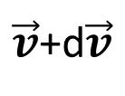



$$v_{y}$$
$$\vec{v}$$
$\vec{v}$+d$\vec{v}$
$$v_{x}$$

Slide 4
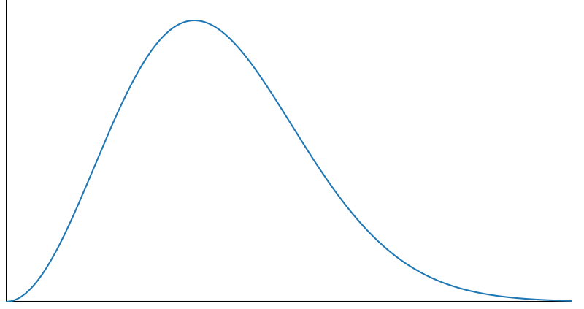




$$\frac{dN_{v}}{dv}$$
$$v$$
$$O$$
d$v$

Slide 5










$$λ_{9}$$
10
9
5
2
$$λ_{5}$$
3
$$λ_{10}$$
$$λ_{2}$$
7
$$λ_{6}$$
6
$$λ_{1}$$
$$λ_{4}$$
$$λ_{8}$$
$$λ_{3}$$
11
1
$$λ_{7}$$
4
8

Slide 6









$$r$$
$$r$$
$$\left\langle v\right\rangle Δt$$
$$2r$$
$$D>2r$$
$$r$$
$$D<2r$$
$$D=2r$$
$$D>2r$$

Slide 7




B
$$\left\langle v\right\rangle$$
O
$$v_{r}$$
$$θ$$
$$\left\langle v\right\rangle$$
A

