Slide 1

Lecture-16
Data Structures
•
Binary
Binary
Trees
Search Trees
•
Kartik Mathur

Slide 2

7-07-2018 2
Binary Trees
1.
Diameter and height
in O(N).
2.
Mirror
of
a Tree.
Input Tree
.
Make a tree using Inorder
3.
Levelwise
4.
and
PostOrder

Slide 3
3
Binary Search Trees

Slide 4
4
BST Properties
Every Node in left
1.
subtree
than or equal to root
has value less
Every Node in right
has value
greater than or equal to root
2.
subtree

Slide 5
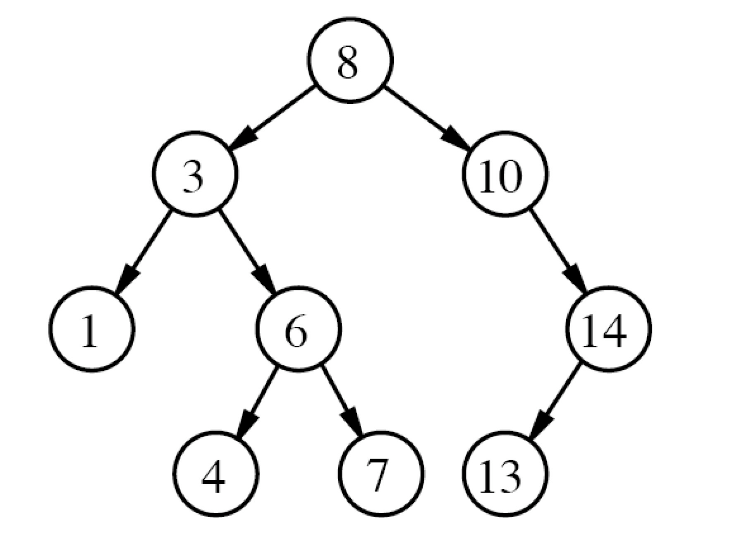
5
Binary Search trees

Slide 6
6
Binary Search Trees
class BinarySearchTree{
// accessor methods
int size();
bool isEmpty();
bool findElement(int element);
// update methods
void addElement(int element);
void removeElement(int element) throws
BSTEmptyException;
}

Slide 7
7
Lets discuss few problems
Print
and K2
Search & Adding element in BST
1.
BST elements
in range K1
2.

Slide 8
8
Your Turn
1.
Convert a BST
into sorted Linked List
Given a binary
BST
Check if a Binary Tree is Balanced
2.
tree check if
its
3.

Slide 9
9
Build a BST using a sorted
array

Slide 10
10
Balanced/unbalanced Tree

Slide 11
11
Balanced Trees
AVL
1.
Tree
Red Black
2.
Trees
3.
2
-
4 Trees

Slide 12
Thank You!
Kartik Mathur

