Slide 1
US Domestic Extremist Groups on the Web: Link Analysis
Paras Pandey
March 26th 2019

Slide 2
University of Arizona
They used two methods to study the dark web movement of these groups
Content Analysis
Hyperlink Connection
By analyzing the site content and visualizing the hyperlinks at the collection level, the methodology formalizes the knowledge discovery process. At the same time, they sought to better understand how domestic extremist groups use the Web infrastructure so that they can develop a comprehensive understanding of the extremists themselves.

Slide 3
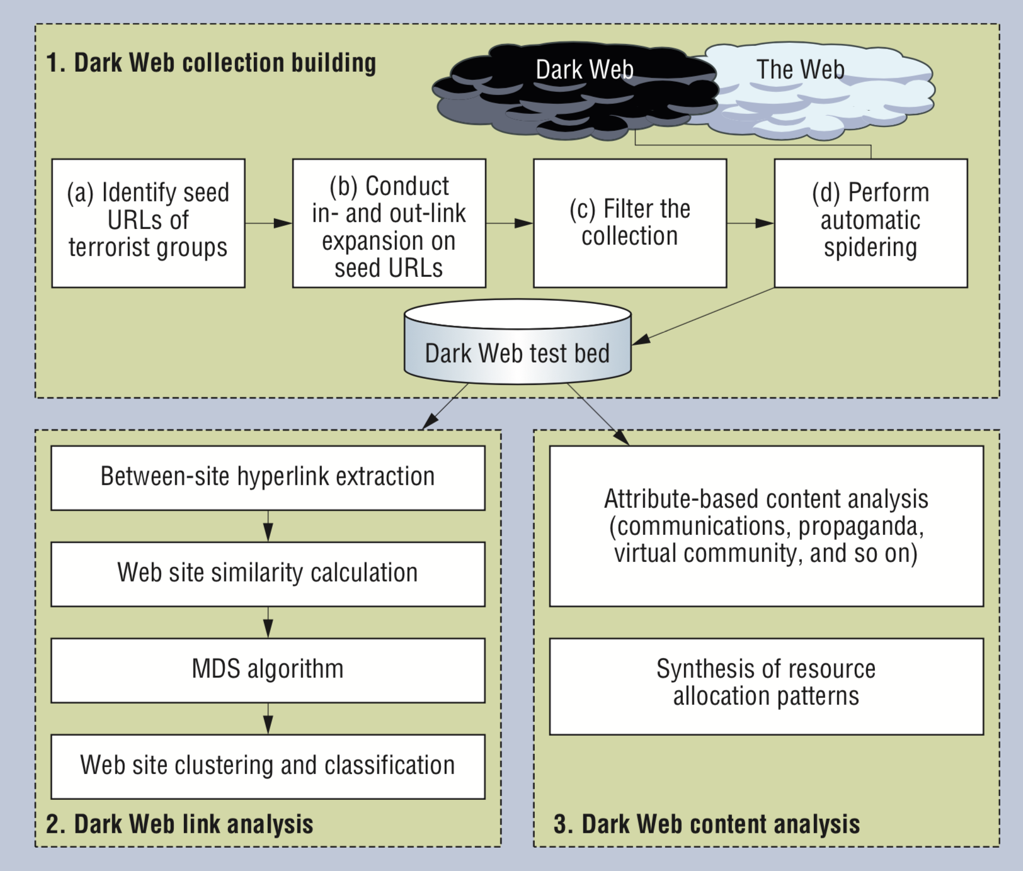

Slide 4
4 groups of hate groups they focused on
Neo Confederate
White supremacist
Christians Identity
Neo Nazis

Slide 5
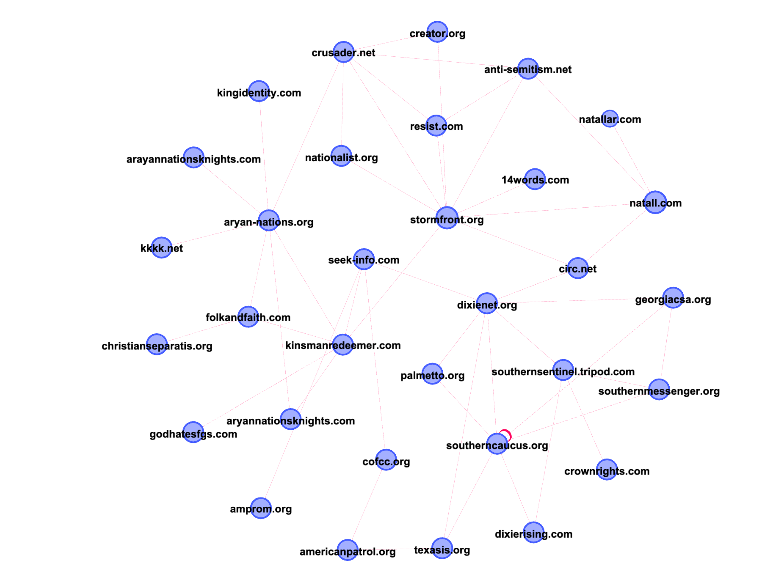
Network Diagram showing the connection between different hate groups

Slide 6
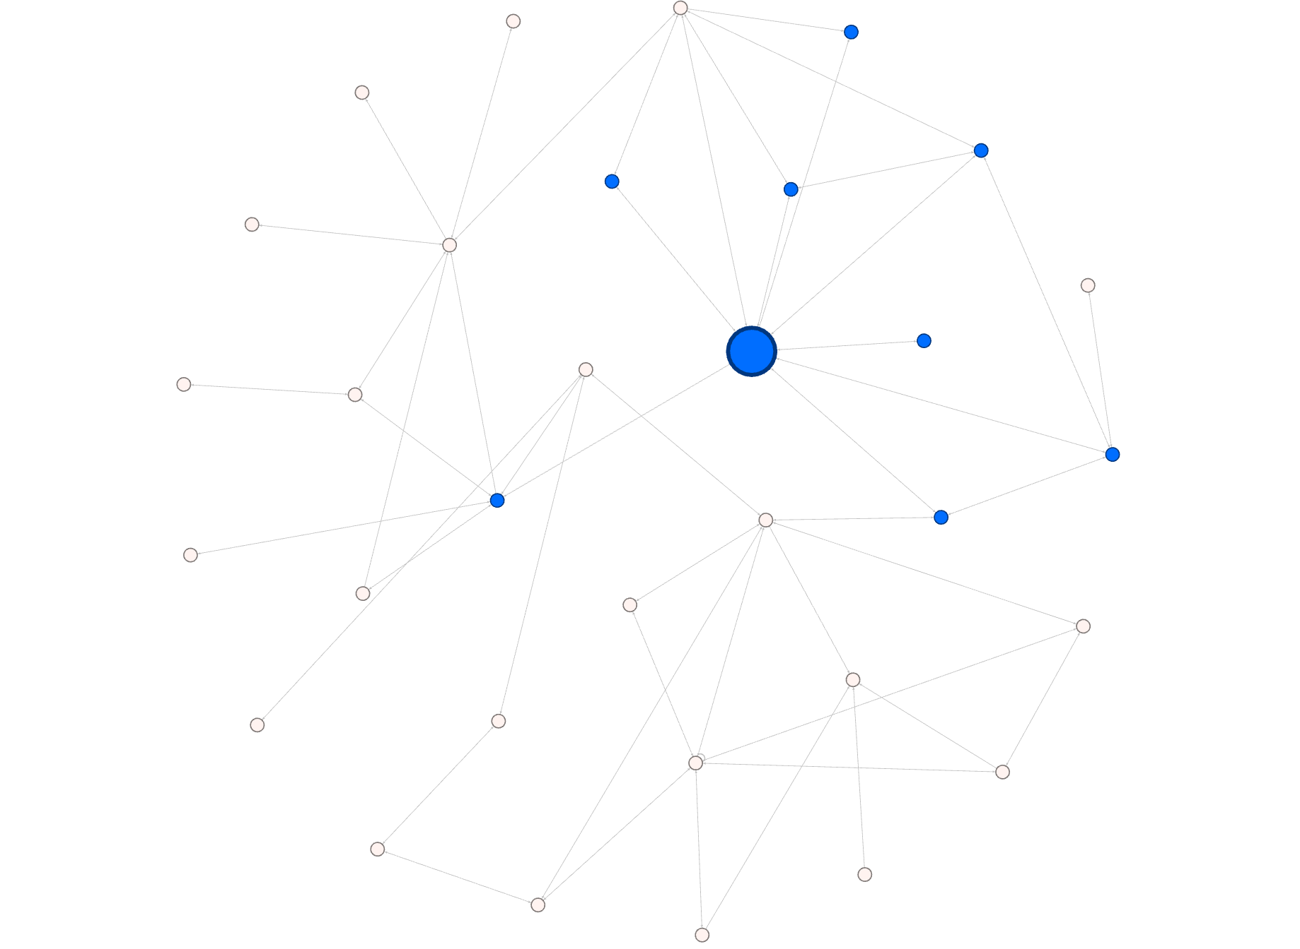
Stormfront
Creator.org
Anti-Semitism
Nationalist.org
Resist.com
14words.in
Stormfront
Natall
kinsmanredeemer
Circ.net
Notes:
The first and by far foremost is www.stormfront.org. It has many in-links indicating its popularity among white supremacists

Slide 7
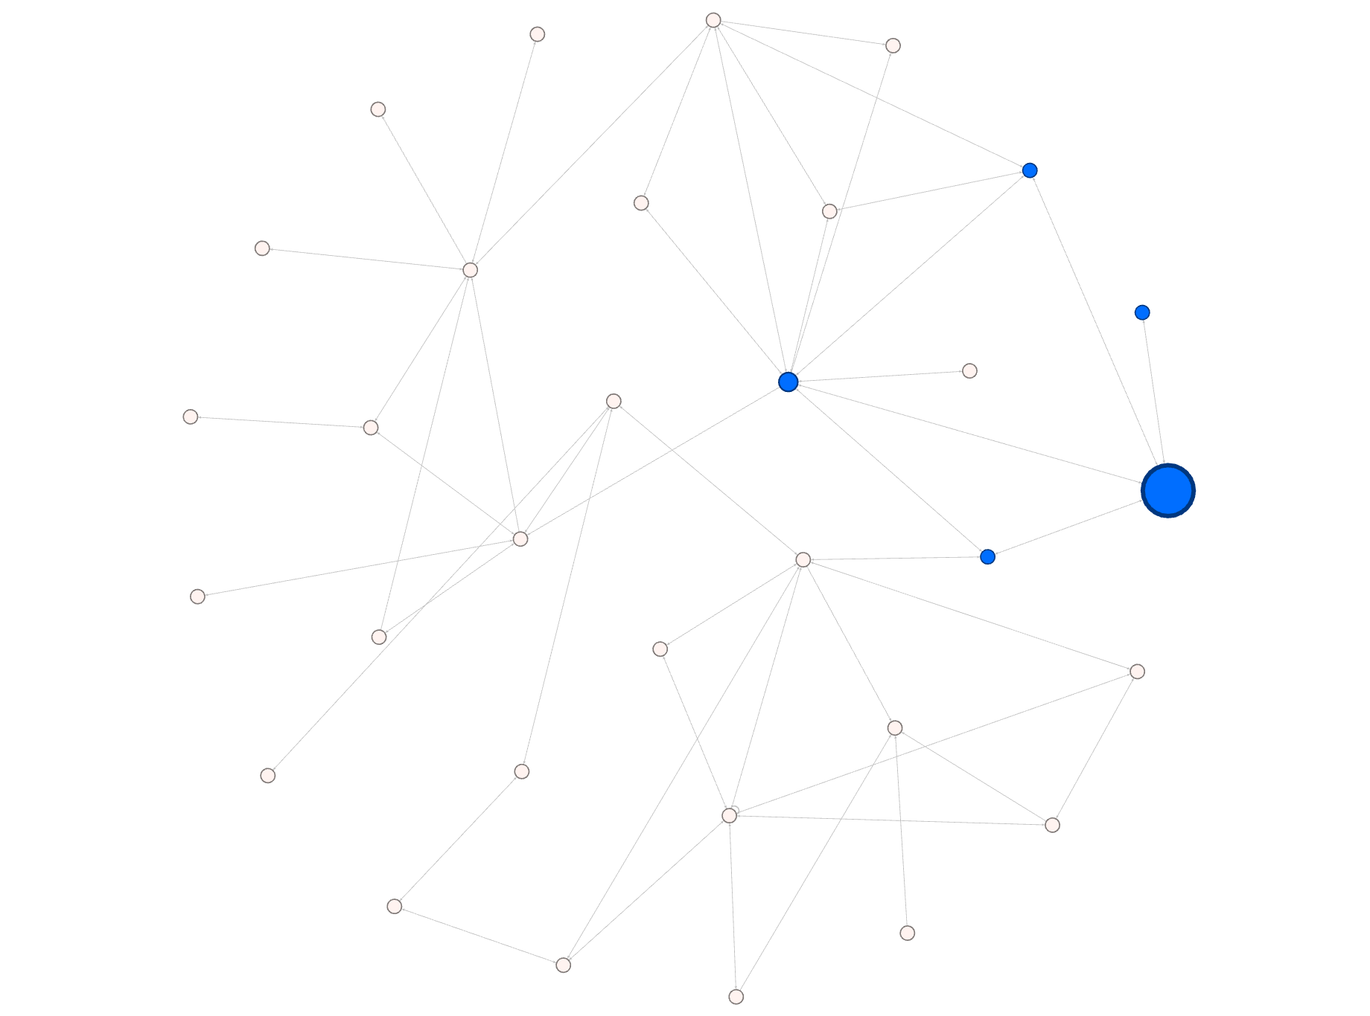
Natall
Anti-Semitism
natallar.in
Stormfront
Natall
Circ.net
Notes:
The second most prominent site belongs to the National Alliance (www.natall.com). It is a neo-Nazi site that also has many in-links, testifying to its popularity

Slide 8
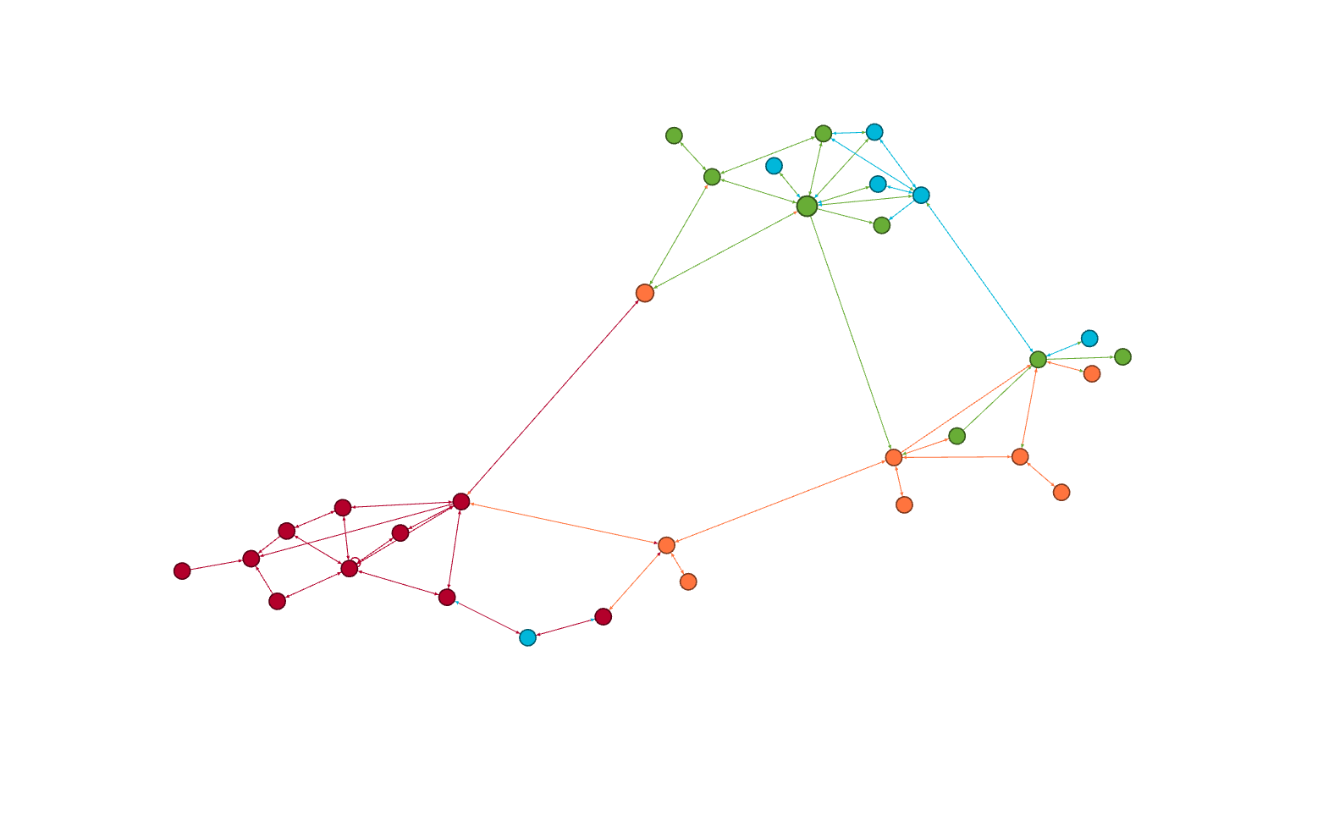
Relationship
White supremacists/ Neo Nazis
Neo Confederate
White supremacist
Christians Identity
Neo Nazis
Neo Confederate Cluster
Christians Identity Cluster
Notes:
The neoconfederate cluster in the top left corner consists mainly of sites espousing a separatist ideology to establish an indepen- dent state in the southern US. The neocon- federates share white-supremacist ideas with other racist organizations such as the Ku Klux Klan—the most prominent US hate group. The White Supremacy/neo-Nazi clus- ter in the network’s top right corner includes the Stormfront site and the White Aryan Resistance site. The bottom right corner iden- tifies a cluster of primarily Christian Identity Web sites.

Slide 9
Thank You

Slide 10
References
https://ieeexplore.ieee.org/document/1511999?tp=&arnumber=1511999&url=http:%2F%2Fieeexplore.ieee.org%2Fxpls%2Fabs_all.jsp%3Farnumber%3D1511999

