Slide 1


Hello World
Paras Pandey, Pradeep Kumar Tamilmani
Samia Haimoura, Russell Huang, Artem Streltsov

Slide 2



Approach
Temperature
Humidity
Normalization

Slide 3



Models
Ranking
OLS Regression
Random Forest

Slide 4
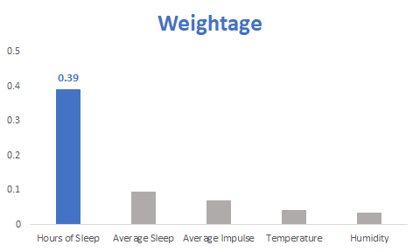
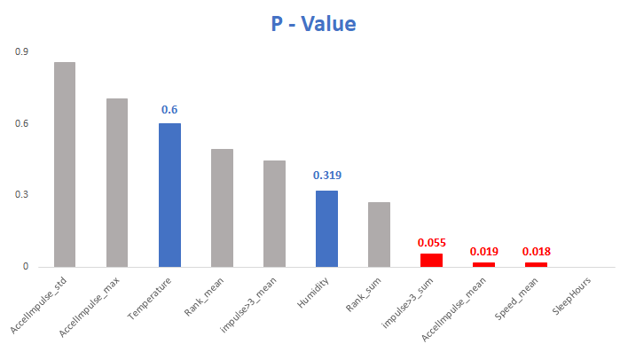
Findings
OLS Regression: 0.36
Random Forest: 0.82

Slide 5
Ranking Models
OLS Regression
Random Forest
Rank_mean: 0.23
Rank_mean: 0.02
Rank_sum: 0.15
Rank_sum: 0.03

Slide 6
Thank you
Comments ???

