Slide 1
DROUGHT & WATER MANAGEMENT
JalSaurashtra
Intelligent Drought & Groundwater Depletion Advisor for Saurashtra
An Agentic AI system that assesses groundwater depletion trends, recommends water-efficient farming practices, and guides community-level recharge interventions for farmers across Saurashtra, Gujarat.
IBM University Engagement Program • Powered by IBM Granite, watsonx.ai & Langflow
Project Submission | Eduent Foundation
Exploring the Power of Agentic AI with IBM Granite and LangFlow

Slide 2
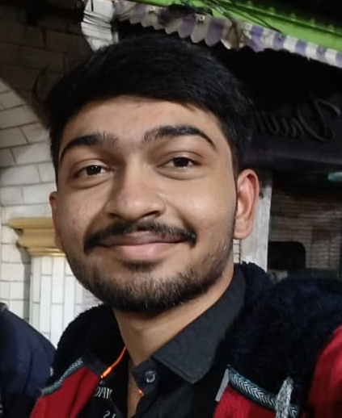
PROJECT SUBMISSION
Project Submission Details
Project Title: JalSaurashtra – Intelligent Drought & Groundwater Depletion Advisor Domain: Drought & Water Management (Agriculture · Groundwater · Climate Resilience)
Student Name
Recent Passport Photo
Email ID
Mobile Number (WhatsApp)
Bhaliya Paras
parasbhaliya2@gmail.com
7600645406
What this submission includes:
Problem & Objective
Agentic AI Architecture
Working Prototype (Live Screens)
Novelty & Future Scope
JalSaurashtra | Drought & Groundwater Depletion Advisor for Saurashtra
2

Slide 3
THE CHALLENGE
THE CHALLENGE
Problem Statement
Recurring Drought & Severe Groundwater Depletion
10
The Saurashtra region of Gujarat faces recurring drought conditions and severe groundwater depletion, driven largely by over-extraction of water for agriculture. Farmers lack timely, localized guidance on:
Saurashtra districts affected by chronic water stress
How stressed their groundwater situation really is, in real time
Which crops and irrigation methods are truly water-efficient for their soil & season
When and how to intervene before conditions turn critical
Which groundwater-recharge structure suits their land and community
60–80%
of Saurashtra's irrigation depends on groundwater
0
The result: falling water tables, failed harvests, and communities left to respond to water crises only after they escalate.
real-time, farmer-facing early-warning tools in most villages today
JalSaurashtra | Drought & Groundwater Depletion Advisor for Saurashtra
3

Slide 4
OUR GOAL
Objective
Build Agentic AI that turns fragmented water data into confident, community-level action.
💧
🌾
♻️
Assess Groundwater Depletion Trends
Recommend Water-Efficient Farming Practices
Guide Community-Level Recharge Interventions
Continuously track depth-to-groundwater against safe & critical thresholds across Saurashtra districts and surface early warnings.
Match crop choice, irrigation method, and scheduling to each farm's soil, season, and water availability.
Point villages and farms to the right recharge structure — farm ponds, check dams, percolation tanks, recharge wells.
JalSaurashtra | Drought & Groundwater Depletion Advisor for Saurashtra
4

Slide 5
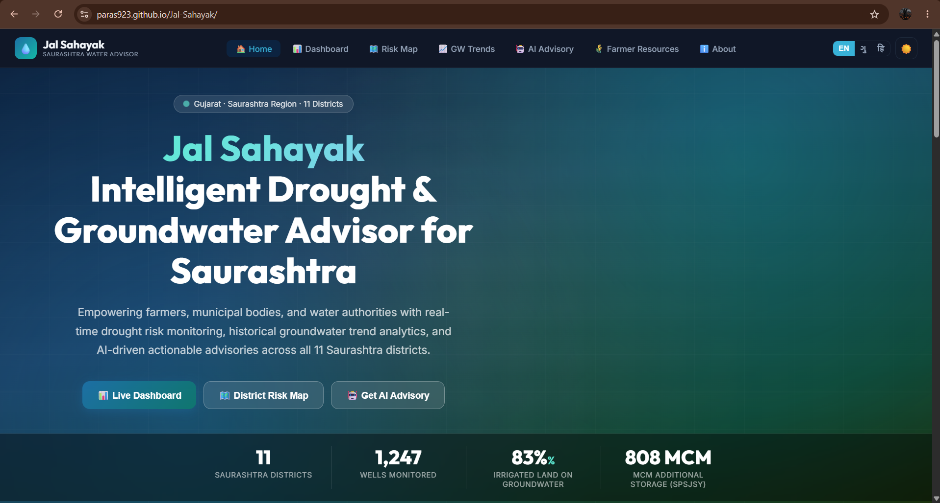
PROPOSED SOLUTION
JalSaurashtra: An Agentic AI Water Advisor
JalSaurashtra is a multi-agent, AI-powered decision-support platform built on Langflow, IBM Granite, and IBM watsonx.ai. It converts scattered groundwater, rainfall, soil, and crop information into a single, personalized water-action plan for every farm — then extends that intelligence to community-level recharge planning.
1
Assess — Farmers or field officers enter farm, soil, irrigation, and groundwater details through a simple guided form.
2
Reason — Specialized agents score drought/water stress, cross-check groundwater trend data, and retrieve locally-relevant agronomic knowledge via RAG.
3
Recommend — The system returns a water-stress score, safer crop choices, irrigation guidance, and a 30-day water-smart action plan.
Farmer-facing web application — home screen
4
Recharge — A dedicated recharge agent matches land slope, soil, and rainfall to the right community recharge structure.
JalSaurashtra | Drought & Groundwater Depletion Advisor for Saurashtra
5

Slide 6
TECHNOLOGY USED
Technology Stack
🤖 Agentic AI Architecture (Backend)
💻 Working Prototype (Delivered)
Langflow — Orchestrates the multi-agent workflow visually and routes requests between specialized agents
HTML5, CSS3, JavaScript — Responsive, mobile-first farmer-facing web application
IBM Granite Models — e.g. ibm-granite-3-2-8b for natural language understanding, reasoning, and recommendation generation
Chart.js — Interactive groundwater trend, rainfall, and crop-comparison charts
IBM watsonx.ai — Model deployment, embeddings, and AI governance for the advisory agents
SVG Visualization — Regional Saurashtra overview map and illustrative graphics
RAG (Retrieval-Augmented Generation) — Grounds recommendations in verified agronomy, groundwater, and rainfall reference data
Rule-Based Decision Engine — Simulates the agent logic end-to-end today; built to swap in Granite/Langflow agent calls
Vector Database (FAISS / Chroma) — Stores and retrieves district-level groundwater, crop, and rainfall knowledge
IBM Cloud — Provides the secure, scalable infrastructure to build and deploy the agent network
Bilingual UI — English / Gujarati toggle for grassroots accessibility
JalSaurashtra | Drought & Groundwater Depletion Advisor for Saurashtra
6

Slide 7
LANGFLOW COMPONENTS
Multi-Agent System Components
🌵
Drought & Water-Stress Agent
Scores each farm's water stress (0–100) from soil, irrigation, water availability and rainfall outlook, and triggers tiered alerts.
1
🌾
Water-Efficient Crop Advisory Agent
Filters and ranks crops by season, soil, drought tolerance and water need; powers side-by-side crop comparisons.
2
💧
Groundwater Monitoring Agent
Tracks depth-to-groundwater vs. safe/critical thresholds per district and classifies status: Normal → Watch → Warning → Critical.
3
♻️
Recharge Advisory Agent
Matches soil, slope, farm size and rainfall to the right recharge structure — farm pond, check dam, percolation tank, recharge well.
4
📊
Orchestrator & Dashboard Agent
Aggregates every agent's output into one unified advisory dashboard and a 30-day water-smart action plan for the farmer.
JalSaurashtra | Drought & Groundwater Depletion Advisor for Saurashtra
7
5

Slide 8
ARCHITECTURE
System Architecture
Farmer Input
(Farm & Soil Form)
Groundwater Data
(CGWB / GWRDC)
Rainfall Data
(IMD)
Crop & Soil Reference
(ICAR / SAU)
🔗 Langflow Agent Orchestrator
Drought & Water-
Stress Agent
Crop Advisory
Agent
Groundwater
Monitoring Agent
Recharge
Advisory Agent
🧠 IBM Granite Models + IBM watsonx.ai + RAG (Vector DB: FAISS / Chroma)
📊 Personalized Advisory Dashboard — Farmer & Field-Officer Web App
JalSaurashtra | Drought & Groundwater Depletion Advisor for Saurashtra
8

Slide 9
WHY AGENTIC AI
Role of Agentic AI in the Solution
Rather than a single chatbot, JalSaurashtra uses autonomous, cooperating agents — orchestrated in Langflow and reasoned over by IBM Granite models — to plan, retrieve, decide and act across the full water-management journey.
🤖
✓
Multi-Step Reasoning — Each agent chains multiple decisions — stress scoring, threshold checks, crop matching — instead of returning a single canned reply.
From Chatbot to
Co-Pilot
✓
Tool & Data Grounded — Agents call groundwater, rainfall and crop-reference tools via RAG, so answers are grounded in current, local conditions.
A single-turn chatbot answers questions.
An agentic system plans, checks thresholds, retrieves local data, coordinates specialist agents, and delivers a complete, actionable water plan — the way a trusted local water officer would.
✓
Context-Aware Personalization — Recommendations adapt to each farm's district, soil, crop, irrigation method and groundwater depth — not generic advice.
✓
Proactive, Not Reactive — The system raises alerts and 30-day action plans before conditions become critical, rather than waiting to be asked.
JalSaurashtra | Drought & Groundwater Depletion Advisor for Saurashtra
9

Slide 10
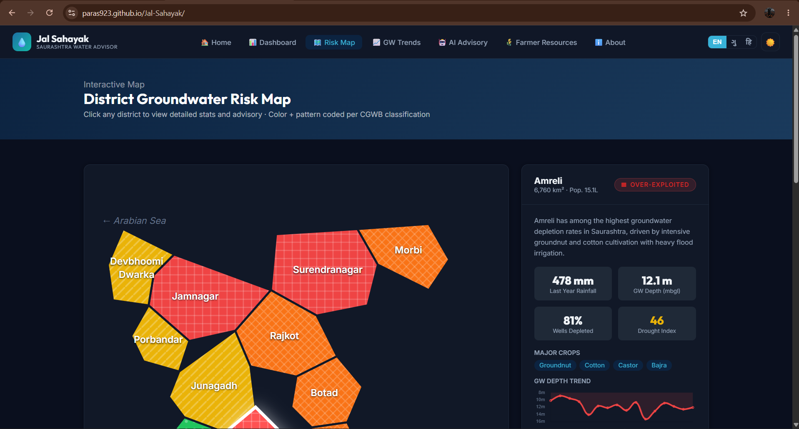
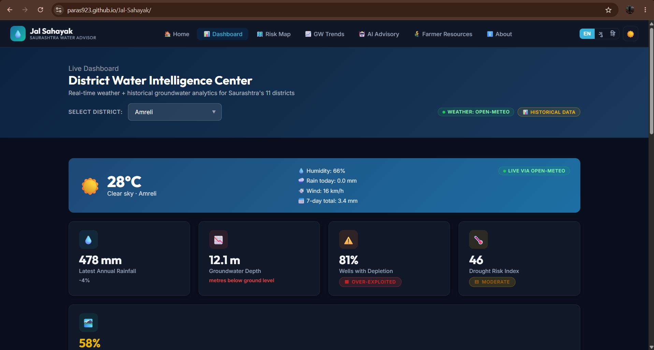
SOLUTION IN ACTION
Personalized Drought & Water-Stress Advisory
Live screens from the JalSaurashtra web application
JalSaurashtra | Drought & Groundwater Depletion Advisor for Saurashtra
10

Slide 11
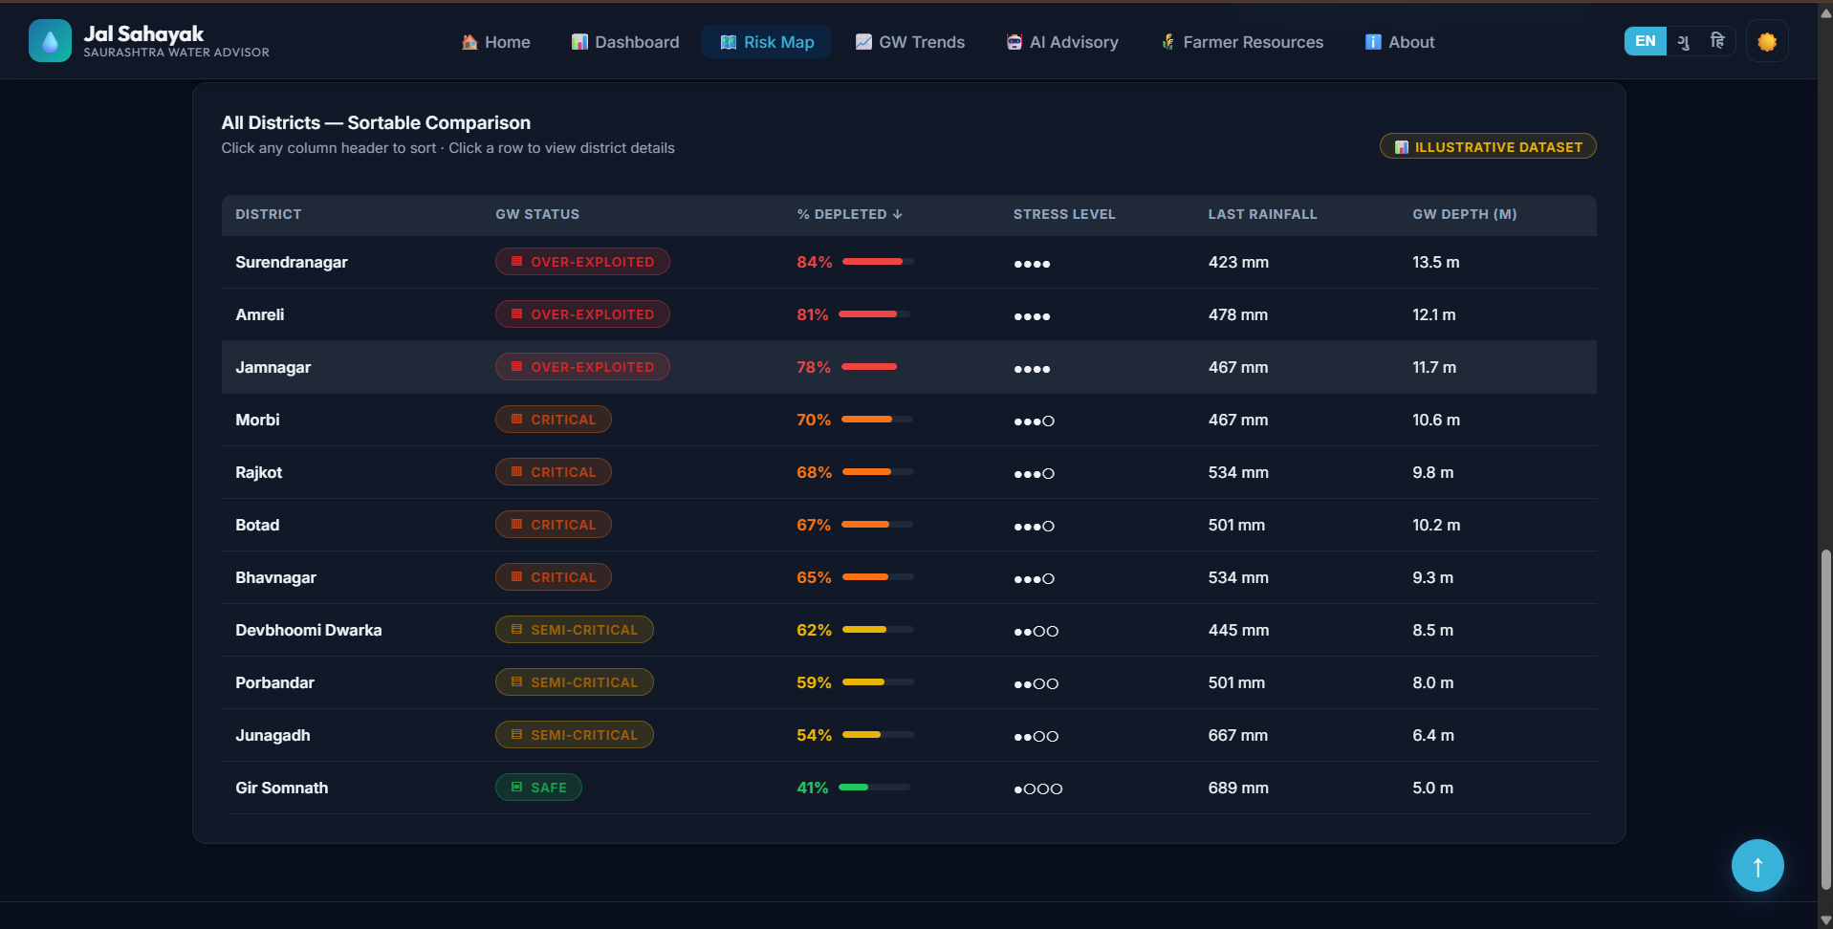
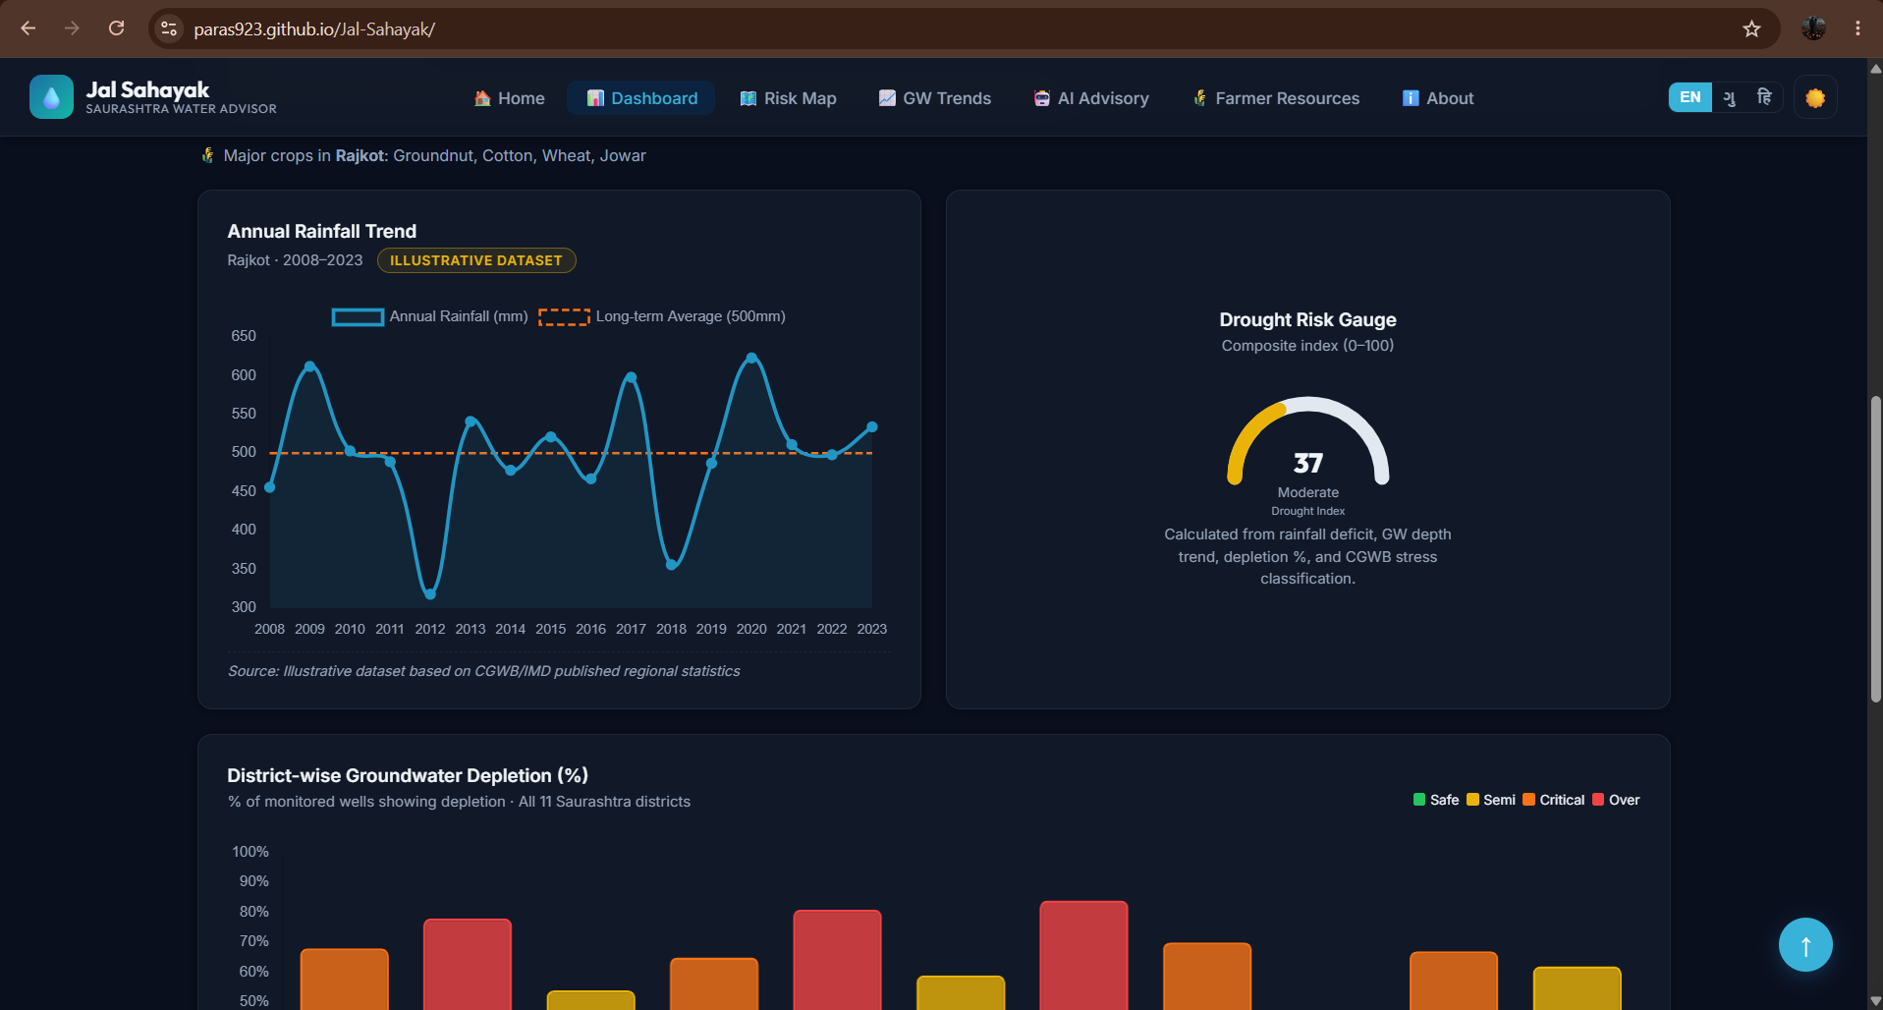
SOLUTION IN ACTION
Groundwater Monitoring & Regional Overview
Tracking depletion trends across Saurashtra districts
JalSaurashtra | Drought & Groundwater Depletion Advisor for Saurashtra
11

Slide 12
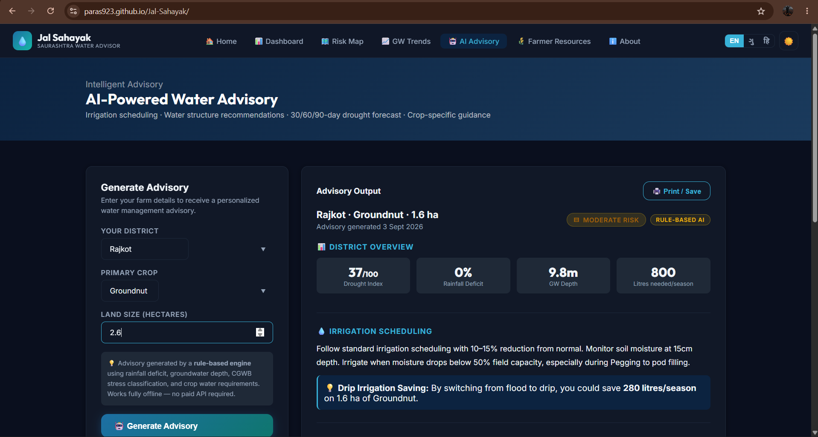
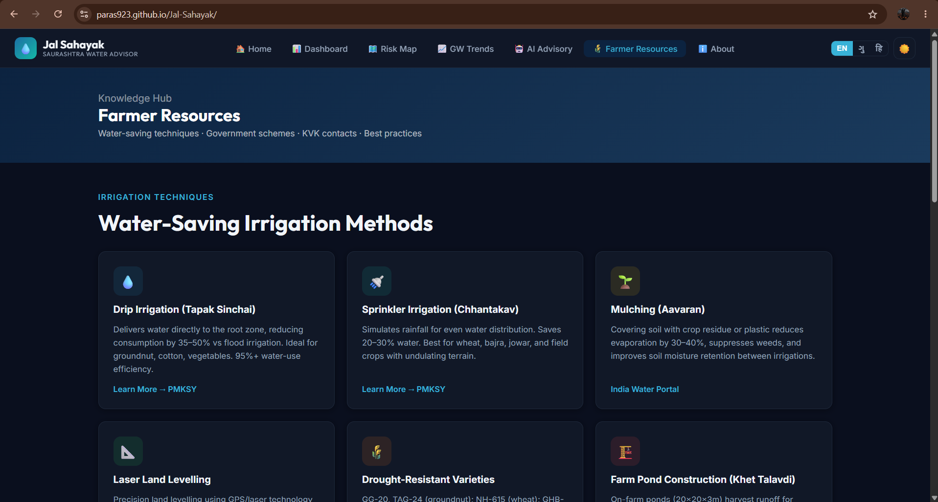
SOLUTION IN ACTION
Crop Advisory & Community Recharge Planning
Matching water-efficient crops and recharge structures to local conditions
JalSaurashtra | Drought & Groundwater Depletion Advisor for Saurashtra
12

Slide 13
DIFFERENTIATION
Novelty and Uniqueness
Multi-Agent Specialization
Groundwater-Aware Reasoning
Dedicated agents for drought risk, crops, groundwater trends and recharge — not one generic chatbot.
Compares live depth-to-groundwater against safe & critical thresholds to trigger tiered, explainable alerts.
Hyper-Local to Saurashtra
Action Plans, Not Just Scores
District & taluka-level granularity across all 10 Saurashtra districts, tuned to regional soils and rainfall.
Outputs a full 30-day water-smart action plan — concrete steps, not just a diagnosis.
Community Recharge Guidance
Built for Real Data Integration
Extends beyond the individual farm to village-level recharge interventions matched to land and rainfall.
Architected to plug directly into CGWB/GWRDC groundwater feeds, IMD rainfall, and ICAR crop datasets.
JalSaurashtra | Drought & Groundwater Depletion Advisor for Saurashtra
13

Slide 14
WHAT'S NEXT
Future Scope
🔌
🛰️
📱
Live Data Integration
IoT & Satellite Monitoring
Voice & SMS/WhatsApp Alerts
Connect to CGWB/GWRDC groundwater feeds, IMD rainfall, and ICAR crop datasets to replace demonstration data.
Piezometer networks and satellite soil-moisture data for automated, village-wide groundwater telemetry.
Multilingual voice assistant and offline-friendly SMS/WhatsApp alerts for farmers without smartphones.
🗺️
📈
📡
GIS-Based Heatmaps
Predictive ML Models
Wearable & Field-Sensor Integration
Leaflet/OpenStreetMap-powered village-level drought and groundwater heatmaps for officials.
Forecast groundwater depletion and crop-water demand from historical and real-time data.
Direct feeds from soil-moisture probes and farm sensors for continuously updated recommendations.
JalSaurashtra | Drought & Groundwater Depletion Advisor for Saurashtra
14

Slide 15
SUBMISSION
GitHub Repository & Submission Checklist
Repository URL: https://paras923.github.io/Jal-Sahayak/
Before submitting, please ensure the repository is public and includes:
✓
app / index.html — The working JalSaurashtra prototype (agent logic, forms, dashboard, charts).
✓
Problem_Statement.pdf — This challenge's problem statement, exactly as issued.
✓
Project_Presentation.pptx — This presentation — architecture, agents, screenshots, novelty & future scope.
✓
README.md — Setup instructions, tech stack summary, and a short demo walkthrough.
⚠ Also enable the README-on-create option when making the repository public, as required by the submission guidelines.
JalSaurashtra | Drought & Groundwater Depletion Advisor for Saurashtra
15

Slide 16
💧
Thank You!
JalSaurashtra — Agentic AI for a Drought-Resilient Saurashtra
Questions & feedback are welcome.
IBM University Engagement Program • Eduent Foundation

