Slide 1
Java Swing Calculator Project
Developed using IntelliJ IDEA
Paras Agrawal
A60205223118
Section –B

Slide 2
Objective
The objective of this project is to develop a GUI-based Calculator application using Java Swing.
It provides both basic and advanced arithmetic operations with user-friendly interaction.

Slide 3
Tools and Technologies Used
• Java Programming Language
• Java Swing for GUI components
• IntelliJ IDEA (IDE) for development
• AWT Event Handling
• JVM (Java Virtual Machine)

Slide 4
Working of the Project
1. The calculator GUI is built using JFrame and JPanel.
2. Buttons represent digits and operations.
3. Event listeners handle user actions.
4. The input is displayed, processed, and results are shown in real-time.
5. Proper layout managers are used for component alignment.

Slide 5
Features
• Basic arithmetic operations (+, -, *, /)
• Clear and backspace functions
• GUI with button-based input
• Error handling (e.g., divide by zero)
• Real-time result display

Slide 6
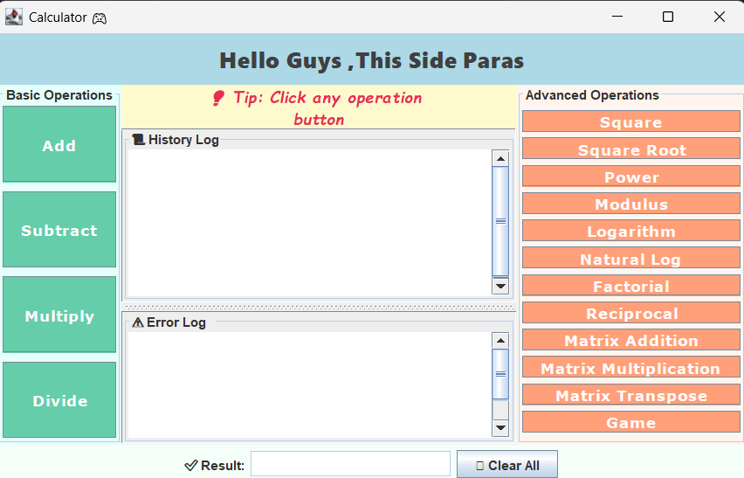
Project GUI

Slide 7
Advantages
• Easy to use graphical interface
• No need for command-line input
• Lightweight and fast
• Platform independent
• Enhances Java GUI development skills

Slide 8
Conclusion
This Java Swing Calculator project demonstrates how GUI applications are built using Swing.
It showcases efficient event handling and user interaction in a practical tool.
Project By: Paras Agrawal

