Slide 1

Introducing
BitBucks...

Slide 2

What is BitBucks?
An interface where anyone can download any app and earn FREE bucks as BitCoins.
Share BitBucks app and earn Bitcoins.
Earn Bitcoins and Use it anywhere , anytime, however you want.

Slide 3

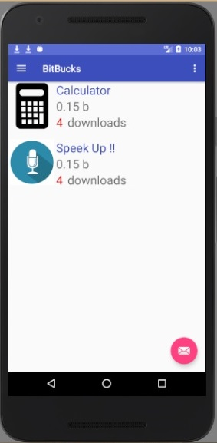

How it works?
Download BitBucks App
Click Here
Click on any app ,it will start downloading
You will get Bitcoins in your wallet

Slide 4

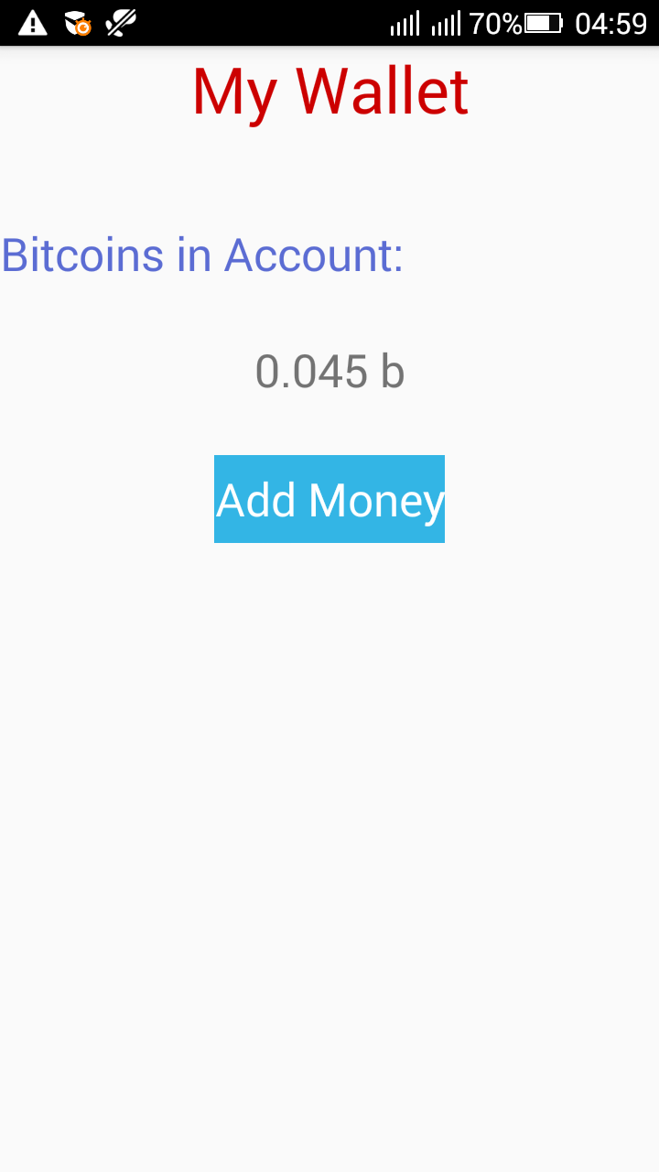
My Wallet
A Digital Wallet- Carry money virtually
Add Money in Bitcoins

Slide 5

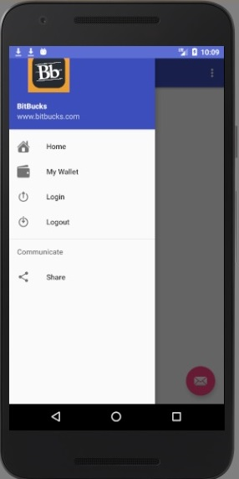
Share ,Earn and Enjoy
Refer your friends, family members
Earn FREE Bitcoins for each successful signup

