Slide 1
Parking Lot Management Application
Ruchitha Parasa

Slide 2
Problem Statement
Design and implement a Parking Lot Management Application that models a parking lot with a configurable number of parking slots. The system should efficiently manage vehicle entry, exit, and real-time slot availability across different vehicle sizes.
Objectives
Accept the total number of parking slots (N) from the user
Categorize parking slots into:
  Small (compact cars)
  Large (full-size cars)
  Oversize (SUVs or trucks)
Support:
  Vehicle Entry (Park)
  Vehicle Exit (Remove)
  Status Display (summary + detailed)
Storing data in memory/file
Implementing solution Command Line application in JAVA

Slide 3
Approach Overview
Implemented as a Java Command-Line Application
Followed OOP + separation of concerns
Modules:
Model Layer: represents vehicles and parking slots (Entities and enums)
Service Layer: contains parking and slot management logic (Business logic)
Storage Layer: handles file-based persistence (CSV)
Main Layer: manages user interaction and program flow (CLI + input flow)

Slide 4
Slot Allocation Strategy
40%
Small Vehicles
Example:
N = 7
SMALL=3, LARGE=2, OVERSIZE=2
Vehicles are parked only in a matching slot type
Parking policy: First available slot of the required type
40%
Large Vehicles
20%
Oversized Vehicles

Slide 5
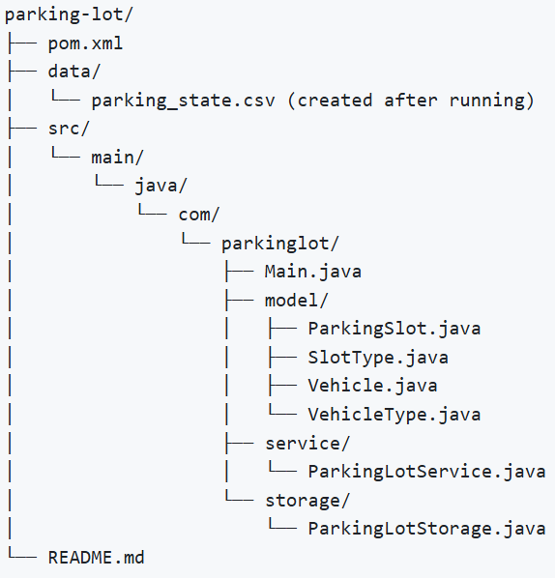
Key Files & Folders
src/main/java/com/parkinglot/Main.java → CLI and workflow
service/ParkingLotService.java → core operations and state
storage/ParkingLotStorage.java → CSV persistence
model/ → Vehicle, ParkingSlot, VehicleType, SlotType
data/parking_state.csv → persistent state file
README.md → instructions + run + output
presentation/ → PPT

Slide 6
Running Application
Running the application
Option 1: IDE (IntelliJ / STS / VS Code)
Open project
Run: src/main/java/com/parkinglot/Main.java
Option 2: Compile: javac com/parkinglot/Main.java
Run: java com.parkinglot.Main
Option 3: Maven (Terminal)
mvn clean compile
mvn exec:java

Slide 7
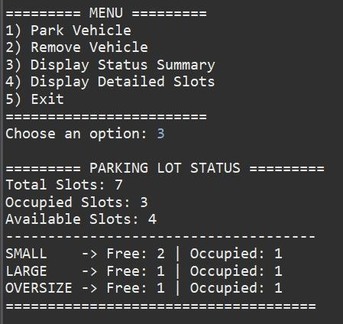
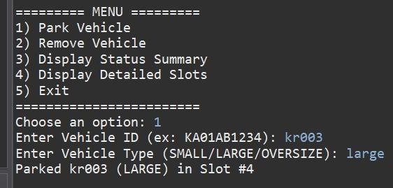
Sample Output
Adding the Vehicle (Park Vehicle, ID and Type)
Display status summary (Free & Occupied)

Slide 8
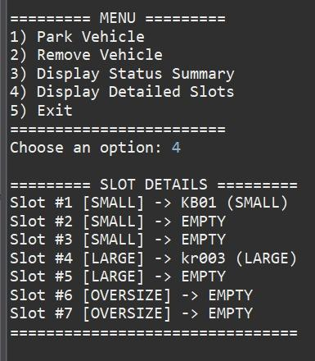
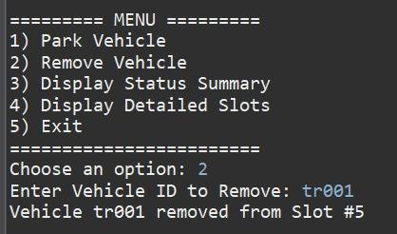
Sample Output
Removing Vehicle
Displaying all Detailed Slots

Slide 9

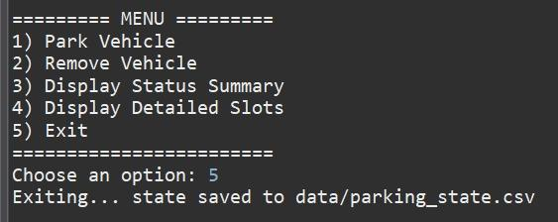
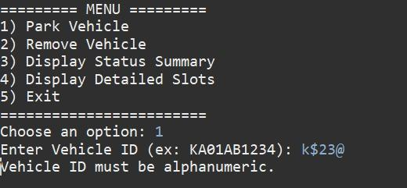
Sample Output
Saving state (parking_state.csv)
Handling Errors (Input Handling)

Slide 10
Thank You

