Slide 1

DEliVERiNGSKiLLS
DRiViNGSUCCESS
www.VINSYS.COM

Slide 2
NORMALIZATION

Slide 3
Normalization
Normalization is the process of efficiently organizing data in a database with two goals in mind
First goal: eliminate redundant data
for example, storing the same data in more than one table
Second Goal: eliminate Insert,Update,Delete anomalies

Slide 4
Benefits of Normalization
Less storage space
Quicker updates
Less data inconsistency
Clearer data relationships
Easier to add data
Flexible Structure

Slide 5
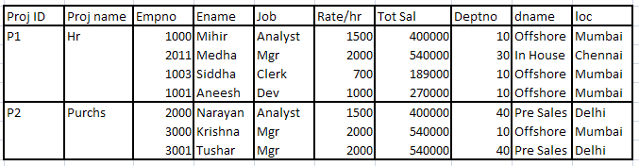
UNF/0NF

Slide 6
Need for NORMALIZATION Contd..
The previous slide is said to be in ‘UN_NORMAL FORM(UNF)’ because:-
There are repeating groups in the slide-
For each Project there is multiple employee’s & Department’s info.
This is against RDBMS according to which each relation(Table) must contain an ‘atomic’ value

Slide 7
Need for NORMALIZATION Contd..
Insert,Update,Delete Anomalies:-
- Insert :- If we want to insert a new Dept information/Job Information, we can’t do without adding Project compulsorily.
- Update :- If information about Project gets changed/dept’s Information gets changed, changes have to be made all over the table causing redundancy . Even if we forget to make changes at one place ,our data is going to be in the inconsistent state
- Delete :- If Project is removed employees as well as Department’s Information is going.
If Employee resigns Or if Department is going,then Project’s info gets removed.

Slide 8
Need for NORMALIZATION
To remove all these problems from the current table we need to Normalize it by separating data into multiple tables & by following different rules of Normalization to avoid previously specified problems.

Slide 9
1NF
Rule :-
All attribute values are atomic.
No repeating group, no composite attributes

Slide 10
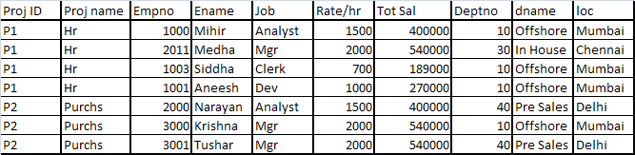
1NF

Slide 11
2 Normal Form(2NF)
A Relation is in 2NF , only if it is in 1NF, &
Second normal form (2NF) further addresses the concept of removing duplicative data.
Here we talk about ‘Functional Dependency’.
Each value of attribute A is associated with only one value of attribute B.
All non-prime attributes are fully dependent on the candidate keys. Which is creating relationships between these new tables and their predecessors through the use of foreign keys.

Slide 12
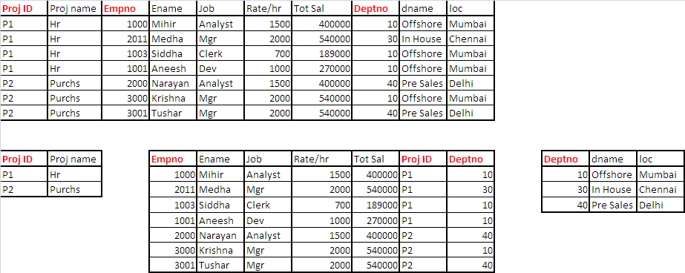
2NF

Slide 13
3NF
No transitive dependency
A relation is said to be in 3NF if it is in 2NF &
All (non-key) attributes must, and only, be functionally dependent on Key Attribute
A → B and B → C, So A → C

Slide 14

Exploring 2NF

Slide 15
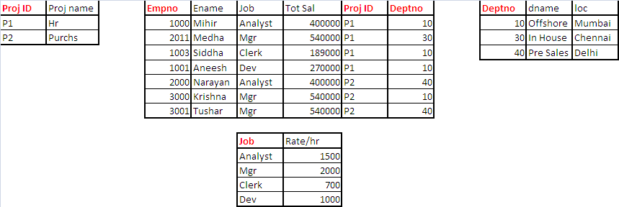
3NF

Slide 16
Effects after NORMALIZATION
Same data got separated into number of tables as & when with every step
(1NF,2NF etc.) followed of normalization.
2. There is no redundancy or minimal redundancy.
3. Insert/Update/Delete Anomalies are removed
Inserting new data without affecting records.
Updation of records doesn’t cause redundancy
Deletion of records independently is possible now

Slide 17
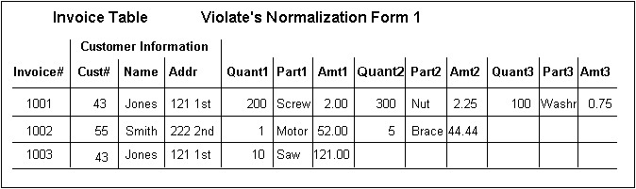
Example with first three forms
Suppose we have this Invoice Table
First Normal Form: No repeating groups.
The above table violates 1NF because it has columns for the first, second, and third line item.
Solution: you make a separate line item table, with it's own key, in this case the combination of invoice number and line number

Slide 18
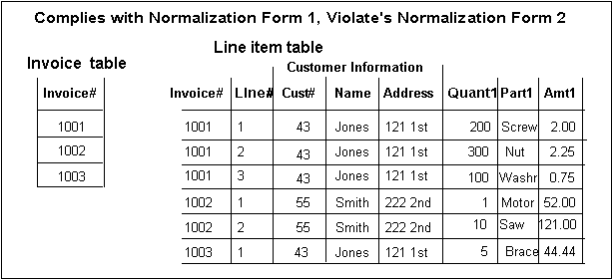
Table now in 1NF

Slide 19
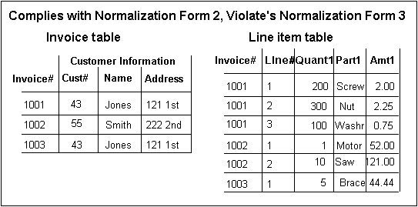
Second Normal Form: Each column must depend on the *entire* primary key.
customer address could go in the invoice table (see above), but this would cause data redundancy if several invoices were for the same customer. It would also cause an update nightmare when the customer changes his address, and would require extensive programming

Slide 20
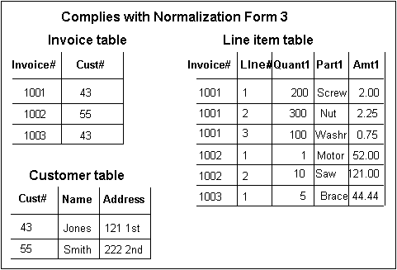
Third Normal Form: Each column must depend on *directly* on the primary key.

Slide 21
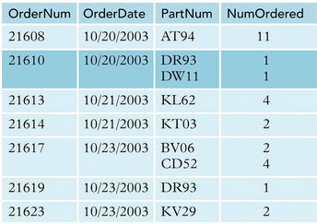
Assignments

Slide 22
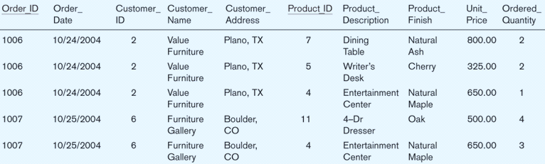
1NF

Slide 23
2NF
Order
Order
Product
OrderItem

Slide 24
Transforming to 3NF
Product
Move the attributes involved in transitive dependency to another relation
OrderItem
Order
Customer

Slide 25
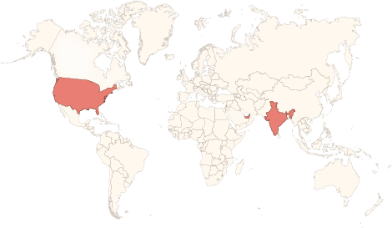






Physical Presence
www.vinsys.com
enquiry@vinsys.com
Shivaji Niketan, Tejas Society, Behind Kothrud Bus Stand, Near Mantri Park, Kothrud, Pune - 411029.
304, City Tower 2, Near Crown Plaza, Sheikh Zayed Road. Dubai, UAE.
PO.Box - 213279
132 West 31st Street, First Floor, New York, 10001, USA

