Slide 1

DEliVERiNGSKiLLS
DRiViNGSUCCESS
www.VINSYS.COM

Slide 3
SQL

Slide 4
SQL
SQL stands for Structured Query Language
SQL is the language used to communicate with the database(Oracle MS-ACCES,MS SQL Server) to access, manipulate, and control data.

Slide 5
SQL
SQL TYPE
ANSI
(Common for all )
PROPRITORY

Slide 6
SQL
SQL Command(categories)
DML
DDL
DRL/DQL
DCL
TCL
MAY BE PROPRITORY

Slide 7
SQL
SQL Reports/outputs
COMPLETE DETAILS
(FILTER OR
WHERE)
COMPLETE SUMMARY
(GROUP BY CLAUSE)
COMPLETE DETAILS
+
SUMMARY
(SUBTOTAL)

Slide 8
SQL
Capabilities of SQL
Projection
Selection
Join

Slide 9
SQL
DRL/DQL
DRL is Data Retrieval Language( Data Query Language)
Used to retrieve or query the database and fetch selected data which matches the criteria
It is done by using a ‘SELECT’ Statement

Slide 10
Select Statement in Sql
It helps to fetch data
It is ‘SELECTION’ Type of query .
Basic Select Statement:-
SELECT *|{[DISTINCT] column|expression [alias],...}
FROM table;

Slide 11
Writing sql statements
• SQL statements are not case sensitive.
• SQL statements can be on one or more lines.
• Keywords cannot be abbreviated or split
across lines.
• Clauses are usually placed on separate lines.
• Indents are used to enhance readability.

Slide 12
SQL example
Example:-
Select * from emp;
Select ename,sal from emp;

Slide 13
Arithmetic Expressions
You can use arithmetic Expressions within select statements
Operator Description
+ Add
- subtract
* multiply
/ divide

Slide 14
Oprt. example
SELECT ename, sal, sal + 300
FROM emp;

Slide 15
Operator Precedence
* / + -
Multiplication and division take priority over addition and subtraction.
Operators of the same priority are evaluated from left to right.
Parentheses are used to force prioritized evaluation and to clarify statements.

Slide 16
SQL Example of Use of Parenthesis
SELECT ename, sal, 12*sal+100
FROM emp;
SELECT ename, sal, 12*(sal+100)
FROM emp;

Slide 17
Defining a Null Value
A null is a value that is unavailable, unassigned,unknown, or inapplicable.
A null is not the same as zero or a blank space.
SELECT ename, job, sal,comm
FROM emp;
Arithmetic expressions containing NULL value evaluate to NULL.

Slide 18
Defining a Column Alias
Renames a column heading
Is useful with calculations
Immediately follows the column name - there can also be the optional AS keyword between the column name and alias
Requires double quotation marks if it contains
spaces or special characters or is case sensitive

Slide 19
Example Using Column Aliases
SELECT ename AS name,
comm comm_given
FROM emp;
SELECT ename "Name",
sal*12 "Annual Salary"
FROM emp;

Slide 20
Concatenation Operator
A concatenation operator:
Concatenates columns or character strings to
other columns
Is represented by two vertical bars (||)
Creates a resultant column that is a character
expression
SELECT ename||job AS "Employees"
FROM emp;

Slide 21
Literal Character Strings
A literal is a character, a number, or a date
included in the SELECT list.
Date and character literal values must be enclosed within single quotation marks.
SELECT ename ||’ is a ’||job
AS "Employee Details"
FROM emp;

Slide 22
Using ‘Distinct’ in Select Stmnt
SELECT deptno
FROM emp;
SELECT distinct deptno
FROM emp;
Will this work?
SELECT DISTINCT deptno, job FROM emp;

Slide 23
SQL REPORTS OR OUTPUT
Complete details

Slide 24
Restricting number of rows
Restrict the rows returned by using the WHERE clause.
The WHERE clause follows the FROM clause.
SELECT *|{[DISTINCT] column|expression [alias],...}
FROM table
[WHERE condition(s)];

Slide 25
Where clause in ‘Select Statement’
Select dname,loc
From dept
Where deptno=30
Select dname,loc
From dept
Where deptno=50;

Slide 26
Character Strings And Dates
Character strings and date values are enclosed in single quotation marks.
Characters are case sensitive
dates are format sensitive

Slide 27
Comparison Conditions
Operator Meaning
= Equal to
> Greater than
>= Greater than equal to
< Less than
<= Less than equal to
!=/<>/^= NOT Equal to

Slide 28
Other Comparison Conditions
Operator Meaning
BETWEEN Between two values(inclusive),
...AND... (NOT BETWEEN……AND)
IN(set)/NOT IN Match any of a list of values
LIKE /NOT LIKE Match a character pattern
IS NULL/
IS NOT NULL Is a null value

Slide 29
Using the between condition
Use the BETWEEN condition to display rows based on a range of values. This range includes Lower as well as Upper Limits
SELECT ename, sal
FROM emp
WHERE sal BETWEEN 2500 AND 3500;
Lower limit Upper limit

Slide 30
Using the in condition
Use the IN membership condition to test for values in a list.
SELECT employee_id, last_name, salary, manager_id
FROM employees
WHERE manager_id IN (100, 101, 201);
* Maximum values which can be provided to the set of IN operator is 1024 for comparison

Slide 31
Using the like operator
• Use the LIKE condition to perform wildcard
searches of valid search string values.
• Search conditions can contain either literal
characters or numbers:
– % denotes zero or many characters.
– _ denotes one character.

Slide 32
Using ‘Escape’ Contd.
The ESCAPE Option
When you need to have an exact match for the actual % and _ characters, use the ESCAPE option.
This option specifies what the escape character is. If you want to search for strings that contain ‘SA_’,

Slide 33
Using Like Operator with Escape
you can use the following SQL statement:
SELECT employee_id, last_name, job_id
FROM employees
WHERE job_id LIKE ’%SA\_%’ ESCAPE ’\’;

Slide 34
Using NULL
IS NULL operator:-
SELECT last_name, manager_id
FROM employees
WHERE manager_id IS NULL;

Slide 35
Rules Of Precedence
SELECT ename, job, sal
FROM emp
WHERE job = ’SALESMAN’
OR job = ‘PRESIDENT’
AND sal > =5000;
* (job_id = ’SA_REP’
OR job_id = ’AD_PRES’)

Slide 36
SORTING DATA
It is displaying data in ‘Ascending’ or ‘Descending’ manner.

Slide 37
ORDER BY Clause
Sort rows with the ORDER BY clause
– ASC: ascending order, default
– DESC: descending order
You can sort Data on Multiple columns too
*The ORDER BY clause comes last in the SELECT
statement.

Slide 38
Which Clause Of The Query Executes First
Select *
From emp
Where sal>4000;

Slide 39
Ways Of Sorting
Select ename,sal+100 as Total_Sal, job
From emp
Order by job;
Select ename,sal+100 as Total_Sal, job
From emp
Order by job Total_Sal;

Slide 40
Ways Of Sorting
Select ename,sal+100 as Total_Sal, job
From emp
Order by 3;
/
Max Number of col. Tht can be used in Order By Clause are – 1024.
Best Practices are use of aliases to expression in order by clause

Slide 41
SUMMARY QUERIES

Slide 42
Aggregate Functions
The summary queries are those queries which use different Functions.
Perform calculations on data
Modify individual data items
Manipulate output for groups of rows
Format dates and numbers for display
Convert column data types
SQL functions sometimes take arguments and always return a value.

Slide 43
Two Types of SQL Functions
FUNCTION
SINGLE ROW FUNCTIONS
MULTI ROW FUNCTIONS

Slide 44
SUMMARY QUERIES
Single row functions
Manipulate data items
Accept arguments and return one value
Act on each row returned
Return one result per row
May modify the data type
Can be nested
Accept arguments which can be a column or an
Expression function_name [(arg1, arg2,...)]

Slide 45
Single Row Function
Character
Date
Single row functions
General
Conversion
Number

Slide 46
Character functions
accept character data as input and can return both character and
numeric values.
LOWER CONCAT
UPPER SUBSTR
INITCAP– Oracle Proprietary LENGTH
INSTR
LPAD | RPAD
TRIM
REPLACE
Character functions
Case manipulation function
Character manipulation function

Slide 47
Character functions
Function Result
CONCAT(’Hello’, ’World’) HelloWorld
SUBSTR(’HelloWorld’,1,5) Hello
LENGTH(’HelloWorld’) 10
INSTR(’HelloWorld’, ’W’) 6
LPAD(salary,10,’*’) *****24000
RPAD(salary, 10, ’*’) 24000*****
TRIM(’H’ FROM ’HelloWorld’) elloWorld

Slide 48
Character functions
e.g.
SUBSTR(column|expression,m[,n])
Returns specified characters from character value starting at character position m, n characters long.
If m is negative, the count starts from the end of the character value.
If n is omitted, all characters to the end of the string are returned.

Slide 49
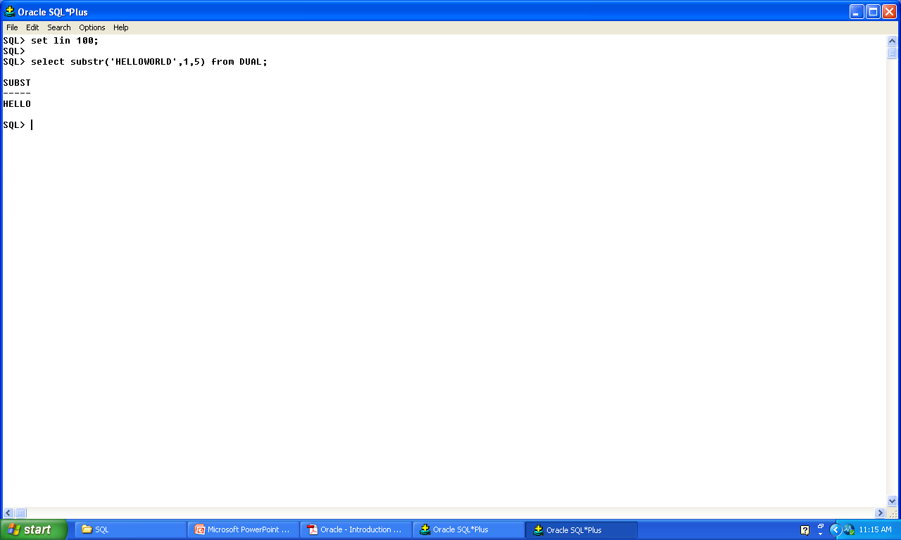
Example

Slide 50
Character function
LPAD/RPAD
SELECT LPAD(sal, 10, ’*') FROM emp;
SELECT RPAD(sal, 10, ’*') FROM emp;
SELECT sal,sal/100,rpad('o',sal/100,'o') as histogram from emp where deptno = 30;

Slide 51
Character functions
Simple ‘TRIM’ function:-
SELECT TRIM (0 FROM 067270676800) "TRIM Example“ FROM DUAL;
SELECT TRIM('S' FROM 'STEVENS') AS TRIM
FROM Dual
SELECT TRIM(TRAILING 'S' FROM 'STEVENS' ) AS TRIM
FROM Dual
SELECT TRIM(LEADING 'S' FROM 'STEVENS' ) AS TRIM
FROM Dual
SELECT TRIM (both ' ' from ' String with blanks ')
FROM dual

Slide 52
Number Functions
Number functions accept numeric input and return numeric values.
Round()
Trunc()
Mod()

Slide 53
Number function ROUND()
select round(788.447,2) from dual
Examples | Result
ROUND(748.58, -1) | 750.00
ROUND(748.58, -2) | 700.00
ROUND(748.58, -3) | 1000.00

Slide 54
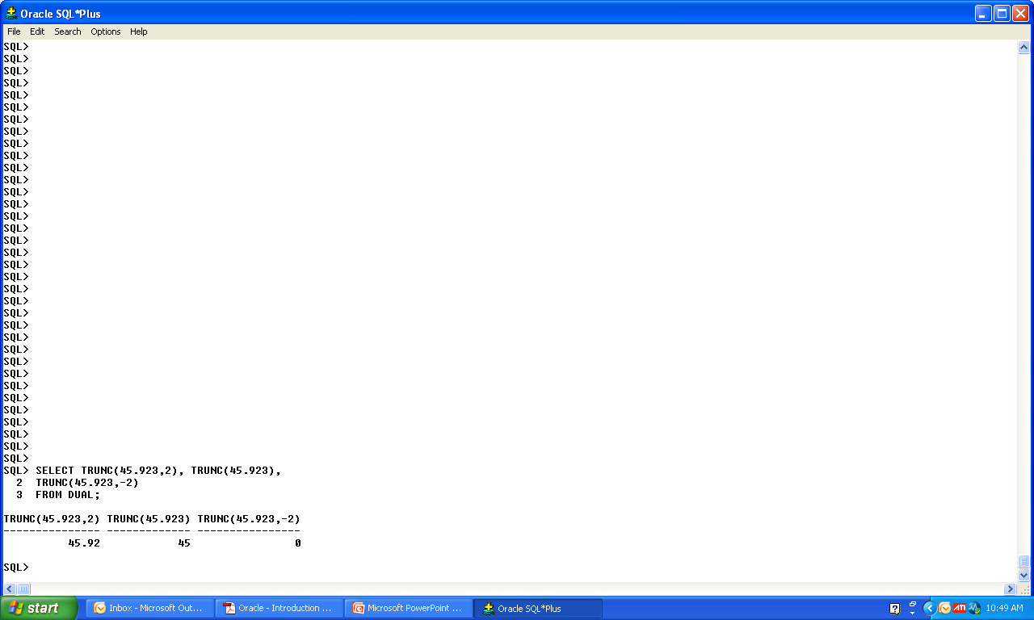
NUMBER FUNCTIONS TRUNC()
The TRUNC function truncates the column, expression, or value to n decimal places
SELECT TRUNC(45.923,2), TRUNC(45.923),
TRUNC(45.923,-2)
FROM DUAL;

Slide 55
Number Function
The MOD function finds the remainder of value1 divided by value2.
SELECT ename, sal, MOD(sal, 5000)
FROM emp
WHERE job= ‘SALESMAN’;

Slide 56
Using Date Function
• Oracle database stores dates in an internal
numeric format: century, year, month, day, hours,minutes, seconds.
• The default date display format is
DD-MON-RR.
SYSDATE is a function that returns:
• Date
• Time

Slide 57
Date Function.
e.g.
SELECT ename, hiredate
FROM emp
WHERE ename like ’A%’;
ENAME HIREDATE
---------- ---------
ALLEN 20-FEB-81
ADAMS 23-MAY-87
SQL>

Slide 58
Arithmetic with Dates
Add or subtract a number to or from a date for a resultant date value.
Subtract two dates to find the number of days between those dates.
Add hours to a date by dividing the number of
hours by 24.

Slide 59
Arithmetic with Dates
Since the database stores dates as numbers, you can perform calculations using arithmetic operators
such as addition and subtraction. You can add and subtract number constants as well as dates
Operation | Result | Description
date + number | Date | Adds a number of days to a date
date - number | Date | Subtracts a number of days from a date
date - date | Number of days | Subtracts one date from another
date + number/24 | Date | Adds a number of hours to a date

Slide 60
Date Functions
Function | Description
MONTHS_BETWEEN | Number of months between two dates
ADD_MONTHS | Add calendar months to Date
NEXT_DAY | Next day of the date Specified
LAST_DAY | Last day of the month
ROUND | Round date
TRUNC | Truncate date

Slide 61
Using Date Function
MONTHS_BETWEEN (’01-SEP-95’,’11-JAN-94’)-
19.6774194
ADD_MONTHS (’11-JAN-94’,6)- ’11-JUL-94’
NEXT_DAY (’01-SEP-95’,’FRIDAY’)- ’08-SEP-95’
LAST_DAY(’01-FEB-95’)- ’28-FEB-95’

Slide 62
ROUND & TRUNC With Date
ROUND(SYSDATE,’MONTH’) 01-AUG-95
TRUNC(SYSDATE ,’YEAR’) 01-JAN-95

Slide 63
Conversion function
Data Type Conversion
-CHAR TO NUMBER
-CHAR TO DATE
-DATE TO CHAR
-NUMBR TO CHAR
Implicit Datatype Conversion
Explicit Datatupe Conversion

Slide 64
Explicit Data Type Conversions
SQL provides three functions to convert a value from one data type to another:
TO_NUMBER
TO_CHAR
TO_DATE

Slide 65
Explicit Datatype Conversion
The format model:
TO_CHAR(date, ’format_model’)
Must be enclosed in single quotation marks and is case sensitive
Can include any valid date format element
Is separated from the date value by a comma

Slide 66
TO_CHAR() With date datatype
SELECT empno, TO_CHAR(hiredate, ’MM/YY’)
FROM emp
WHERE ename = ‘SMITH’;
YYYY Full year in numbers
MONTH Full name of the month
DD Numeric day of the month
DY Name of day; three-letter abbreviation

Slide 67
Elements of the Date Format Model
Time elements format the time portion of the date.
Add character strings by enclosing them in double quotation marks.
Number suffixes spell out numbers.
HH24:MI:SS AM 15:45:32 PM
DD "of" MONTH 12 of OCTOBER ddspth fourteenth

Slide 68
TO_CHAR() With Number Datatype
TO_CHAR(number, ’format_model’)
These are some of the format elements you can use with the TO_CHAR function to display a number value as a character:
TO_CHAR(number, ’format_model’)

Slide 69
TO_CHAR() With Number
9 | Represents a number
0 | Forces a zero to be displayed
$ | Places a floating dollar sign
L | Uses the floating local currency symbol
. | Prints a decimal point
, | Prints a thousand indicator
B | Display zero values as blank , not zero

Slide 70
Using the TO_NUMBER and TO_DATE Functions
Convert a character string to a number format
using the TO_NUMBER function:
TO_NUMBER(char[, ’format_model’])
Convert a character string to a date format using the TO_DATE function:
TO_DATE(char[, ’format_model’])

Slide 71
TO_NUMBER() Datatype
SELECT TO_NUMBER('-$12,345.67', '$99,999.99') FROM dual;
TO_DATE() Datatype
e.g. 22-july-2009
Select to_char(to_date(‘22-jul-2009’,’dd-mon yyyy’),’day-mon-yy’) from dual;
SELECT TO_DATE('061167','MMDDYY') "Birthday" from DUAL

Slide 72
Nesting Functions
Single-row functions can be nested to any level.
Nested functions are evaluated from deepest level to the least deep level.
F3(F2(F1(col,arg1),arg2),arg3)

Slide 73
General Functions
These functions work with any data type and pertain to using nulls.
NVL (expr1, expr2)
NVL2 (expr1, expr2, expr3)
NULLIF (expr1, expr2)
COALESCE (expr1, expr2, ..., exprn)

Slide 74
General function
Function | Description
NVL | Converts a null value to an actual value
NVL2 | If expr1 is not null, NVL2 returns expr2. If expr1 is null, NVL2 returns expr3. The argument expr1can have any data type.
NULLIF | Compares two expressions and returns null if they are equal, or the first expression if they are not equal
COALESCE | Returns the first non-null expression in the expression list

Slide 75
NVL Function
Converts a null to an actual value.
Data types that can be used are date, character,and number.
e.g.
NVL(comm,0)

Slide 76
NVL2 function
SELECT ename, sal, comm,
NVL2(comm,'SAL+COMM', 'SAL') income
FROM emp WHERE deptno IN (20, 30)
SELECT ename, sal, comm,
NVL2(comm,SAL+COMM, SAL) income
FROM emp WHERE deptno IN (20, 30)

Slide 77
Using the NULLIF Function
SELECT first_name, LENGTH(first_name)"expr1“,
last_name, LENGTH(last_name)”expr2“,
NULLIF(LENGTH(first_name),LENGTH(last_name)) result
FROM employees;

Slide 78
Using the COALESCE Function
The advantage of the COALESCE function over the NVL function is that the COALESCE function can take multiple alternate values.
If the first expression is not null, it returns that
expression; otherwise, it does a COALESCE of the remaining expressions.

Slide 79
Using COALESCE Functions
SELECT COALESCE (NULL, NULL , 'NOT NULL' , NULL ) test from dual;
TEST
--------
NOT NULL
SELECT ename,
COALESCE(comm, sal, 10) comm
FROM emp
ORDER BY comm;

Slide 80
Conditional Expressions
Provide the use of IF-THEN-ELSE logic within a
SQL statement
Use two methods:
– CASE expression
– DECODE function

Slide 81
The CASE Expression
Facilitates conditional inquiries by doing the work of an IF-THEN-ELSE statement:
CASE expr WHEN Compare _expr1 THEN return_expr1
[WHEN Compare _expr2 THEN return_expr2
WHEN Compare _exprn THEN return_exprn
ELSE else_expr]
END

Slide 82
Case
SELECT last_name, job_id, salary,
CASE job_id WHEN ’IT_PROG’ THEN 1.10*salary
WHEN ’ST_CLERK’ THEN 1.15*salary
WHEN ’SA_REP’ THEN 1.20*salary
ELSE salary
END "REVISED_SALARY"
FROM employees

Slide 83
Decode Function
The DECODE function decodes expression after comparing it to each search value.
If the expression is the same as search, result is returned.
If the default value is omitted, a null value is returned where a search value does not match any of the result values.

Slide 84
Decode Function
SELECT last_name, job_id, salary,
DECODE(job_id, ’IT_PROG’, 1.10*salary,
’ST_CLERK’, 1.15*salary,
’SA_REP’, 1.20*salary,
salary) REVISED_SALARY
FROM employees;

Slide 85
Aggregating data
Using group functions

Slide 86
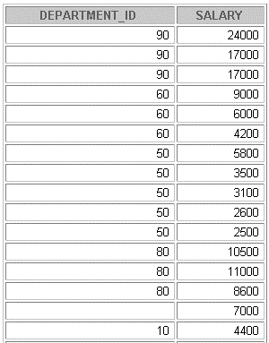
Group Function
Group functions operate on sets of rows to give one result per group
EMPLOYEES
The maximum
salary in
the EMPLOYEES
table
24000

Slide 87
Types of Group Functions
AVG-Number Type
SUM-Number Type
COUNT
MAX
MIN
These functions accept single parameter & are not overloaded
FOR ANY DATA TYPE

Slide 88
Types Of Group Functions
Function Description
AVG([DISTINCT|ALL]n) Average value of n, ignoring null values
COUNT({*|[DISTINCT|ALL]expr}) Number of rows, where expr evaluates to
something other than null (count all selected rows using *, including duplicates and row with nulls)
SUM([DISTINCT|ALL]n) Sum values of n, ignoring null values
MAX([DISTINCT|ALL]expr) Maximum value of expr, ignoring null values
MIN([DISTINCT|ALL]expr) Minimum value of expr, ignoring null values

Slide 89
Syntax
SELECT [column,] group_function(column), ...
FROM table
[WHERE condition]
[GROUP BY column]
[ORDER BY column];

Slide 90
Tips About Groups
The Oracle server on it’s own arranges output in ascending order when group by clause
All group functions ignore NULL values
except COUNT with *

Slide 91
Example
SELECT MIN(sal), SUM(sal)
FROM emp
where job LIKE '%SA%'
/
Or
MIN(distinct sal),MAX(distinct sal);
COUNT(*),COUNT(),COUNT(DISTINCT expr);

Slide 92
Types Of Group Function
You can nest a Function within a Function.
SELECT AVG(NVL(commission_pct, 0))
FROM employees;

Slide 93
Creating Groups of Data
Until now, all group functions have treated the table as one large group of information.
At times, you need to divide the table of information into smaller groups.
This can be done by using the GROUP BY clause.

Slide 94
Syntax Of Group By
SELECT column, group_function(column)
FROM table
[WHERE condition]
[GROUP BY group_by_expression]
[ORDER BY column]

Slide 95
Using the GROUP BY Clause
The GROUP BY column does not have to be in the SELECT list.
SELECT AVG(sal)
FROM emp
GROUP BY deptno;
* But vise versa not allowed

Slide 96
Using the GROUP BY Clause Contd.
SELECT deptno, AVG(sal)
FROM emp
GROUP BY deptno;
Will this work ?
SELECT department_id, COUNT(last_name)
FROM employees;

Slide 97
Grouping by More Than One Column
SQL> select deptno,job,avg(sal)
from emp
group by deptno,job;

Slide 98
Illegal Queries Using Group Functions
You cannot use group functions in the WHERE clause.
You use the HAVING clause to restrict groups.
SELECT empdeptno,MIN(sal)
FROM emp
WHERE MIN(sal)>1250
GROUP BY deptno

Slide 99
Using Having Clause
The Oracle server performs the following steps when you use the HAVING clause:
1. Rows are grouped.
2. The group function is applied to the group.
3. The groups that match the criteria in the HAVING clause are displayed.
The HAVING clause can precede the GROUP BY clause

Slide 100
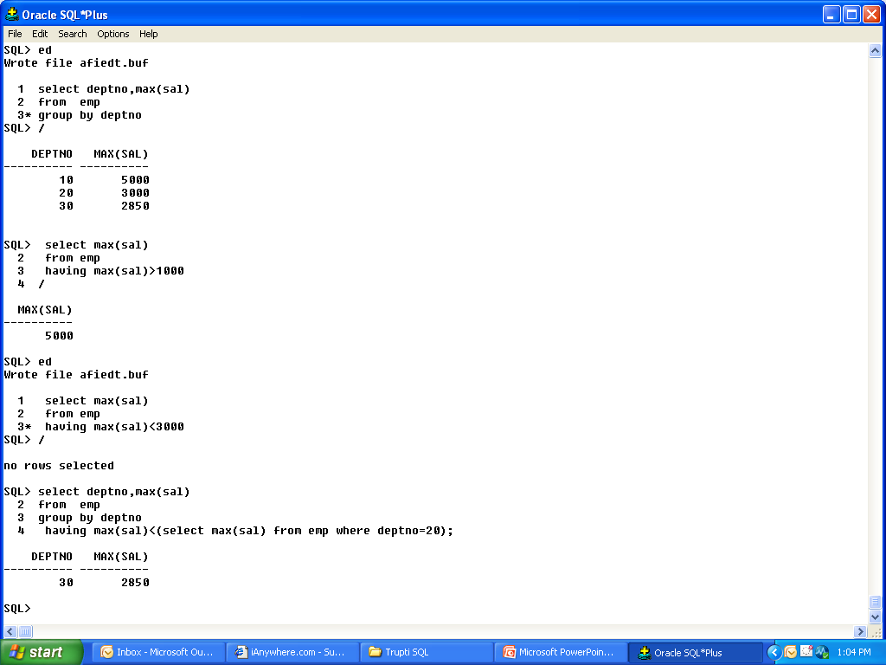
Using Having Clause
You can Even use subquery in Having.
e.g. Find Max of Salary of those Emp whose Max sal is less than Maximum Sal from Dept 20

Slide 101
Manipulating Data

Slide 102
Data Manipulation Language
A DML statement is executed when you:
Add new rows to a table
Modify existing rows in a table
Remove existing rows from a table
Logical unit of DML is a ‘Transaction’

Slide 103
Insert
To add a new row to the table ‘Insert’ Statement is issued.
The INSERT statement syntax –
INSERT INTO table [(column [, column...])]
VALUES (value [, value...]);
Only one row is inserted at a time with this syntax.

Slide 104
Guidelines
Insert a new row containing values for each column.
List values in the default order of the columns in the table.
Optionally, list the columns in the INSERT clause.
Enclose character and date values within single quotation marks.
Explicitly use NULL Or ‘’ if no col. names are provided

Slide 105
Caution
Be careful about inserting data with these constraints:-
• Mandatory value missing for a NOT NULL column
• Duplicate value violates uniqueness constraint
• Foreign key constraint violated
• CHECK constraint violated
• Data type mismatch
• Value too wide to fit in column

Slide 106
Inserting Specific Date Values
INSERT INTO emp
VALUES (114,'Den', 'ACCOUNT',7902
,TO_DATE('FEB 3, 1999', 'MON DD, YYYY')
, 1000, 100, 30)
/

Slide 107
Using Substitution Variable
Use & substitution in a SQL statement to prompt for values.
& is a placeholder for the variable value
SQL> insert into dept(deptno,dname,loc)
2 values(&deptno,'&dname','&loc');

Slide 108
Copying Rows from Another Table
Write your INSERT statement with a subquery.
Do not use the VALUES clause.
Match the number of columns in the INSERT
clause to those in the subquery.

Slide 109
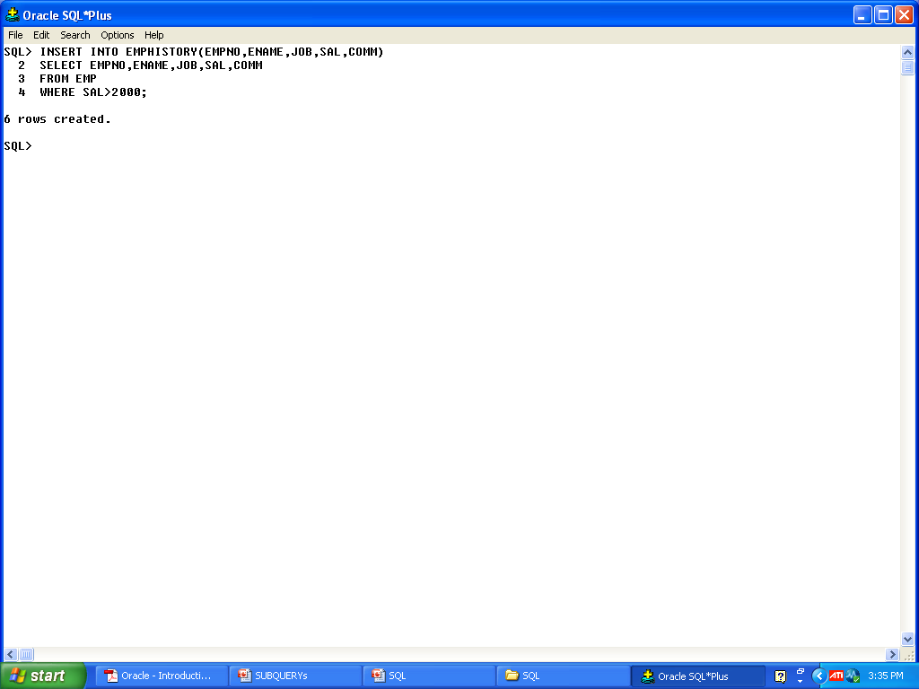
Inserting Based On Another Table

Slide 110
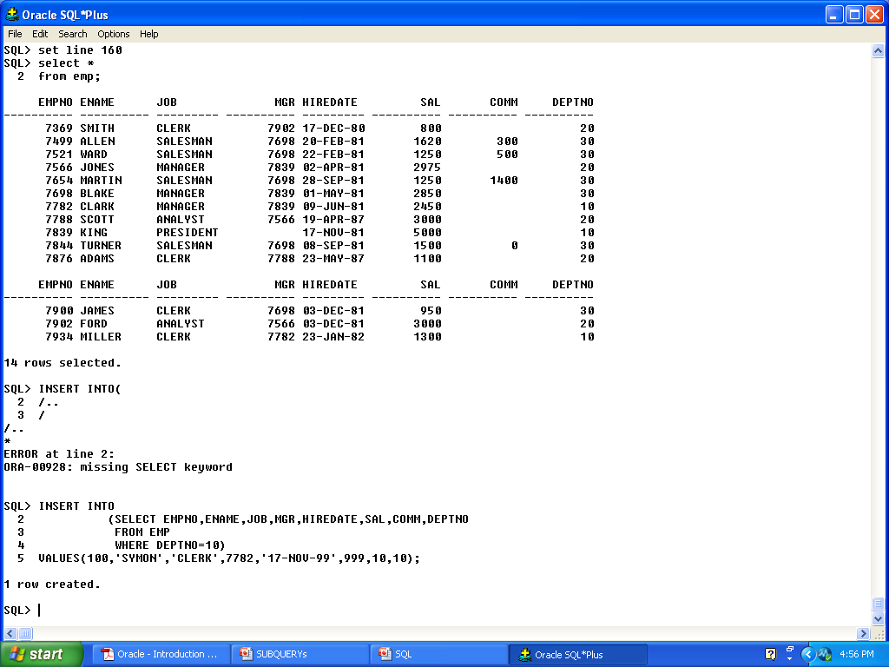
Subquery In INSERT Statement
YOU HAVE TO INCLUDE ALL THE COL. FROM THE TABLE USING SUCH AN INSERT STATEMENT

Slide 111
Using the WITH CHECK OPTION Keyword on DML Statements
A subquery is used to identify the table and
columns of the DML statement.
The WITH CHECK OPTION keyword prohibits you from changing rows that are not in the subquery.

Slide 112
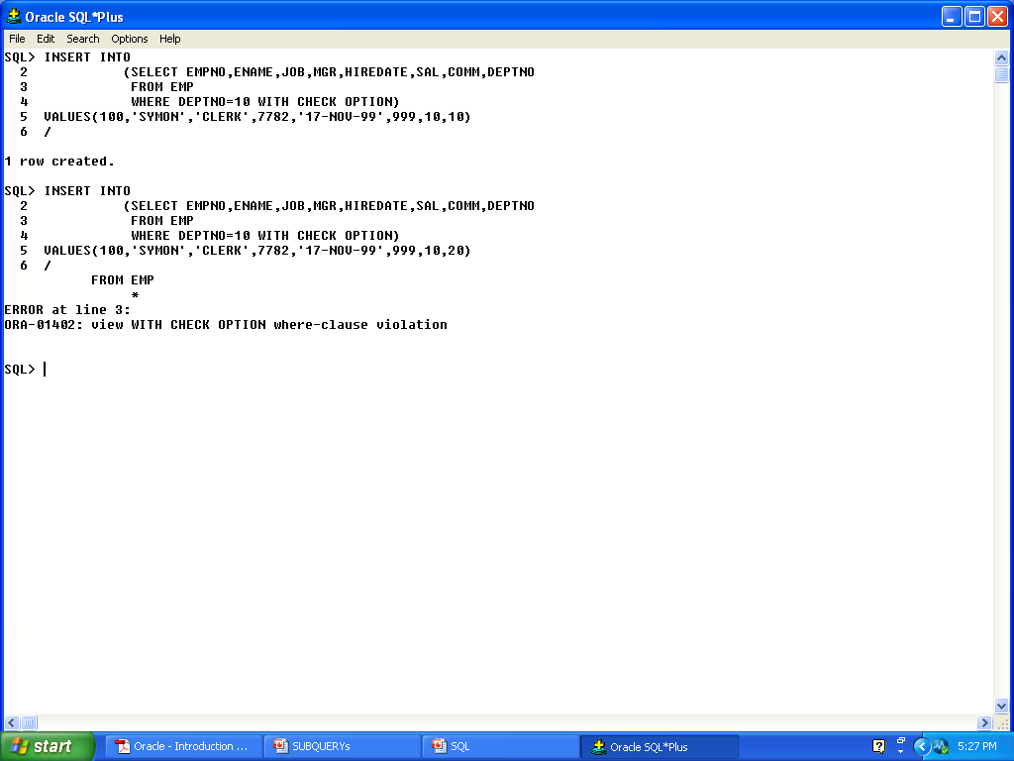
Example

Slide 113
Update
Modify existing rows with the UPDATE statement.
UPDATE table
SET column = value [, column = value, ...]
[WHERE condition];

Slide 114
Update
Updating single row:-
SQL> UPDATE DEPT
2 SET DNAME='MAHA_SALES'
3 WHERE DEPTNO=20;
1 row updated.

Slide 115
Updating All Rows In The Table
SQL> update emphistory
2 set comm =NULL;
3 rows updated.

Slide 116
Updating Specific Columns With Subquery
SQL> update emp
set job=(select job from emp
where empid=7902),
sal=(select sal from emp
where empno=7876)
where ename='ADAMS';

Slide 117
Updating Rows Based on Another Table
UPDATE leave_emp
SET tenure= (SELECT sysdate_hiredate
FROM emp
WHERE empno= 7902)
/

Slide 118
Updating Rows: Integrity Constraint Error
UPDATE emp SET deptno= 9
WHERE department_id = 10;
update dept set deptno=9
*
ERROR at line 1:
ORA-02292: integrity constraint (SCOTT.FK_DEPTNO) violated - child record found

Slide 119
Using Default Values In INSERT &UPDATE
With the explicit default feature, you can use the DEFAULT keyword as a column value where the column default is desired.
Takes Default col. Value if no value is supplied to specified column.
Can be used for INSERT & UPDATE Stmnt

Slide 120
Default
DEFAULT with INSERT:
INSERT INTO dept (depto, dename, loc)
VALUES (300, 'Engineering', DEFAULT);
DEFAULT with UPDATE:
UPDATE dept SET loc=DEFAULT
WHERE deptno=90;

Slide 121
Removing a Row from a Table
One or more rows can be deleted by using
DELETE Statement
You can remove existing rows from a table by using the DELETE statement.
DELETE [FROM] table
[WHERE condition];
* If no rows are deleted, a message “0 rows deleted.” is returned:

Slide 122
Deleting Rows from a Table
Specific rows are deleted if you specify the WHERE clause.
Deleting Rows from a Table
DELETE FROM emp
WHERE ename = ‘CLARK’;
1 row deleted.

Slide 123
Deleting Rows From Table
All rows in the table are deleted if you omit the WHERE clause.
e.g- DELETE FROM emp;

Slide 124
Deleting Rows Based on Another Table
Use subqueries in DELETE statements to remove
rows from a table based on values from another table.
DELETE FROM emp
WHERE deptno=
(SELECT deptno
FROM dept
WHERE dname LIKE ’%ING%’);

Slide 125
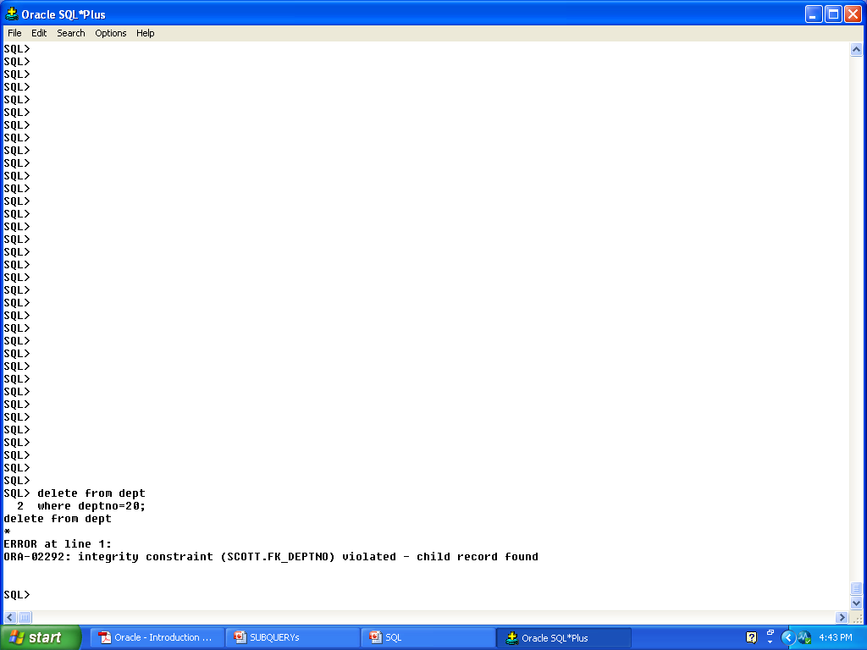
Deleting Rows: Integrity Constraint Error

Slide 126
The ‘Merge’ Statement
Provides the ability to conditionally update or
insert data into a database table
Performs an UPDATE if the row exists, and an
INSERT if it is a new row:
– Avoids separate updates
– Increases performance and ease of use
– Is useful in data warehousing applications

Slide 127
Merge-Syntax
MERGE INTO table_name table_alias
USING (table|view|sub_query) alias
ON (join condition)
WHEN MATCHED THEN
UPDATE SET
col1 = col_val1,
col2 = col2_val
WHEN NOT MATCHED THEN
INSERT (column_list)
VALUES (column_values);

Slide 128
Example
MERGE INTO MERG_EMP M
USING EMP E
ON( M.EMPNO=E.EMPNO)
WHEN MATCHED THEN
UPDATE SET
M.ENAME=E.ENAME,
M.JOB=E.JOB,
M.MGR=E.MGR,
M.HIREDATE=E.HIREDATE,
M.SAL=E.SAL,
M.COMM=E.COMM,
M.DEPTNO=E.DEPTNO
WHEN NOT MATCHED THEN
INSERT VALUES(E.EMPNO,E.ENAME,E.JOB,E.MGR,E.HIREDATE,E.SAL,E.COMM,E.DEPTNO);

Slide 129
Database Transactions

Slide 130
A transaction is a logical unit of related SQL Statements.
The DBMS must ensure that a Transaction either completes successfully or not at all
It must not be intermediate.

Slide 131
Transaction
Begin when the first DML SQL statement is Executed
End with one of the following events:
– A COMMIT or ROLLBACK statement is issued
– A DDL or DCL statement executes (automatic
commit)
– The user exits iSQL*Plus
– The system crashes

Slide 132
Statements Used
Commit
Rollback
Savepoint

Slide 133
TCL-Transaction Control Language
Commit-Makes changes made to the data,Permenent.
Rollback-Used to undo the changes made to the database till last commit was fired
Savepoint-Creating a mark for previous action taken on database.

Slide 134
Advantages of COMMIT and ROLLBACK Statements
With COMMIT and ROLLBACK statements, you can:
Ensure data consistency
Preview data changes before making changes
permanent
Group logically related operations

Slide 135
You can control transaction by using
Commit/Rollback/Savepoint depending upon whether to make SQL Statement permanent or not.

Slide 136
Transaction
Statement | Description
COMMIT | Ends the current transaction by making all pending data changes Permanent
SAVEPOINT name | Marks a savepoint within the current transaction
ROLLBACK | ROLLBACK ends the current transaction by discarding all pending data changes
ROLLBACK TO SAVEPOINT name | ROLLBACK TO SAVEPOINT rolls back the current transaction to the specified savepoint, thereby discarding any changes and or savepoints created after the savepoint to which you are rolling back. If you omit the TO SAVEPOINT clause, the ROLLBACK statement rolls back the entire transaction. As savepoints are logical, there is no way to list the savepoints you have created

Slide 137
Rolling Back Changes to a Marker
UPDATE...
SAVEPOINT update_done;
Savepoint created.
INSERT...
ROLLBACK TO update_done;
Rollback complete.

Slide 138
Implicit Transaction Processing
An automatic commit occurs under the following
circumstances:
DDL statement is issued
DCL statement is issued
Normal exit from iSQL*Plus, without explicitly
issuing COMMIT or ROLLBACK statements
An automatic rollback occurs under an abnormal
termination of iSQL*Plus or a system failure.

Slide 139
State of the Data Before COMMIT or ROLLBACK
The previous state of the data can be recovered.
The current user can review the results of the DML operations by using the SELECT statement.
Other users cannot view the results of the DML statements by the current user.
The affected rows are locked; other users cannot change the data within the affected rows.

Slide 140
State of the Data after COMMIT
Data changes are made permanent in the database.
The previous state of the data is permanently lost.
All users can view the results.
Locks on the affected rows are released; those rows
are available for other users to manipulate.
All savepoints are erased.

Slide 141
Committing Data
COMMIT;
Commit complete.

Slide 142
State of the Data After ROLLBACK
Discard all pending changes by using the ROLLBACK statement:
Data changes are undone.
Previous state of the data is restored.
Locks on the affected rows are released.
DELETE FROM copy_emp;
22 rows deleted.
ROLLBACK;
Rollback complete

Slide 143
Statement-Level Rollback
If a single DML statement fails during execution,
only that statement is rolled back.
The Oracle server implements an implicit savepoint.
All other changes are retained.
The user should terminate transactions explicitly
by executing a COMMIT or ROLLBACK statement.

Slide 144
Read Consistency
Read consistency guarantees a consistent view of the data at all times.
Changes made by one user do not conflict with
Changes made by another user.
Read consistency ensures that on the same data:
– Readers do not wait for writers.
– Writers do not wait for readers

Slide 145
Locking
In an Oracle database, locks:
Prevent destructive interaction between
concurrent transactions
Require no user action
Automatically use the lowest level of restrictiveness
Are held for the duration of the transaction
Are of two types: explicit locking and implicit
locking

Slide 146
Implicit Locking
Two lock modes:
– Exclusive: Locks out other users
– Share: Allows other users to access
High level of data concurrency:
– DML: Table share, row exclusive
– Queries: No locks required
– DDL: Protects object definitions
Locks held until commit or rollback

Slide 147
DCL

Slide 148
Data Control Language
In a multiple-user environment, you want to maintain security of the database access and use.
Oracle server database can give you security for
Access of data.
Giving privileges on the data to user or group
Revoking privileges back from the user

Slide 149
Controlling User Access
Database Security
SYSTEM SECURITY
DATA SECURITY
SYSTEM LEVEL ACCESS
e.g.
--USER NAME
-PASSWORD
ACCESS & USE OF DATABASE OBJECTS
e.g. ACCESS TO DATABSE OBJECTS

Slide 150
System Privileges
The database administrator has high-level system privileges for tasks such as:
Typical DBA Privileges
System Privilege s | Operations Authorized
CREATE USER | Grantee can create other Oracle users (a privilege required for a DBA role).
DROP USER. | Grantee can drop another user
DROP ANY TABLE. | Grantee can drop a table in any schema
BACKUP ANY TABLE | Grantee can back up any table in any schema with the export utility.
SELECT ANY TABLE | Grantee can query tables, views, or snapshots in any schema.
CREATE ANY TABLE | Grantee can create tables in any schema

Slide 151
Creating Users
The DBA creates users by using the CREATE USER
statement.
User created.
CREATE USER user
IDENTIFIED BY password;
Example:-
CREATE USER scott
IDENTIFIED BY tiger;

Slide 152
User System Privileges
Once a user is created, the DBA can grant specific
system privileges to a user.
An application developer, for example, may have
the following system privileges:
– CREATE SESSION
– CREATE TABLE
– CREATE SEQUENCE
– CREATE VIEW
– CREATE PROCEDURE

Slide 153
Granting System Privileges
The DBA can grant a user specific system privileges.
GRANT create session, create table,
create sequence, create view
TO scott;
Grant succeeded.

Slide 154
Role
A role is a named group of related privileges that can be granted to the user.
This method makes it easier to revoke and maintain privileges.
A user can have access to several roles, and several users can be assigned the same role.

Slide 155
Creating and Granting Privileges to a Role
Create a role
CREATE ROLE manager;
Grant privileges to a role
GRANT create table, create view
TO manager;
Grant a role to users
GRANT manager TO DEHAAN,KOCHHAR;

Slide 156
Changing Your Password
The DBA creates your user account and initializes your password.
You can change your password by using the
ALTER USER statement.
ALTER USER scott
IDENTIFIED BY lion;

Slide 157
OBJECT PRIVILEGES

Slide 158
Object Privileges
An object privilege is a privilege or right to perform a particular action on a specific table, view,sequence, or procedure.

Slide 159

Object Privileges
Object Privilege | Table | View | Sequence | Procedure
ALTER
DELETE
EXECUTE
INDEX
INSERT
REFERENCES
SELECT
UPDATE

Slide 160
Object Privileges
Object privileges vary from object to object.
An owner has all the privileges on the object.
An owner can give specific privileges on that owner’s object.
GRANT object_priv [(columns)]
ON object
TO {user|role|PUBLIC}
[WITH GRANT OPTION];

Slide 161
Granting Object Privileges
Grant query privileges on the EMPLOYEES table.
GRANT select
ON employees
TO sue, rich;
Grant succeeded.
Grant privileges to update specific columns to users and roles.
GRANT update (department_name, location_id)
ON departments
TO scott, manager;
Grant succeeded.

Slide 162
Using the WITH GRANT OPTION and PUBLIC Keywords
Give a user authority to pass along privileges.
GRANT select, insert
ON departments
TO scott
WITH GRANT OPTION;
Grant succeeded.
Allow all users on the system to query data from
Alice’s DEPARTMENTS table.
GRANT select
ON alice.departments
TO PUBLIC;
Grant succeeded.

Slide 163
Using Data Dictionary For Checking Privileges
ROLE_SYS_PRIVS System privileges granted to roles
ROLE_TAB_PRIVS Table privileges granted to roles
USER_ROLE_PRIVS Roles accessible by the user
USER_TAB_PRIVS_MADE Object privileges granted on the
user’s objects
USER_TAB_PRIVS_RECD Object privileges granted to the user
USER_COL_PRIVS_MADE Object privileges granted on the
columns of the user’s objects
USER_COL_PRIVS_RECD Object privileges granted to the
user on specific columns
USER_SYS_PRIVS Lists system privileges granted to the
user

Slide 164
How to Revoke Object Privileges
You use the REVOKE statement to revoke privileges granted to other users.
Privileges granted to others through the
WITH GRANT OPTION clause are also revoked.
REVOKE {privilege [, privilege...]|ALL}
ON object
FROM {user[, user...]|role|PUBLIC}
[CASCADE CONSTRAINTS];

Slide 165
Example
As user Alice, revoke the SELECT and INSERT privileges given to user Scott on the DEPARTMENTS table.
REVOKE select, insert
ON departments
FROM scott;
Revoke succeeded.

Slide 166
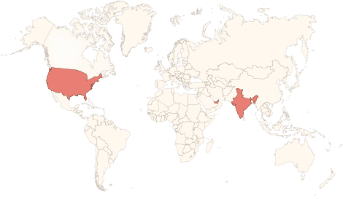






Physical Presence
www.vinsys.com
enquiry@vinsys.com
Shivaji Niketan, Tejas Society, Behind Kothrud Bus Stand, Near Mantri Park, Kothrud, Pune - 411029.
304, City Tower 2, Near Crown Plaza, Sheikh Zayed Road. Dubai, UAE.
PO.Box - 213279
132 West 31st Street, First Floor, New York, 10001, USA

