Slide 1
Functional Programming

Slide 2
First-class functions
first-class citizen: An element of a programming language that is tightly integrated with the language and supports the full range of operations generally available to other entities in the language.
In functional programming, functions (methods) are treated as first-class citizens of the languages.
can store a function in a variable
can pass a function as a parameter to another function
can return a value from a function
can create a collection of functions
...

Slide 3
Lambda expressions
lambda expression ("lambda"): Expression that describes a function by specifying its parameters and return value.
Java 8 adds support for lambda expressions.
Syntax:
(parameters ) -> expression
Example:
(x) -> x * x // squares a number
The above is roughly equivalent to:
public static int squared(int x) {
return x * x;
}

Slide 4
Add/multiply tutor
Consider a program that gives addition and multiplication quiz problems to the user:
9 + 6 = 15
you got it right
3 * 7 = 18
incorrect...the answer was 21
How do we generalize the idea of "add or multiply"?
How much work would it be to add other operators?
Would functional programming help?

Slide 5
Code w/ lambdas
We can represent the math operation as a lambda:
Scanner console = new Scanner(System.in);
// quiz the user on 3 addition problems
giveProblems(console, 3, "+", (x, y) -> x + y);
// quiz the user on 3 multiplication problems
giveProblems(console, 3, "*", (x, y) -> x * y);

Slide 6
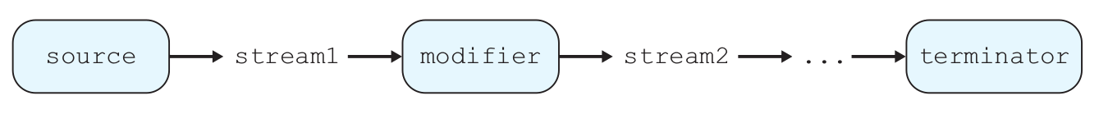
Streams
stream: A sequence of elements from a data source that supports aggregate operations.
Streams operate on a data source and modify it:
example: print each element of a collection
example: sum each integer in a file
example: concatenate strings together into one large string
example: find the largest value in a collection
...

Slide 7

Code w/o streams
Non-functional programming sum code:
// compute the sum of the squares of integers 1-5
int sum = 0;
for (int i = 1; i <= 5; i++) {
sum = sum + i * i;
}

Slide 8
The map modifier
The map modifier applies a lambda to each stream element:
higher-order function: Takes a function as an argument.
// compute the sum of the squares of integers 1-5
int sum = IntStream.range(1, 6)
.map(n -> n * n)
.sum();
// the stream operations are as follows:
IntStream.range(1, 6) -> [1, 2, 3, 4, 5]
-> map -> [1, 4, 9, 16, 25]
-> sum -> 55

Slide 9

The filter modifier
The filter stream modifier removes/keeps elements of the stream using a boolean lambda:
// compute the sum of squares of odd integers
int sum =
IntStream.of(3, 1, 4, 1, 5, 9, 2, 6, 5, 3)
.filter(n -> n % 2 != 0)
.map(n -> n * n)
.sum();
// the stream operations are as follows:
IntStream.of -> [3, 1, 4, 1, 5, 9, 2, 6, 5, 3]
-> filter -> [3, 1, 1, 5, 9, 5, 3]
-> map -> [9, 1, 1, 25, 81, 25, 9]
-> sum -> 151

Slide 10
Streams and methods
Using streams as part of a regular method:
// Returns true if the given integer is prime.
// Assumes n >= 0.
public static boolean isPrime(int n) {
return IntStream.range(1, n + 1)
.filter(x -> n % x == 0)
.count() == 2;
}

Slide 11
The reduce modifier
The reduce modifier combines elements of a stream using a lambda combination function.
Accepts two parameters: an initial value and a lambda to combine that initial value with each next value in the stream.
// Returns n!, or 1*2*3*...*(n-1)*n.
// Assumes n is non-negative.
public static int factorial(int n) {
return IntStream.range(2, n + 1)
.reduce(1, (a, b) -> a * b);
}

Slide 12
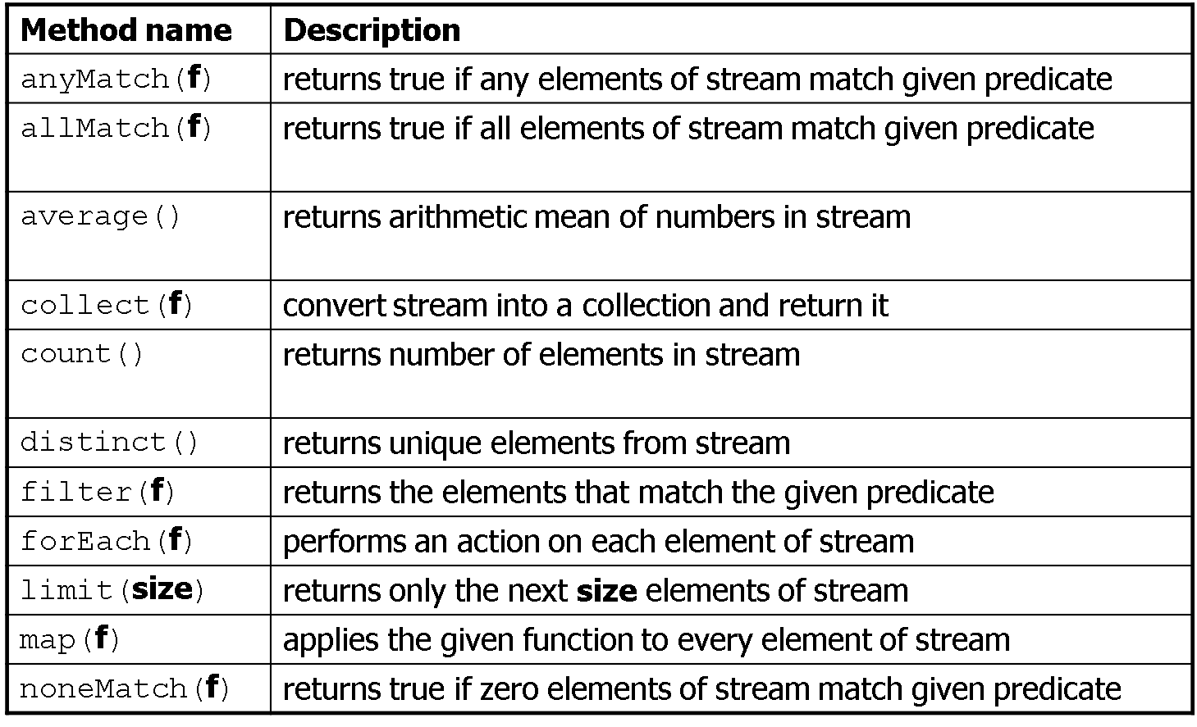
Stream operators

Slide 13
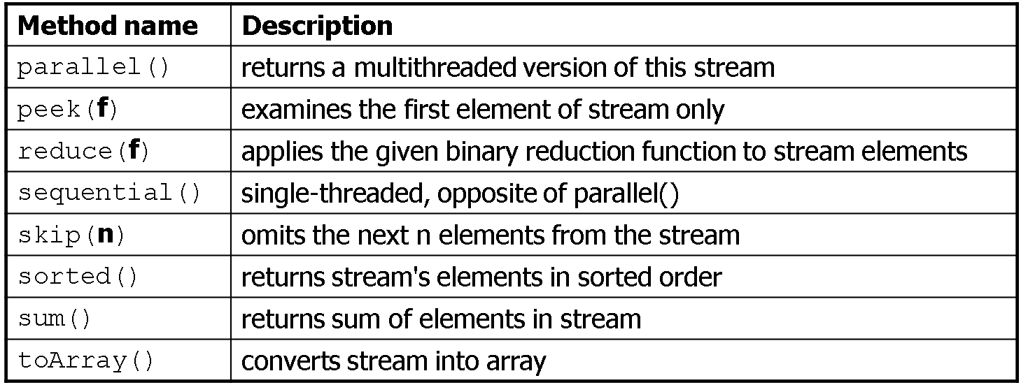
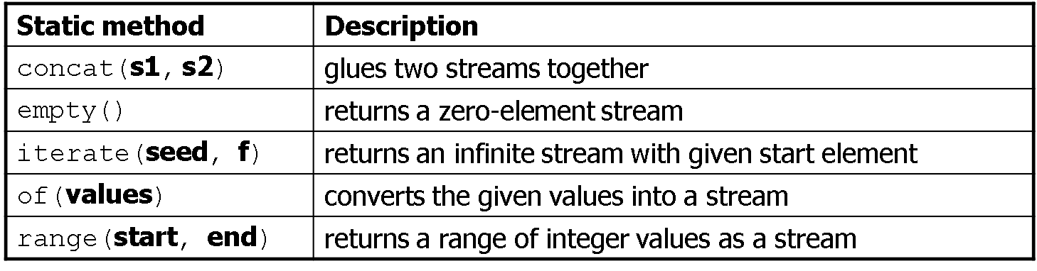
Stream operators

Slide 14
Optional
Some stream terminators like max return an "optional" result because the stream might be empty or not contain the result:
// print largest multiple of 10 in list
// (does not compile!)
int largest =
IntStream.of(55, 20, 19, 31, 40, -2, 62, 30)
.filter(n -> n % 10 == 0)
.max();
System.out.println(largest);

Slide 15
Clousures
bound/free variable: In a lambda expression, parameters are bound variables while variables in the outer containing scope are free variables.
function closure: A block of code defining a function along with the definitions of any free variables that are defined in the containing scope.
// free variables: min, max, multiplier
// bound variables: x, y
int min = 10;
int max = 50;
int multiplier = 3;
compute((x, y) -> Math.max(x, min) *
Math.max(y, max) * multiplier);

Slide 16

Arrays as Stream
An array can be converted into a stream with Arrays.stream:
// compute sum of absolute values of even ints
int[] numbers = {3, -4, 8, 4, -2, 17,
9, -10, 14, 6, -12};
int sum = Arrays.stream(numbers)
.map(n -> Math.abs(n))
.filter(n -> n % 2 == 0)
.distinct()
.sum();

