Slide 1
Tarpitting malicious connections

Slide 2

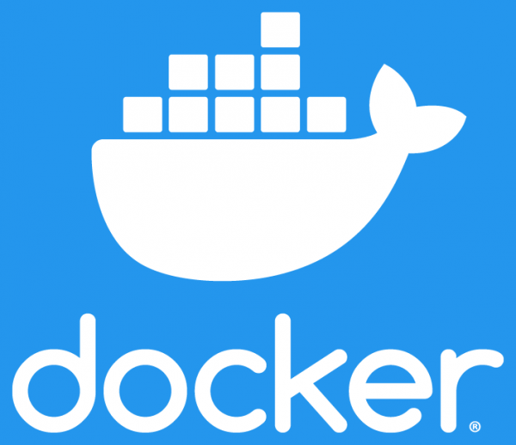

Components used
Minikube (v1.16.0)
Creates local kubernetes cluster
Docker (v20.10.5)
Used as vm driver for minikube
Open vSwitch (v2.14.0)
SDN compatible virtual network switch

Slide 3
Pods Created
DGA detector
This service uses a machine learning model that detects requests to domains created by domain generation algorithms
When a malicious request arrives from the bridge, the offending IP is forwarded to the Flow controller
Flow controller
This service listens for requests from DGA detector
It generates OVS commands from the request and sends them to the OVS controller service
OVS controller
This service runs on the same pod with the Open vSwitch bridge
It listens for commands from Flow controller
It applies the received commands to the Open vSwitch bridge

Slide 4
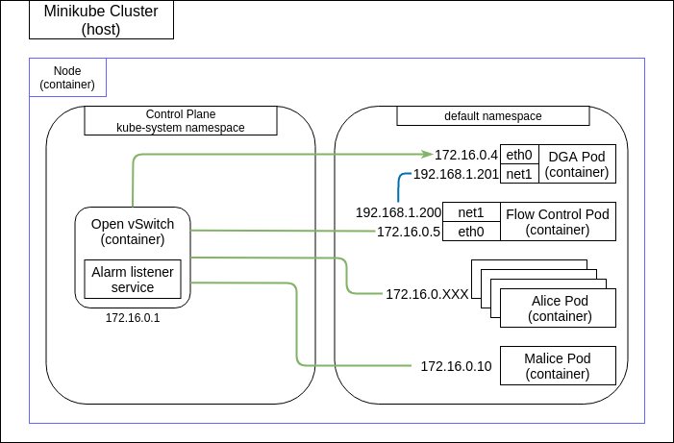
Cluster initial state
Kubernetes creates automatic rules for each newly created pod
By default they can communicate with each other
Traffic is mirrored through dga port connected to the ovs bridge
Dga and flow-controller after mirroring talk using a secondary network

Slide 5
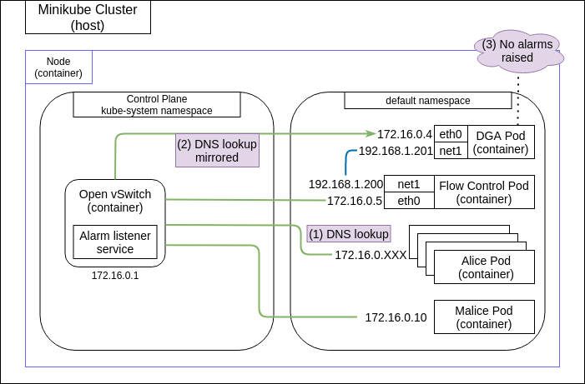
Tarpitting malicious dga requests [1/3]
Requests pass through dga pod and are analysed
Requests are analysed with the help of a machine learning model running on a python script
Non-malicious requests are allowed

Slide 6
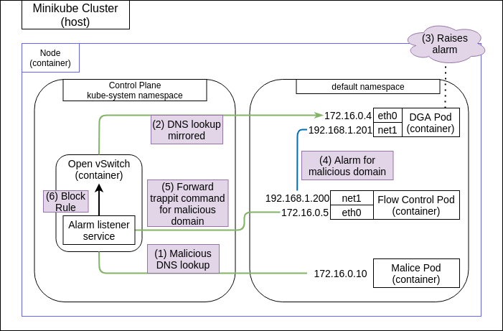
Tarpitting malicious dga requests [2/3]
When a malicious request is detected, the resolved ip of the domain is registered
Dga pod reports that ip to flow-control pod
Flow control pod generates an OVS command with that ip, and sends it to alarm listener service
Alarm listener service applies the tarpitting command to the OVS bridge

Slide 7
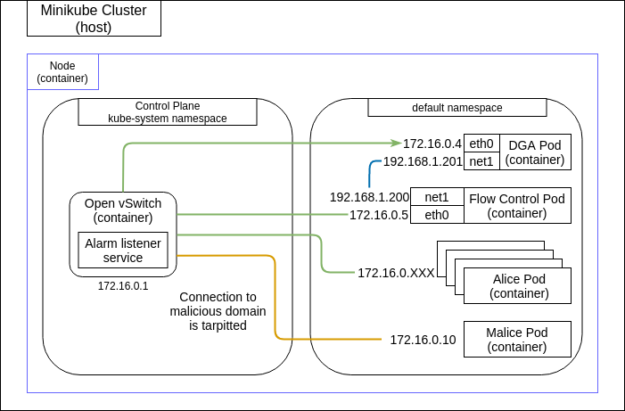
Tarpitting malicious dga requests [3/3]
Connections from every pod to the malicious domain are tarpitted
Tarpitted speeds are up to 1Mbps

Slide 8
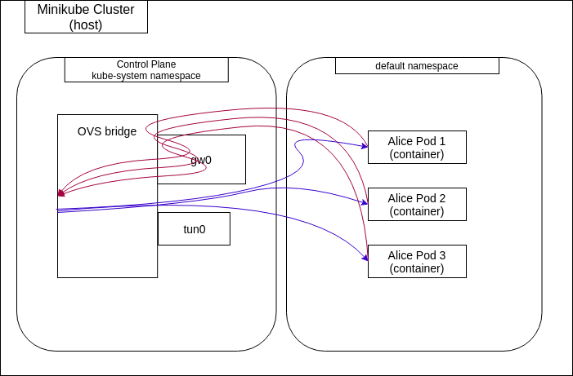
How does tarpitting work? [1/2]
On a kubernetes cluster traffic going to an outside network passes through the gateway (gw0)
Incoming traffic connects to the pods interface

Slide 9
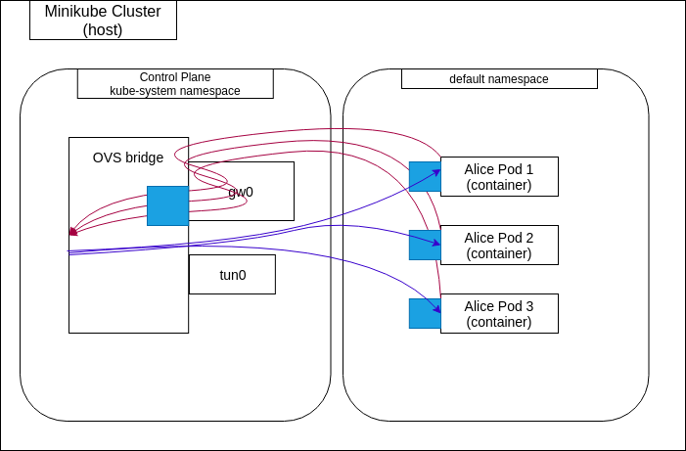
How does tarpitting work? [2/2]
In order to create tarpitting we add queues on all pods interfaces and on the gateway
When we detect a malicious domain we make the corresponding flows pass through the queue
We use the following set of commands:
ovs-ofctl add-flow br-int ip,nw_src='<malicious_ip>',action=set_queue:100,goto_table:10'
ovs-ofctl add-flow br-int ip,nw_dst='<malicious_ip>',action=set_queue:100,goto_table:10'

